Slide 1


CFTPG Meeting
March 29, 2018

Slide 2
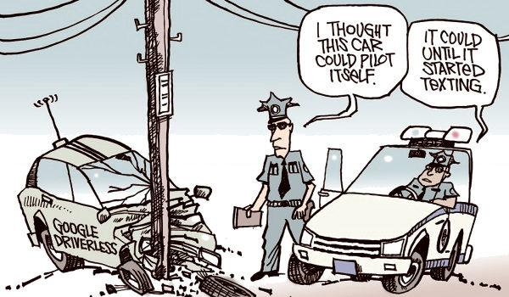

Slide 3
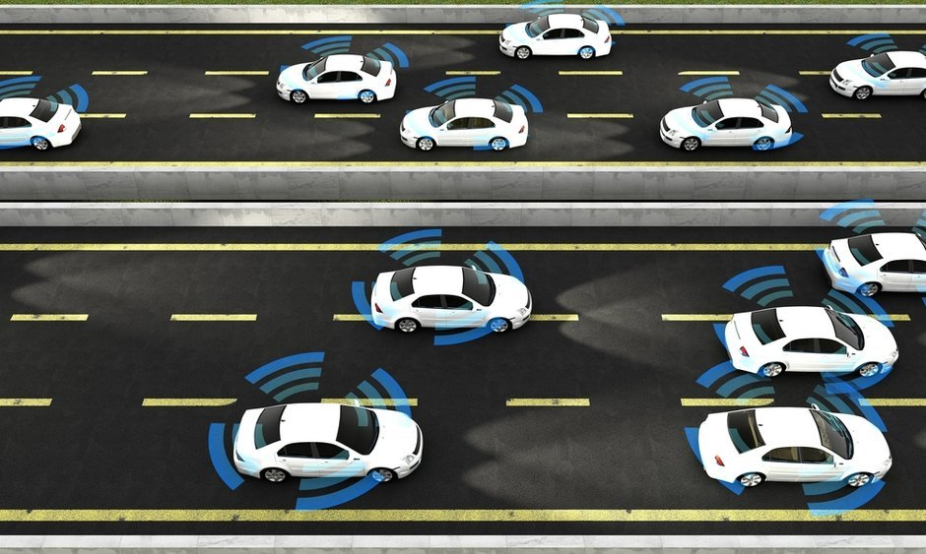

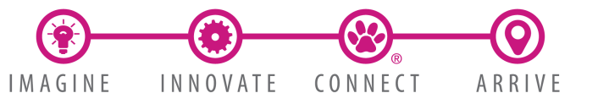

Autonomous Vehicles (AV):
The Adolescent Years
Central Florida Transportation Planning Group
March 29, 2018
Image courtesy www.govtech.com (Shutterstock)

Slide 4

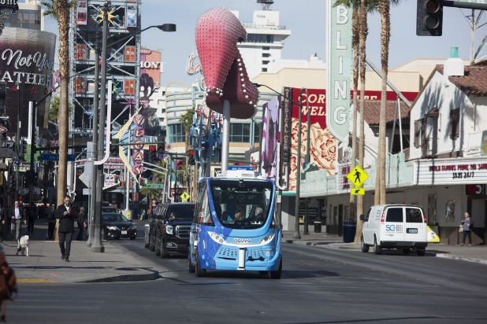
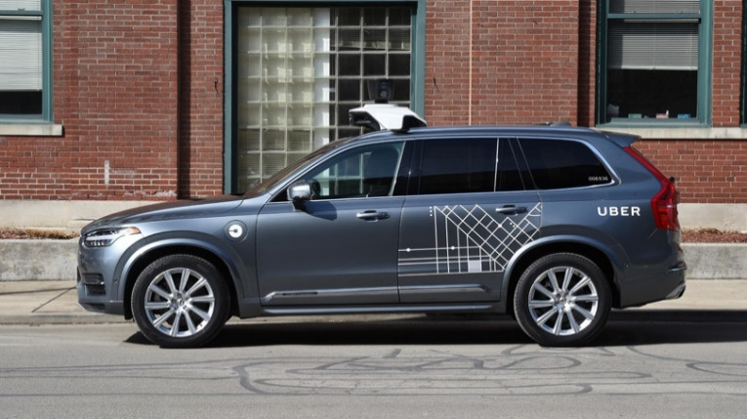
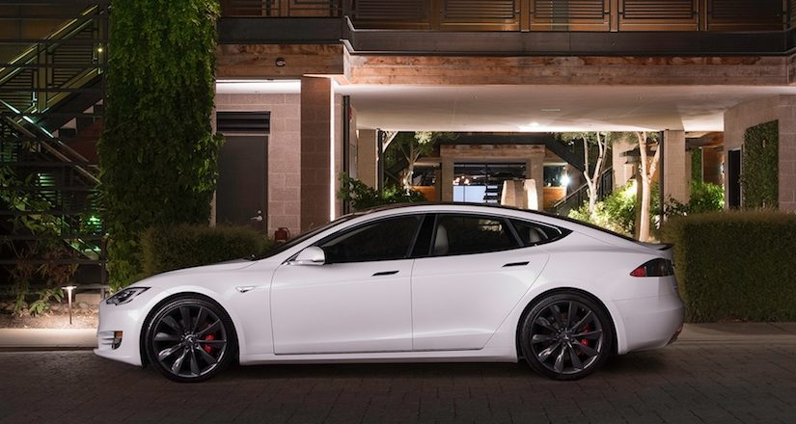
AV in the News
Navya Vehicle Crash – Las Vegas, NV (Nov. 2017)
Image courtesy www.curbed.com (Keolis)
Uber Self-Driving Car Fatally Kills Pedestrian
– Tempe, AZ (March 2018)
Tesla Driver Dies with Autopilot Engaged– Williston, FL (May 2016)
Image courtesy www.pcmag.com (Uber)
Image courtesy www.cheatsheet.com (Tesla)
Notes:
With all of the discussions about autonomous vehicle testing, incidents and accidents, it can be overwhelming. Much like the transition from elementary to middle or high school. If we allowed the hype and news articles about the tests occurring nationwide and obstacles to autonomous and connected vehicle technology for public transit, we would probably run like a toddler into their parents arms on the first day of Pre-School.
If you only read the headlines you wouldn’t know that the Navya vehicle crash was the fault of a delivery truck driver running into the AV; The driver in the Tesla accident was watching a movie; and lastly, preliminary results of the Uber accident earlier this month may indicate that even with a human driver, the pedestrian accident may not have been avoidable. These are cautionary tales that come with any new innovation and inventions.

Slide 5
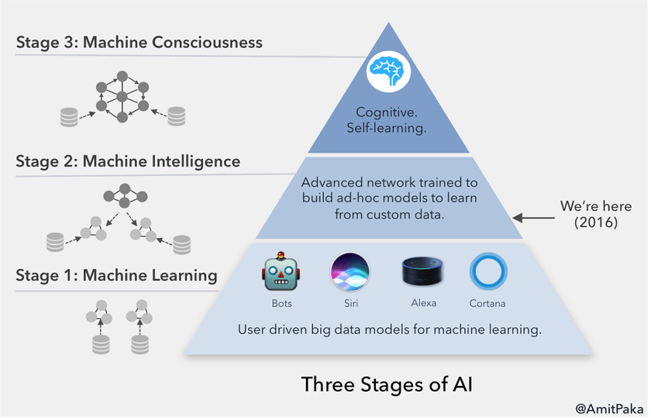
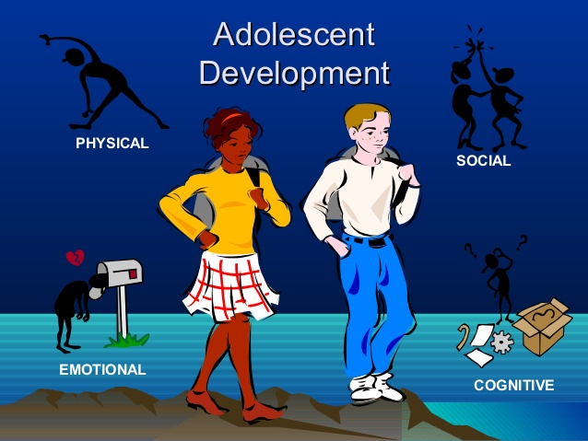
Stages of AI* and Adolescence
We are here 2018
*Artificial Intelligence (AI)
Adolescent Development (AD)
Notes:
Since we are in the adolescent years of AV, I wanted to share a little about the fact that many of the technologies we utilize today are a form of Artificial Intelligence or AI, and their evolution and development is very similar to that of a high school bound middle schooler, experiencing many “firsts”. Biometrics is a form of AI and the relationship between machines and human body language akin to the physical and emotional stages of adolescence. (By a show of hands, how many of you have teenagers living at home?)
Similarly, Text Analytics or Natural Language Processing (NLP) speaks to the concept of social interactions with adolescents. Decision Management with AI is a form of technology that allows an engine to operate using rules and logic that are similar to a teen making cognitive choices between doing good or bad based on the consequences of either action. This cognitive stage of development comes last and is where we see AV’s operating independently, or with Cognitive Self Learning at Levels 3-5.

Slide 6
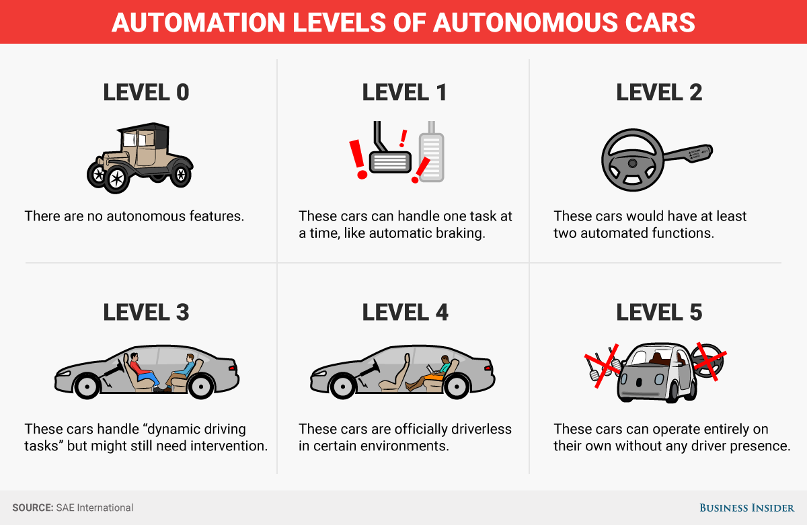
Autonomous Vehicle Levels
Image courtesy Business Insider and SAE
Notes:
Here is a visual representation of what is occurring with private autonomous vehicles today.

Slide 7
Levels 0-2: Driving Environment Monitored by Human Driver
Level 0 – How you and I drove here today.
Level 1 – Primary operator is the driver; but the vehicle may assist with a few functions (i.e. braking systems).
Level 2 – Vehicle can assist with steering and acceleration functions; driver is primarily responsible for safety-related functions (i.e. Tesla Autopilot) like lane change and automatic steering.

Slide 8
Levels 3-5: Driving Environment Monitored by Automated Driving System
Level 3 – Vehicle monitors and controls itself using sensors and LiDAR; have speed limits and still needs driver to apply brakes or halt the car (i.e. Audi A8 AI Traffic Jam Pilot).
Level 4 – Vehicle is capable of accelerating, braking, steering and monitoring the external environment and responding to real-world events; vehicles cannot predict traffic jams or speed up on highways (i.e. Google/Waymo self-driving cars).
Level 5 – 100% autonomy that requires no human interference or intervention.

Slide 9

The FTA, LYNX & AV Technology
Image courtesy www.arborinvestmentplanner.com

Slide 10

FTA S.T.A.R. Program
Strategic Transit Automation Research (S.T.A.R.), 5-Year Plan
  Three-pronged approach
    Enabling Research
      Accelerate entry of manufacturers, and transit providers into common foundational policies, human factors, cost benefit
    Integrated Demonstrations
      Demonstrating autonomous technology in real-world settings
    Strategic Partnerships
      Enhance research in the industry and disseminate findings to expand participation of providers and suppliers
https://www.pcb.its.dot.gov/t3/s171205/s171205_FTA_Strategic_Transit_Automation_Research_Plan_presentation_Valdes.pdf

Slide 11
Challenges to Public Transit AV
Compliance
  Americans with Disabilities Act (ADA): Federally funded transit services must provide assistance for ADA
  Title VI: Deployment of AV services must be equitable
Facilities, Operations & Staffing
  Electric vehicle charging stations: Siting and location of charging stations are needed for LYNX span of service
  Maintenance requirements: AV will require new facilities, equipment, hardware and software to support new propulsion
  Staff Training: New technology and operating platform will necessitate training and wholesale system integration with conventional fleets/services
Customer Experience
  Vehicle Capacity: Recent tests were completed in vehicles with capacity <12 passengers
  Vehicle Distance per Charge: No tests of high-capacity AV have occurred on uncontrolled/unmanaged lanes or corridors

Slide 12
LYNX Autonomous Vehicle Mobility Initiative (AVMI) & RFI
Strategic Plan to Incorporate AV into All Aspects of Transit Service Delivery
Seven Focus Areas
  Research & Development
  Local Policies and Regulations to Support AV in local and regional land use decision-making
  Design, building and testing of AV technologies
  Financing and Funding Strategies
  Data and Communication Protocols
  Workforce Development Strategies
  Improving Regional Health & Air Quality
Request for Information (RFI-18-R09) Autonomous Transit Vehicles (RFP Fall 2018)

Slide 13
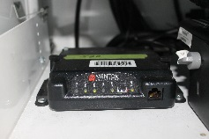
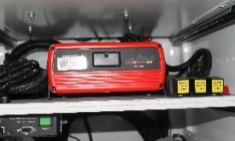
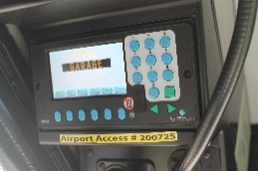


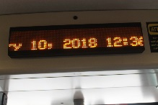
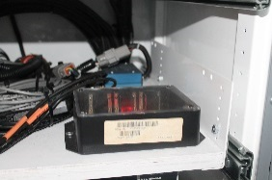
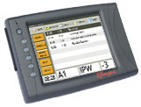
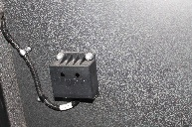
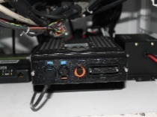
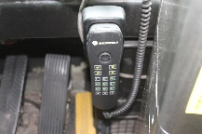
Existing Bus Technology
Wireless Modem
Automatic Voice Annunciator (AVA)
Destination Keypad
External Destination Sign
Internal Destination Sign
Automatic Passenger Count (APC) Controller Unit
Mobile Data Terminal (MDT)
Automatic Passenger Count (APC) Counter
Radio Control Unit
Operator Radio Handset
Notes:
Future applications of AV technology and systems will require compatibility and interoperability with a number of existing and future transit bus technologies.

Slide 14

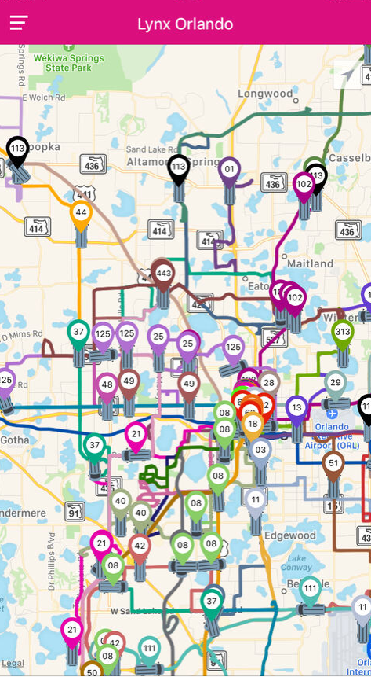
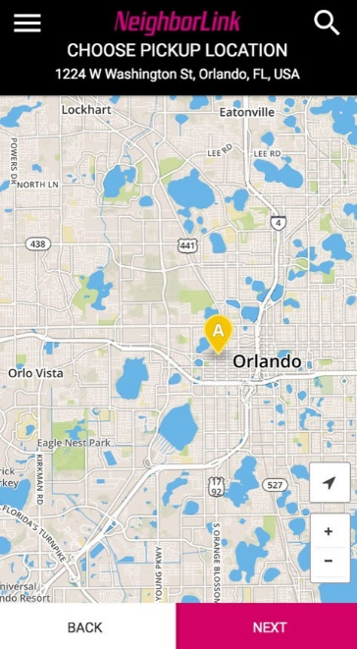
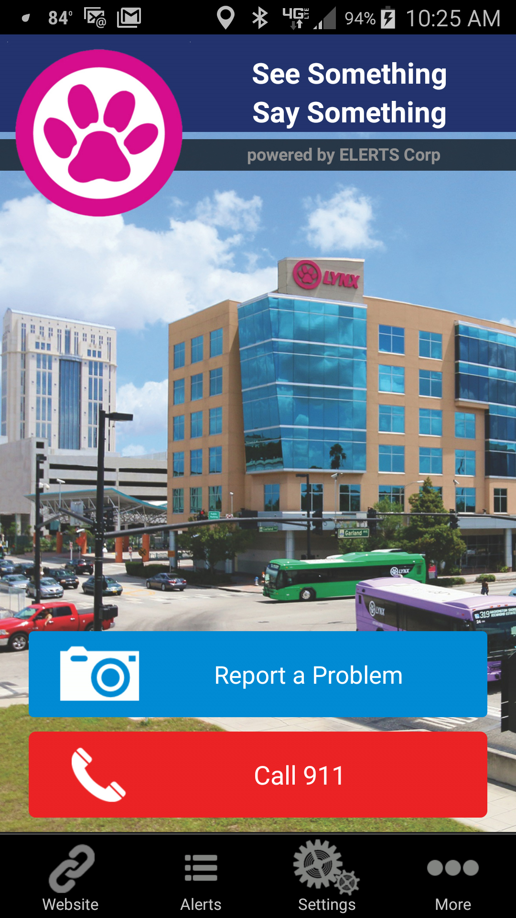
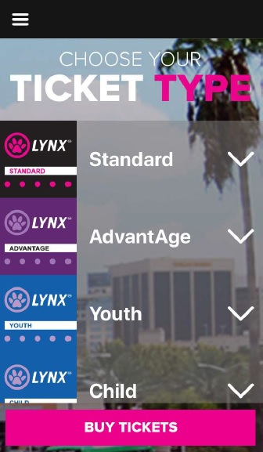


Communication Tools
Wi-Fi LYNX Bus Tracker NeighborLink See & Say LYNX PawPass
Images courtesy of LYNX
Notes:
All AV must connect to our tools that we utilize to communicate and help our customers plan for their services.

Slide 15
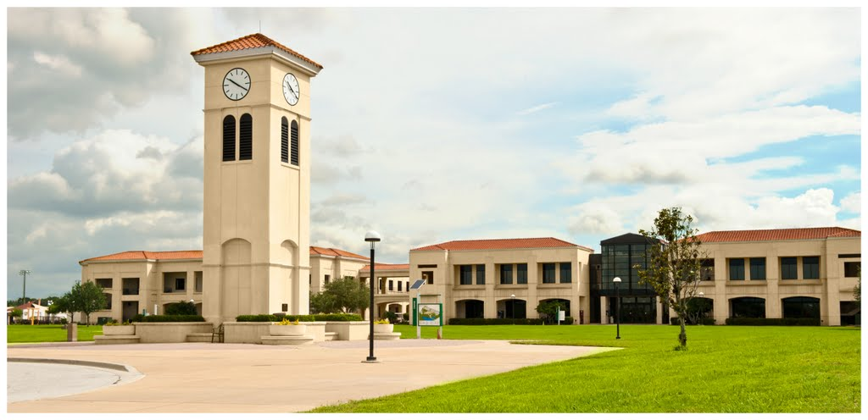
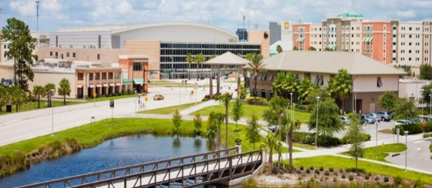
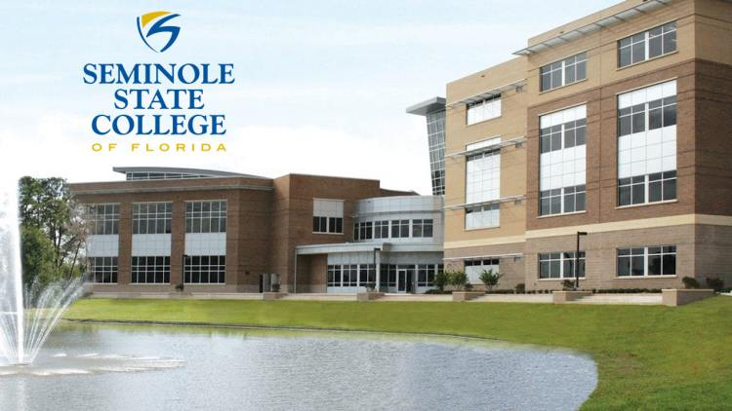
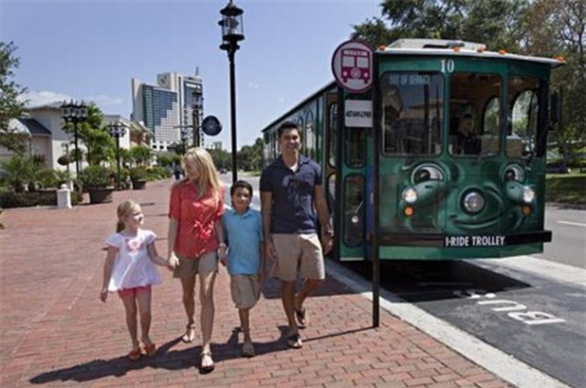
Partnerships
Valencia College
University of Central Florida
Seminole State College
I-Ride
Central Florida Autonomous Vehicle Partnership (CFAVP)
Notes:
Partnerships with FDOT, MetroPlan, jurisdictions and municipalities are required to help prepare LYNX and the region for utilizing and applying AV and Connected Vehicle technologies to our regional transportation network. It cannot be done in a vacuum and our CFAVP is one of the initiatives that is going to help us prepare and plan for incorporating AV into our region.

Slide 16

Contact Information
Tomika Monterville
Planning & Development Director
Central Florida Regional Transportation Authority
Email: tmonterville@golynx.com
Direct: (407) 254-6019
Cell: (407)398-9841
Fax: (407) 254-6392
www.golynx.com
LYNXFORWARD.COM

Slide 17
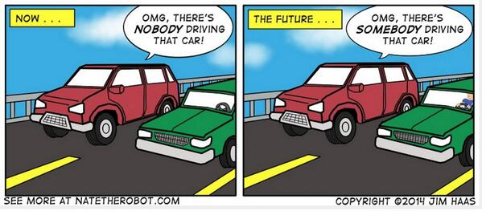

Slide 18
Connecting the East Orlando Communities
Overview of Advanced Transportation and Congestion Management Technologies Deployment Grant
March 29, 2018
CFTPG Meeting, Orlando, FL

Slide 19

ATCMTD by the Numbers
$11.9M
AWARDED
Largest Grant Recipient
GRANT BACKGROUND APPROACH PROGRAMS BENEFITS Q&A

Slide 20











Project Partners

Slide 21
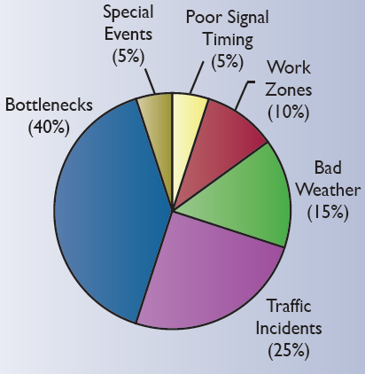


What transportation challenges are we addressing
Pedestrian and Bicycle Safety
Vehicular Safety
Generation doesn’t want to drive and expects choices
Emerging technology changing the game
Crash related congestion
Congestion during peak hours

Slide 22
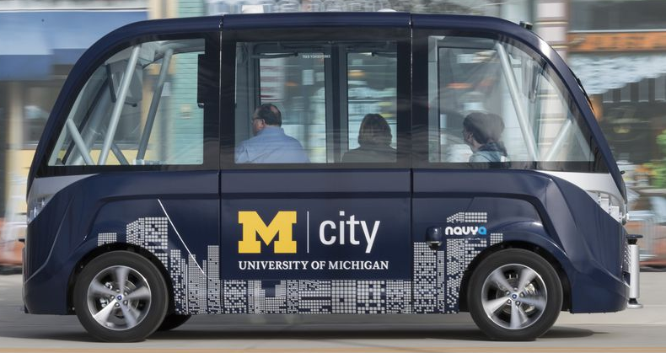
What we are doing
Ready for next wave
  Deploying Autonomous Vehicle; kicking the tires
  Connected Vehicle
    Fleets with devices
    Signals Equipped
    Smart Signals ready
    for upgrade

Slide 23
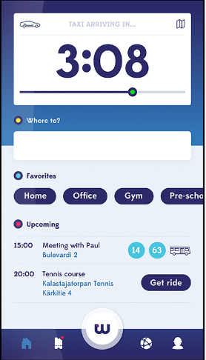
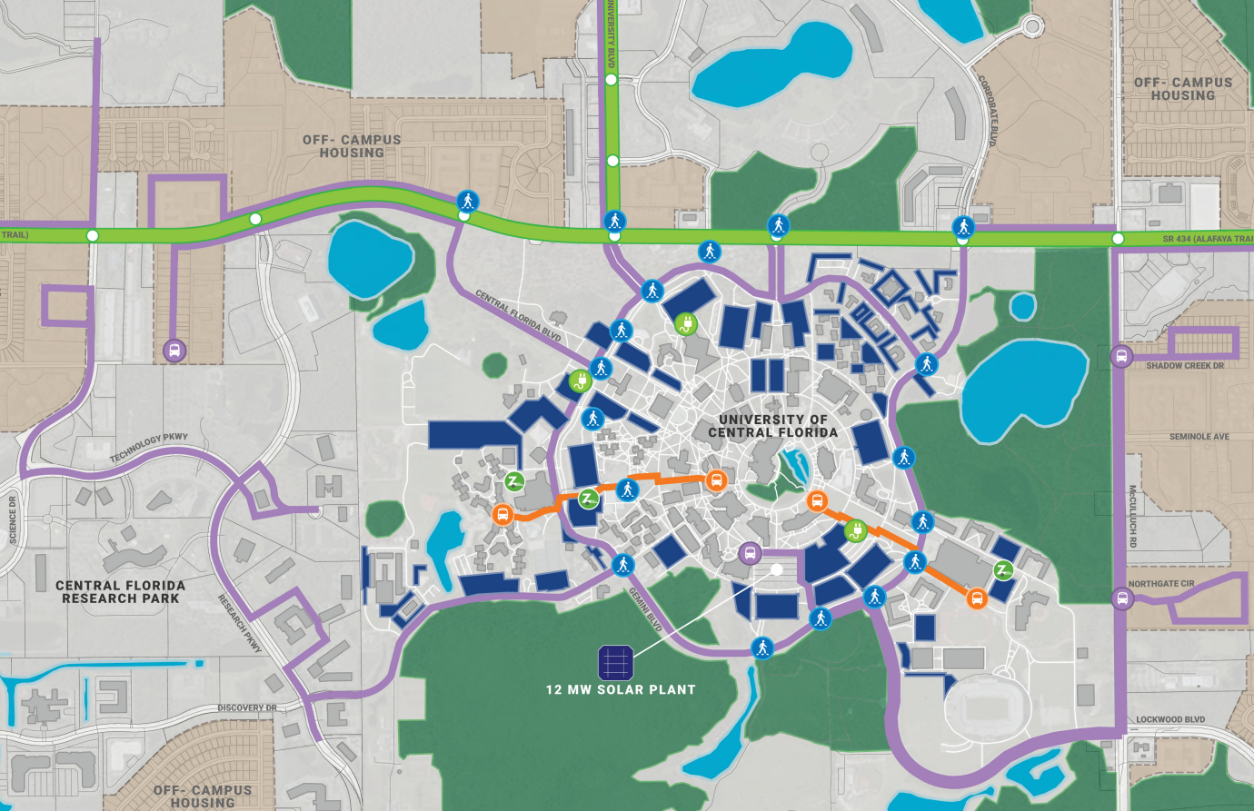
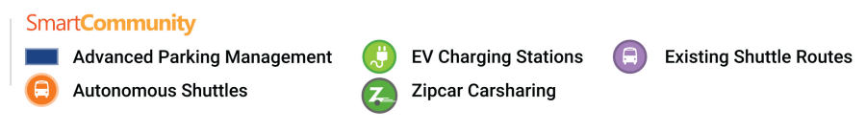
What we are doing
Modal Choice
  Deploy Autonomous Shuttle
  Engine that connects trips transit (including shuttle),
  vehicle, Uber, and Lyft
  Deploy with App at UCF
  Provide transit kiosk

Slide 24
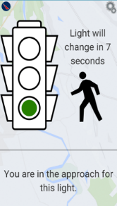
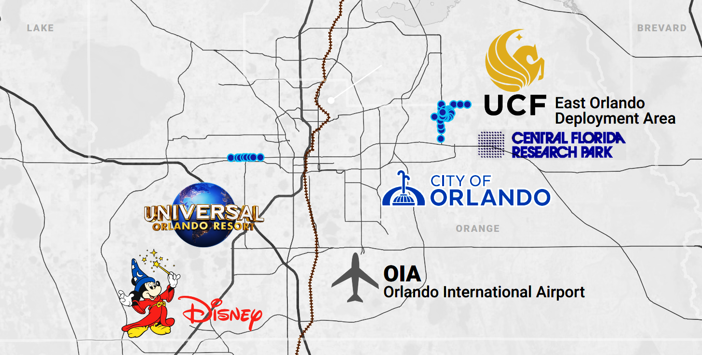
What we are doing
Pedestrian, Bike, and Bus Safety
  Detectors determine conflict likely to occur
  Cell Phone Alerts to prevent crashes
UCF Area
Pine Hills

Slide 25
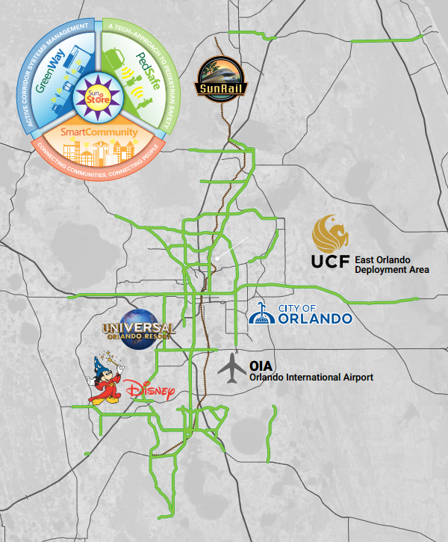
What we are doing
Smart Signal Timing
  Let the signals tell us when they need to be retimed
  Connect data to engineers to develop timings
Coordination
  Let Signals and Traffic Management Center detect events
  In Real-time evaluate potential actions; activate one provides
  best result across agencies
  Call best timing available to the controller
  Change DMS
  Alert LYNX

Slide 26
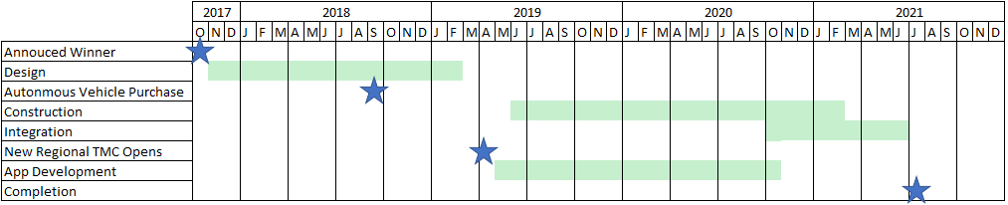
Hitting Ground Running

Slide 27
Questions?

Slide 28
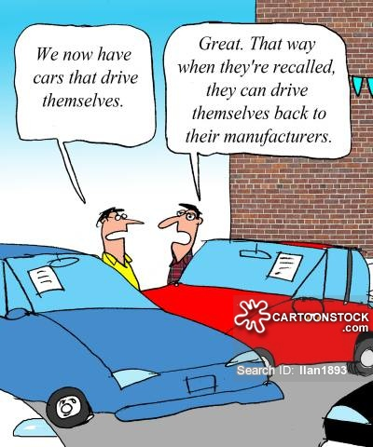

Slide 29
Gainesville Autonomous Transit Shuttle (GAToRS)
Pilot Project
Jesus Gomez, Transit Director
City of Gainesville
EVENT
March 29, 2018

Slide 30
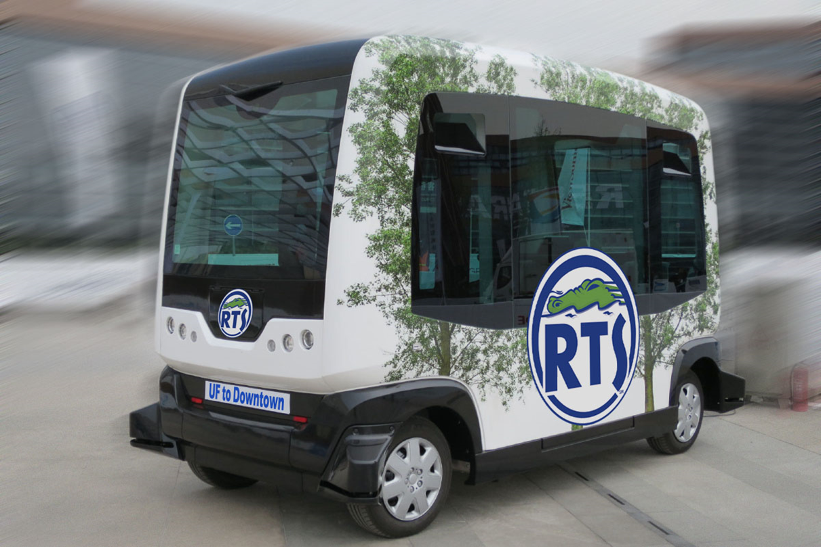

Slide 31
Gainesville.
Citizen centered
People empowered

Slide 32
GAToRS
Project in Partnership with University of Florida (UF) and Florida Department of Transportation (FDOT)
Autonomous Vehicle (AV) shuttle between the University of Florida (UF) and Downtown
Project has 100% FDOT funding
AV shuttle operating in regular traffic conditions
Test Connected Vehicle Technology as part of UF research projects

Slide 33
GAToRS Solicitation
RFP issued on August 21, 2017
October 3, 2017 proposals received
December 7, 2017 selected vendor
March 9, 2018 contract executed
Vendor: Transdev Services, Inc.
Vehicle Manufacturer: Easy Mile

Slide 34
GAToRS Vendor
Transdev Services, Inc.
  The largest private provider of multiple modes ( bus, paratransit, BRT, streetcar, ferry, coach, taxi and shuttles) of transport in North America.
  Served 200 cities and communities, 200 million passenger trips
  Workforce of 20,000
Transdev AV deployment projects:
  In hundreds of cities in 19 countries
  Sample AV operations:
    Rotterdam, Netherlands: 2,400 people per day from the metro to a business park
    Civaux, France
    Rungis Business Park, Paris

Slide 35
GAToRS Project Scope
Project term: 3 years, possibility for expansion into on-demand service after 3-phase fixed route rollout.
Monday through Friday
10 hours of service at 10 - 20 minute frequency
Fares will not be collected during the demonstration period
Vehicle Capacity: 12 Passengers

Slide 36
GAToRS Project Goals
Significant research and data collection “add on” projects in key areas:
  EV charging
  Data sharing
  Workforce re-training etc.
Phased approach, starting with limited mixed—traffic demo
  Single-vehicle demo on April 5th and 6th
  2 Dedicated EasyMile Gen 2 Vehicles to start (August)
  3 vehicle fleet by the end of year 1 (end of 2018)

Slide 37
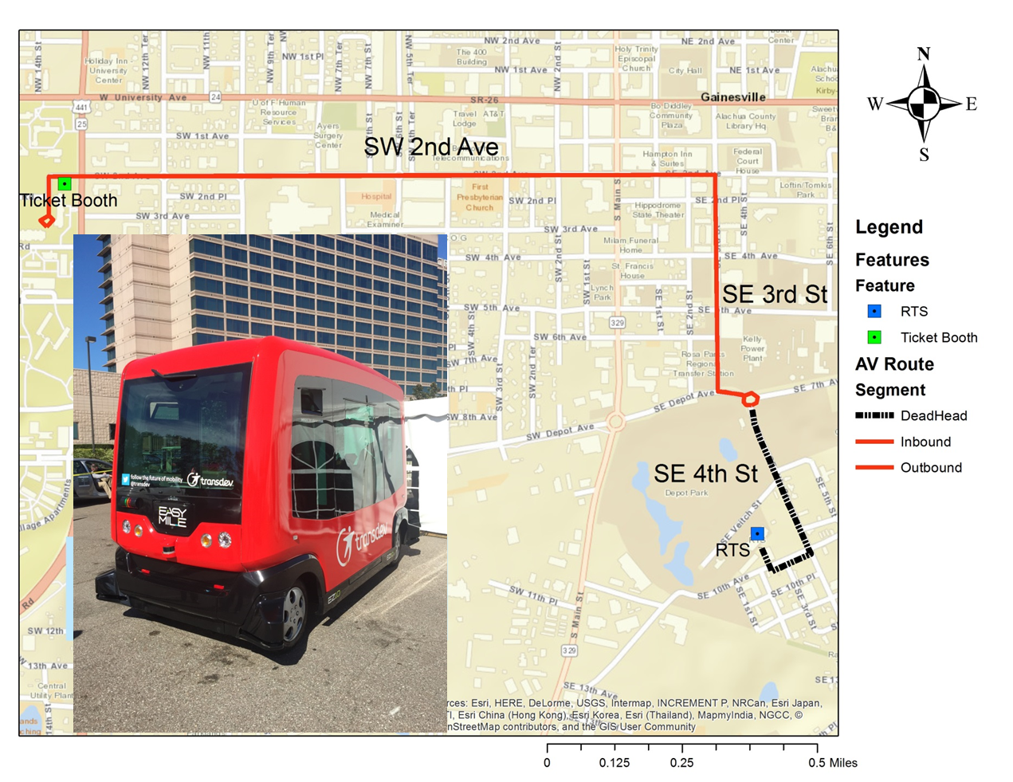
GAToRS Route

Slide 38
Demo Route + Phase 1

Slide 39
Phase 2 Expansion (V2I)

Slide 40
Phase 3 and 4 Depot Park to UF

Slide 41
Timeline and Budget
Start Date | Route | Phase | Dependency
4/2/18 | Demo- Off-Peak loop | Demo | Gen 2 NHTSA Certification
8/18 | Off-Peak Innovation Square Loop | Startup | Facility
9/18 – 12/18 | Regular Innovation Square Route | 1 | Feedback on Service
1/19 | Expansion to UF Campus | 2 | V2I Integration
6/19 | RTS Facility/Depot Park | 3 | V2I Integration AV Software Upgrade
9/19 | On-Demand Service | 4 | User Acceptance

Slide 42
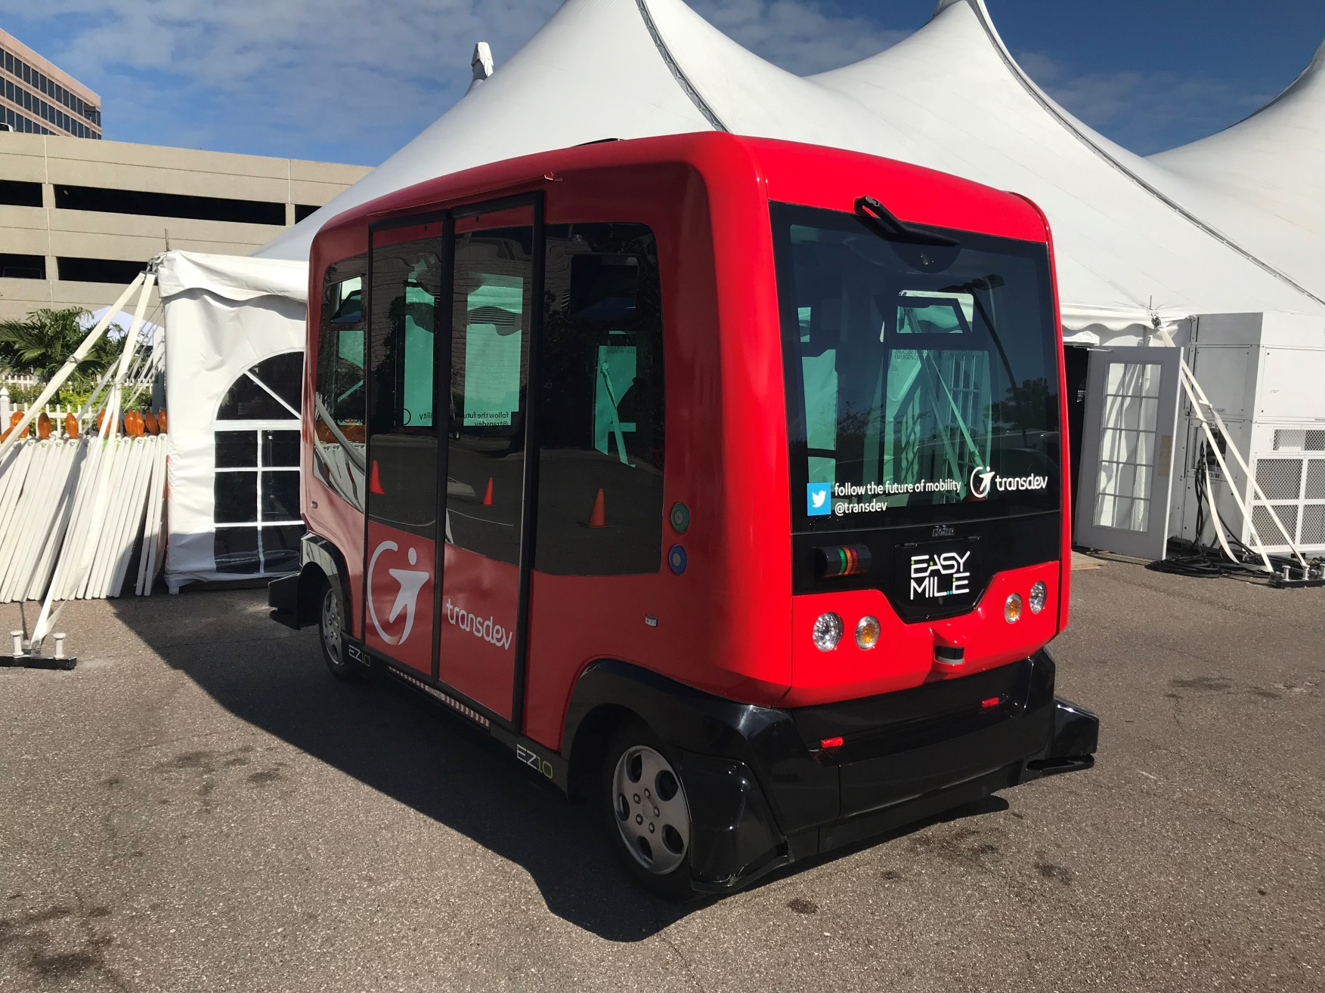
Gainesville Autonomous Transit Shuttle (GAToRS) Pilot Project

Slide 43
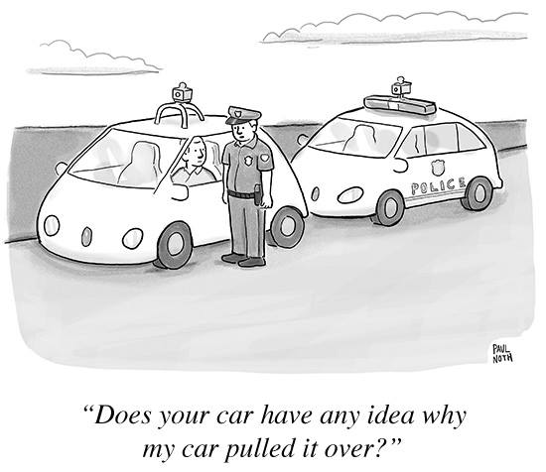
Questions?

