Slide 1

SE FL FSUTMS User Group Meeting
March 16, 2018

Slide 2

Future Starts Now
welcome to the
future
Notes:
We are at the verge of a paradigm shift. If you haven’t realized, the journey has started. Future is now. Emerging technologies and societal trends will change the world as we know it today.

Slide 3
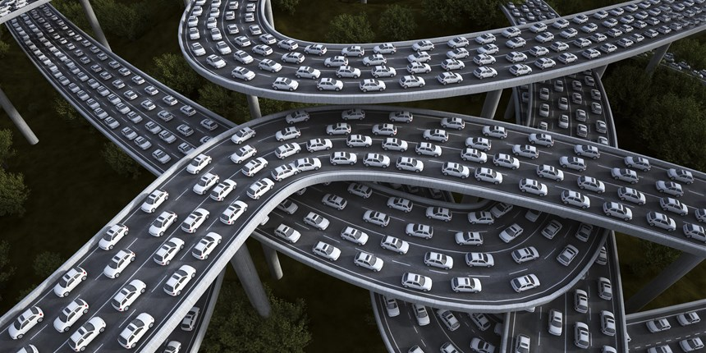
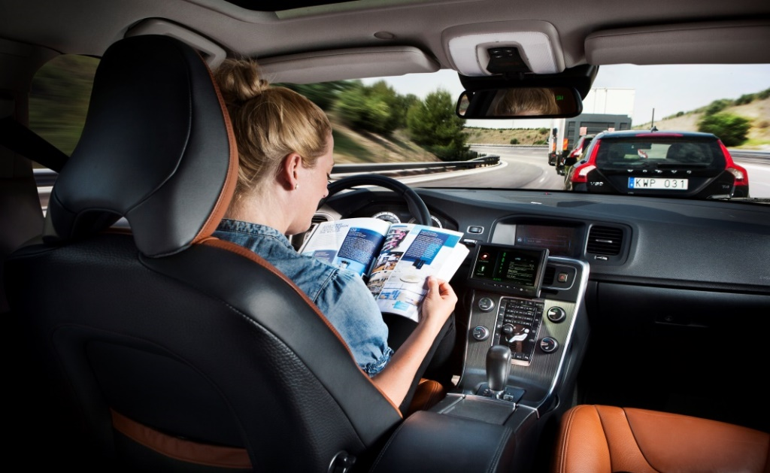
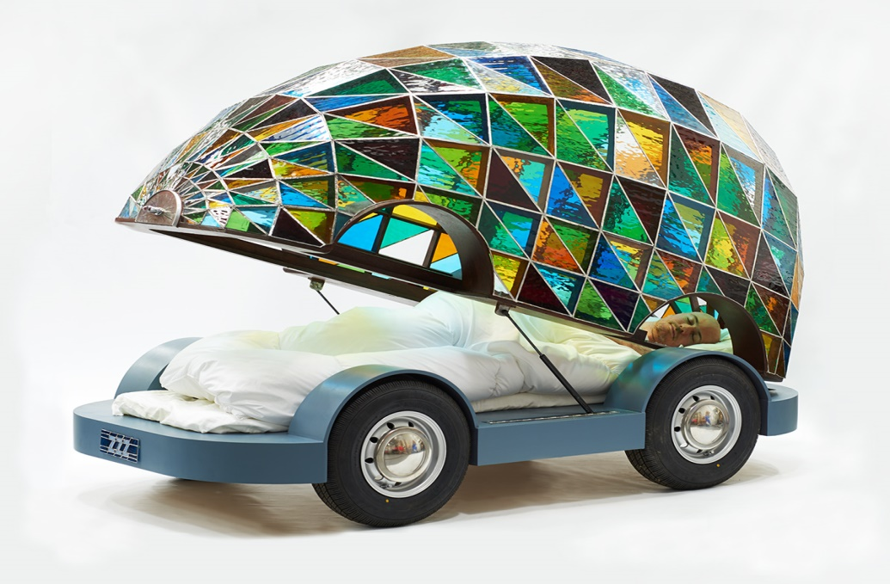
Autonomous & Connected Vehicles
Five-fold roadway capacity increase
90% + reduction in crashes
New driving experience

Slide 4

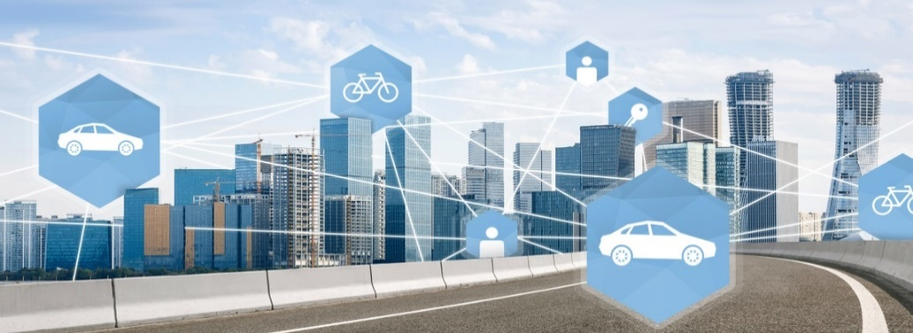
Shared Mobility
Potential to reduce fleet size by 90 percent
Shared auto-ownership impacts
Internet of things – big data

Slide 5
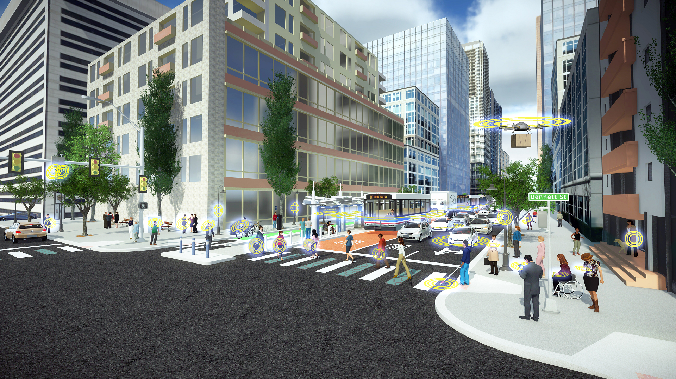
Smart Cities
Endless possibilities for a connected future

Slide 6
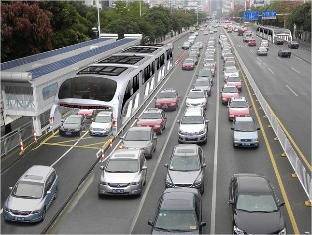
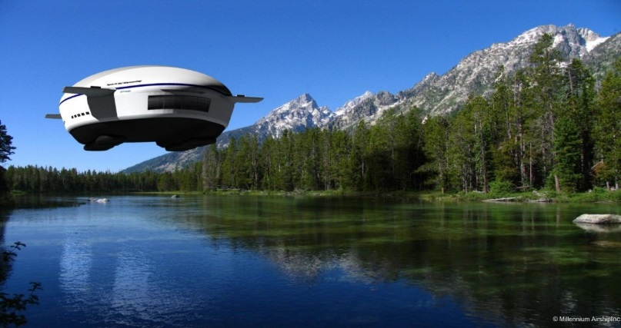
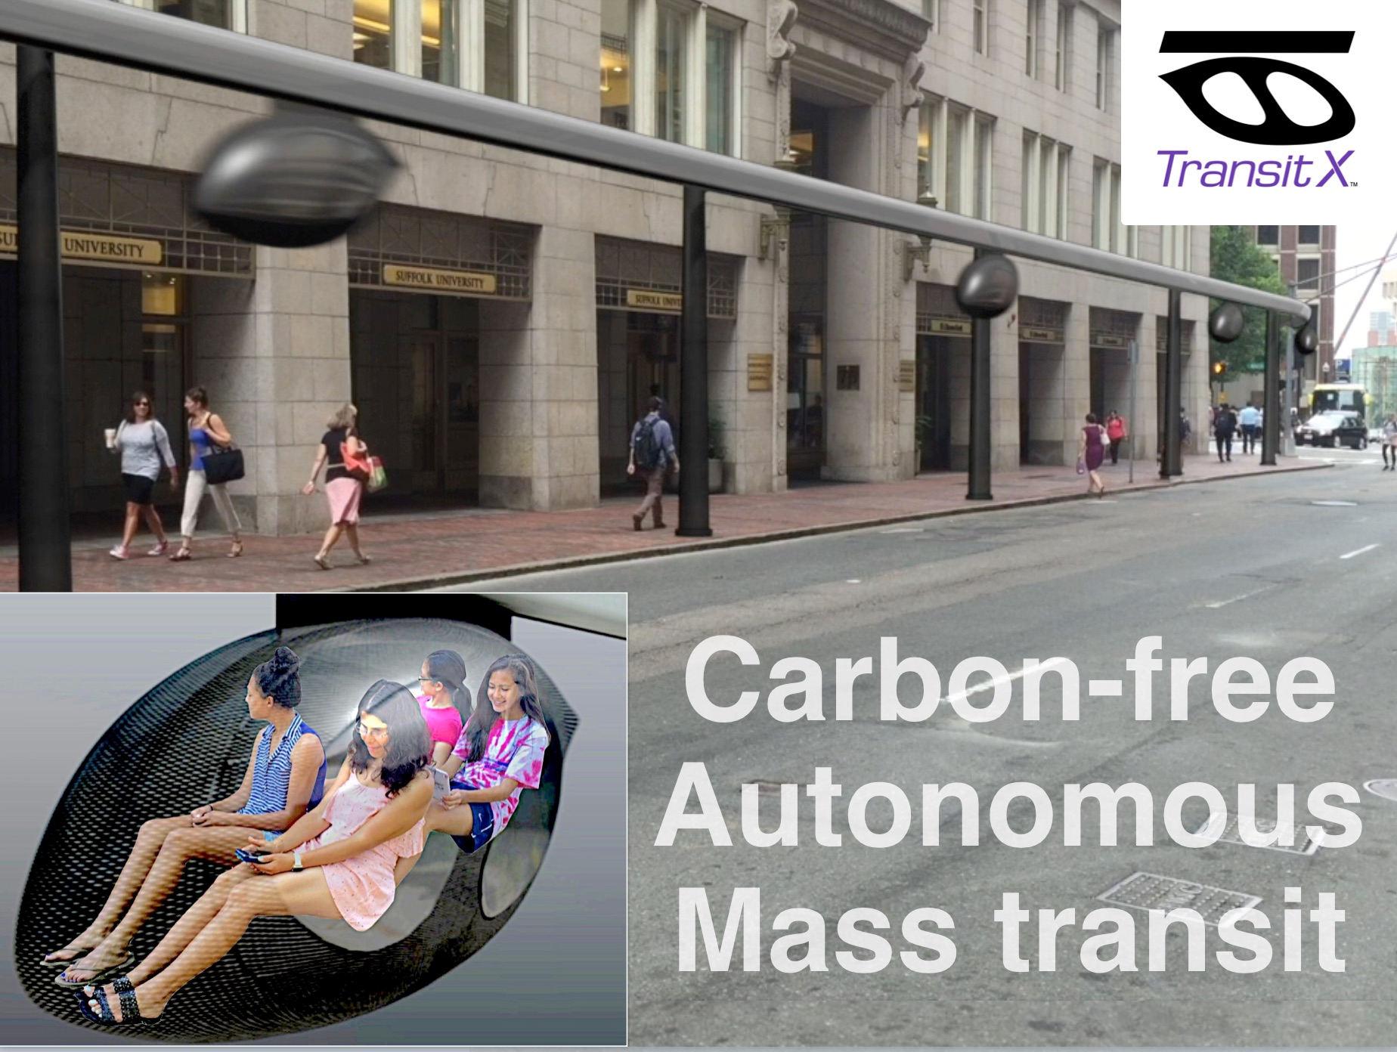
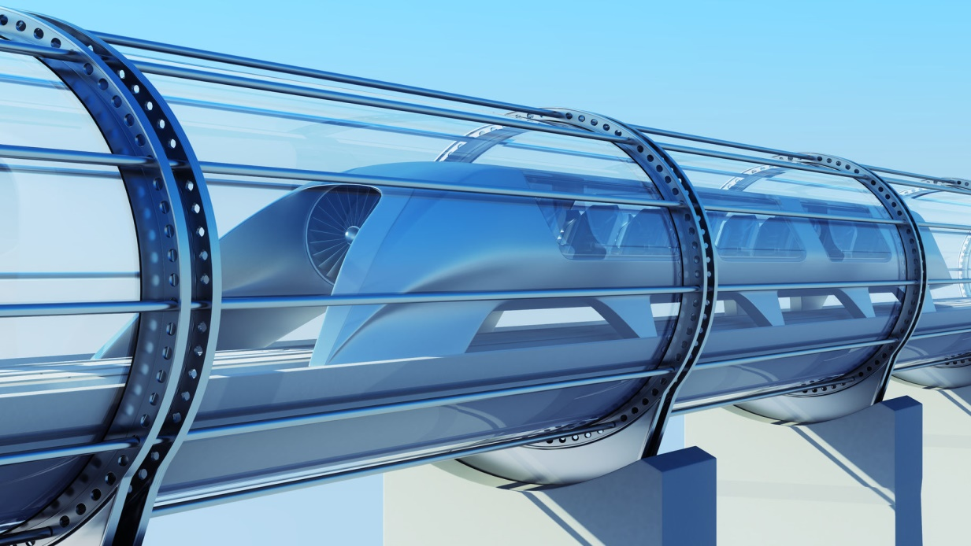
Science or Fiction?
Straddling Bus Transit X
Helium Airships Hyperloop

Slide 7
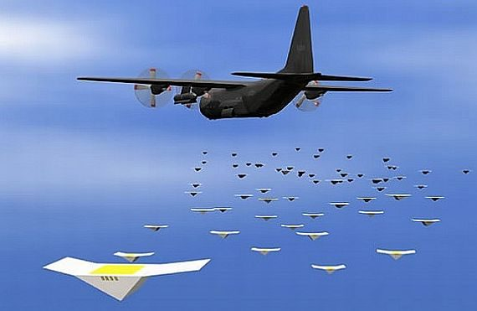
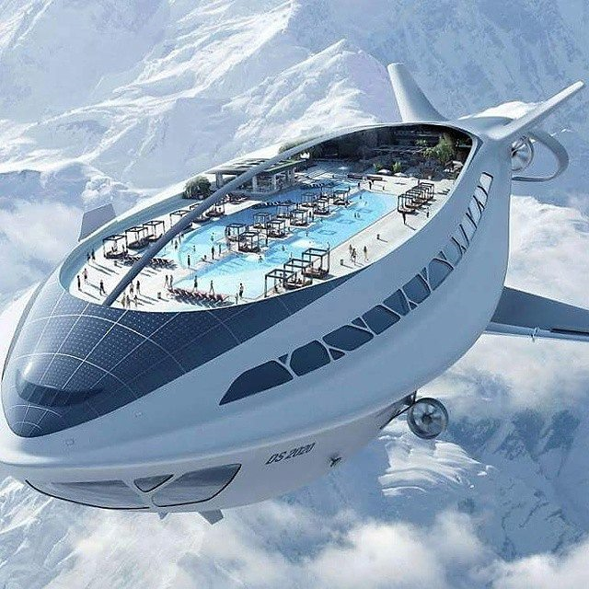
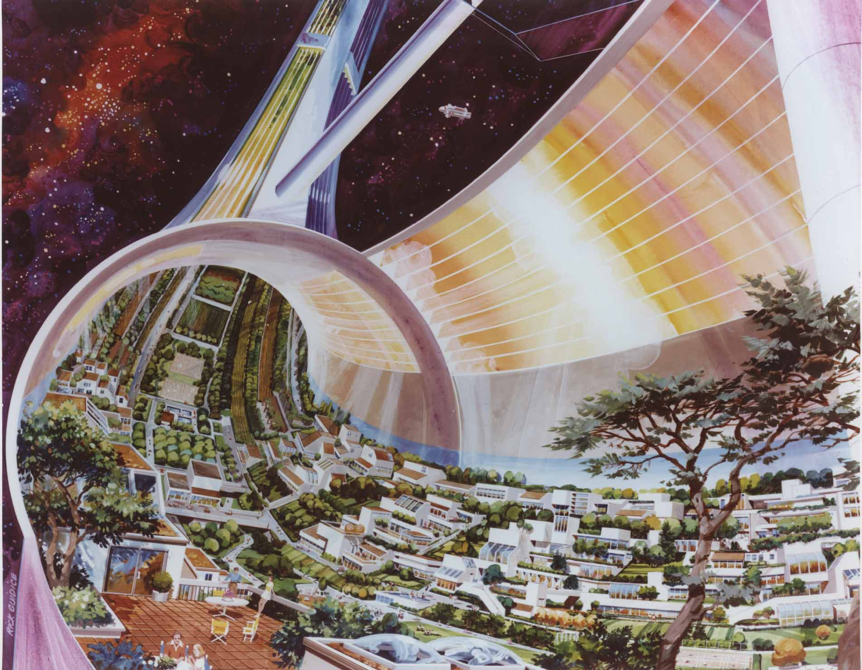
Science or Fiction?
Space Tourism – Vacation of the Future
Drone Hub Space Colony

Slide 8
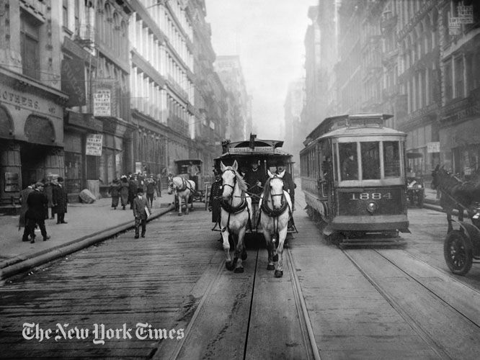
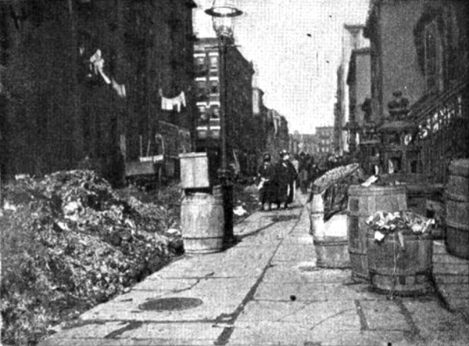
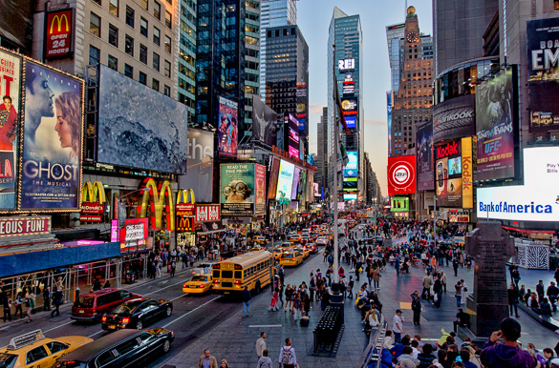

Transformation is Real

Slide 9
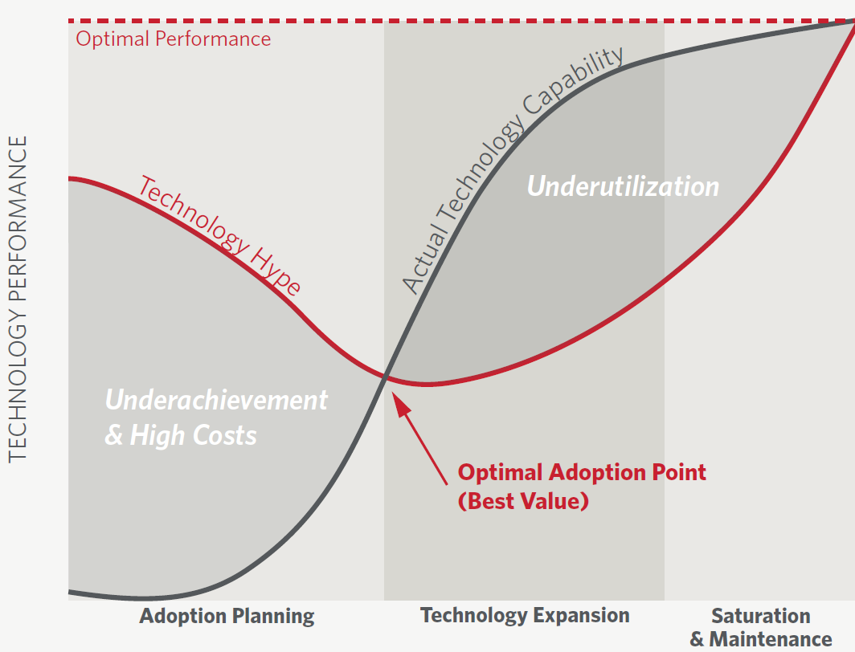

Sorting Facts from Fiction
Optimal adoption point for best value
Cutting edge vs. bleeding edge

Slide 10
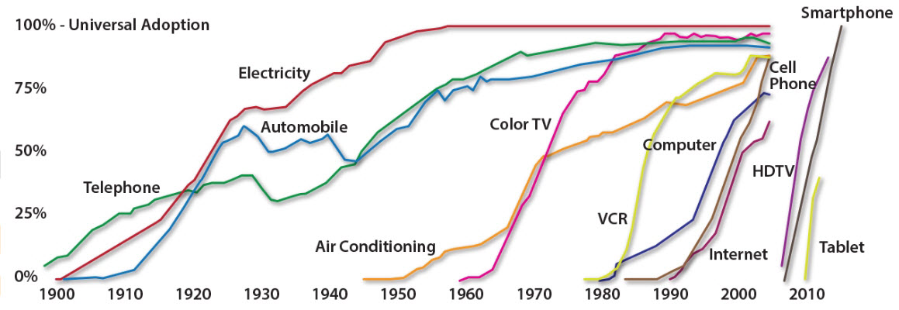
Why Now?
Moore’s law – computing power doubles every 2 years

Slide 11
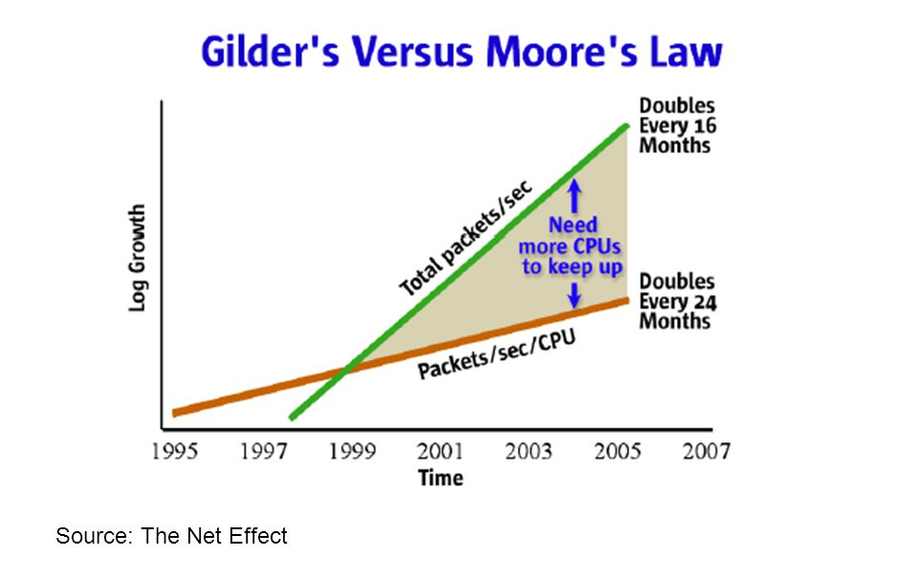
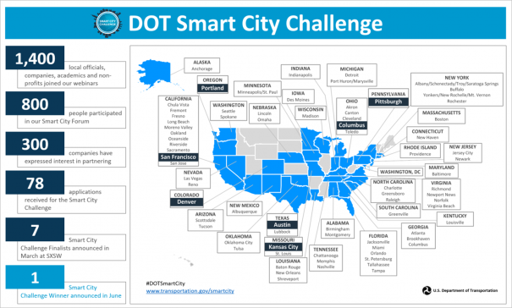
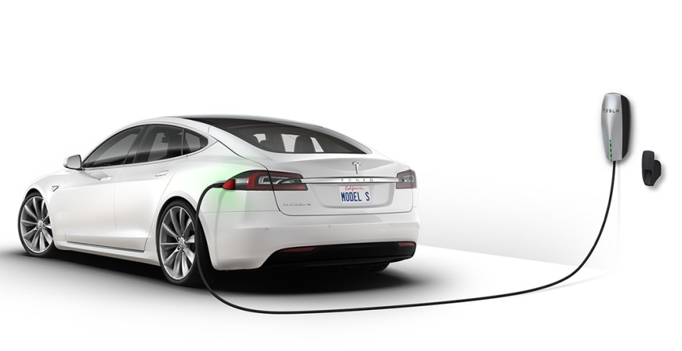
Market Readiness
78 cities participated in Smart Cities challenge
34 States enacted autonomous vehicle legislation since 2012
Most new vehicles sold today have advanced features

Slide 12
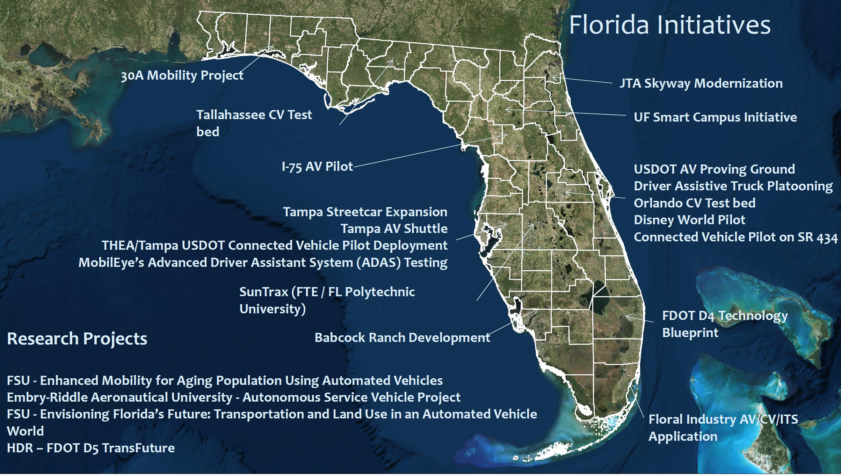
Market Readiness

Slide 13

Decision Making Challenge
Traditional tools and methods are falling short of answering policy questions of tomorrow
How to prepare for the unknown?

Slide 14
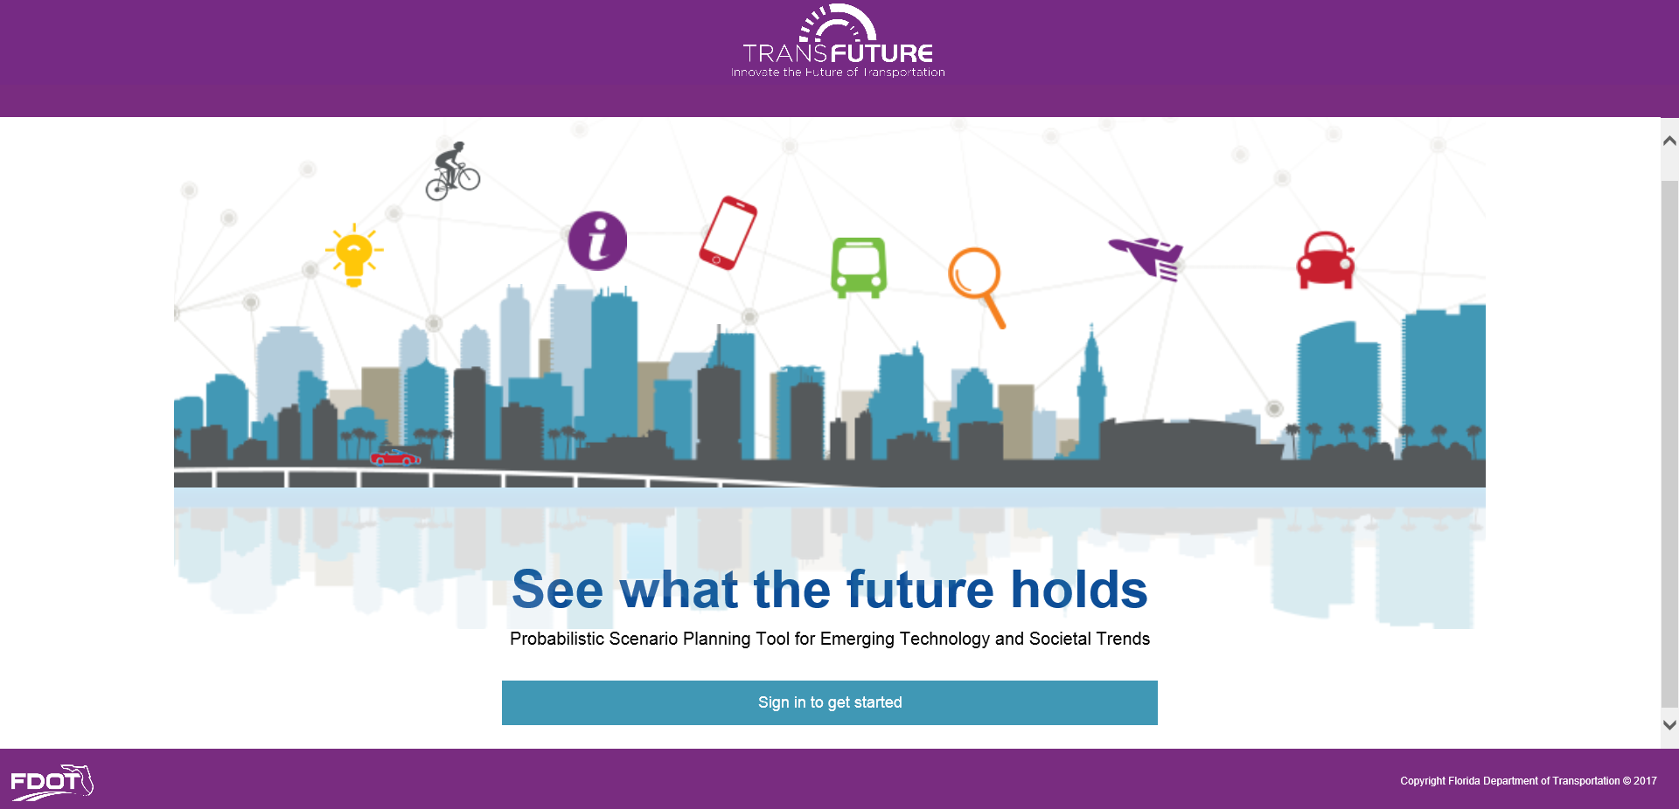

Introducing TransFuture
Next-gen scenario planning tool
Prepare for multiple futures
Explicitly account for uncertainty
Support a desirable future by incorporating flexibility
Add-on lens to improve decision-making

Slide 15
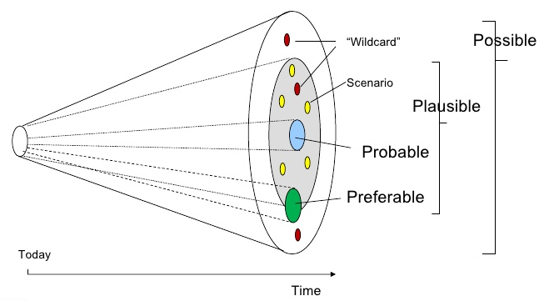
Planning for Multiple Futures
Traditional planning for most likely future
Scenario I
Scenario II
Considering multiple futures and uncertainties
Scenario III
Scenario IV
Acknowledging uncertainty
Future Baseline
Composite Uncertainty Cone

Slide 16
Development Approach
Identify Trends
Quantify Trends
Deterministic to Probabilistic
Understand Uncertainties
Make Informed Decisions
Implementation Plan

Slide 17
Emerging Trends
Changing Demographics
Improved
Technology
Shifting User Preferences
Improved
Travel Options
Millennial travel behavior
Automated vehicles
Urbanization
Better walking and biking options
Aging population
Generation Z
Workplace automation
Improved user information & navigation
Smart City
Shift from individual ownership to fleet ownership
Telecommuting
E-commerce & delivery options
Improved public transit
Shared mobility
EVs

Slide 18
Sample Literature
Autonomous Vehicle Implementation Predictions – VTPI
NCHRP Report 750, Informing Transportation’s Future – TRB
Preparing a Nation for Autonomous Vehicles – Eno Center
Shared Mobility and the Transformation of Public Transit - APTA
Millennials & Mobility: Understanding the Millennial Mindset – APTA
City of the Future – National League of Cities
Shared Mobility and the Transformation of Public Transit – APTA
Evaluating Carsharing Benefits – VTPI
Planning for an Uncertain Future: Using Scenario Planning to Add Clarity When the Future Is Unclear - TRB

Slide 19
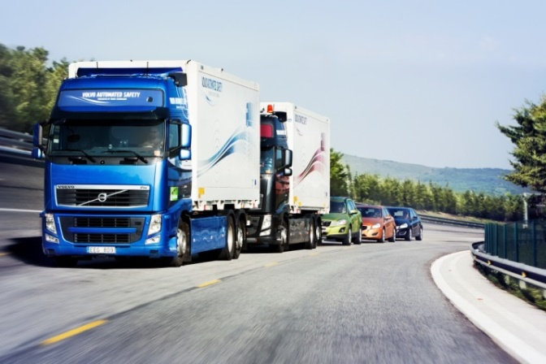
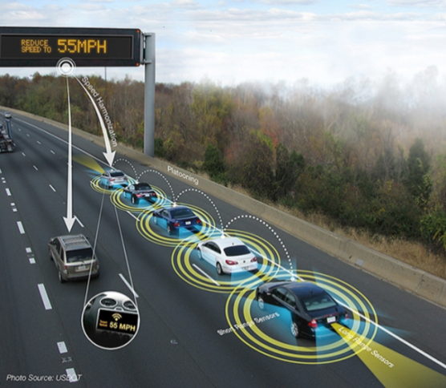
Automated Vehicles
Capacity and demand increase
Penetration Rate
100%
90%
Kockelman - Aggressive
80%
70%
VTPI - Conservative
60%
50%
VTPI - Aggressive
40%
Kockelman - Conservative
30%
20%
Kockelman - Moderate
10%
Goldman Sachs
0%
2020
2025
2030
2035
2040
2045
2050
2055
2060
Market penetration
Early adoption - trucks?
Connected features in cars

Slide 20
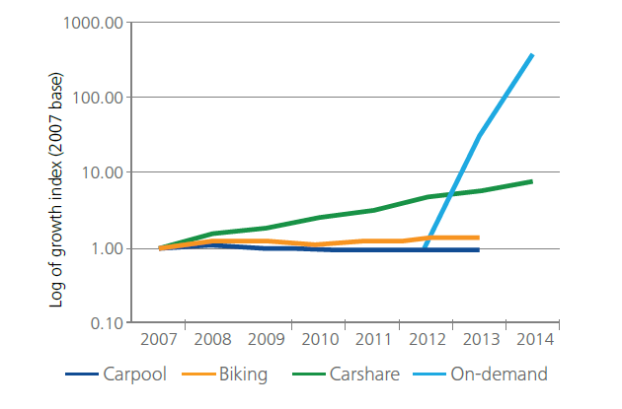
Shared Mobility
  Reduction in auto ownership
  Potential increase in trips
  Fleet size reduction

Slide 21
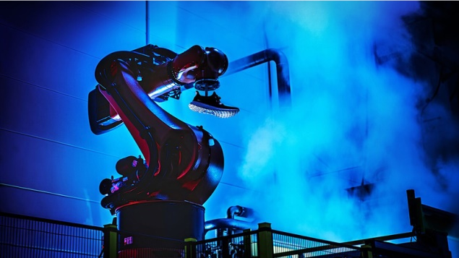


Workplace Automation
  Jobs at risk for automation
  Transformation of the labor force
  Jobs of Generation Z (1995-today)

Slide 22
Conceptual Framework
Input
Process
Output
Frontend
Backend
Regional travel demand model files
Define scenarios
Regression analysis
Elasticity analysis
Monte Carlo Simulation
Probabilistic results and confidence intervals - AADT, VMT, VHT, etc.
Scenario comparison
Facility footprint

Slide 23
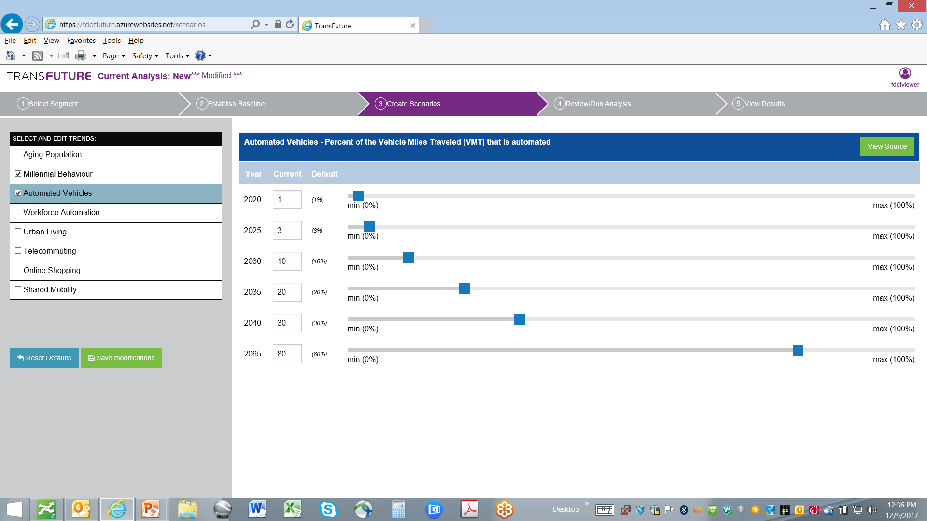
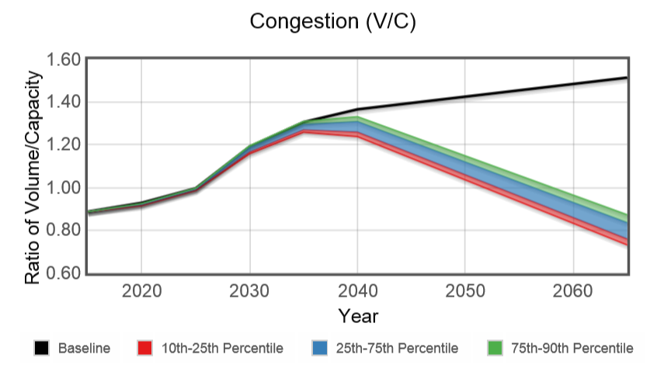
User Interface

Slide 24
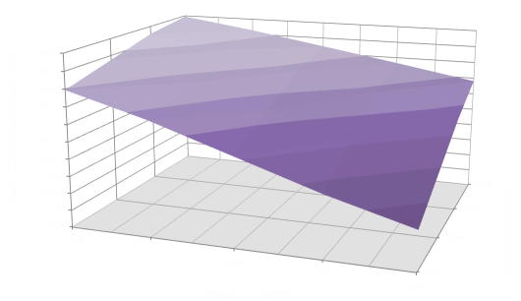
Methodology Framework
Generalized Cost
Supply
N-dimensional supply-demand surface
Quantifying impacts of emerging trends
Demand
Auto Trips

Slide 25
Accounting for Uncertainty
Joint probability distribution

Slide 26
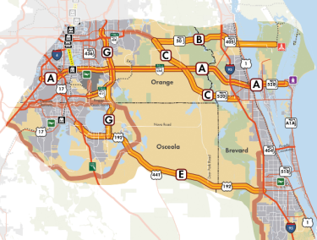
Future Corridors Application

Slide 27
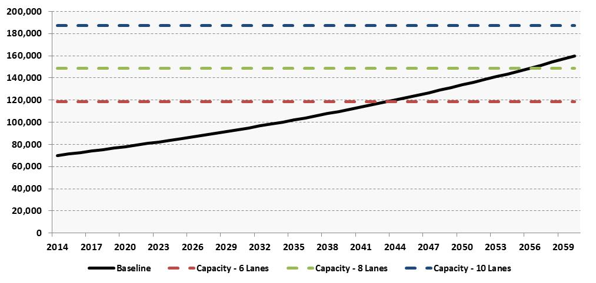
Hypothetical Corridor Analysis
Baseline Scenario
10-lane capacity
8-lane capacity
6-lane capacity
AADT
8 lane by 2045;
10 lane by 2056

Slide 28
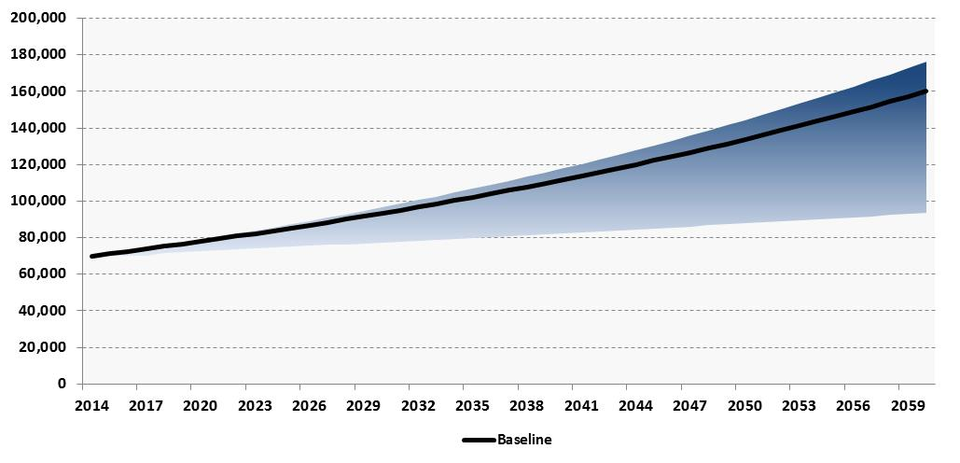
Hypothetical Corridor Analysis
Build Scenario
    AV/ CV Market penetration = 2035 – 10%; 2060 – 50%
Two emerging trends considered:
Aging population - Reduced demand
Automated vehicles - Capacity increase, Demand increase

Slide 29
Hypothetical Corridor Analysis
Build Scenario
We are 90% confident that the 2060 AADT will be <170,000

Slide 30
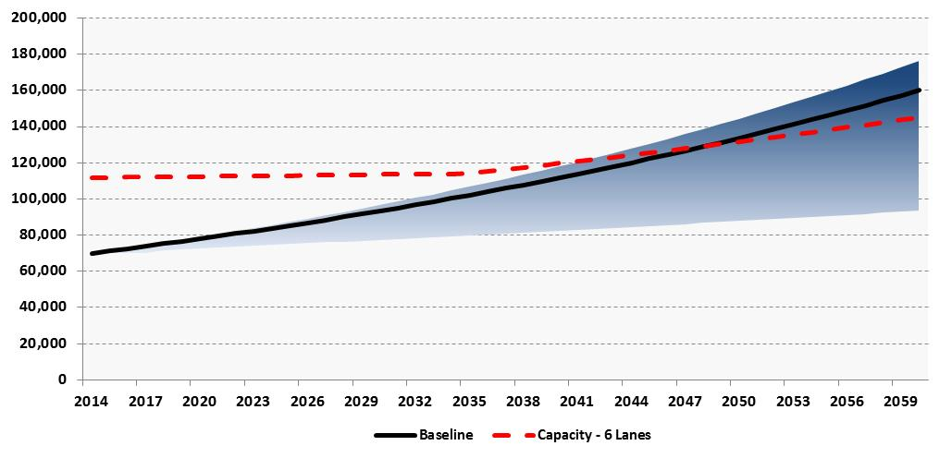
Hypothetical Corridor Analysis
Build Scenario
6-lane capacity
AADT
8 lane by 2048

Slide 31
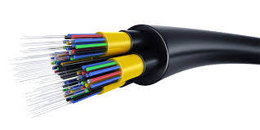

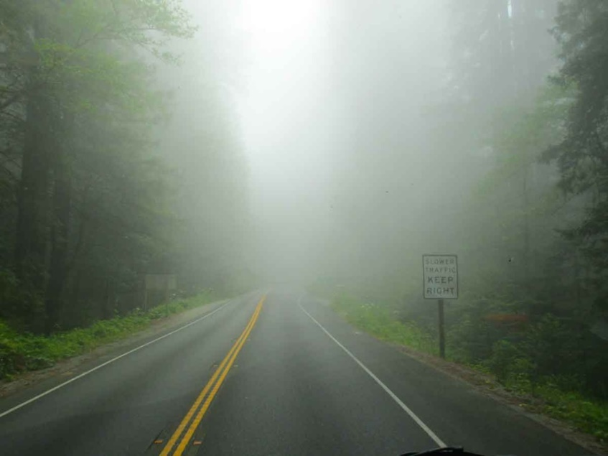
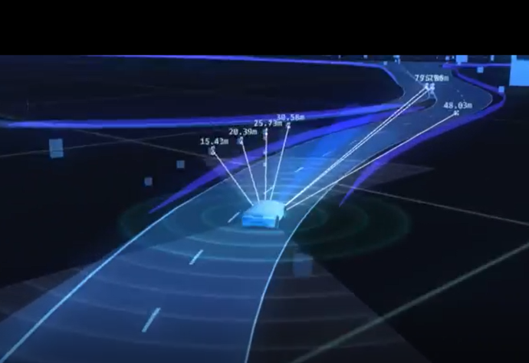
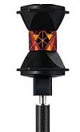
New Paradigm
Don’t over build – cost savings (value of stranded assets)
Preserve ROW for potential future need
Invest in technology – future proof investments
  Cable, power, machine vision (reference markers), data management

Slide 32
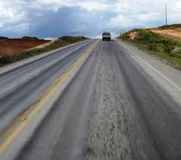
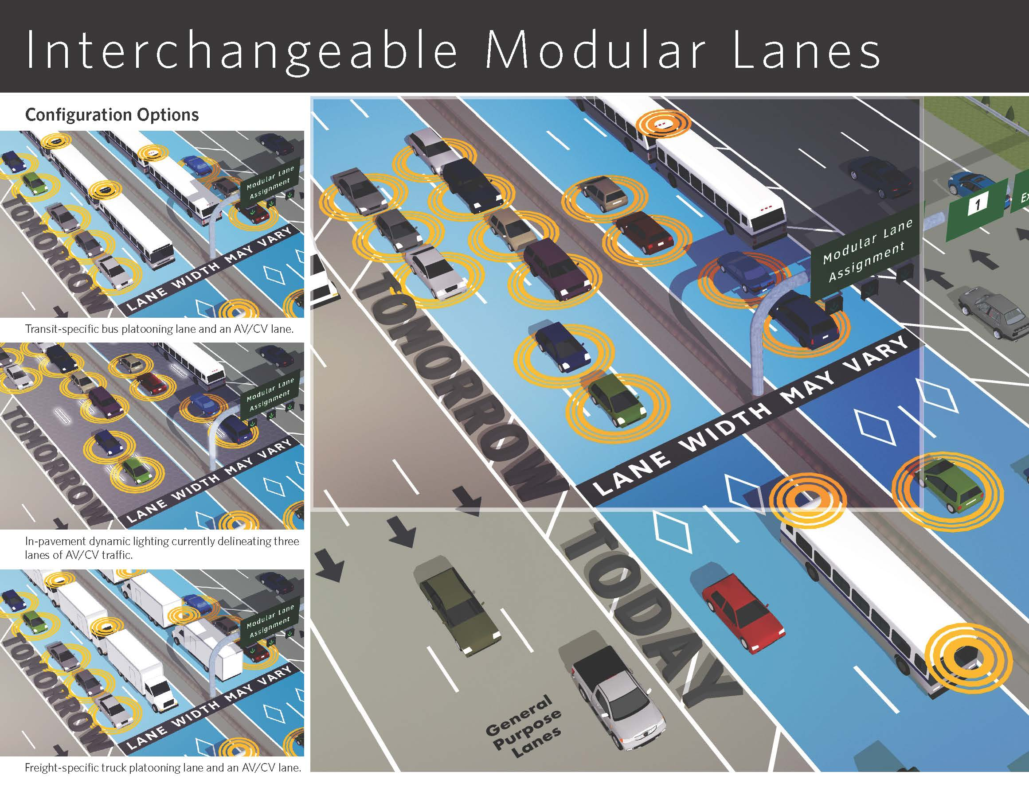

New Paradigm
Design flexibly – modular lanes
  Dynamic lane markings
  Right pavement design
  Full depth shoulder
  Technology roadmap

Slide 33
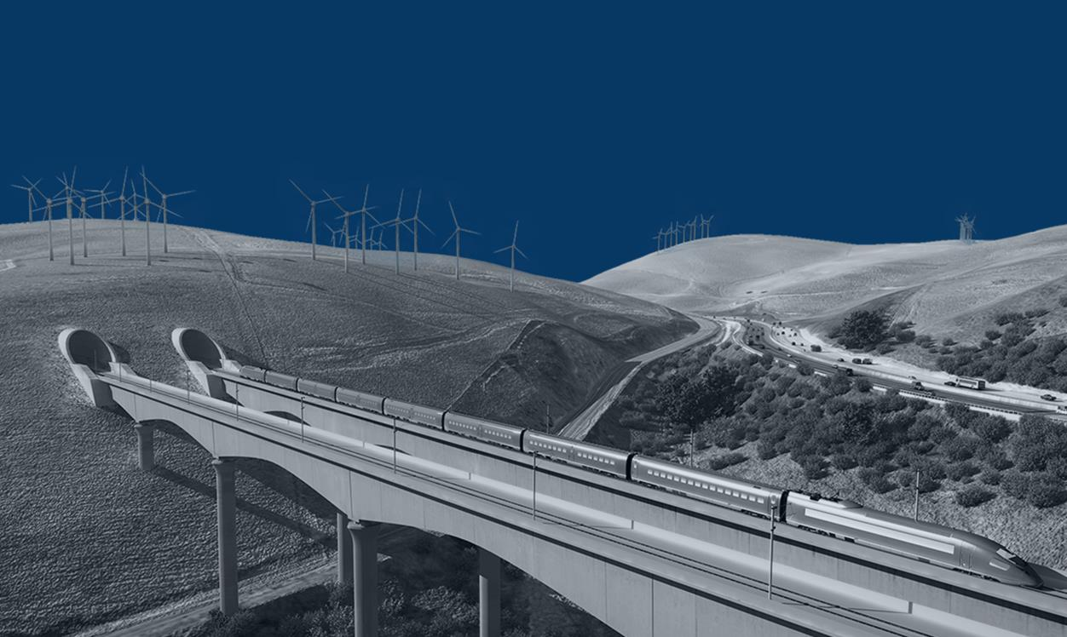
Innovate the Future
“The best way to predict the future is to invent it”
- Alan Kay, Computer Scientist

Slide 34
CONTACTS
John Zielinski
SIS Administrator
FDOT District Five
John.Zielinski@dot.state.fl.us
Santanu Roy, PTP
Vice President
HDR Engineering, Inc.
Santanu.Roy@hdrinc.com

