Slide 1
Employment data sources comparison
RTTAC-MS
Marty Milkovits, JJ Zang, Jay Evans
8/28/2017

Slide 2
Slide-doc revision history
08282017
Clarification of self-employment data recommendation text
08182017
Updated 2010 wage/salary calculations with correct self-employment factor
Added description of self-employment data and recommended approach
08042017 – Initial Version

Slide 3
Outline and Purpose
Purpose:
To resolve the seemingly high growth in employment implied by the Central Office 2015 employment dataset.
To better understand the self-employment data sources.
Outline
Wage and salary employment data
Description of the wage and salary data sources
Wage and salary county control totals comparison
Next steps and recommendation
Self-employment data
Description of the self-employment data sources
Self-employment data comparison
Next steps and recommendation

Slide 4
Description of wage data sources
2010 model MAZ employment data
Total employment: wage employment and self-employment
2010 & 2015 BEA county wage employment
2014 InfoGroup MAZ wage employment
2015 Central Office MAZ wage employment
Notes:
The 2015 central office MAZ employment data used BEBR 411 County Employment data as control total, which is the BEA wage and salary employment estiamtes.

Slide 5

Derivation of 2010 wage data
Obtain the 2010 model wage employment data by category *.
$total emp=wage emp∗ selfemp scale factor$
*2010 control factors were documented in PB's memo "Development of Micro-Area Zone Employment Estimates".

Slide 6
Example derivation of Wage/Salary
Miami-Dade | 2010 total employment | 2010 Self-Employment Scale Factor* | 2010 wage employment
emp_ag | 3,974 | 2.02 | 1,967
emp_const_non_bldg_prod | 71,076 | 1.94 | 36,637
emp_utilities_prod | 4,120 |  | 4,120
emp_mfg_prod | 67,621 | 1.09 | 62,038
emp_whsle_whs | 78,459 | 1.13 | 69,433
emp_trans | 42,784 | 1.30 | 32,911
emp_retail | 138,084 | 1.15 | 120,073
emp_prof_bus_svcs | 257,597 | 1.28 | 201,248
emp_pvt_ed_post_k12_oth | 21,210 | 1.01 | 21,000
emp_health | 112,649 | 1.08 | 104,305
emp_personal_svcs_office | 102,421 | 1.58 | 64,823
emp_amusement | 19,217 | 1.56 | 12,319
emp_hotel | 22,714 | 1.02 | 22,269
emp_restaurant_bar | 77,159 | 1.06 | 72,792
emp_state_local_gov_ent | 53,767 | 1.09 | 49,328
emp_public_ed | 52,216 | 1.00 | 52,216
Total | 1,125,068 |  | 927,477
*2010 control factors were documented in PB's memo "Development of Micro-Area Zone Employment Estimates".

Slide 7
2010 County Wage Employment
County | Model 2010 | BEA 2010 | Differences
Palm Beach | 533,264 | 534,249 | -0.2%
Broward | 738,008 | 737,629 | 0.1%
Miami-Dade | 927,477 | 1,034,961 | -10.4%
Region | 2,198,748 | 2,306,839 | -4.7%
2010 Model wage employment for Miami-Dade is below BEA.
Notes:
2010 MAZ data development methodology: county level factors were used to scale raw infoGroup data - “These factors ensure that employment for each county is consistent with BEA”.
But here we see inconsistency between model maz data and BEA control.

Slide 8
2015 County Wage/Salary Comparison
County | Central Office 2015 | BEA 2015 | Differences
Palm Beach | 618,812 | 618,640 | 0.0%
Broward | 823,647 | 824,197 | -0.1%
Miami-Dade | 1,165,725 | 1,173,629 | -0.7%
Region | 2,608,184 | 2,616,466 | -0.3%
2015 Central Office is consistent with BEA
Notes:
2010 MAZ data development methodology: county level factors were used to scale raw infoGroup data - “These factors ensure that employment for each county is consistent with BEA”.
But here we see inconsistency between model maz data and BEA control.

Slide 9
InfoGroup vs. BEA
County | InfoGroup 2014 | BEA 2014 | Differences
Palm Beach | 608,565 | 594,919 | 2.3%
Broward | 812,565 | 801,421 | 1.4%
Miami-Dade | 1,058,526 | 1,138,693 | -7.0%
Region | 2,479,656 | 2,535,033 | -2.2%
2014 InfoGroup is inconsistent with BEA in different directions across the region.

Slide 10
2010 – 2015 W/S Employment
County | BEA 2010 | BEA 2015 | Differences
Palm Beach | 534,249 | 618,640 | 15.8%
Broward | 737,629 | 824,197 | 11.7%
Miami-Dade | 1,034,961 | 1,173,629 | 13.4%
Region | 2,306,839 | 2,616,466 | 13.4%
County | Model W/S 2010 | BEA 2015 | Differences
Palm Beach | 533,264 | 618,640 | 16%
Broward | 738,008 | 824,197 | 12%
Miami-Dade | 927,477 | 1,173,629 | 27%
Region | 2,198,748 | 2,616,466 | 19%
Implied growth factors (model to BEA) are greater than BEA to BEA growth factors and are most different for Miami-Dade, which had the largest difference from BEA in 2010.

Slide 11
Options
Key question: 2015 total employment = BEA or not?
Option 1: Use the Central Office 2015 data.
Total employment will match BEA
Assumes that BEA control totals are more reliable than 2010 model employment data
Option 2: Apply the BEA 2010-2015 growth rates (slide 9) to model 2010 county total employment to produce 2015 control totals. Scale Central Office 2015 accordingly.
Assumes that model 2010 employment totals are more reliable (results will not equal BEA 2015)

Slide 12
Options
Option 3: (ideal) Apply the BEA 2015 control total targets to InfoGroup 2015 data.
InfoGroup 2015 is not available for the region so this option is not available.
The Central Office 2015 dataset (Option 1) is the closest to this dataset.

Slide 13
Example Application

Slide 14
Example Application

Slide 15
Recommended Approach: Wage and Salary Base
Option 1: Use the Central Office 2015 data.
Consistent with local employment data
Explaining ‘growth’ between Model 2010 and Central Office 2015
Comparison of different data sources (apples and oranges)
SERPM8 calibration would be specific to BEA 2015
Better foundation for employment projections based on BEA

Slide 16
Description of the self-employment data sources
BEA proprietor data
PUMS self-employment
BEA Total
By type
Wage and salary employment
Proprietor employment
By industry
Employment by industry (NAICS)
PUMS Total
By Industry
Wage and salary employment
Self-employment

Slide 17
Description of the data sources
BEA county proprietors employment
Data source: tax filing
Type: sole proprietors (non-incorporated) and general partners (incorporated) who incorporated their businesses with legal entities.
PUMS self-employment
Data source: ACS survey
The ACS form asks people whether they are self-employed or salaried-employees.
Based on major employment activity and primary source of income.
Notes:
Reference: How Hard is it to Count Workers? Self-Employment Data in Nonemployer Statistics and in American Community Survey
https://www.fhwa.dot.gov/planning/census_issues/ctpp/status_report/sr1214/index.cfm#ftn1

Slide 18
Comparison of self-employment data sources
Differences between BEA and PUMS (2015)
Why
“There are people whose primary sources of income are not unincorporated businesses and have to file income tax forms for the proprietary businesses; and
A self-employed individual can be involved in multiple businesses and each of the businesses may require filing of income tax forms.”
How Hard is it to Count Workers? Self-Employment Data in Nonemployer Statistics and in American Community Survey https://www.fhwa.dot.gov/planning/census_issues/ctpp/status_report/sr1214/index.cfm#ftn1
County | BEA Proprietor employment | PUMS Self-employment
Palm Beach | 257,339 | 108,242
Broward | 314,487 | 147,153
Miami-Dade | 507,624 | 205,904
Region | 1,079,450 | 461,299

Slide 19
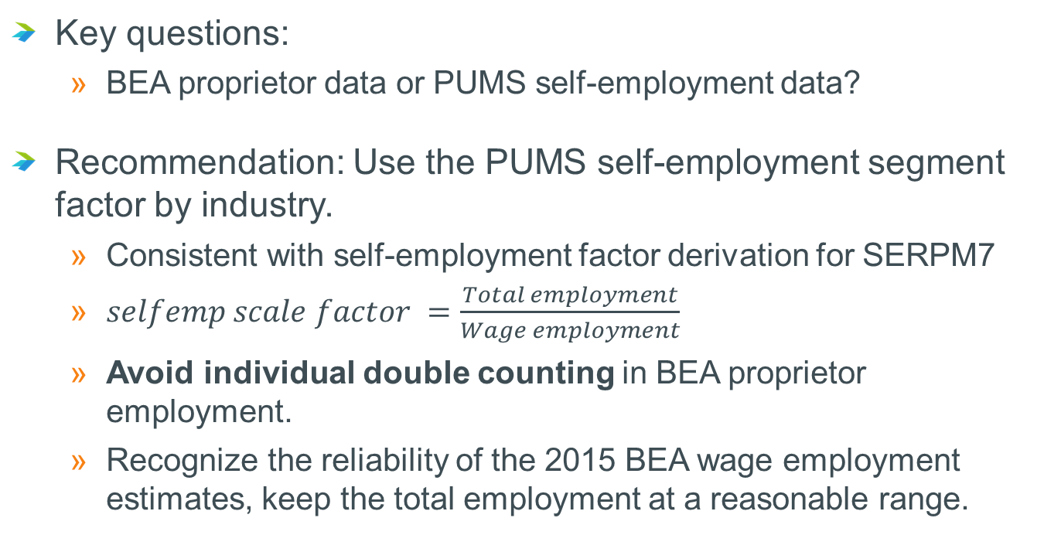
Recommended Approach: Self-Employment Factors
Key questions:
BEA proprietor data or PUMS self-employment data?
Recommendation: Use the PUMS self-employment segment factor by industry.
Consistent with self-employment factor derivation for SERPM7
$selfemp scale factor =\frac{Total employment}{Wage employment}$
Avoid individual double counting in BEA proprietor employment.
Recognize the reliability of the 2015 BEA wage employment estimates, keep the total employment at a reasonable range.

Slide 20
Summary of Recommendations
Wage / Salary: Use 2015 Central Office Employment Data
Consistent with BEA 2015 county control totals
MAZ-Level Adjustments based on T/MPO feedback
Self-Employment: Apply factors derived from PUMS data
Consistent with SERPM7 self-employment derivation process

