Slide 1
SERPM 8 NPMRDS SPEED DATA
---------
Marty Milkovits, Xuemei Liu
8/29/2017

Slide 2
Outline
Description of data sources
Methodology
Initial Results and findings

Slide 3

Description of validation data sources
2015 NPMRDS Data*
  April 1st to 30th 2015 weekdays & weekends
  1-hour interval average speed data from vehicle probe
2015 Here Data**
  April 1st to 30th 2015 weekdays & weekends
  Speed data with high confidence (>0.7)
24-hour Count Data
  April 1st to 30th 2015 weekdays & weekends
  2014 Stations Available
*Data downloaded from RITIS Probe Data Analytics Suite. https://vpp.ritis.org/suite/download/
Notes:
* and ** are downloaded from https://vpp.ritis.org/suite/download/
**Used to cross-check NPMRDS data
Username: xliu@camsys.com
Password: lxm123456

Slide 4
Approach
Use NPMRDS speed data to identify NHS network links with valid speed data:
Identify valid links in NHS
All +/- TMC have been removed and only N/P TMC kept
Attach TMC to NHS
The TMC identification table is processed to establish the multiple-to-multiple correspondence between TMCs and NHS links*
The multiple-to-multiple correspondence is cleaned up in consideration of the duplicated LINK_ID
Each LINK_ID is only associated with one TMC for each direction **
Notes:
*Xuemei conducted these two steps in ArcGIS
**See line 53-63 of X:\Proj\2016\160136 - FLDOT D4 UMdlDev16_OnCall\Validation\data\Speeds\version_0808\Speed_0905.R

Slide 5
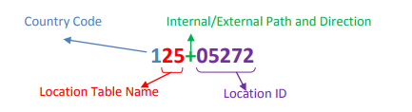
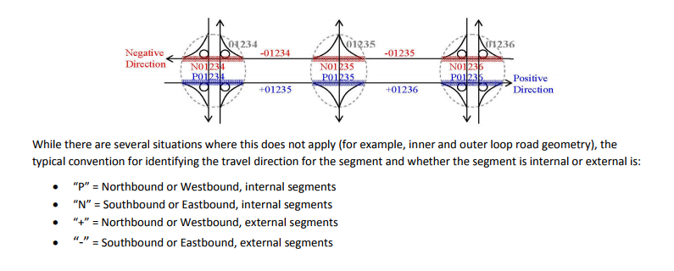
Link Direction Identification
Image Source: Inrix (2014). I-95 Vehicle Probe Project II. page 81 & 82.
http://i95coalition.org/wp-content/uploads/2015/02/I-95-VPP-II-INRIX-Inteface-Guide-v1-Dec-2014.pdf?dd650d
Notes:
After discussion, only data of N & P are selected.

Slide 6
Approach
Attach TMC from NPMRDS speed data to highway network links using count station lookup, or spatial join between highway network and NHS network shape file.
Only NHS links close to highway count station (50 feet) with 24-hour counts and Highway network links close to NHS links with valid speed data(200 feet) would be considered
65% links are joined with TMC based on shared LINK_ID between Master network and NHS network
Others are joined based on the spatial relationship between NHS and latest highway network

Slide 7
Approach
Calculate 5th and 50th percentile hourly speed using average speed data from the NPMRDS speed data for highway links with TMC attached
  5th percentile speed correlates with congested speed
  50th percentile speed is calculated to replace outliers of 5th percentile speed if any
Notes:
*From Dan Beagan’s email

Slide 8
Approach
Calculate weighted daily average speed or TOD using hourly counts data
Calculate 85th percentile average speed for each link for all time periods as reference speed, and reference speed has been rounded to the nearest 5 mph

Slide 9
Initial Results
Tabulate speed data by facility type and area type
Compare reference speed with free-flow speed and posted speed

Slide 10
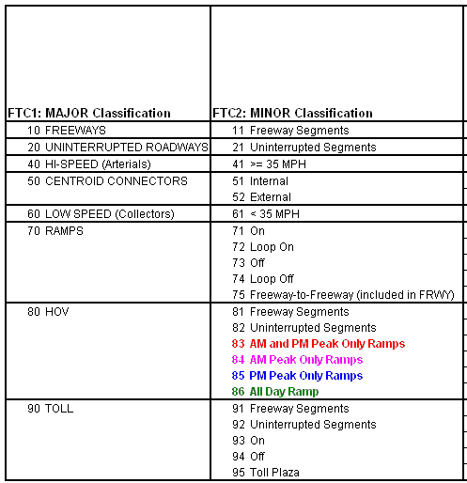
FTC2 Tabulation

Slide 11
Links matched
FTC2 | Categories | # of TMC
11 | Freeway | 201
12 | Freeway-type II | 6
21 | Uninterrupted Segment | 58
41 | Hi-Speed (Arterials) | 1,274
61 | Low-speed Collectors | 113
71 | On Ramp | 7
72 | Loop On | 2
73 | Off Ramp | 6
74 | Loop Off | 1
75 | Freeway-to-Freeway (included in FRWY) | 5
91 | Freeway Segments | 162
92 | Uninterrupted Segments | 6
93 | On | 17
94 | Off | 2
 | Total | 1,880
Categories | # of TMC
CBD | 83
Fringe | 55
OBD | 472
Generally Residential | 1,169
Rural | 101
Total | 1,880

Slide 12
Average Speed by Area Type
5 percentile speed
  TOD
    AM Peak (6AM – 9AM)
    Midday (9AM – 3PM)
    PM Peak (3PM – 7PM)
    Evening (7PM – 10PM)
    Night (10PM – 6AM)
  ATG
    1 → CBD
    2 → Fringe
    3 → OBD
    4 → Generally Residential
    5 → Rural
Notes:
Average speed increases from CBD to Rural for roadways of all facility types

Slide 13
Average Speed by Area Type

Slide 14

Average Speed by Functional Class
5 percentile speed
  FTC*
    10 → Freeway
    20 → Uninterrupted Facility
    40 → Higher Speed Interrupted Facility
    60 → Lower Speed & Collector Facility
    70 → Ramps
    90→ Toll Roads
Notes:
As shown in the blue rectangular, AM, PM and Midday average speed are quite similar for arterials and collectors.

Slide 15
Average Speed by Functional Class

Slide 16
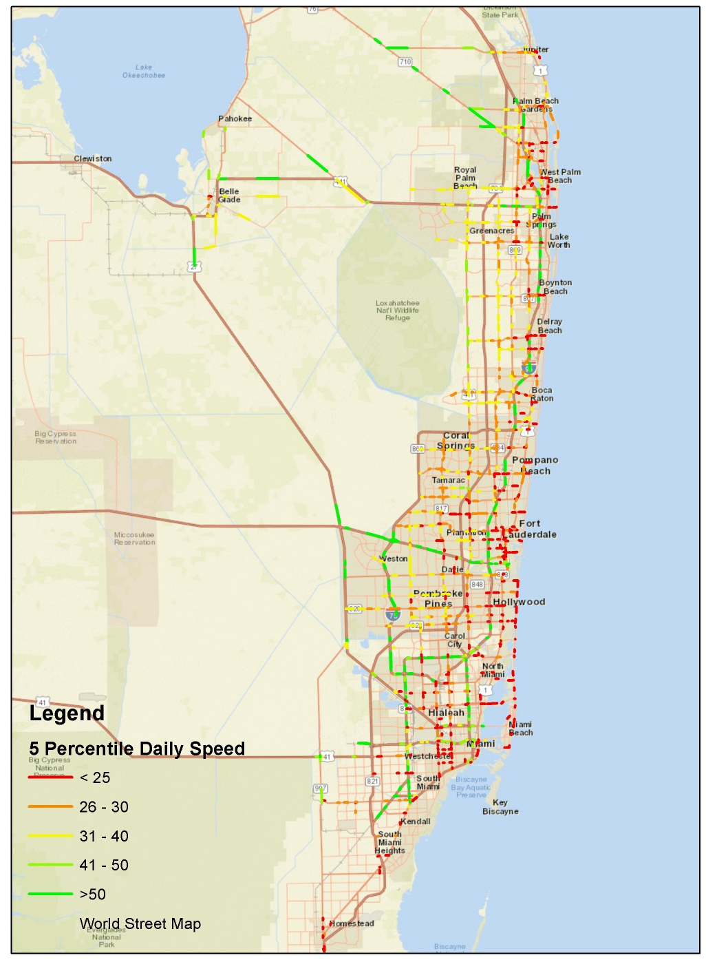
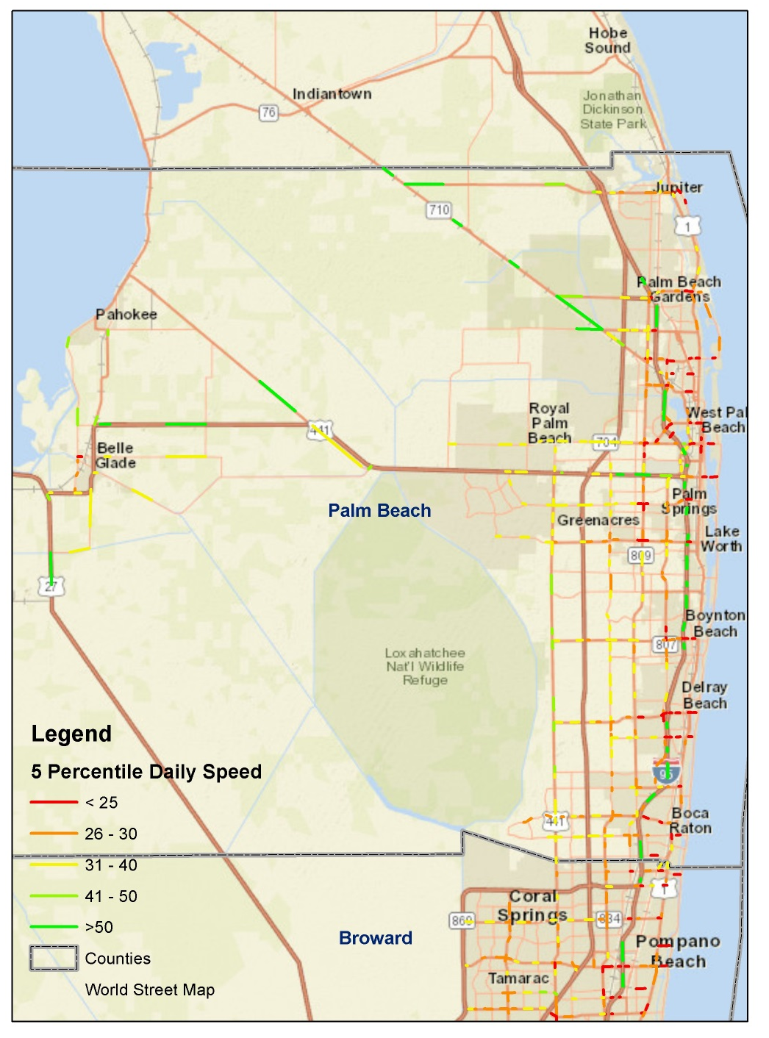

Slide 17
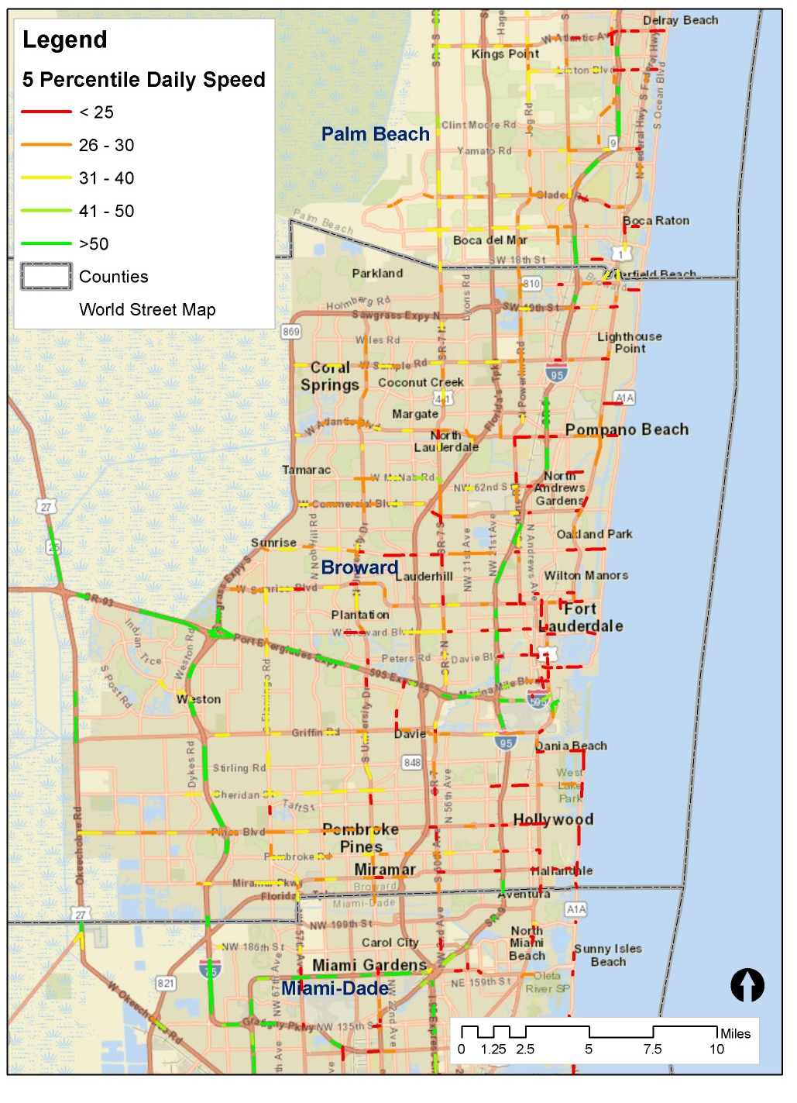
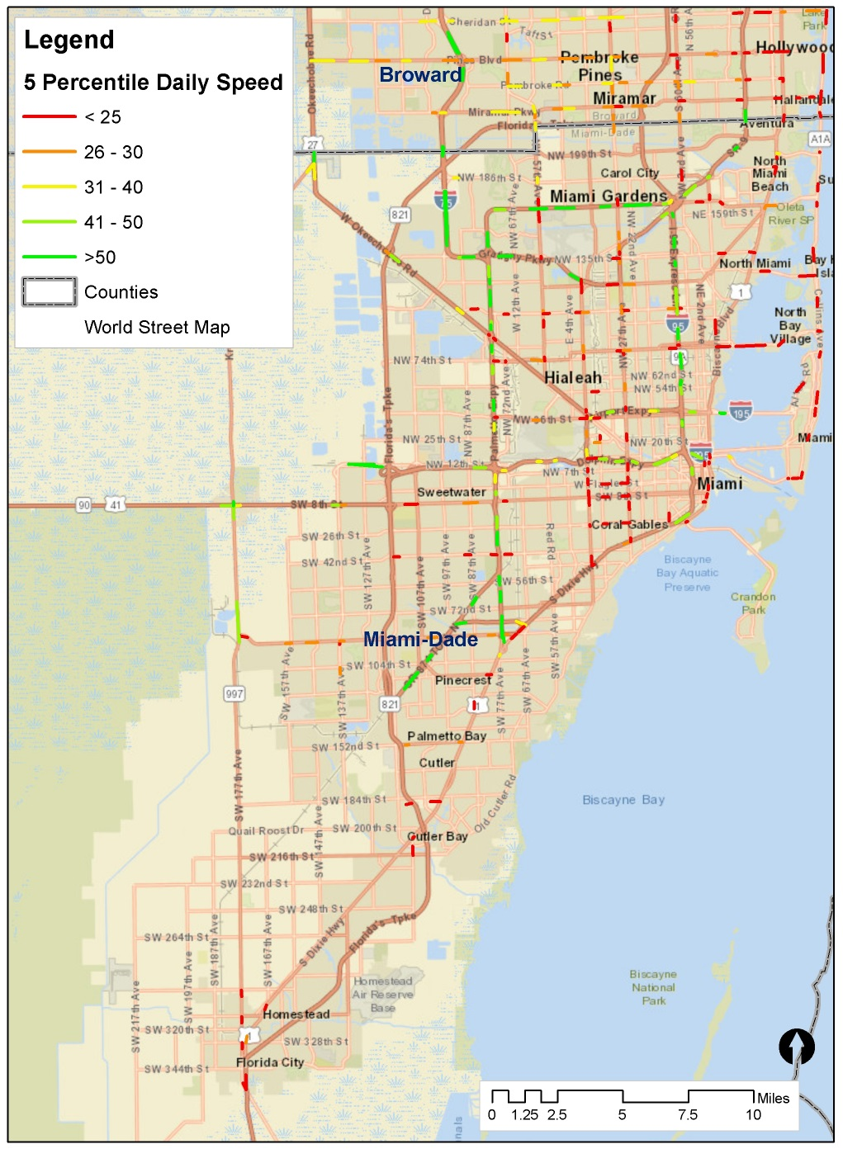

Slide 18
Average Speed by Area Type
50 percentile speed
  TOD
    AM Peak (6AM – 9AM)
    Midday (9AM – 3PM)
    PM Peak (3PM – 7PM)
    Evening (7PM – 10PM)
    Night (10PM – 6AM)
  ATG
    1 → CBD
    2 → Fringe
    3 → OBD
    4 → Generally Residential
    5 → Rural
Notes:
Average speed increases from CBD to Rural for roadways of all facility types

Slide 19

Average Speed by Area Type

Slide 20
Average Speed by Functional Class
5 and 50 percentile speed
  FTC*
    10 → Freeway
    20 → Uninterrupted Facility
    40 → Higher Speed Interrupted Facility
    60 → Lower Speed & Collector Facility
    70 → Ramps
    90→ Toll Roads
Notes:
As shown in the blue rectangular, AM, PM and Midday average speed are quite similar for arterials and collectors.

Slide 21
Average Speed by Functional Class
*80-HOV is not included because 24-hr count for HOV is not available.

Slide 22
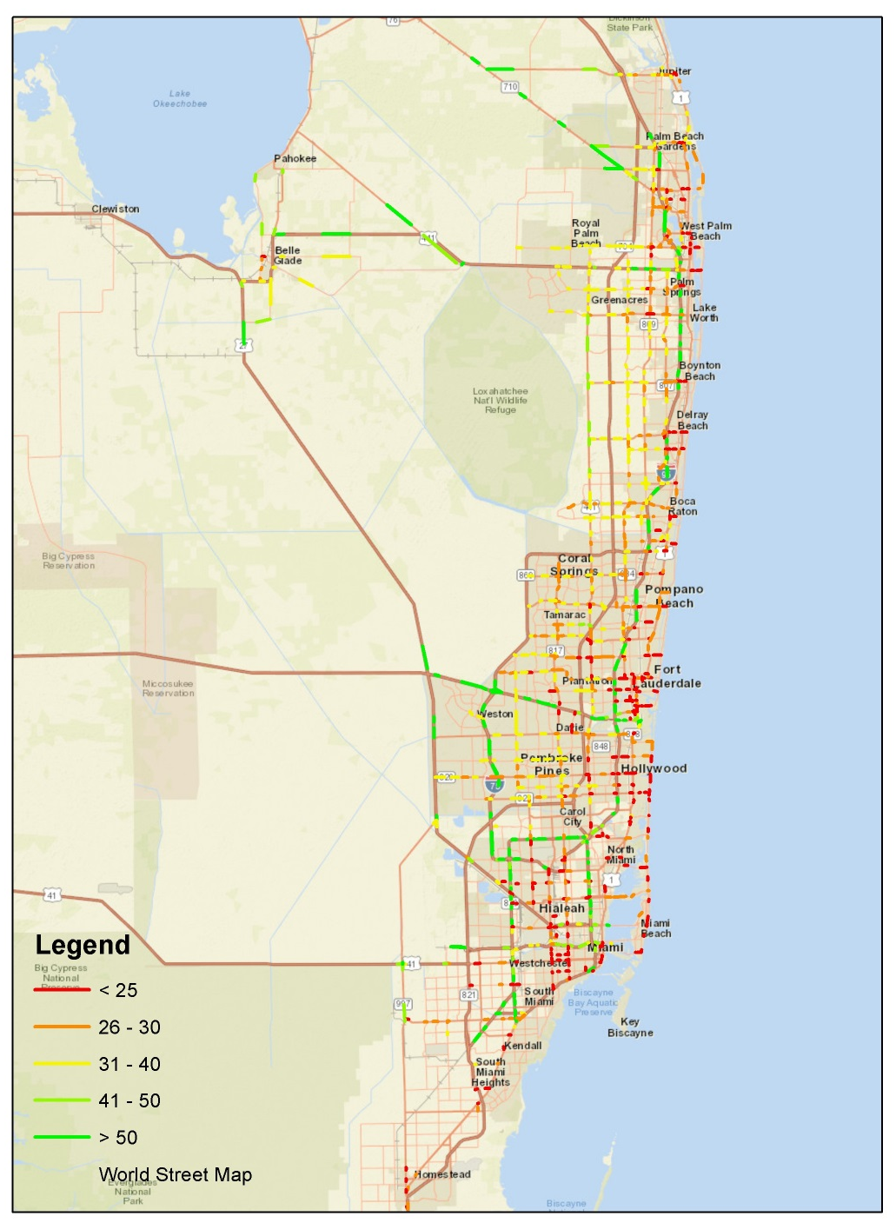
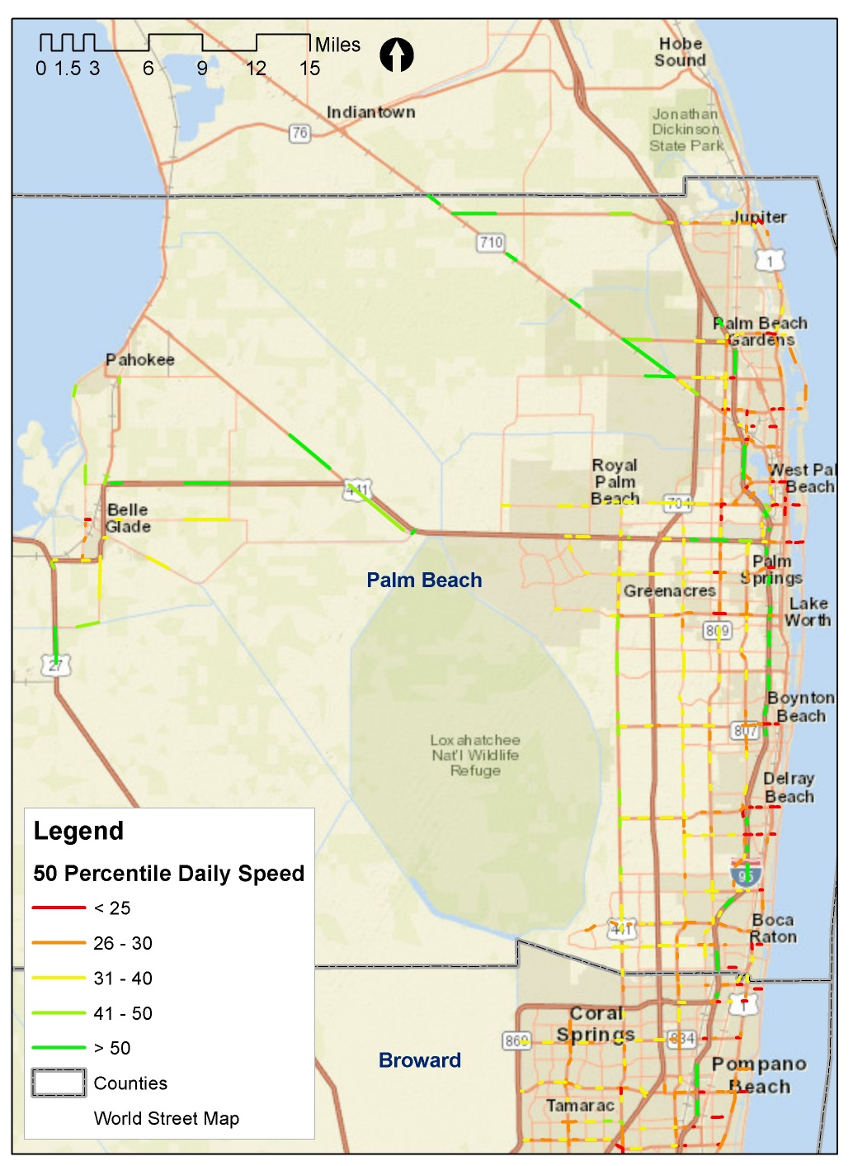

Slide 23
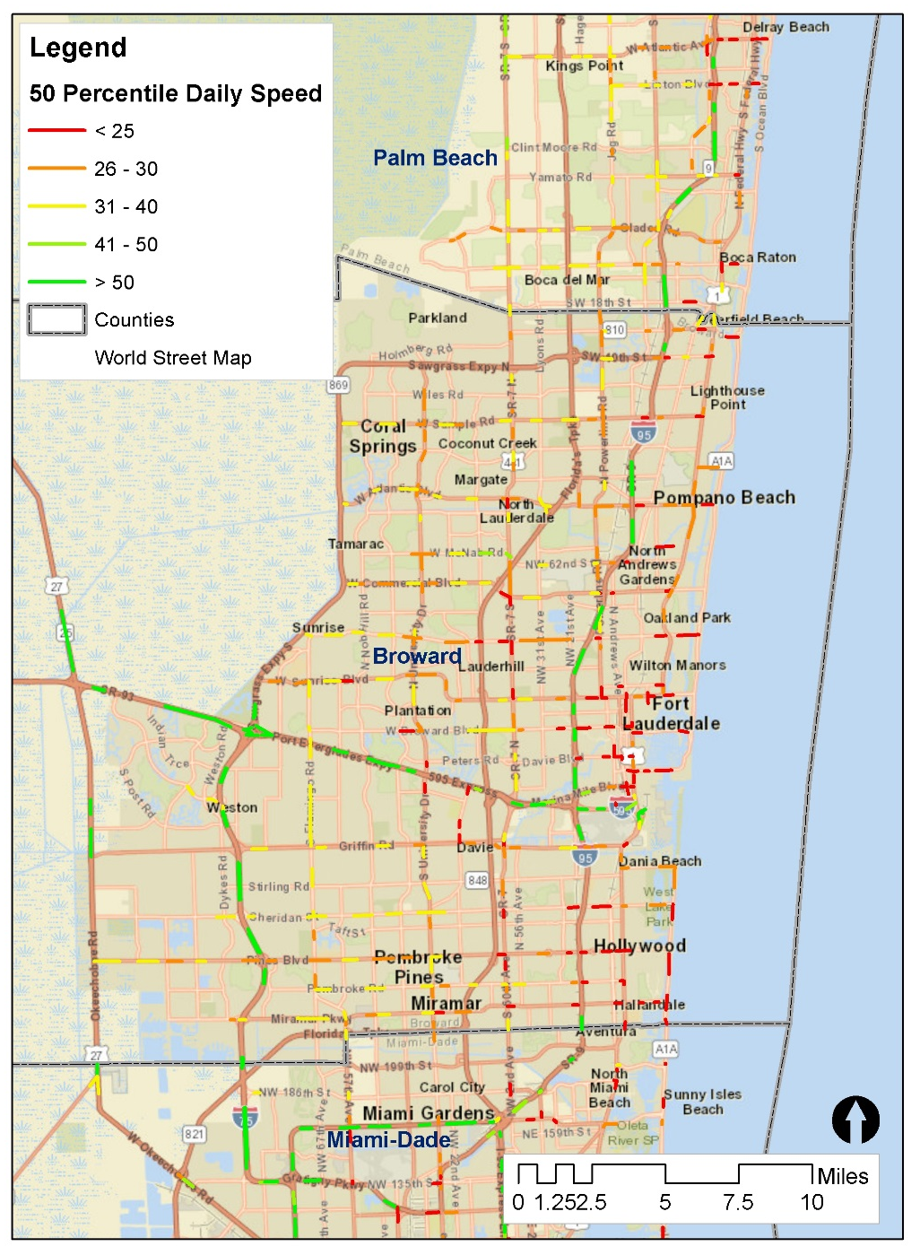


Slide 24
Discussion
Midday speed is as congested as AM speed for arterials and collectors
Notes:
http://www.fsutmsonline.net/images/uploads/md_lctr_2006/SERPM7_Model_Development_Report_Feb_17_2015_Final.pdf
*Only 11% of workers above 16 leaving home from 10 am to 4 pm for county-to-county flow according to CTPP 2006-2010 data
*That number for MWCOG region is about 8%
More non-mandatory tours than other region?
More flexible work schedule in this region?* (not likely)
Departure or arrival times at noon for university & school tours?
Comparing Arterial Speeds from “Big-Data” Sources in Southeast Florida
(Abstract) (Presentation)Presented by Sujith Rapolu
Authors:
Sujith Rapolu, AECOM
Ashutosh Kumar, AECOM

Slide 25
Discussion
Comparing Arterial Speeds from “Big-Data” Sources in Southeast Florida (Rapolu & Kumar, 2015)
  Midday speed is as slow as AM speed
  Congested Speed is approximately half of the posted speed limit
  PM speed is the slowest
NPMRDS data for Higher Speed Interrupted Facility
is almost consistent with the previous study conducted in 2015 .
Notes:
Comparing Arterial Speeds from “Big-Data” Sources in Southeast Florida
(Abstract) (Presentation)Presented by Sujith Rapolu
Authors:
Sujith Rapolu, AECOM
Ashutosh Kumar, AECOM

Slide 26
Discussion
Comparing Arterial Speeds from “Big-Data” Sources in Southeast Florida (Rapolu & Kumar, 2015)
  Average travel speed during the day is 20-25 mph for the four major corridors
NPMRDS daily weighted congested speed is a bit higher than data in this previous study.
Notes:
Weighted 5th daily speed for arterial is a bit higher compared to major arterials because speed of roadways in rural area is also included.
Comparing Arterial Speeds from “Big-Data” Sources in Southeast Florida
(Abstract) (Presentation)Presented by Sujith Rapolu
Authors:
Sujith Rapolu, AECOM
Ashutosh Kumar, AECOM

Slide 27
SERPM 6 – Speed Validation
 |  | Average Weighted Speed (mph)
 |  | Model |  |  |  | Observed
Facility Type |  | AM | PM | Off Peak | All Periods | AM | PM | Off Peak | All Periods
Freeway - | 11 | 45.41 | 45.47 | 48.81 | 46.44 | 46.84 | 54.15 | 52.25 | 50.58
Surface Streets - | 41 | 29.86 | 27.45 | 31.67 | 30.13 | 24.69 | 23.60 | 26.62 | 25.25
HOV Lanes - | 81 | 54.02 | 51.57 |  | 52.79 | 64.19 | 57.58 |  | 60.89
Toll Facility - | 91 | 63.79 | 62.17 | 62.84 | 62.96 | 65.16 | 65.47 | 63.97 | 65.17
All Facilities: |  | 41.00 | 43.94 | 37.87 | 40.88 | 39.97 | 46.75 | 35.41 | 40.48
Data Source: Li, S, et al. (2007). Validation of Speeds and Capacities in a Large Regional Model. Page 23. http://www.trbappcon.org/2007conf/program.html#s16a
Notes:
54 mph for NPMRDS AM looks a bit high compared with 2000 freeway speed (46.84 mph) shown in the table of this slide
28 mph for NPMRDS AM looks a bit high compared with 2000 freeway speed (24.69 mph) shown in the table of this slide
Data source of observed speed looks like an inventory maintained by FDOT

Slide 28
Average Speed by Functional Class
5 percentile speed
  FTC*
    10 → Freeway
    20 → Uninterrupted Facility
    40 → Higher Speed Interrupted Facility
    60 → Lower Speed & Collector Facility
    70 → Ramps
    90→ Toll Roads
Here data has freeway and arterial AM speed more consistent with 2000 highway speed
Data Source: HERE
with high confidence (>0.7))
*80-HOV is not included because 24-hr count for HOV is not available.
Notes:
Here data has freeway and arterial AM speed more consistent with 2000 highway speed

Slide 29
Free-flow Speed Derivation
FTC2 | Functions
11-12, 81-82, 91-92 | FFSPD=12.56418+0.64058*POSTSPD+0.00340*(POSTSPD)^2
21,41,61 | FFSPD=10.10+0.65735*POSTSPD+0.00348*(POSTSPD)^2
71-75, 83-86, 93-95 | FFSPD=11.33209+0.64896*POSTSPD+0.00344*(POSTSPD)^2
*Based on SERPM 7 CUBE script, free-flow speed is derived based on posted speed.
Notes:
IF (FTC2=11-12,81-82) ;Freeway & HOV
FFSPD=(12.56418+0.64058*POSTSPD+0.00340*(POSTSPD)^2)
ELSEIF (FTC2=91-92) ;Mainline Toll Links
FFSPD=(12.56418+0.64058*POSTSPD+0.00340*(POSTSPD)^2)
ELSEIF (FTC2=21) ;Uninterrupted Roadways
FFSPD=(10.10+0.65735*POSTSPD+0.00348*(POSTSPD)^2)
ELSEIF (FTC2=41) ;High Speed Arterials
FFSPD=(10.10+0.65735*POSTSPD+0.00348*(POSTSPD)^2)
ELSEIF (FTC2=61) ;Low Speed Collectors
FFSPD=(10.10+0.65735*POSTSPD+0.00348*(POSTSPD)^2)
ELSEIF (FTC2=71-75) ;Ramps-Freeway
FFSPD=(11.33209+0.64896*POSTSPD+0.00344*(POSTSPD)^2)
ELSEIF (FTC2=93,94) ;Ramps-Toll Facilities
FFSPD=(11.33209+0.64896*POSTSPD+0.00344*(POSTSPD)^2)
ELSEIF (FTC2=83-86) ;HOV Slip Ramps
FFSPD=(11.33209+0.64896*POSTSPD+0.00344*(POSTSPD)^2)
ELSE
FFSPD=(11.33209+0.64896*POSTSPD+0.00344*(POSTSPD)^2) ;Others (for ex. Toll plazas-95) excluding connectors
ENDIF

Slide 30
Reference, Free-flow & Posted Speed Cont’d.
Data source:
1) Reference speed: NPMRDS one-hour 85th percentile average speed for each link attached with a valid TMC
2) Free-flow and posted speed: SEPRM 7 loaded network
Notes:
Not sure if the reference speed a bit low to uninterrupted facilities in urban area.
Data source:
1) Reference speed: NPMRDS one-hour 85th percentile average speed for each link attached with a valid TMC
2) Free-flow and posted speed: SEPRM 7 loaded network
Reference speed is too low for Lower Speed & Collector Facility in CBD

Slide 31
Discussion
For categories with counts greater than 20, most of free-flow speed calculated in the loaded network is between posted speed and reference speed, which is consistent with SERPM 7 summary in the model development report

Slide 32
Conclusion
Average speeds for different time periods are consistent with other sources
Reference speed calculated by 85 percentile daily speed has logical relationship with post speed and free flow speed

