Slide 1
MOBILITY DATA INTEGRATION SPACE (MDIS)
Model Task Force Data/GIS Quarterly Meeting
June 29, 2022

Slide 2
Mobility Data Integration Space (MDIS)
Modernized environment to access and integrate mobility and travel demand modeling data​
Orderly ingestion of data from various functional areas ​
User friendly navigation to applications and dashboards​
Meaningful performance measures, indicators, and trends​
Comprehensive and scalable
Single source of truth ​
Notes:
The Forecasting and Trends Office is the Department’s trusted source for transportation system forecasting and performance metrics.
This is why we are taking the lead on agency-wide adoption and access to modeling data and mobility performance measures, and the associated data governance and management, with the Mobility Data Integration Space.
<CLICK> You can think of the Mobility Data Integration Space (MDIS) as a modernized environment that holds integrated and processed mobility and travel demand modeling data. It will act as an enterprise clearinghouse of information used for model inputs, performance measures, and other data pertinent to transportation system performance.
<CLICK> It supports FDOT’s evolving data needs and allows for orderly integration of mobility data from various functional areas across the Department and Districts.
<CLICK> It leverages existing investments in our enterprise tools and provides a framework for the data cataloging, data processing and analytics to report on system performance in a meaningful way for other FDOT offices, districts, and our external partners.
<CLICK> It will be the single source of transportation system performance and travel demand model input data and will drive a suite of interconnected, easy to use applications, dashboards, and tools.
There are concurrent efforts throughout the Department to create other data integration spaces, including one for safety and traffic engineering and operations.

Slide 3
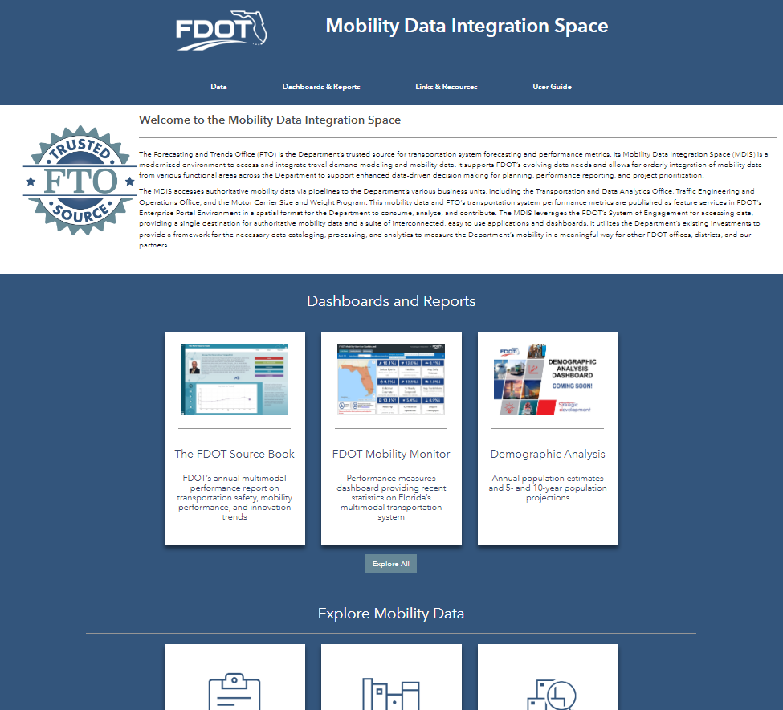
Available Content
Data
Dashboards & Reports
Links & Resources
User Guide
Notes:
While on the surface, these spaces may just look like a webpage with links, behind the scenes is where the magic happens
We are working to connect directly to authoritative data sources and automate the transformation of that data as much as possible to meet the needs of our modeling community.
The MDIS is where we will combine these different data sources to paint a cohesive picture of travel movements at corridor, regional, and statewide resolutions.
It will facilitate data analysis and distribution by creating a central nexus where diverse mobility data is integrated and can be accessed by data generators and data consumers alike.
The draft MDIS landing page, shown here—connects you directly to key resources, including:
<CLICK> Data
<CLICK> Dashboards and reports
<CLICK> Links and resources, and
<CLICK> A User Guide

Slide 4
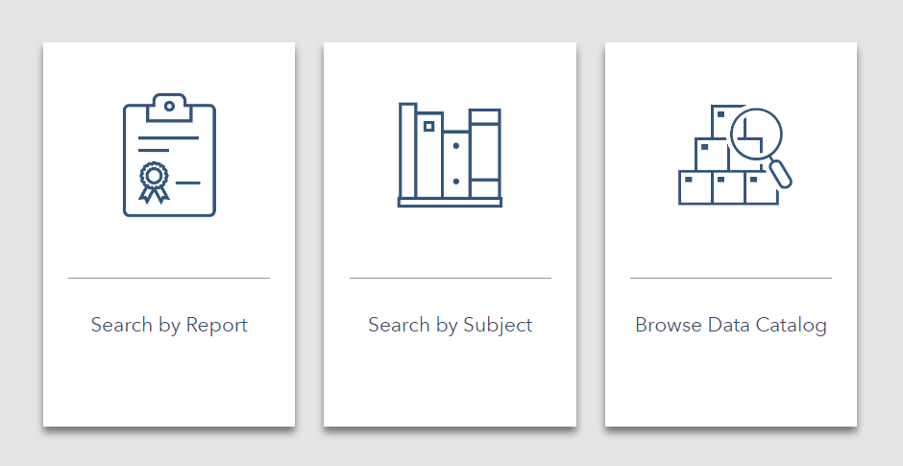
Mobility Data: Ways to Search
Notes:
In regard to data in the MDIS—we are setting up three ways to search and access the data, by:
Performance report,
Subject, or by
Browsing the complete data catalog

Slide 5
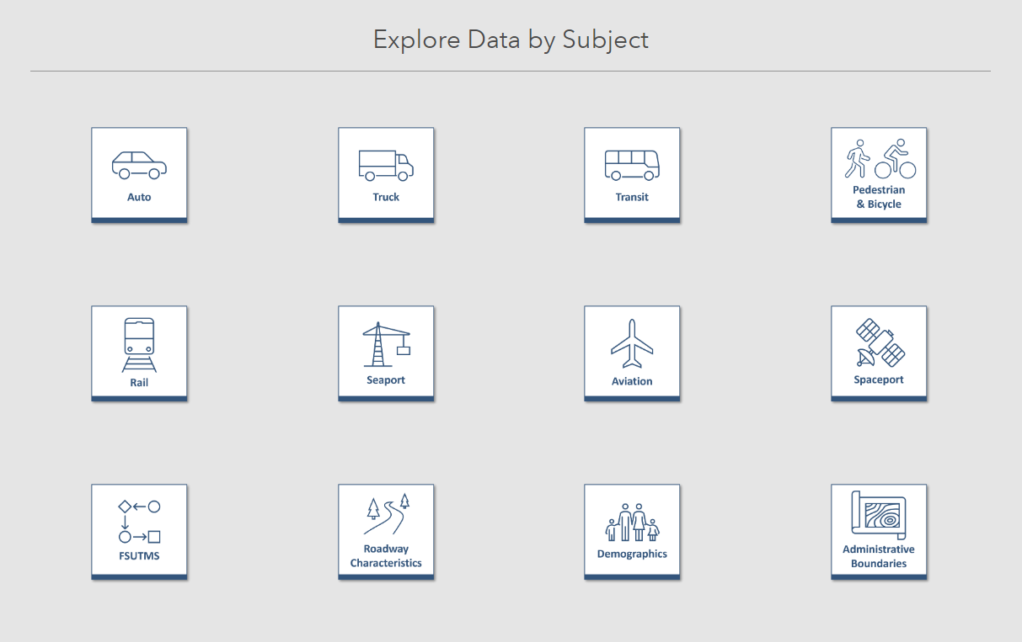
Explore Data by Subject
Notes:
Under the search data by subject capability, all of the topical groupings of data that the MDIS offers are shown
You simply click on a subject icon to view the replated datasets
<CLICK> There is a FSUTMS subject button where all modeling data can be easily accessed.

Slide 6
Feedback
What data should be included in the MDIS?
At what level of detail?
How often should data be updated?
What data sources should be utilized?
How will you use the data in the MDIS?
Notes:
I would really like to hear from you. What are your thoughts and input on:
<CLICK> What data should be included?
<CLICK> To what level of detail?
<CLICK> How often should it be updated?
<CLICK> What data sources should be utilized?
<CLICK> How will you use the data in the MDIS?

Slide 7
FSUTMS Next Generation Data: Example Framework
PRACTICE | ELEMENTS
Demographics | Continue dwelling unit by type? Greater differentiation in type? Auto ownership versus income? Greater differentiation in population (age, employment status, sex)?
Employment | General categories (Industrial, Commercial, etc.) versus 2-digit NAICS? School and university employment? Include average salaries?
Traffic Analysis Zones (TAZs) | Numbering practices (incorporate county FIPS?) Nesting practices Delineation standards
Costs | Travel times Tolls Operating Costs
Capacities | Include HCM characteristics (lane width, shoulders, median, parking)? Intersection locations, control types, cycle length, green time, context class etc.?
Master Network | Project ID numbers Specific flags for which links belong to which scenarios Separate database for project characteristics?
Notes:
As shared in the FSUTMS Next Generation Draft White Paper, data considerations for FSUTMS NextGen can be organized according to a framework.
This table from the Draft White Paper, shows a potential example of this framework—which when finalized will drive what data is included in the MDIS.
But it is important to remember, the MDIS is not just a repository of a snapshot of data, but rather it is a pipeline to access up to date and processed data needed for model inputs

Slide 8
Potential Data for Inclusion in the MDIS
DATA INPUTS
MODEL OUTPUTS
Socio-economic data inputs
Census
American Community Survey
Employment
School Enrollment
Future land use
Speed
Posted speed limits
HERE data
Florida Statewide Model network from RCI
FHWA Smoothed Urban Area Boundaries
Traffic counts
Class
24 hour
15-minute
Incidents
Point location
Clearance times
Transit
GTFS routes
Ridership data
Survey Data
Trip Generation
Employment
Future Year Annual Average Daily Traffic
Future Year Level of Service / Congestion
Notes:
Florida’s travel demand models not only make use of a variety of datasets identified for incorporation into the MDIS, but the models also generate data that are intended to be brought into the MDIS.
What we would like to get your feedback on today is: what data is used by the model that should be housed within the MDIS?
This includes:
<CLICK> Socio-economic data inputs, such as data from the Census, ACS, employment data, school enrollment, and future land use
<CLICK> Speed data, both posted speed limits and actual travel speed data from HERE, including peak hour speed data that can be used to validate models
<CLICK> We are also working to leverage RCI data to create a statewide network, that all models can use
A comprehensive statewide highway network database would allow for a central source of transportation network data.
This database could contain multiple levels of resolution that could account for statewide, regional, and local modeling needs.
Consistency in network characteristics and attribute nomenclature will be crucial for this effort.
Other potential data sets for inclusion are:
<CLICK> FHWA Smoothed Urban Area Boundaries
<CLICK> Traffic counts—including class, and by 24-hour and 15-minute periods
<CLICK> Incident data, such as point location and clearance times
<CLICK> Transit routes and ridership data, and
<CLICK> Survey data
Furthermore, data generated by the models can also be brought into the MDIS.
This includes:
<CLICK> future year traffic and
<CLICK> level of service / congestion model outputs

Slide 9
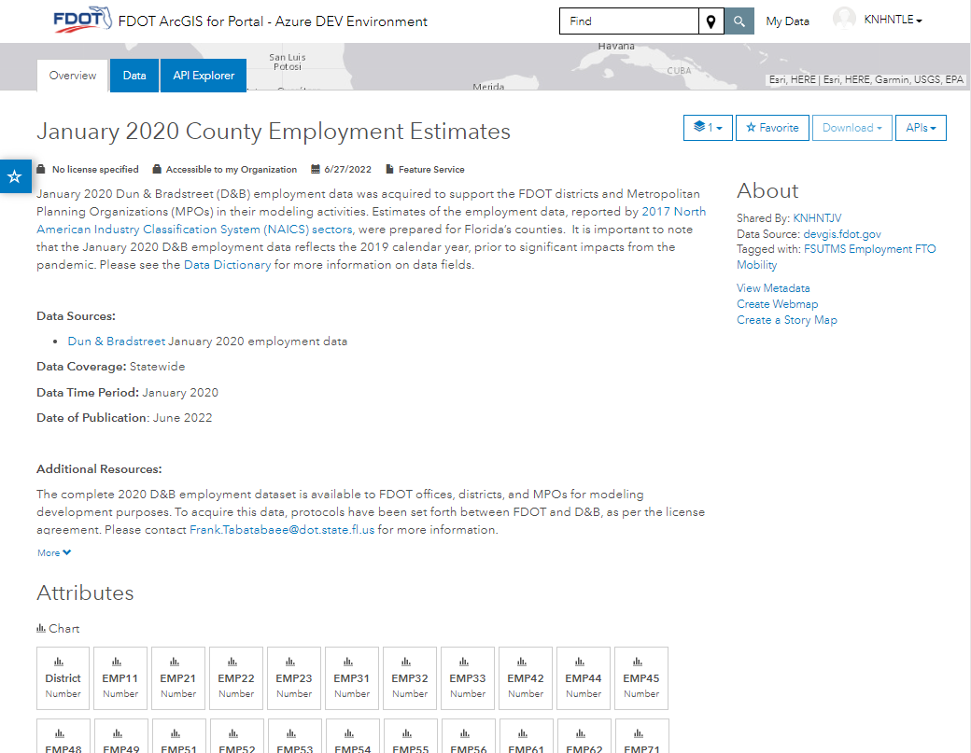
Accessing Data
8
4
5
9
1
6
Item details
Dataset overview
Data dictionary
Favoriting
Downloading
About
View via Webmap
Explore attribute table
API
2
3
7
Notes:
Modeling data will be published as feature services and easily accessed through the ArcGIS Portal environment
For each feature service, detailed information about the dataset will be provided, along with multiple ways to access and view the data. This includes:
<CLICK> Item details, which provides information on the licensing, sharing status, date last updated, and item type
<CLICK> A detailed overview of the dataset, including data sources, coverage, time period, publication date, and additional resources
<CLICK> A link to a detailed data dictionary will also be provided here
<CLICK> Users can utilize the “favorite” functionality, which allows saving of frequently used datasets to your ArcGIS Portal account for easy access
<CLICK> The download button will allow for downloading the data locally in a variety of formats
<CLICK> The “About” section provides information on the item owner, data source, tags, and metadata
<CLICK> One of the easiest ways to view the data is by clicking “Create a Webmap”; the dataset loads into a blank maps where the data can be explored with webmap tools
<CLICK> The dataset attribute table can also be explored and filtered in the “Data” tab
<CLICK> And finally, the API button allows direct access to the data in other programs through its REST API endpoint

Slide 10
Jennifer Fortunas, P.E.
Forecasting and Trends Office
Office Manager
605 Suwannee Street
Tallahassee, FL 32399
Phone: 850-414-5396
jennifer.fortunas@dot.state.fl.us

