Slide 1
Origin / Destination Sources
presented by Daniel R. Miller, P.E. September 1st, 2020

Slide 2
Overview
Data Source
Data Provider
Data Type
Committee Comments
Source

Slide 3
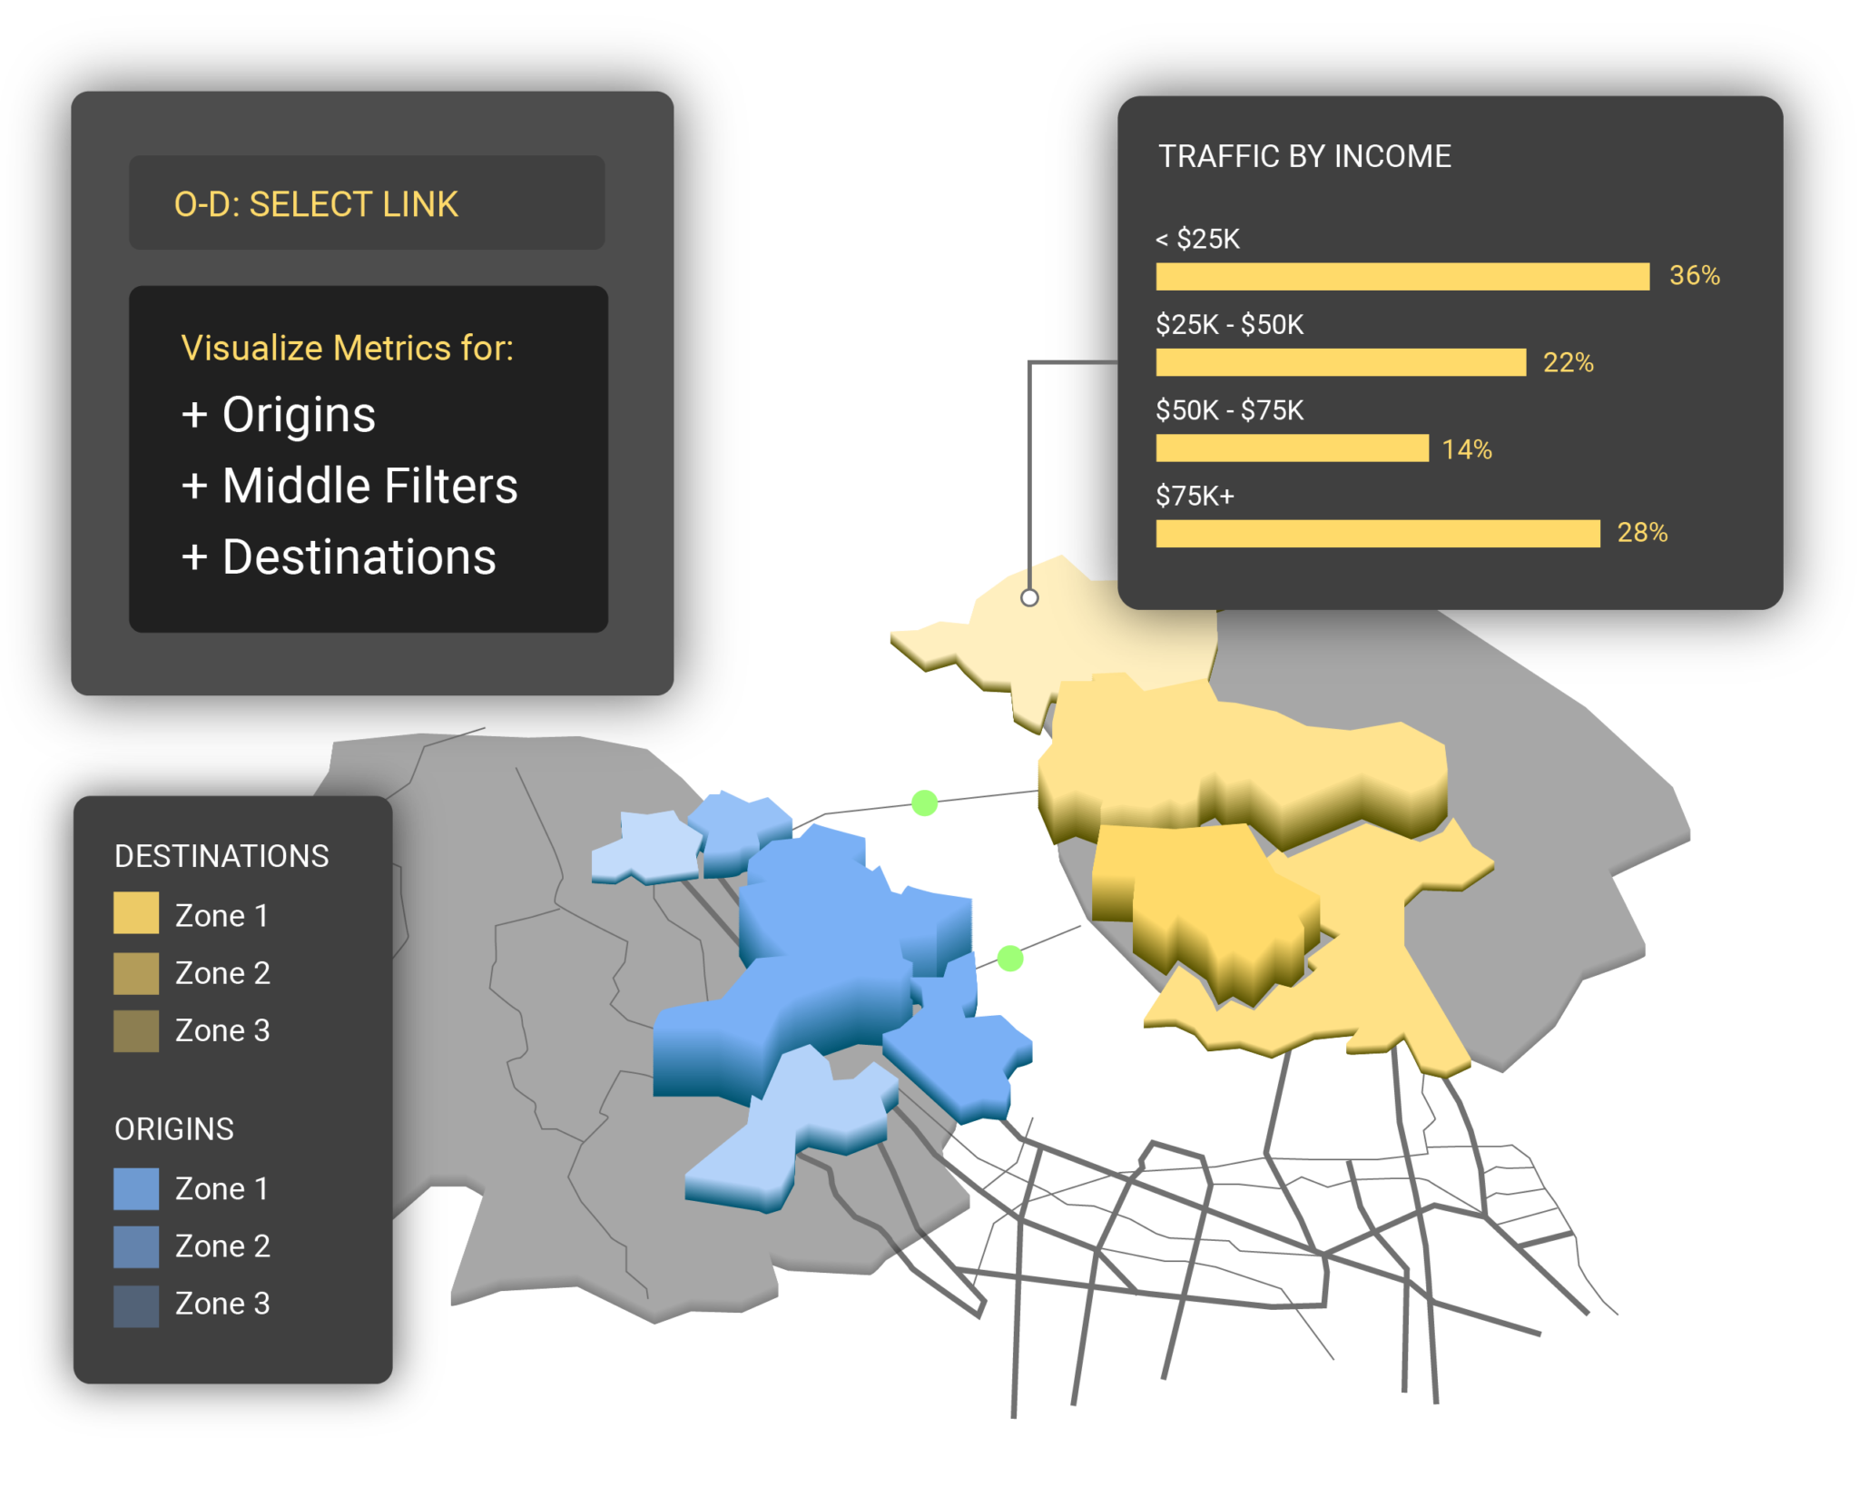
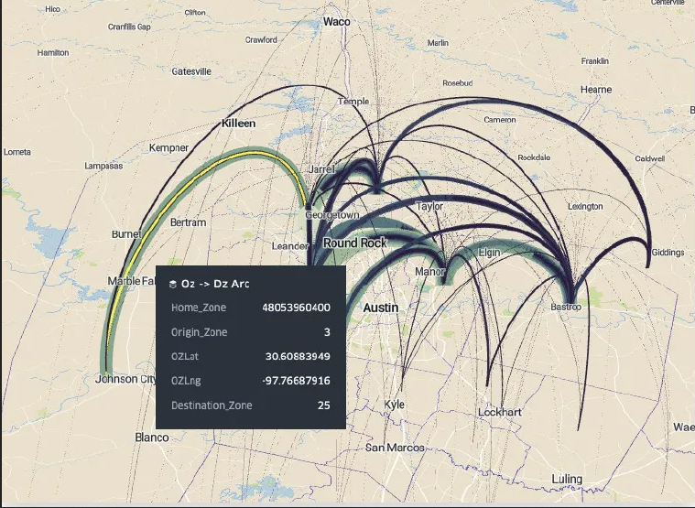
Commercial
Streetlight
AirSage
Cell-phone / GPS based
Inrix, Siemens, Forum Analytics, Iteris
Saas platform
Notes:
Pretty good, accomplished Richmond TAZ extraction, has been to TMC OD level
Most satisfied
Cell-Phone / GPS based
Saas platform
Comments
Used for Kentucky Validation
Concerns over Data
Found that the raw data could not be used, procured data and had to produce a factor. Data was good for trip frequency.
AirSage has an option for trucks as one purchase;

Slide 4
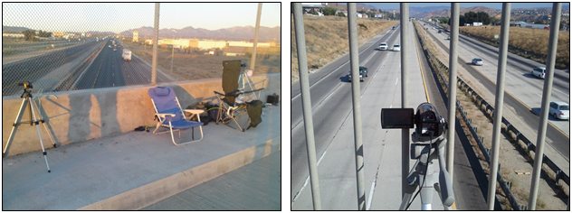
Commercial
License Plate Survey
Helicopter / Drone (SkyComp)
On-Site Survey: Photo/Video
Capture license plates at locations and O-D paths
Read License Plate and match with DMV
Comments:
Reliable
Only deals with limited areas
Public pushback on how acquired
OCR will output regardless of validity
On-Site Survey:
Video of vehicles and develop O-D paths
Track vehicles within camera field
Possible to piece together larger area using multiple drones
Comments:
Skycomp: Study in Bronx, limited study area, high speed aerials, track individual vehicles. Very expensive. Provide an O-D Matrix with file of aerials.
Research looks to be going to drones

Slide 5
Commercial
American Transportation Research Institute
IHS Tourism Data
Data Set
Processed truck GPS data
Data only from companies that volunteer to share
Comments:
Study for Polk TPO. Provides a select link assignment that provides volumes (trucks only)
ATRI data is very good,
Matrix data was expanded to rural parts of trucking industry
Data Set
Metropolitan Statistical Area Level
Survey of IHS members
Comments:
Good for national data to Florida
Need to disaggregate data

Slide 6
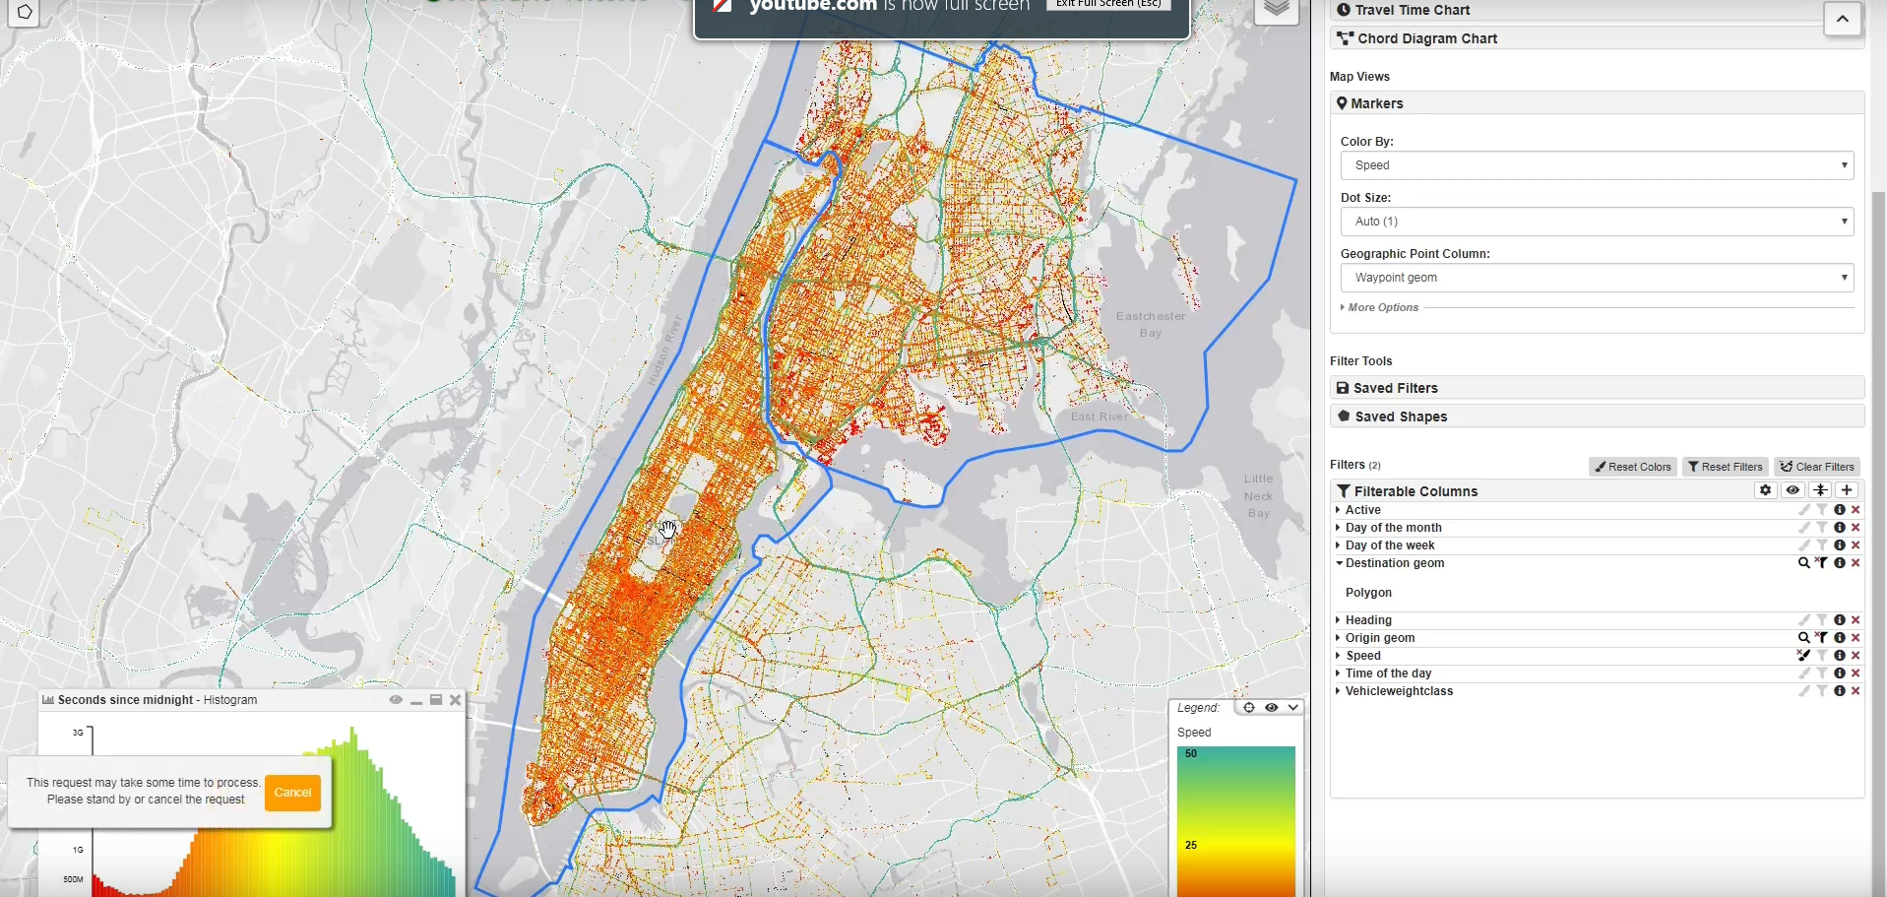
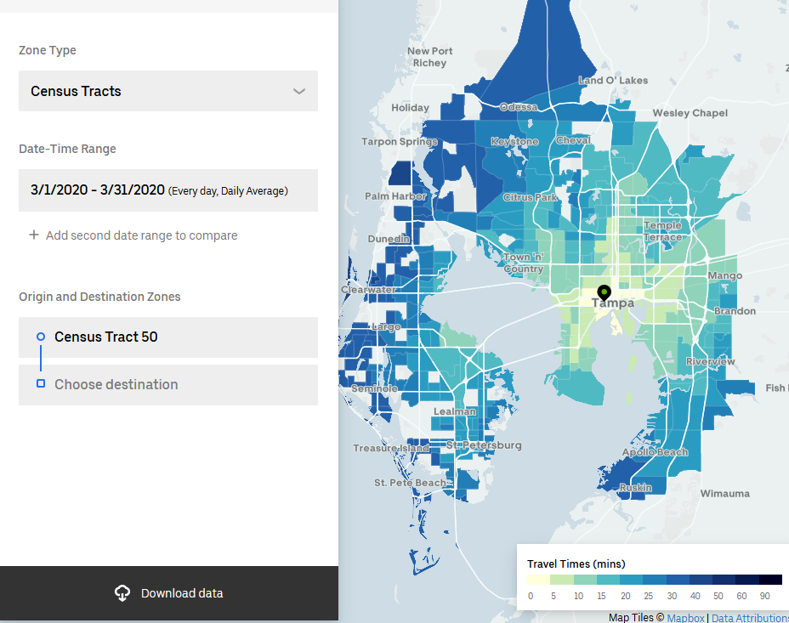
Commercial
Uber Movement
Moonshadow / WeJo
Data Set
Travel Times by period
Highly customizable
Urban Cities
Free to download
Comments:
Limited to cities with enough data
No volumes
Data Set
Inrix Trip Paths
GPS data
Organizes to DB4IoT
Comments:
Not familiar with them
Inrix Trip Analytics is another data source to look at

Slide 7
Commercial
Bluetooth
Strava
Data:
Collected from Bluetooth MAC addresses that are open
Needs collection spots
Comment:
Low capture rates
MioVision at the ports, set there to identify trucks with bluetooth across the state. Good for long distance capture.
Data:
Pulls from Runners and Cyclists
Comment:
Department has the data

Slide 8
Commercial
InfoGroup
Credit Card Data
Data:
Parcel data and in-depth data to differentiate populations in TAZ
Comment:
Identify methods for destination
LinkedIn
Data:
Provides credit card purchase locations
Comment:
Provides possible trip chains
Not capable of identifying origin

Slide 9
Government
Travel Diary
National Household Travel Survey
Data Set
Contact individuals
Collect and organize data
Comments:
Done all over the country, now done via phone surveys, becoming more difficult as individuals go to cell phones. Samples have been adjusted to be based from Post Office addresses.
Infogroup to get addresses, but having difficulties getting respondents to paper survey.
Has been done via phone app, tracks via GPS, battery issue
User engagement
Data Set:
2009 NHTS (Travel Diary Based)
2017 is available but not a lot of data points from Florida
Comments:
Even with 2009 sample still felt we needed more

Slide 10
Government
Longitudinal Employer-Household Dynamics
Freight Analysis Framework
Data:
Employment Statistics
2002 – 2017
Census Blocks
Comment:
Data:
Access database with future forecasts from 2020 to 2045
Tonnage, value, and ton-miles by region
Comment:
Broken down to lower levels using TranSearch data

Slide 11
Government
Department of Motor Vehicles
Weigh in Motion Stations
Data Set:
Difficult to get access
Comment:
Single point information, no O-D data
Ed Hutchinson is working to capture taxonomy for the trucks

Slide 12
Government
Video Camera’s on Site
Sunpass / E-Pass
Data:
In-situ cameras
OCR of license plate between cameras
Comment:
Proposed with app, Waze, to find origins / destinations
Private industry may implement something similar
Data:
Transponder O-D’s
Off-system items
Comment:
Very difficult to get the data

Slide 13
Social Media
Four Square
Twitter
Data:
Older data is available for download
Comment:
Not officially released
Data:
GPS data on images
Hashtags provide general information
Comment:
Use the twitter pipe to organize data
Concern for socio-economic bias
Better in high density areas

Slide 14
Social Media
Instagram / Facebook
LinkedIn
Data:
API is available
Comment:
Facebook is difficult to access the API to pull data from
Data:
Work site
Comment:
Scrape of LinkedIn data to pair with available parcel data for general O-Ds

Slide 15
Questions?

