Slide 1
Florida Statewide Model Strategic Intermodal System Prioritization and Integration
Presented by
Jeanette Berk and Hoyt Davis

Slide 2
FLSWM – SIS Prioritization and Integration
Goal of Project
Supplement to the SIS Work Program Process
Provide backcheck for the current project ranking process
Generate Measures of Effectiveness (MOE) Reporting
Geographical representation of SIS Work Program projects associated with travel demand estimates
Plots of Network Differences
Plots of Model Volumes
Analysis of Project Phasing
Definition of project phasing

Slide 3
FLSWM – SIS Prioritization and Integration
FLSWM Master Network
Network used for statewide traffic forecasts
Does have True Shape shapefile
SIS Shapefile
Inventory of SIS facilities and future year plans
RCI
Data
Maintained inventory of all State and Federal roadway Systems
Data
Sources

Slide 4
FLSWM – SIS Prioritization and Integration
Methodology
Create network and attributes from RCI
Refine network directionality and characteristics
Create additional tools
RCI database
Network elements
Expand RCI data
Facility types and centroid connections
True shape structure
Centroids and connectors
Other FLSWM attributes

Slide 5
FLSWM – SIS Prioritization and Integration
Network Creation Automation Process

Slide 6
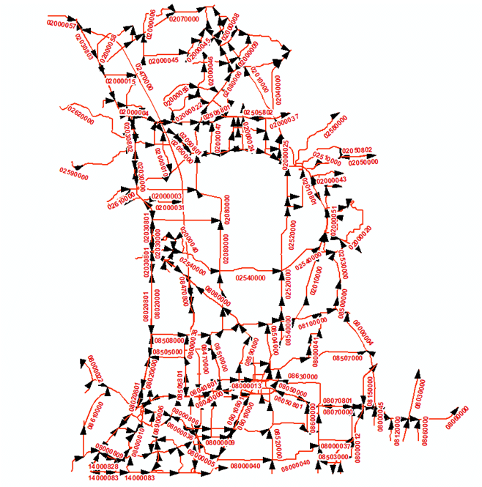
RCI Base Map Automation to Model Network
#1 Select RCI Basemap Arcs
Demo tool was developed to sub-select RCI Basemap Routes and Arcs by County
Demo used Hernando & Citrus Counties were selected
Current tool is Statewide for SIS network development
Citrus
Hernando
Citrus
Hernando

Slide 7
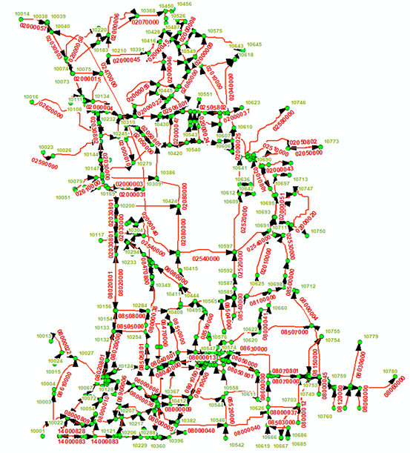
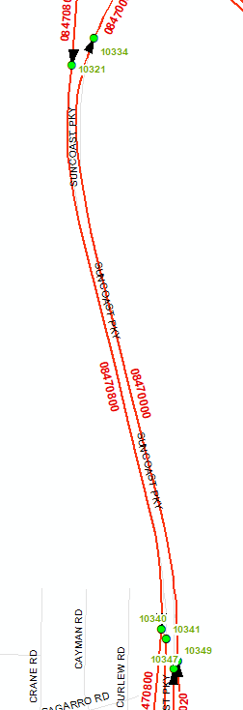
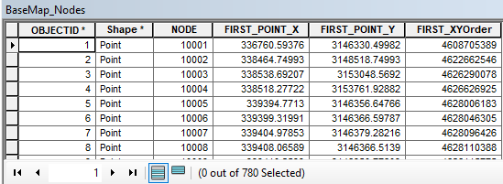
RCI Base Map Automation to Model Network
#2 Create RCI Arc Nodes
To create node features for Basemap arc identification
Redundant nodes are removed
Preserves RCI Basemap intersections, measures and other points of connectivity
#3 Route 800 Series to Route
To analyze RCI route relationships in GIS to better process divided roadways and their reverse traffic flow routes and attributes

Slide 8
RCI Base Map Automation to Model Network
#4 Create RCI Arc Events
Basemap Arcs
Unique node (ANODE - BNODE) pairs added to each arc
New Arcs RCI Event Table
Arcs layer exported to table with RCI linear reference
#5 Update/Capture 800 RCI Arc Events
Process relationships of reverse traffic flow routes attributes of divided roadways
8

Slide 9
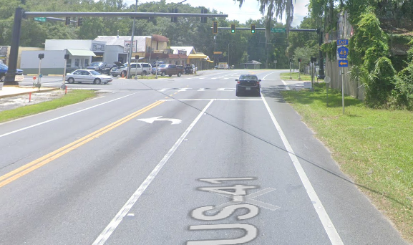
RCI Base Map Automation to Model Network
#6 Capture RCI Attribute Events Tables
Initial Attributes
SIS
Functional Classification
Number of Lanes
Max Speed
Road Type
Additional attributes
Count Stations
TTMS
PTMS
Signal locations
Turn-lanes
SIS Cost Feasible and Needs Plans

Slide 10
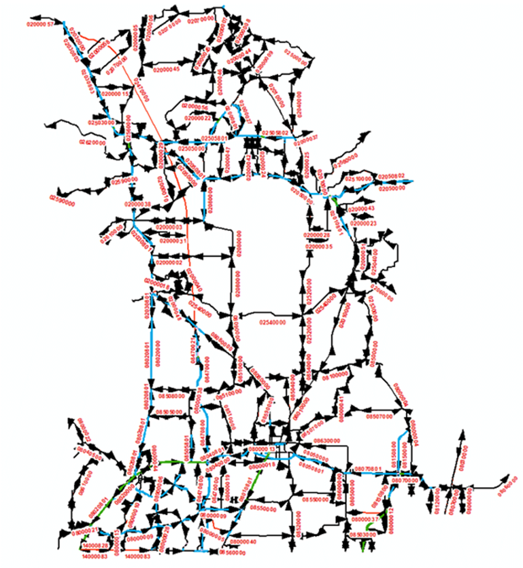
RCI Base Map Automation to Model Network
#7 Reverse 800 RCI Arc Events
Assign reverse traffic-flow attributes for use on the RCI “800” routes which represents the opposite-side of divided roadway facilities
RCI uses side attribute types L, R, & C for distinction of side-of-road
#8 Manipulate RCI Layer
Make graphic adjustments for a combined model network layer
Maintain “True” shape GIS characteristics
Change “C”-Composite link attributes
Add break points for centroid link connectors
Adjust directionality
Add back in GIS based network connectors without RCI attributes

Slide 11
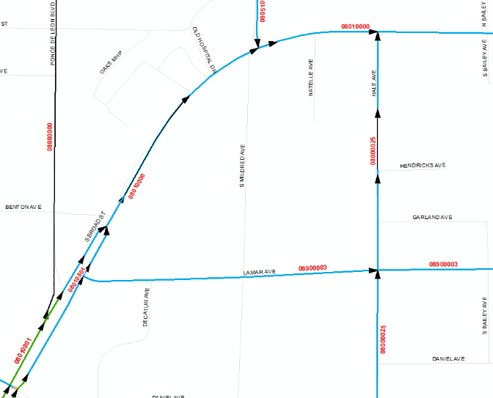
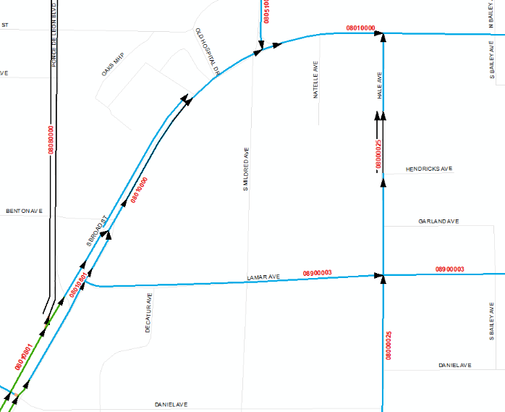
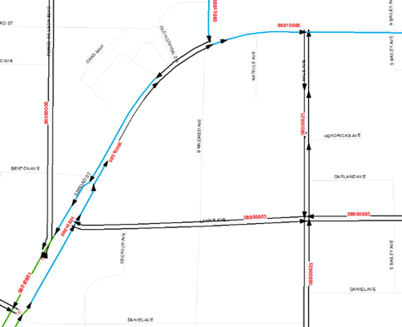
RCI Base Map Automation to Model Network
Example of Graphical Changes
Change “C”-Composite link information to directional
Adjust Arcs directionality
Attributes Layer w/ RCI Directional Arcs
Attributes Layer w/ RCI Directional Arcs (offset for clarity)
Attributes Layer w/Reverse Directional Arcs (offset for clarity)
14

Slide 12
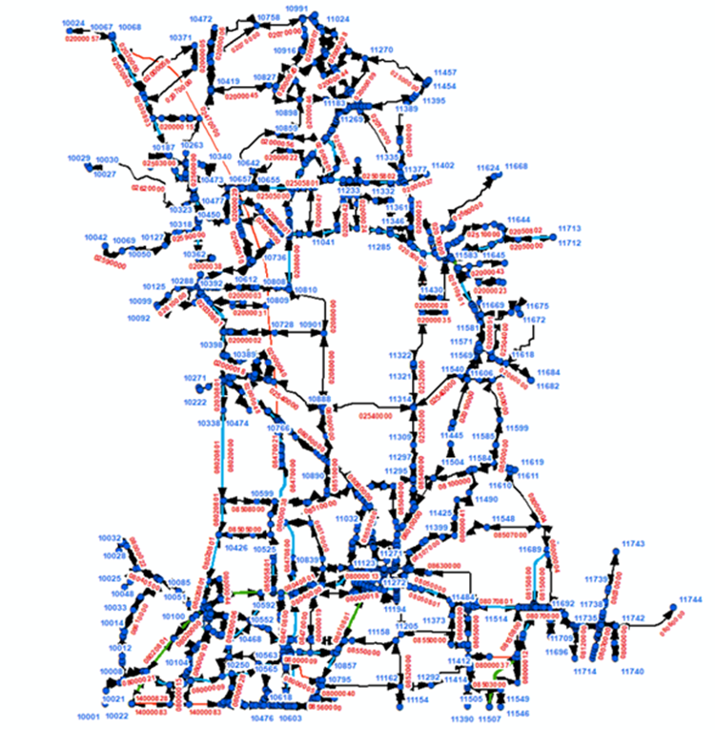
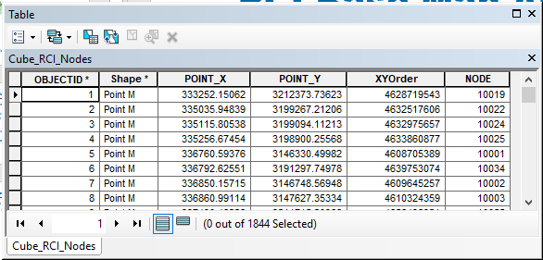
RCI Base Map Automation to Model Network
#9 Create RCI Attribute Nodes
Create a final node structure / nodes layer for the new combined model links layer with RCI attributes
#10 Create RCI Nodes on Layer
To relate the new node structure back to the combined model links layer with RCI attributes

Slide 13
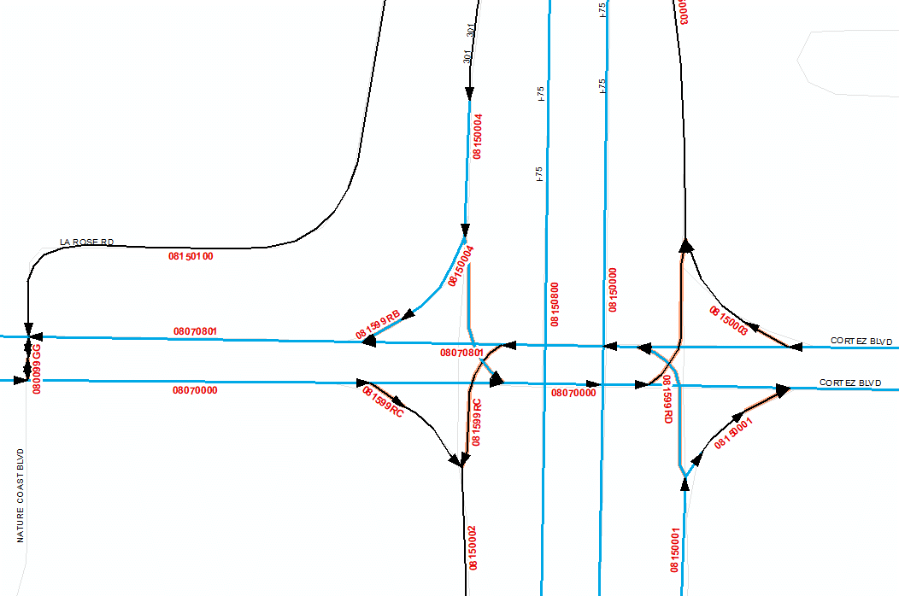
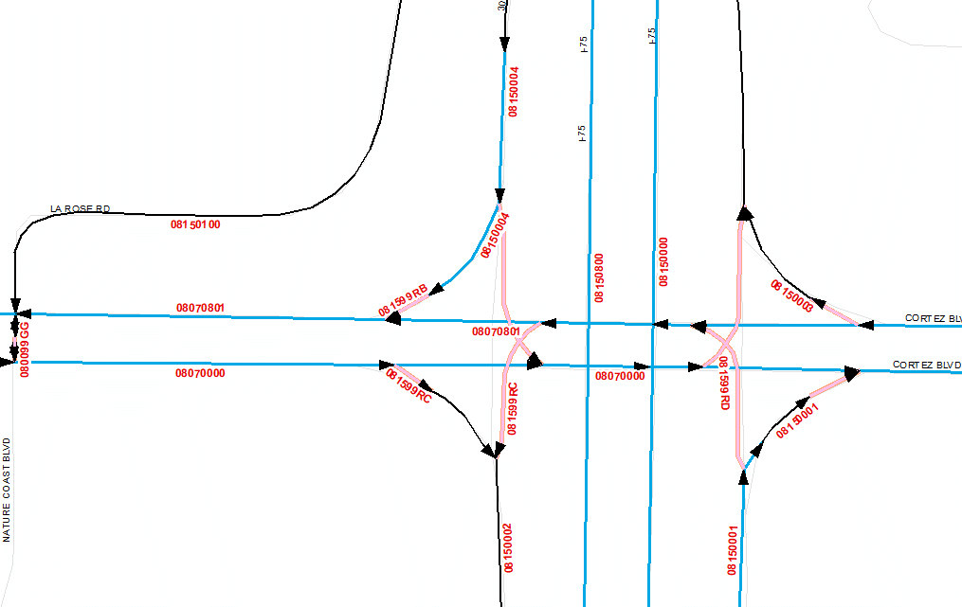
RCI Base Map Automation to Model Network
#11 Update Connectors
To extend RCI attributes to network connectors from their neighboring links
RCI Arc Connectors shown in Pink are not part of RCI Attributes
Arc Connectors are added to Travel Demand Model network layer and given adjacent link Attributes

Slide 14
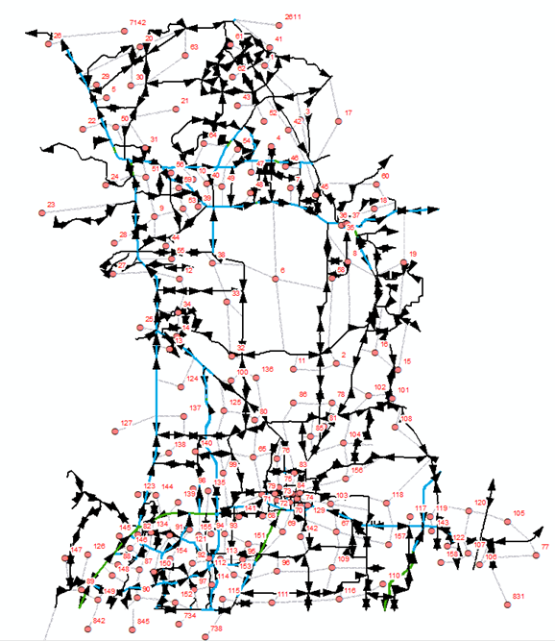
RCI Base Map Automation to Model Network
Other Tool Development
Add centroids and centroid connectors to RCI model links to be use for FLSWM network
Add any other attribution used by the FLSWM for reporting
Add new attributes to represent the future SIS network changes
SIS Cost Feasible Plan
SIS Needs Plan

Slide 15
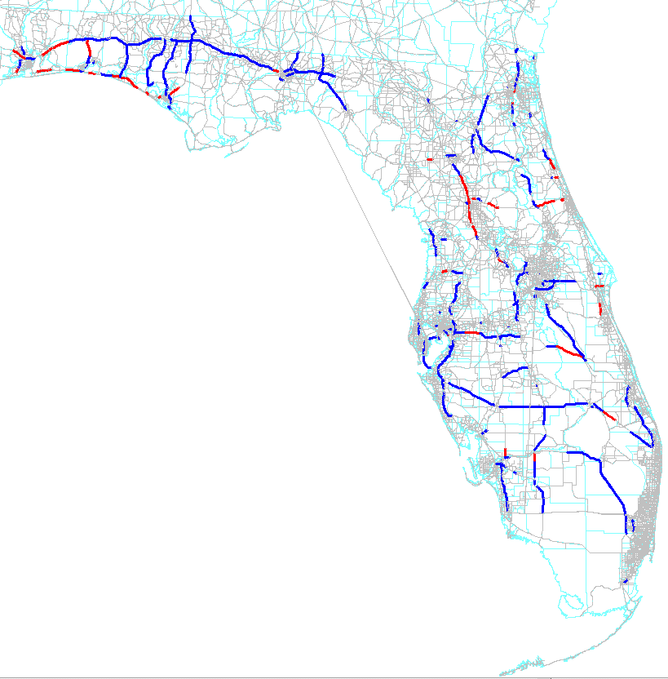
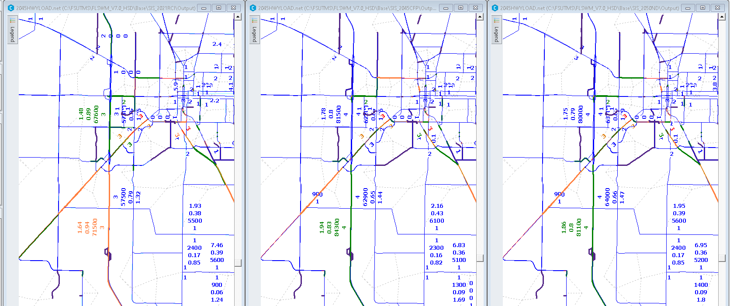
RCI Base Map Automation to Model Network
FLSWM Application
Build master model network
Run model alternatives
Compare SIS model runs
Current Year
Cost Feasible Plan
Needs Plan

Slide 16
Contact Infomration
Terrence Corkery
Terrence.Corkery@dot.state.fl.us
Jeanette Berk
jberk@gfnet.com
Hoyt Davis
hdavis@gfnet.com
Questions
Thank You!

