Slide 1
Modeling Future Freight Vehicle Technologies in Florida
presented by
Sheldon Harrison, Cambridge Systematics, Inc.
Other Contributors
Thomas Hill, Terrence Corkery, Florida DOT
John Gliebe, Brent Selby, Kazi Ullah, Cambridge Systematics, Inc.
Feb 23, 2024
Notes:
Thank you. I am going to tell you about a project that we did with the Florida DOT Central office to study the potential impacts of coordinated automated trucks and battery electric trucks on freight transport within the State of Florida, using the statewide freight model.
First, I would like to acknowledge my co-authors, whom you see on the slide, as well as Krishnan Viswanathan the CS program manager.

Slide 2
Expected Impacts
Expected Impacts
Coordinated and Autonomous Trucks (CAT)
  Fuel savings through coordinated platooning (aerodynamic drafting)
  Schedule savings through autonomous driving (bypass hours-of-service restrictions)
  Improved safety due to collision avoidance features
  Lane/facility utilization impacts
Battery Electric Trucks (BET)
  Emissions reductions
  Need for a fast-charging network
Notes:
A lot is not known about the potential impacts of coordinated autonomous trucks and battery electric trucks. Some expected impacts include:
< READ slide >
In the remainder of this presentation, I want to share with you interesting elements of the most likely business cases for CATs and BETs.

Slide 3
Key Findings in the Literature: CATs
Market penetration is expected to be greater for larger firms/fleets:
  More opportunities to platoon
  Economies of scale for new insurance requirements due to automation
Speculation that hours of service (HOS) rules will be relaxed with automated driving
Importance of “Platoonability” conditions (network conditions, trailer types, critical mass)
Notes:
To gain a better understanding of how these technologies might work, we conducted an extensive literature review. Much of what has been written is speculative. There are a lot of industry briefs and promotional content from vehicle technology manufacturers. In the area of platooning, there are some solid field studies and microsimulation research on potential cost savings and the conditions that would make automated platooning cost effective. CATs with platooning capabilities are likely to favor companies with larger fleets. Larger fleets means more opportunities for platooning and economies of scale for the expected, new insurance requirements related to automated driving.

Slide 4
Key Findings in the Literature: BETs
Market penetration is expected to be greater for larger firms
  More likely to build/maintain charging networks
  Adoption subject to lifecycle costing vis-à-vis diesel engines
Current battery ranges:
  100 mile range for Medium trucks (conventional chassis)
  300 mile range for Heavy trucks (conventional chassis)
Under Development / Speculative:
  500+ mile range for Heavy trucks (optimized chassis)
  Fast charging facilities; Nationwide charging network
“Well-to-Wheel” perspective on emissions savings
Notes:
Battery electric trucks adoption is also likely to favor larger firms. For long-distance freight hauling, you need to build and maintain a network of fast charging stations. BETs currently cost significantly more than diesel trucks but are expected to have lower long-term maintenance costs. Adoption is likely hinge on a lifecycle cost calculations. This currently favor internal combustion diesel engines based on 2020 fuel prices. Current battery ranges are 100 miles for medium and 300 miles for heavy trucks. Ranges are expected to increase significantly as new technologies come to market. Higher range vehicles are significantly more expensive to purchase.
Another important consideration is how to measure the emissions savings from BETs. Some of the literature recommends a well to wheels approach, where you account for the emissions used to produce the electric power that is used to charge the vehicles.

Slide 5
“Platoonability” Efficiency
Tractor trailer geometry – rectangular box shape
  Eliminates use of flatbeds, tankers, vehicle carriers, open-tops, pole trucks.
Sufficient number of trucks traveling together over long distances with the ability to synchronize timing
Minimum average travel speeds (e.g., 50 mph) and minimum journey lengths to make platooning worthwhile
Full highway access control, ideally at least ½-mile between interchanges to minimize interruptions from merging traffic
Cost savings a function of time spent platooning and traffic disruptions. Research range varies widely (2.5% - 12% per mile)
Notes:
Platoonability is an interesting topic in and of itself. What are the ideal conditions for platooning and aerodynamic drafting?
< READ from slide >

Slide 6
Highway Network Enhancements
Platoonable link indicator: “IsPlatoonable”
  Minimum travel speed (50 mph)
  Minimum number of lanes (2+)
  Minimum percent truck volumes (5%)
  Facility types: freeways, expressways, divided arterials (+tolls)
  Area types: rural, outlying business districts, undeveloped urban areas
Skim calculation of percent platoonable miles
HOS travel time skims: “HOSTime”
  Step function adds mandatory 10-hour break after 11 hours, plus 30-minute breaks at 4-hour intervals
Notes:
To facilitate analysis of CATs, we enhanced the statewide model’s highway network model, which covers the entire U.S., to represent platoonability conditions, and then generated skims for the percent platoonable miles for each OD pair. We also created a step function and generated skims to represent travel times under hours-of-service restrictions for comparison with travel times under the lifting of those restrictions. (Federal Motor Carrier Administration)

Slide 7
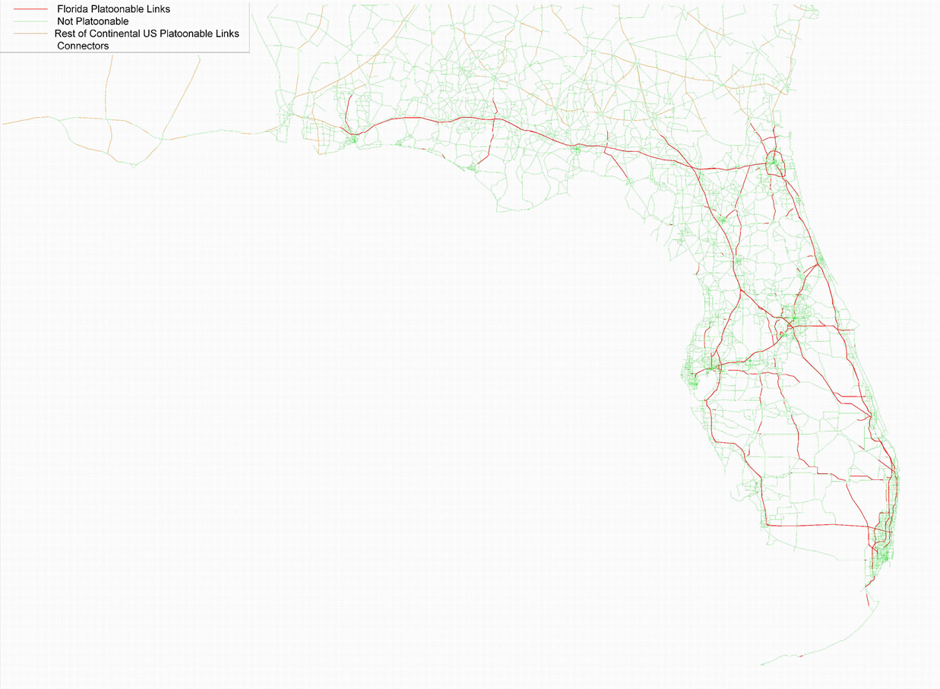
Platoonable Links in Florida
Notes:
This map and table shows that less than 10% of the highway miles in Florida would be platoonable under these assumptions.

Slide 8
Florida Statewide Model – FreightSIM Structure
Firm Synthesis
Supplier Selection
FAF Flow Apportionment
Distribution Channel
Shipment Size & Frequency
Mode Paths & Transfers
Truck Vehicle Tables
Notes:
This graph shows the major components of the statewide freight model. The parts that we modified, shown in orange, were the mode path module and the module that assigns truck types.

Slide 9
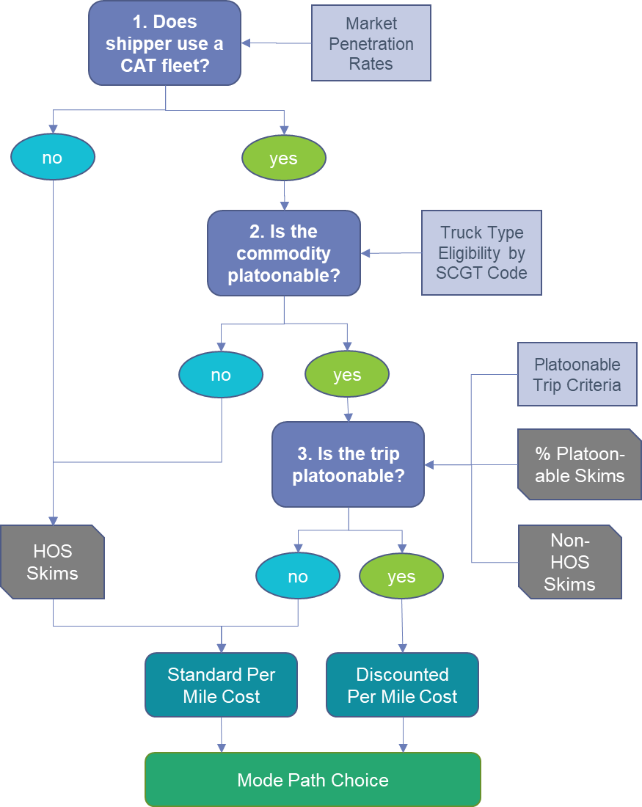
Florida Statewide Freight Model
CAT Decision Components Added to Mode Path Choice
Notes:
We modified the mode path choice module in FreightSim to consider three additional decision dimensions:
Whether the shipper would use a CAT, based on assumed market penetration rates
Whether the commodity would be platoonable based on the type of trailer typically used to haul that commodity
Whether the trip itself is platoonable, which incorporates several interesting factors.

Slide 10
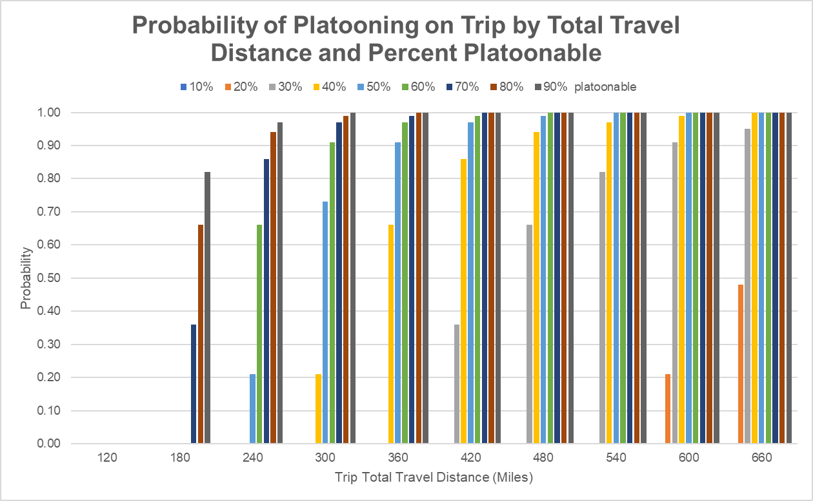
Network Conditions for Platooning
Break Even Analysis
Parameter | Value | Description
valueOfTime | $36.60 | Average truck operating team value of time ($/hour)
fuelCost | $2.50 | Price per gallon of diesel fuel
milesPerGal | 6.50 | Fuel efficiency in miles per gallon
expSynchDelay | 5.00 | Expected synching delay in minutes of wait time
planTimeIndex | 1.50 | Planning time index (uncertainty due to reliability)
platDiscount | 7.0% | Discount for each mile platooning
platSpeed | 60.00 | Expected speed while platooning in miles per hour
Notes:
This slide illustrates a break-even analysis for making platooning cost effective. The chart at right illustrates the modeled probability of platooning for a total trip travel distance in miles and percent of those miles that are platoonable according to network conditions. This is our“Most Likely” scenario.
For a fuel savings of 7% per mile, an average diesel price of $2.50 per gallon, an average fuel economy of 6.5 miles per gallon, and operating team labor costs of $36.60 per hour, if the truck operating team is delayed by 5 minutes during which they are unproductive, then there needs to be at least 113 miles of platooned driving at 60 mph to break even. If we factor uncertainty into the calculation, applying a planning time index of 1.5, then that minimum amount increases to 170 miles.
What this should tell us is that we’re unlikely to see trucks sitting parked on the sides of the road or at rest areas waiting for other trucks with which to platoon. Information technologies will need to provide near delay-free in-motion synching. More likely, platoons will be formed by vehicles from the same shipper traveling together from the same starting point to minimize coordination delay.

Slide 11
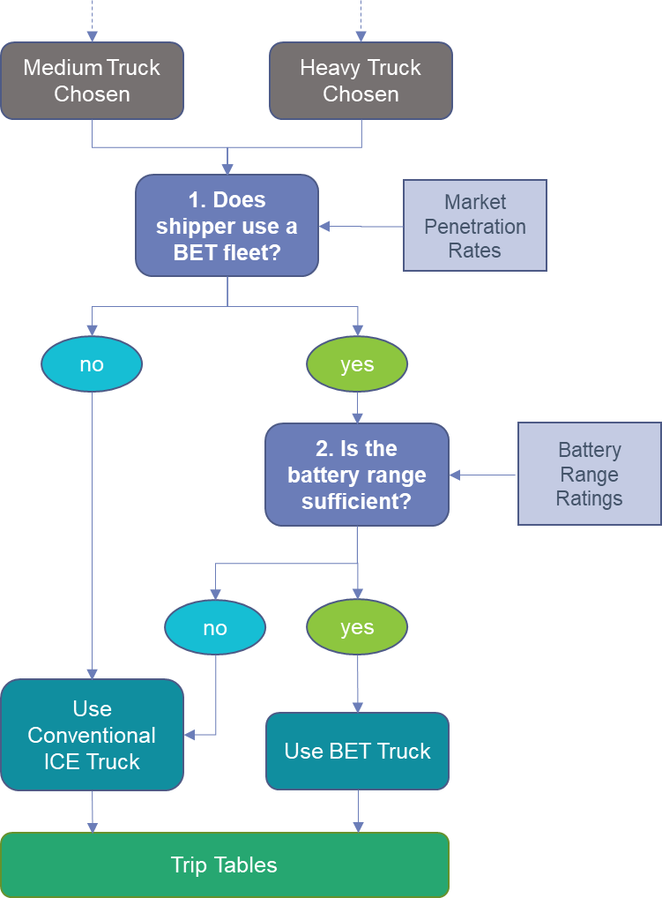
Florida Statewide Freight Model
BET Decision Components Added to Vehicle Type Choice
Notes:
We modified the FreightSim module that simulates vehicle type choices to include a choice of whether to use a battery electric truck. Here the two decision points are:
Whether the shipper use a BET fleet based on market penetration rates for vehicles of different sizes and ranges.
Whether the battery range sufficient for the trip. This second question required us to make assumptions about the availability of a fast-charging network for trucks.

Slide 12
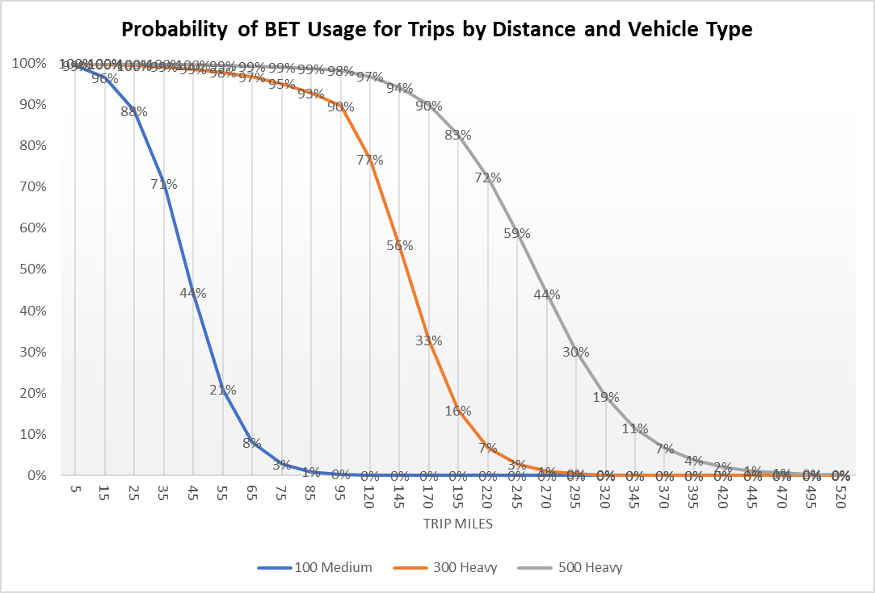
BET Range Restrictions and Probabilities
Notes:
This slide shows the modeled probability of BET usage on a particular trip based on assumed medium and heavy truck battery ranges. In our more conservative scenario, we assumed that drivers would not consider a trip longer than their battery range and set a 50% probability at about half the range. This was to represent possibilities such as no charging station at their destination or the need to turn around immediately or traveling to another delivery location.
In our more optimistic high technology scenario, we assumed that fast charging stations are much more prevalent, such that there is a 50% probability of using a BET for a trip that exceeds the battery range.

Slide 13
Sensitivity Testing
CATs
  Half market penetration
  Double diesel prices
  High system reliability
  Slow platoon synchronization
  Fast platoon synchronization
BETs
  Double market penetration
  Enhanced charging network
  50% Higher battery ranges
Notes:
We conducted a small set of sensitivity tests to see which of these factors the model was most sensitive to.

Slide 14
Scenario Analysis
0. Baseline: 2045 scenario without CATs and BETs
1. Most Likely:
  CATs: “Level 4” Automation for CATs (human operators onboard, but high-level of automated driving to allow operators to rest); optimistic market penetration (80% for heavy trucks for eligible commodities); 2020 diesel fuel prices; current fuel economies; labor rates.
  BETs: low expected market penetration; current battery ranges; charging network coverage does not allow vehicles to exceed battery ranges
2. High Technology:
  CATs: Same “Level 4” Automation and market penetration; double diesel prices; high system reliability; near instant platoon synching
  BETs: double market penetration; 50% higher battery ranges; greater charging network coverage allows vehicles to exceed battery ranges (drivers half as sensitive to range anxiety).
Notes:
We also constructed a baseline 2045 scenario and what we are calling a “Most Likely” scenario and a “High Technology” scenario. We then summarized results across numerous dimensions. I will highlight just a few.

Slide 15
Impacts on Total Travel
Notes:
This slide shows the impact on daily VMT across the three scenarios for five modeled vehicle types. Reading across, they are Medium ICEs, Heavy ICEs, Heavy CAT-Platooning in the middle. The two on the right are Medium BETs and Heavy BETs.
What we are seeing is not much change at all in terms of total VMT. The model predicts a redistribution of VMT among the three new vehicle types. Mostly, we expect to see shifts from conventional heavy trucks to heavy trucks with CAT technologies. Heavy ICE trucks have 94% market share of VMT in the baseline scenario. This share shrinks to 65% in the most likely scenario and 60% in the high scenario. BETs have comparatively tiny shares of VMT, limited by battery ranges and charging networks.

Slide 16
Average Trip Characteristics
Notes:
We looked at average trip characteristics. Here you see differences in average trip distances on the left. On the right are average payload values. Heavy CATs with platooning stand out in the middle of both charts.

Slide 17
Market Share by Distance (High Technology Scenario)
Notes:
Market shares by trip distance ranges favor CATs with platooning for very long trips and BETs for shorter trips. Note that the conventional Heavy ICEs shown in orange continue to dominate even in the High Technology Scenario. We also observed heavier use of CATs for internal-external trips and both CATs and BETS for port import/export trips.

Slide 18
Market Share by Commodity (High Technology Scenario)
Notes:
We looked at market shares for different commodity types. These charts show half of the commodity codes in the model. For CATs with platooning, this is restricted by the trailer types they use.
*****
This slide shows tons and shares carried by different truck types by commodity group for about half of the SCTG commodities in the model. This is for the High Technology scenario, expressed in annual tons. These graphs partially reflect the types of commodities that are likely to be hauled in trailers that are considered efficient for automated platooning, which mostly includes finished goods. The silver/gray bars show the shares of CAT platooning trucks. Where the silver/gray is absent is a commodity that we assume is not eligible for the platooning based on its likely trailer type. BETs are predicted to be used most heavily for raw materials used in construction, mining, and some agricultural uses. The prevalence of he orange color shows that even under the high technology scenario, heavy diesel ICEs are likely to command a majority for most commodities.

Slide 19
Impacts on Mode Paths (High Technology Scenario)
Scenario Comparison: 2. High Technology vs. 0. Baseline
Mode Path | Change in Tons | Percent Change
1. FTL Direct | -82,881 | 0%
2. LTL Direct | 819,280 | 1%
3. LTL-Air-LTL | -279,667 | -15%
4. FTL-Carload-FTL | -1,184,653 | 0%
5. LTL-IMX-LTL | -169,032 | 0%
6. FTL-IMX-FTL | 1,247,511 | 14%
7. FTL-Water-FTL | -660,427 | 0%
8. FTL-No Transload-Port (40' container) | -46,239 | 0%
9. LTL-No Transload-Port (40' container) | 174,394 | 0%
10. FTL-Transload-Port (53' trailer) | 44,793 | 14%
11. LTL-Transload-Port (53' trailer) | -30,635 | -4%
15. LTL-DC-LTL | 1,107,511 | 0%
16. LTL-DC-FTL-DC-LTL | 208,594 | 0%
17. FTL-DC-FTL | -993,975 | -2%
18. FTL-DC-FTL-DC-FTL | -4,030,940 | -6%
Total All Mode Paths | -3,876,366 | 0%
Notes:
Impacts on the shares for different mode paths are minimal according to the model. The first graph shows truck types by mode path for the High Technology scenario in annual tons. The table on the right suggests that mode paths that use intermodal transfers and transloads at ports will be more competitive with these new technologies, possibly diverting some business from air freight and FTL distribution centers.

Slide 20
Synthesis and Predictions (1 of 2)
CATs and BETs serve very different markets
CATs with platooning will gain market footholds for very long-distance trips, advantages being automated overnight travel and fuel savings
  Model predicts usage for high-value loads; automated overnight travel could affect air freight and may make some ports more competitive
  Platooning cost savings are limited by drafting physics (~7%); sensitive to synchronization delay, labor costs, fuel costs, and network conditions
  Platooning more prevalent on rural freeways between metro areas
Notes:
< READ slide >

Slide 21
Synthesis and Predictions (2 of 2)
BETs for freight will see early market adoption for short-distance hauls, particularly for lower value bulk commodities; and intermodal, port, and distribution center connections
  Market adoption hinges on lifecycle costs of BET vs. diesel (ICE) alternatives
  Usage ranges depend on future buildout of fast-charging networks
  Prevalent on urban roadways near industrial land uses (warehousing, ports)
  Model predicts total truck emissions (well-to-wheel) reduced by 1.6% to 3% for Florida ODs
Notes:
< READ slide >

Slide 22
    Questions?

Slide 23
BET Emissions Savings Rates
Derived from European Union studies accounting for mix of “clean” and “dirty” fuel sources used to power the electric grid
Due to higher average travel speeds and more aerodynamic profiles, heavy vehicles rate more efficiently than medium

Slide 24
Scenario Testing: Most Likely Future
Parameter | Value | Description
mktSmall | 40% | Market penetration rate: firm size categories 1 - 2
mktMedium | 60% | Market penetration rate: firm size categories 3 - 5
mktLarge | 80% | Market penetration rate: firm size categories 6 - 8
valueOfTime | $36.60 | Average truck operating team value of time ($/hour)
fuelCost | $2.50 | Price per gallon of diesel fuel
milesPerGal | 6.50 | Fuel efficiency in miles per gallon
expSynchDelay | 5.00 | Expected synching delay in minutes of wait time
planTimeIndex | 1.50 | Planning time index (uncertainty due to reliability)
platDiscount | 7.0% | Discount for each mile platooning
platSpeed | 60.00 | Expected speed while platooning in miles per hour
 | Market
 | Penetration | Range | Probability
Truck Type | Rates | (Miles) | Coefficient
Medium BET | 18% | 100 | 0.110
Heavy BET Standard | 4% | 300 | 0.038
Heavy BET Superior | 2% | 500 | 0.024

Slide 25
Scenario Testing: High Technology Future
Parameter | Value | Description
mktSmall | 40% | Market penetration rate: firm size categories 1 - 2
mktMedium | 60% | Market penetration rate: firm size categories 3 - 5
mktLarge | 80% | Market penetration rate: firm size categories 6 - 8
valueOfTime | $36.60 | Average truck operating team value of time ($/hour)
fuelCost | $5.00 | Price per gallon of diesel fuel
milesPerGal | 6.50 | Fuel efficiency in miles per gallon
expSynchDelay | 1.00 | Expected synching delay in minutes of wait time
planTimeIndex | 1.15 | Planning time index (uncertainty due to reliability)
platDiscount | 7.0% | Discount for each mile platooning
platSpeed | 60.00 | Expected speed while platooning in miles per hour
 | Market
 | Penetration | Range | Probability
Truck Type | Rates | (Miles) | Coefficient
Medium BET | 0.36 | 150 | 0.055
Heavy BET Standard | 0.08 | 450 | 0.019
Heavy BET Superior | 0.04 | 750 | 0.012

Slide 26
Market Share by OD Segment

