Slide 1
D&B Employment Data Update
Presented by: Frank Tabatabaee
February 22, 2022
2022 FMTF - General session

Slide 2
D&B employment data update
FDOT/Forecasting and Trends Office entered into a contract with D&B on June 29, 2020
Batch data output were at 1,568,368 employment records in Florida
Data procurement targeted for January, June and September 2020
January for Pre-Pandemic, June for during Pandemic and September as of last available data at the time

Slide 3
D&B employment data update
We also acquired DEO’s Employment data to understand Pandemic impact on employment
DEO’s Employment data are highly confidential and cannot be shared other than aggregated form

Slide 4
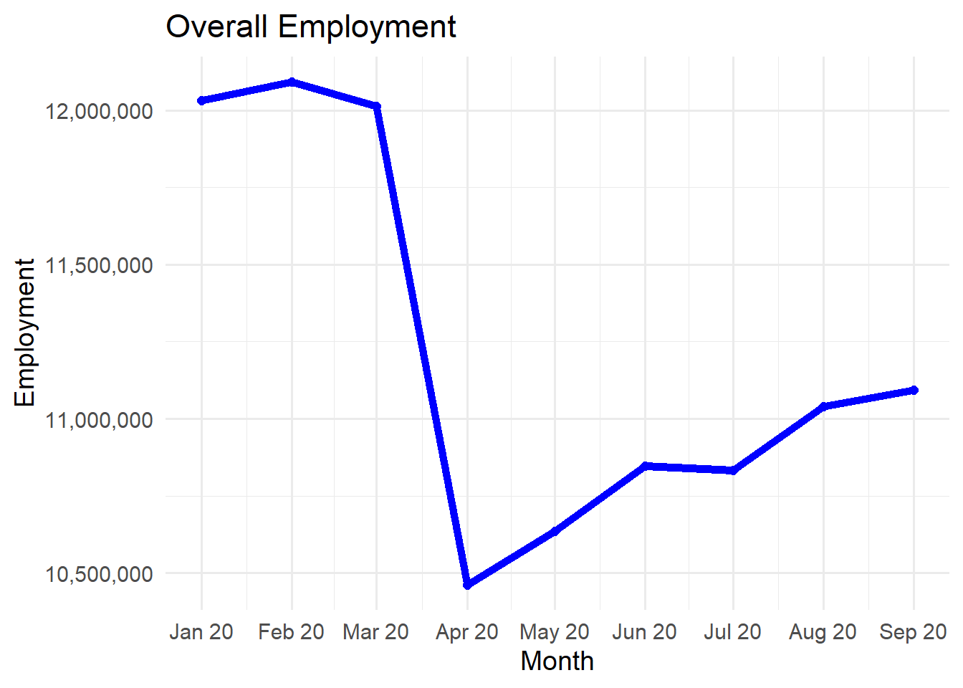
D&B employment data update
DEO/QCEW Employment data from Q1 to Q3 2020

Slide 5
D&B employment data update
Due to fluctuation in employment and traffic count variation during pandemic in 2020 a survey across the board was conducted
The objective was to understand the consensus among modeling community the best data source and year to utilize due to pandemic impact for building 2020 base year model

Slide 6
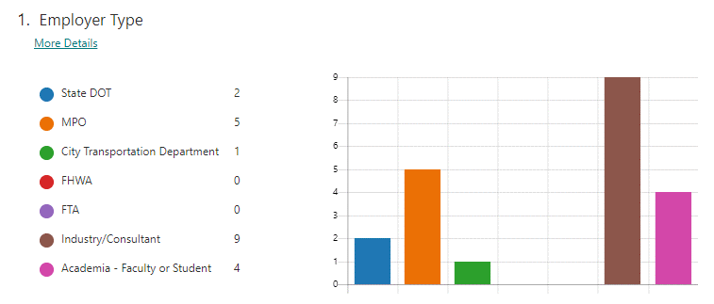
D&B employment data update
Survey results:

Slide 7
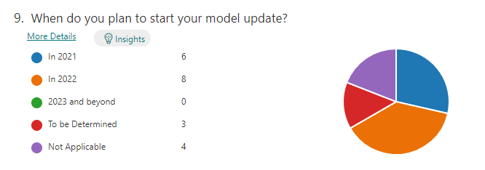
D&B employment data update
Survey results:

Slide 8
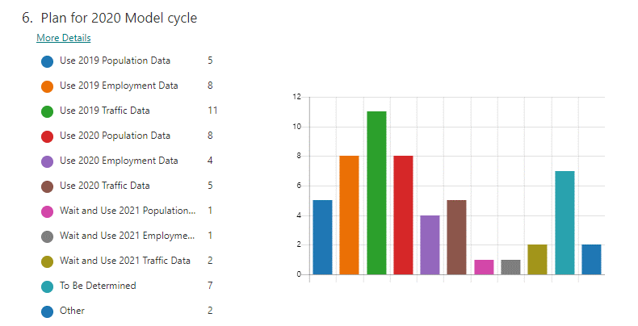
D&B employment data update
Survey results:

Slide 9
D&B employment data update
Majority in the survey responded 2019 data will be used
Second in the survey responded using the 2020 data
And some responded to wait and to be determined

Slide 10
D&B employment data update
Since we now know more about the pandemic, the consensus was to use January 2020 pre-pandemic D&B data in order to not skew projection years
Traffic count from TTMS may also be used from the 2019 count year as a normal year

Slide 11
D&B employment data update
The January employment data from D&B was broken down by districts and statewide
We padded a few extra data elements to the set
Documents were added including data layout
D&B data was shared with Districts and MPOs who requested it
We found some issues related to employment geo-locations

Slide 12
D&B employment data update
Geo-code locations tally:
District | # of Erroneous Records | Total rds | %
1 | 210 | 207,484 | 0.101%
2 | 137 | 132,632 | 0.103%
3 | 60 | 96,088 | 0.062%
4 | 316 | 342,503 | 092%
5 | 464 | 83,844 | 0.163%
6 | 164 | 227,283 | 0.072%
7 | 227 | 211,578 | 0.107%
Grand Total | 1578 | 1,501,412 | 0.105%

Slide 13
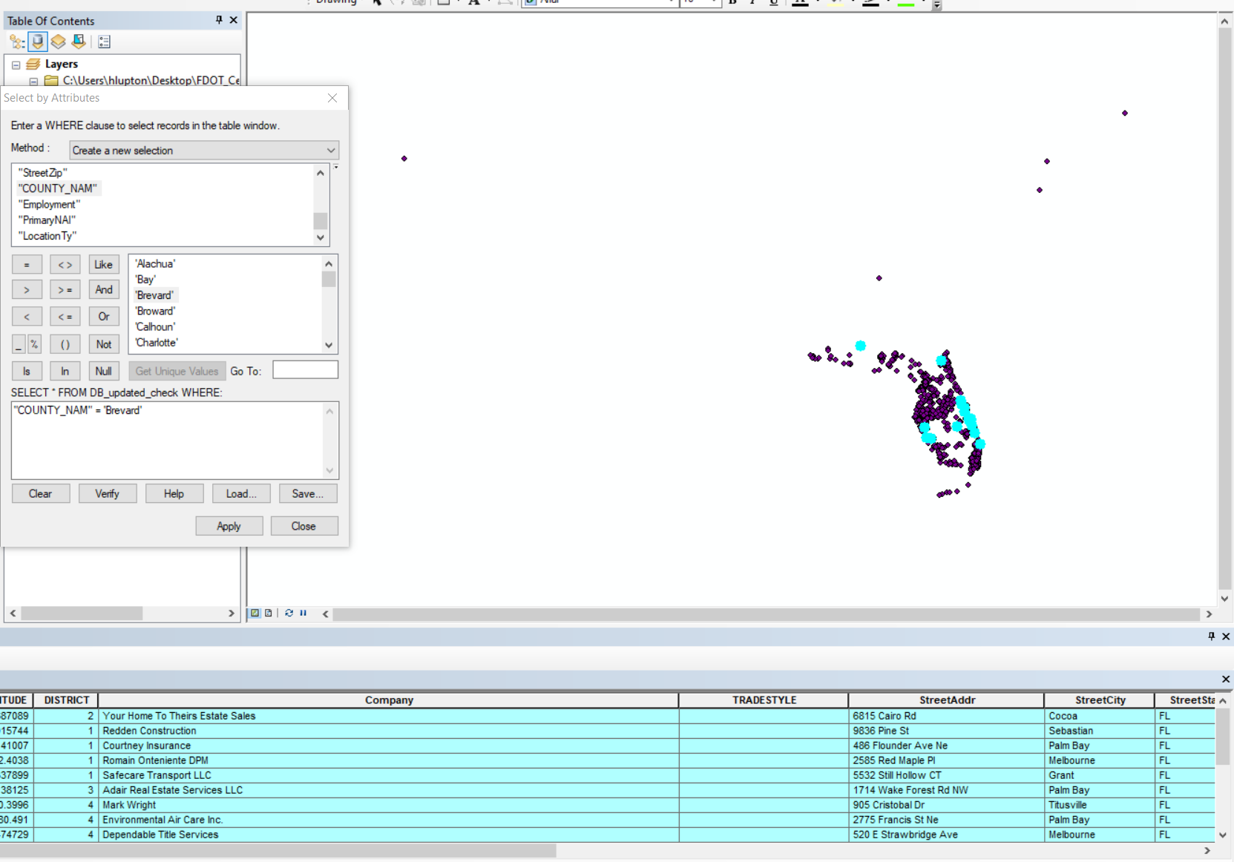
D&B employment data update
Notes:
After taking a quick spot check, the lat/long information in the “corrected” file is still not accurate. When doing a test of points with the county name “Brevard”, you can see they’re located in and outside of Brevard County (the bright teal points are the highlighted/selected records). I’ve looked at other counties as well and they each have the same problem. You can also see there are five points completely outside of the state of Florida.

Slide 14
D&B employment data update
Our office has invested time to resolve these issues
We have 1578 employment locations fixed but need to verify
64 employment records could not be geo-coded and we allowed it to default to the nearest city center

Slide 15
D&B employment data update
We are working with D&B to resolve these employment geo-location issues
D&B provided sample records with location issues corrected
Awaiting for the remaining of the corrected records from D&B

Slide 16
D&B employment data update
We do have the listings of the employment data recipients and will contact you as soon as we have finalized them with D&B
You may email me at Frank.Tabatabaee@dot.state.fl.us and request the employment data
The protocols for data distribution remains the same

Slide 17
D&B employment data update
For all modeling activity/communication/information please visit:
WWW.FSUTMSOnline.net
Questions/Comments?

