Slide 1
Florida Model Task Force Meeting
presented by Huiwei Shen, Chief Planner (former modeler)
February 23, 2022
Notes:
Good morning. Thank you for inviting me to this meeting. Good to see so many friends and familiar faces. For those of you who don’t know me - I’m Huiwei Shen, Chief Planner with the Florida Department of Transportation. I started my career at FDOT as a modeler and the RICS 6000 systems administrator, but once a modeler always a modeler. ☺

Slide 2
Best in Class
Legendary Talent
Industry Partnership
New
Platform
Notes:
I must start by saying that the Florida Model Task Force is the best of its kind. We have been establishing standards, developing procedures, and setting policy directions for advancing travel demand modeling in the state for couple of decades now. I have not seen so much talent in one room in any other event. You all are smart, passionate about what you do, and you are the future of our industry.
Speaking of talent, let me take a minute to remember Jerry Faris, who passed away late last year. I'll always remember Jerry's warmth and professionalism. Many of us attended Jerry’s workshops, mostly conducted at a beach location that is close to a steakhouse. We learned a lot and had fun at the same time.
I also appreciate the partnership approach of the model task force. Public and private sector employees including software vendors work together to develop best solutions that work for everyone. The industry partnership will be more and more important moving forward.
As most of you know, we are transitioning to an era that the Florida Standard Model is software platform agnostic. We have agreements with PTV and Caliper for software services. Both company offer excellent platforms. We are currently offering training in each District. The existing models are also being converted to the new platforms. They need to get done on time for the upcoming MPO/TPO LRTP updates.
So what’s going on in the wider world of transportation planning?

Slide 3
Planning Emphasis Areas
Notes:
The Federal Highway Administration (FHWA) and the Federal Transit Administration (FTA) Offices of Planning jointly issued the 2021 Planning Emphasis Areas for statewide and metropolitan planning. These are things we need to consider incorporating in our models to the extent practical. I’ll play a video and then discuss the topics so that I don’t interfere with the dramatic star wars music.
Tackling the Climate Crisis – Transition to a Clean Energy, Resilient Future – our transportation plans and infrastructure investments need to help achieve the national greenhouse gas reduction goals of 50 to 52 percent below 2005 levels by 2030, and net-zero emissions by 2050, and increase resilience to extreme weather events and other disasters resulting from the increasing effects of climate change. Electric and other alternative fueled vehicles will play an important role in reducing emissions.
Equity and Justice40 in Transportation Planning - racial equity is a focus area for the current administration. We need to make sure that our transportation investments are not adversely impacting the underserved and disadvantaged communities.
Complete Streets – FDOT adopted a Complete Streets Policy back in 2014. We are taking a 360-degree approach to plan, design and operate transportation facilities. Incorporating all modes, considering all users and improving safety are key objectives. We are striving for no fatalities or serious injuries involving roadway traffic.
Public Involvement - Early, effective, and continuous public involvement brings diverse viewpoints into the decision-making process. The Department’s Public Involvement process gives voice to everyone throughout the life cycle of transportation projects.
Strategic Highway Network (STRAHNET)/U.S. Department of Defense (DOD) Coordination – providing access to DOD facilities like military bases is important from a national security perspective.
Federal Land Management Agency (FLMA) Coordination – similarly, access to federal lands is important from a national perspective.
Planning and Environment Linkages (PEL) - PEL is a collaborative and integrated approach to transportation decision-making that considers environmental, community, and economic goals early in the transportation planning process. This ensures seamless transition of projects from planning to PD&E and expedites project delivery.
Data in Transportation Planning – data sharing is becoming more and more important in the transportation planning process. Jennifer Fortunas will talk about a data integration space we are currently working on.

Slide 4
2020 Census & Urban Boundary Update
2021
Planning & Coordination
Summer 2022
US Census Releases
Finalized 2020
Urban Areas
2022-2023
Coordination of 2020
Urban Area
Adjustments
2023
Finalization of Adjusted
Urban Areas &
Functional Classifications
2024
FDOT Business
System Integration
& HPMS Submission
2026
Finalize Transportation Improvement Plans (TIPS)
Notes:
The 2020 Census brought us changes in urban area criteria that would reshape and change urban boundaries and funding allocation. We are waiting for final criteria and FHWA guidance at this time.
You can see the schedule on the slide. This is an important process as it may impact some of the MPO boundaries and funding allocations.

Slide 5
Infrastructure Investments & Jobs Act
$16.7B
Formula Funds for Florida
$187B
Discretionary Federal Funding Opportunity
Notes:
The Bipartisan Infrastructure Law (BIL) was signed on November 16, 2021.
The BIL includes a five-year reauthorization of the federal surface transportation act (FAST Act)
The BIL provides a total of $1.2 trillion in funding nationally - $973 billion is available over the next five years from FFY 2022 through FFY 2026, including $550 billion for new investments for all modes of transportation, water, power and energy, environmental remediation, public lands, broadband, and resiliency.
The BIL is estimated to bring $16.7 billion in transportation formula funds to Florida among FDOT, transit agencies, airports, and other partners.
Assistant Secretary Brad Thoburn will do a deeper dive on the BIL first thing tomorrow morning.
It will be very important for us to identify good projects for these opportunities and travel demand modeling will play a critical role. There is a lot of work ahead of us, and it will come fast and furious – so buckle up and get ready.

Slide 6
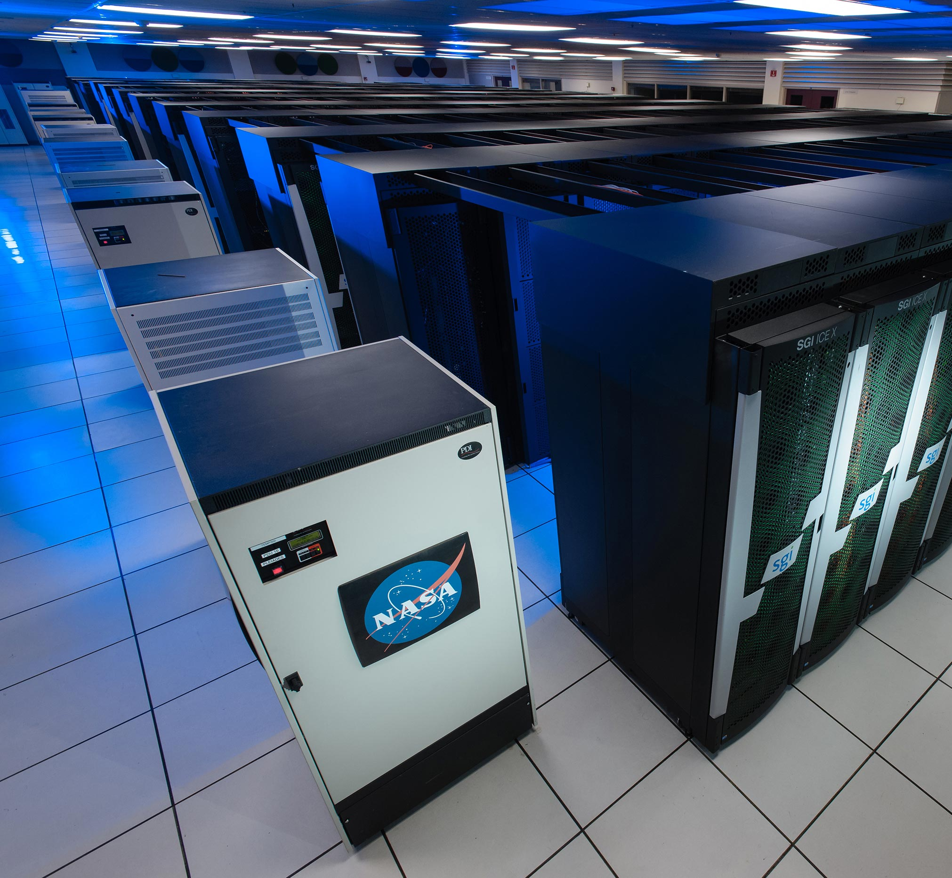
Next Generation Modeling
Quantum Computing
Universal Visitation
Law of Human Mobility
Notes:
Technology and big data are providing new insights into how people travel
When I started working for DOT, the big debate is about whether we will ever use a personal computer for travel demand modeling. Within the past few years, emerging research on quantum computing is gaining momentum. It’s going to be able to solve problems too complex for classical computers. Travel behavior is a complex phenomenon – can quantum algorithms be used to identify patterns linking individual data points emerge?
I don’t think anyone one of us want to live without our cell phones. Studying anonymized cell-phone data, researchers discovered what is called the Universal Visitation Law of Human Mobility. What this law basically says is that there is an inverse square relation between the number of people in a given urban location and the distance they traveled to get there, as well as how frequently they made the trip. It seems intuitive that people visit nearby locations frequently and distant ones less so. This newly discovered idea puts the concept into specific numerical terms. The image on the slide is showing visitor flows across the greater Boston area from cell-phone data. Thickness indicates the number of visitors, and color indicates visit frequency. The holy grail of the four step modeling process may need to be re-evaluated. This visitation law, considering both distance and the frequency of visits, outperformed the gravity model. Fruit for thought.
This model is outperforming gravity model. We need to think about how we can leverage new information and advance technological capabilities to enhance our modeling practices.

Slide 7
A New Paradigm
Notes:
We are living the transformation of the transportation industry. Automated, connected, electric, and shared vehicles, big data, e-commerce, and other emerging trends are changing the world as we know it today. This is making future travel demand forecasting very challenging and exciting at the same time. How could we forecast demand 20 years out when everything is changing so fast, and we really don’t know what’s ahead of us. The sensible approach to take is to consider multiple possibilities in a probabilistic framework and conduct scenario planning so that we are prepared for all possible futures and remain flexible to adapt.

Slide 8
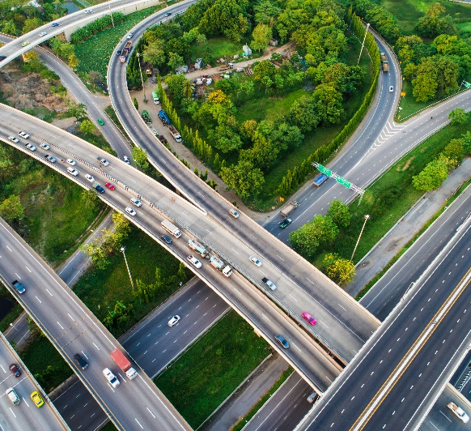
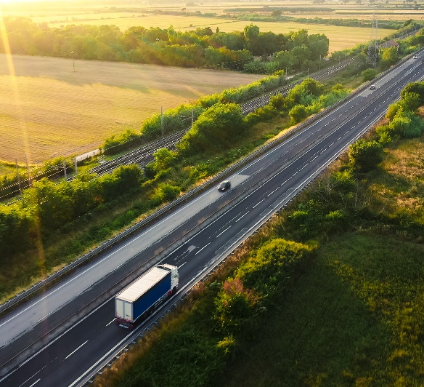
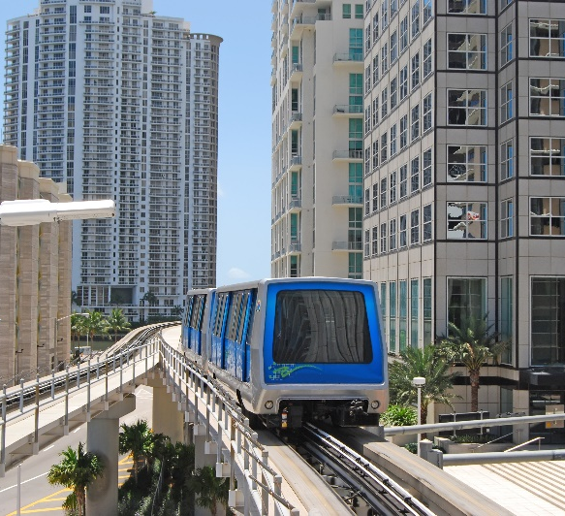
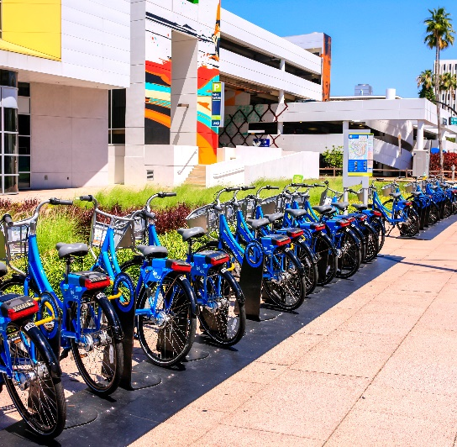
Call for Action
Incorporate Planning Emphasis Areas
Leverage Emerging Technology
& Data
Consider
Future
Scenarios
Think
Outside of the Box
Align with Priorities
Notes:
So, I’ll leave you with these 5 things
Incorporate Planning Emphasis Areas – think of how to analyze equity, emissions reduction, demand for all modes including emerging modes like micro-mobility
Leverage Emerging Technology and Data – how to enhance existing models leveraging new datasets and potentially think of new ways to better capture travel behavior
Consider Future Scenarios – how can we be prepared for all future possibilities and be nimble
Think outside of the box – there is a lot of opportunity for innovation in today’s environment. We cannot keep doing the same thing and expect different results.
Align with Priorities – finally, there may be an opportunity to rethink the MTF committee and sub-committees and their mission statements given the new opportunities. Focus on these key areas to move the needle.

Slide 9
Huiwei Shen Chief Planner
Florida Department of Transportation
huiwei.shen@dot.state.fl.us
850.414.4911
Notes:
That’s all from me. Enjoy the event. Although I provided my contact information on this slide, don’t reach out to me. ☺ Reach out to Thomas Hill if you have any questions. Thank you.

