Slide 1
Shopping Behavior and Attitudes during the Transition Phase (to normalcy) of the COVID-19 Pandemic
By
Ibukun Titiloye
Feb 22, 2022

Slide 2
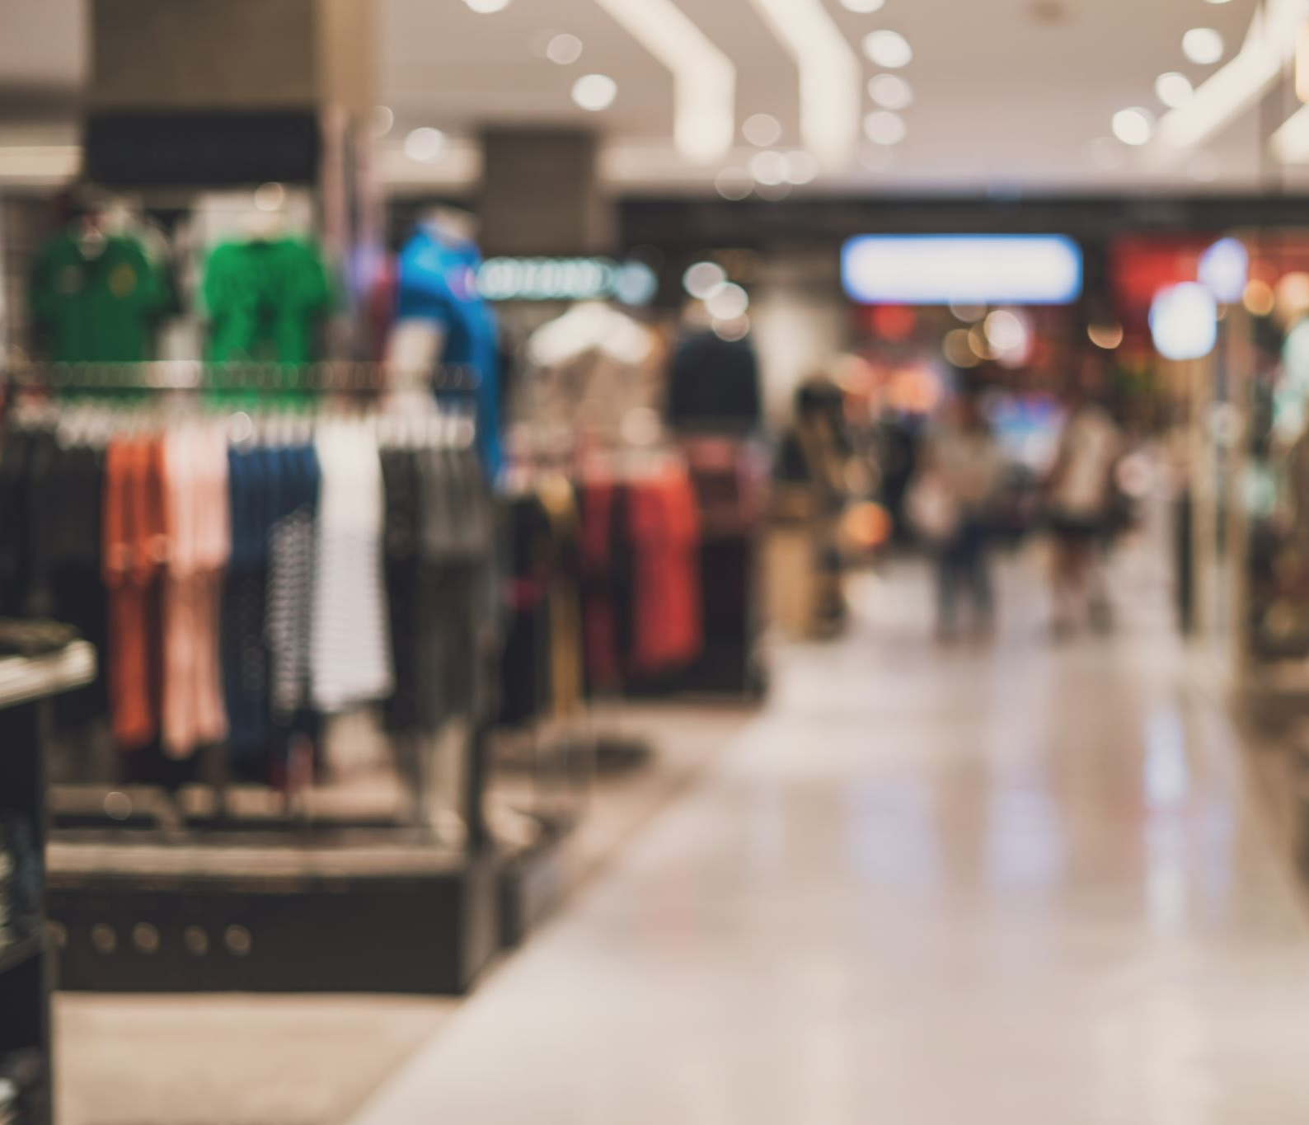
Purpose
Understand shopping patterns during the Pandemic
Two waves of data collection
Jan-Feb 2021 (Early Transition)
Oct-Nov 2021 (Back to Normal ?)
Online vs. In-store

Slide 3
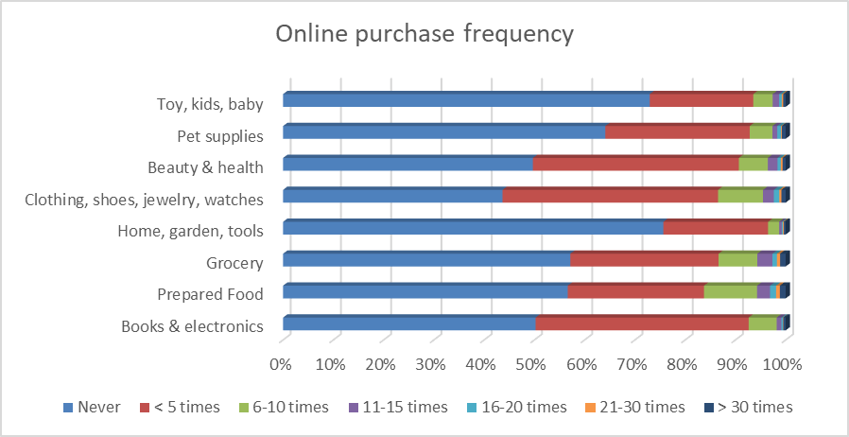
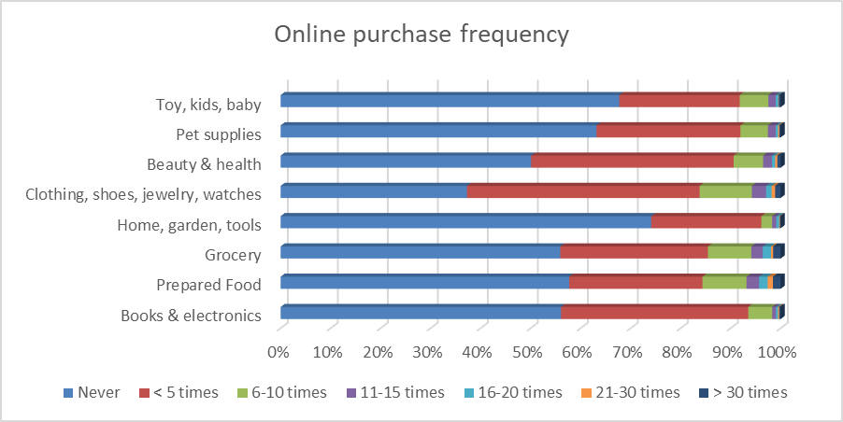
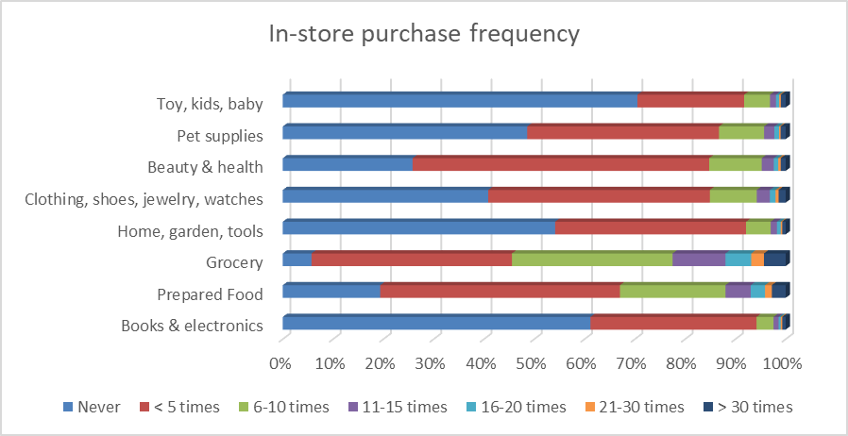
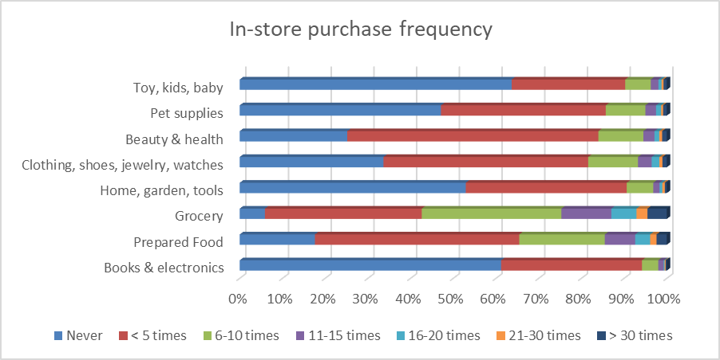
Shopping Frequency for Online and In-store
Shopping behavior between Jan - Feb 2021 (2,257)
Shopping behavior between Oct - Nov 2021 (1,747)

Slide 4
More than 60% never ordered groceries for pick up or delivery before; about 10% more adopted grocery delivery during COVID-19.
In-restaurant food/meal saw the largest impact, about 65% hadn’t gone into a restaurant compared to 10% before the outbreak.
May 2020 Shopping Behavior
Notes:
About 20% expect to participate more shopping activities than before across all activities. 50% will maintain the same level of participation across all activities except for in restaurant meal.
40% will eat in restaurant less than before.

Slide 5
Shift in Online Shopping
More people adopted online shopping for groceries at the beginning of the outbreak; part of the effect remains and has stabilized.
Most people still went grocery shopping in stores, with less frequency at the beginning, but has returned to pre-pandemic condition.
Online shopping for other items has seen slight increase in frequency during the pandemic.

Slide 6
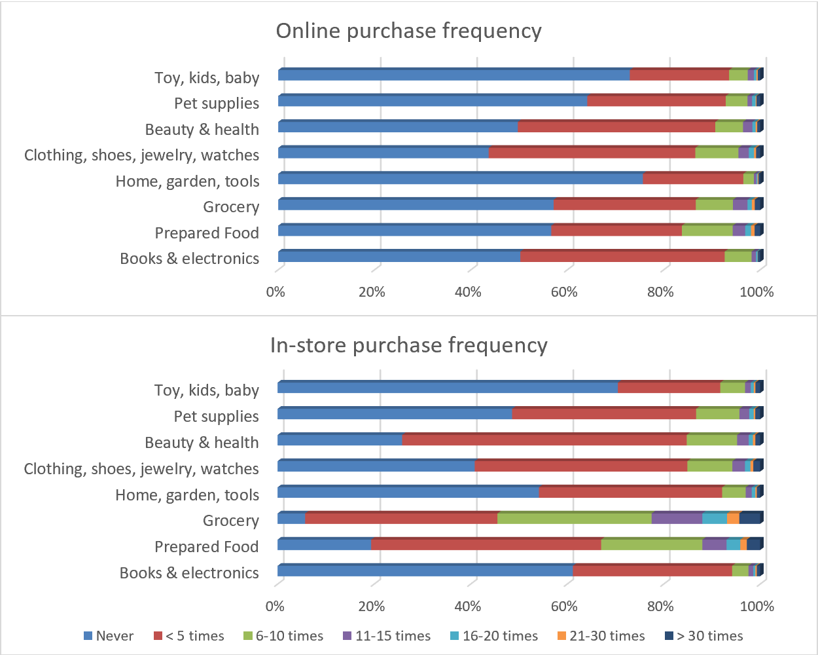
Purchase pattern
People tended to shop online more often for CSWJ and BH than other products
In-store shopping for grocery and prepared food was the dominant mode for most people
In-store shopping frequency slightly exceeded online shopping frequency in general, except for BE.

Slide 7
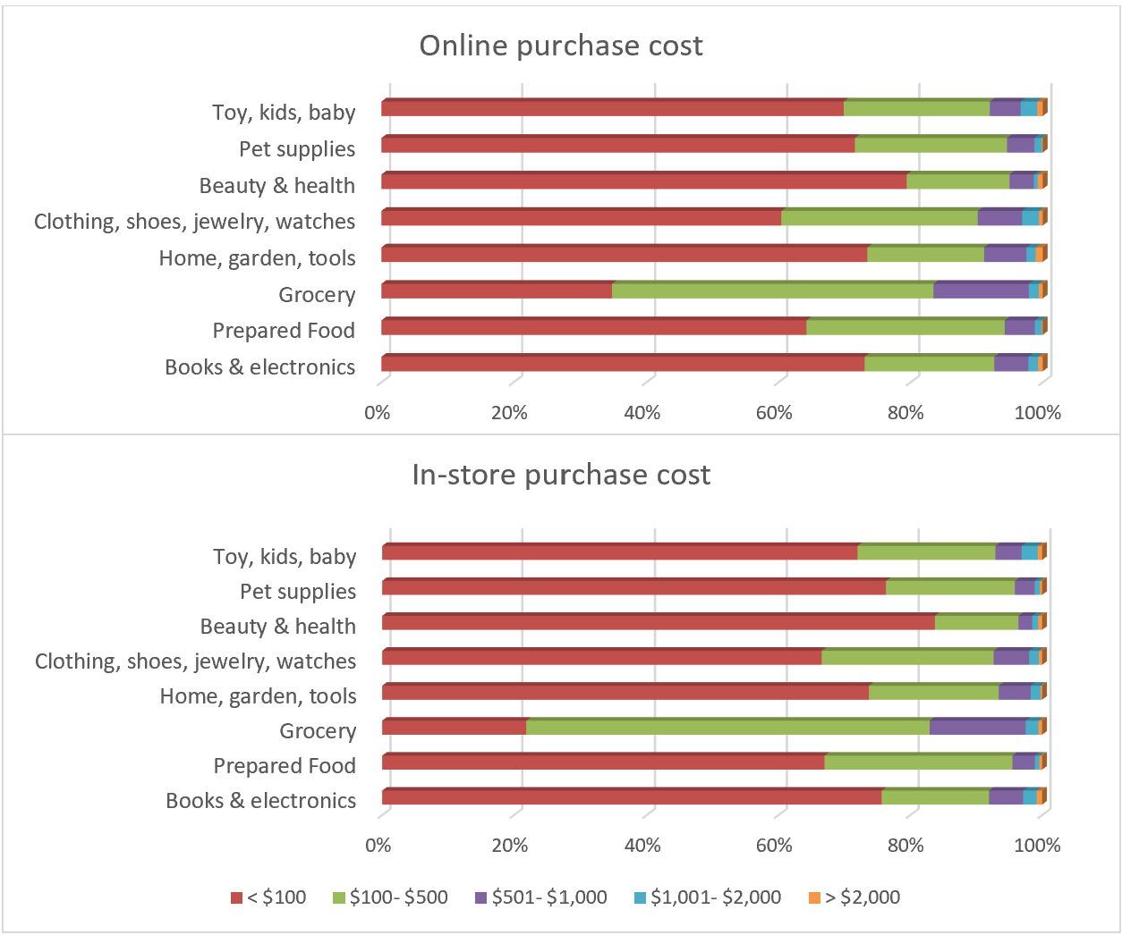
Purchase expenditure
Shoppers spent slightly more money for the same product categories online than in-store, except for grocery items

Slide 8
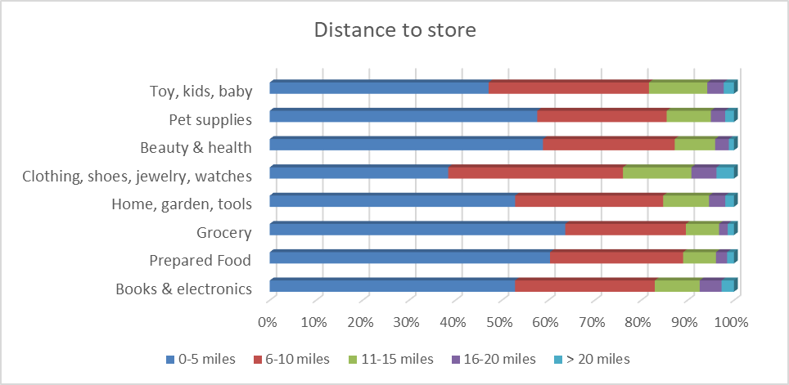
Travel distance to store
People were more willing to travel further for CSWJ
Grocery and prepared food purchases were more likely to be within shorter distances

Slide 9
Attitudes toward online vs. in-store shopping
Shopping attitudes toward shopping method, technology, social interaction, data security, cost consciousness, time consciousness, convenience, the environment, mobility options, etc.
Comparison between those who shopped online at least once (online shoppers) and those who did not shop online in the past month (in-store shoppers).
Unweighted sample sizes for online shoppers and in-store shoppers were 1,971 and 286 observations, respectively.

Slide 10
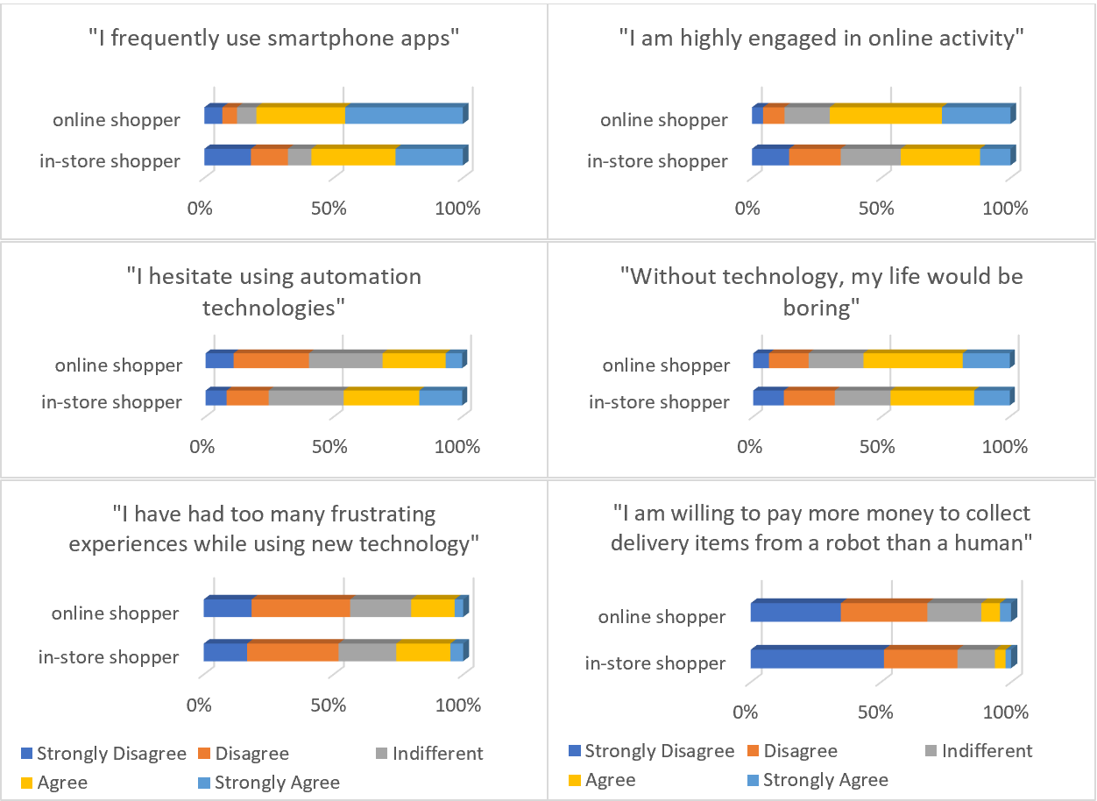
Technology and Automation
1
2
Online shoppers tended to be those who used phone apps¹ and the Internet more², and to have positive attitudes toward technology in general

Slide 11
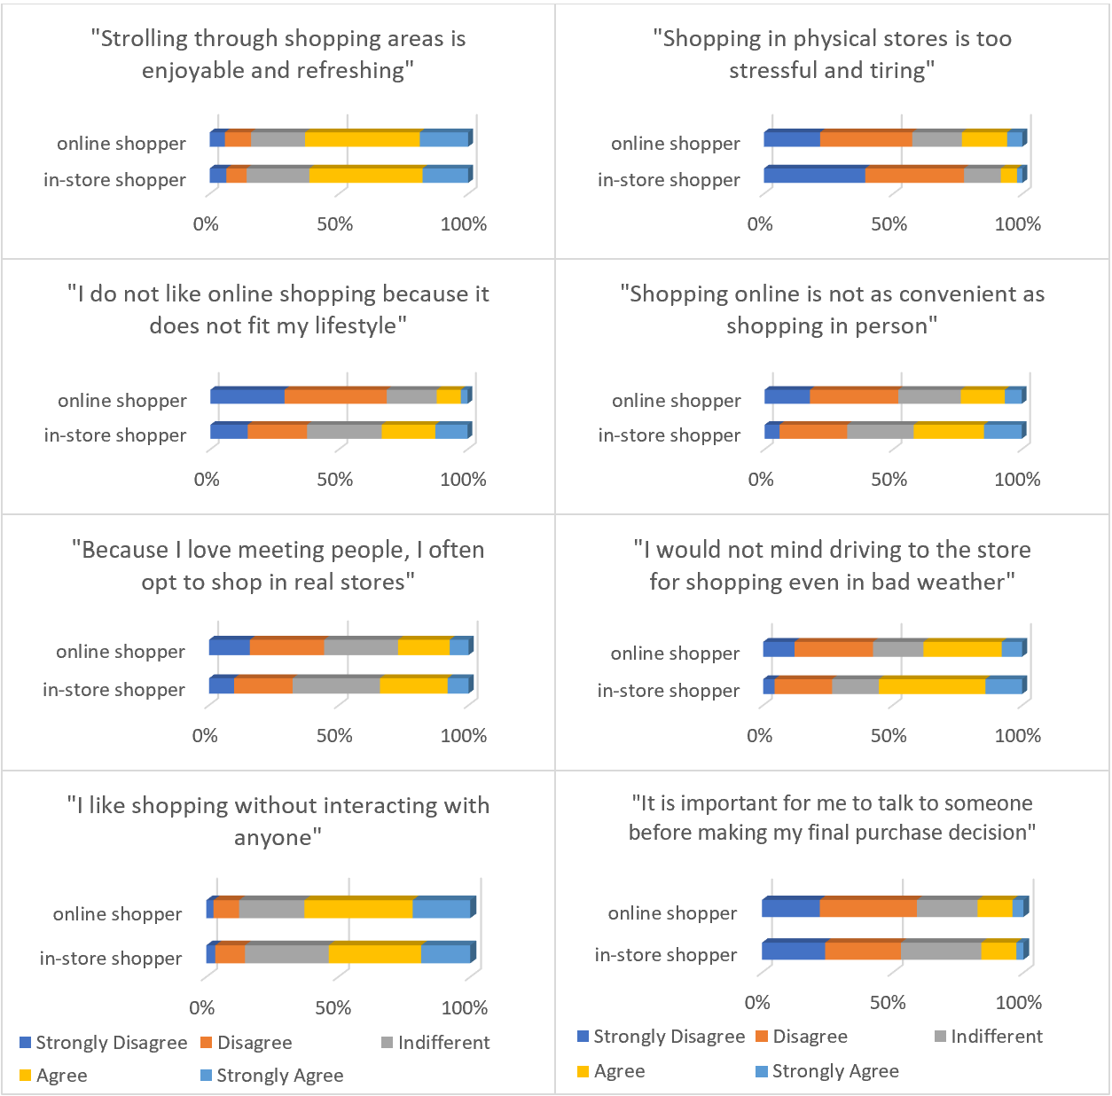
Shopping method & social interaction
2
1
Online shoppers found online shopping more convenient¹
Online shoppers were more likely to feel stressed from physical shopping²
People generally did not necessarily like talking to or meeting people in stores³
3

Slide 12
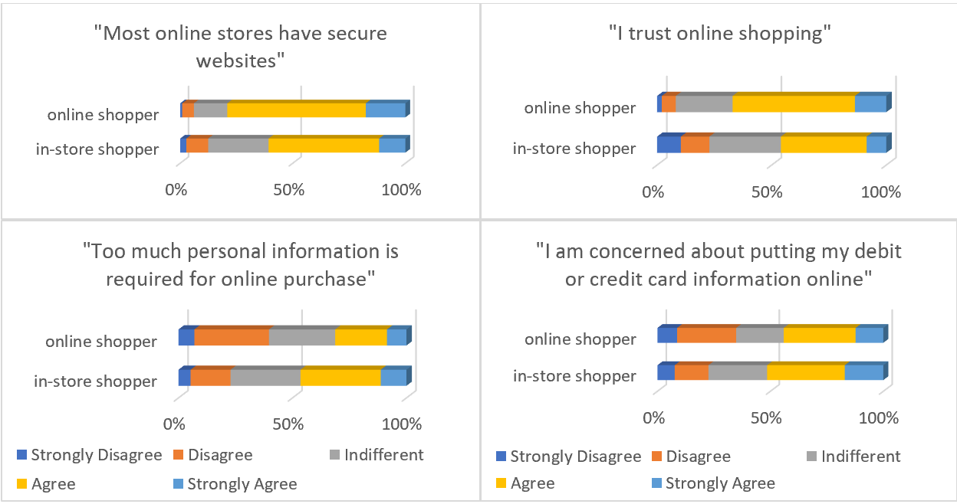
Data security
1
People generally trusted online shopping¹
However, in-store shoppers were relatively less likely to trust online shopping and online stores’ websites and tended to be more concerned about putting in their personal information online

Slide 13
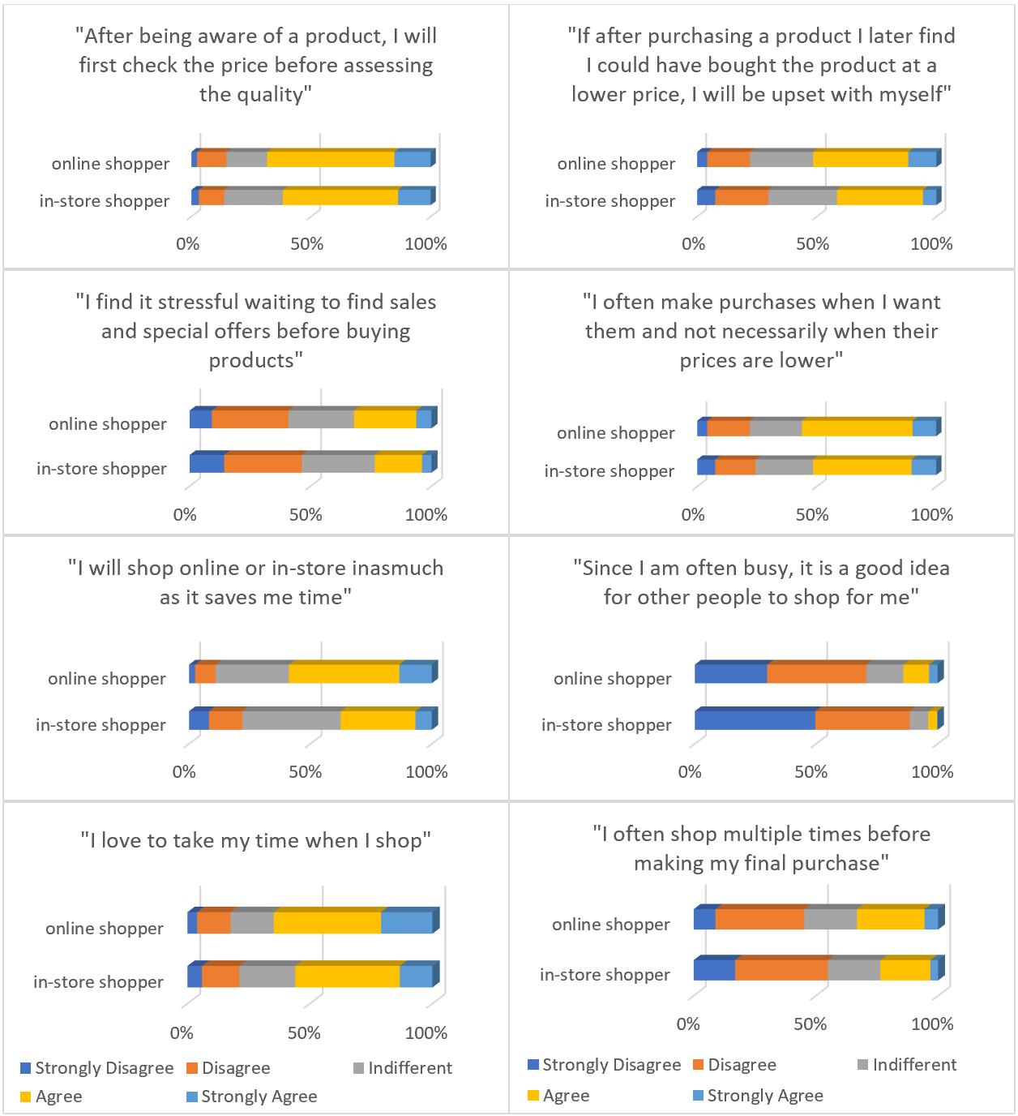
Cost-Consciousness & Time-Consciousness
1
People were generally price conscious, but that depends on how strongly the shopper wants the product¹.
Online shoppers seemed to be more time conscious than in-store shoppers when choosing whether to shop online or in store² (though they liked to take their time and shop multiple times before making their final purchase)³
2
3

Slide 14
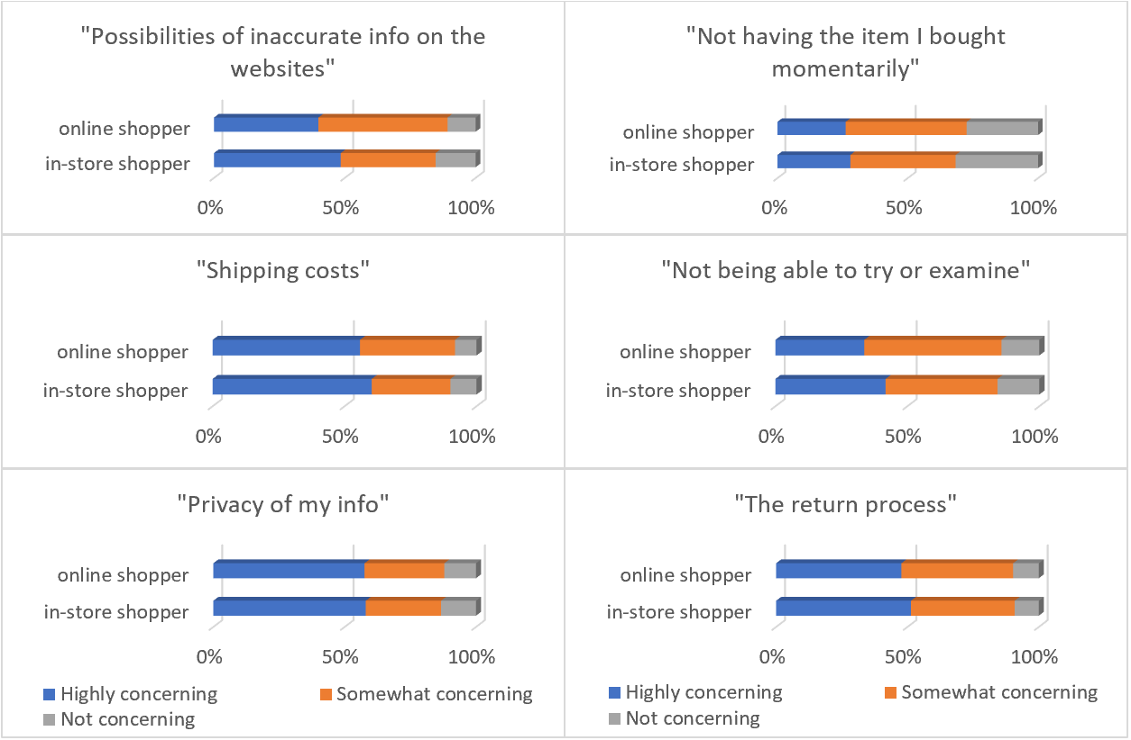
Factors Discouraging Online Shopping
Concerns over putting information online (privacy issues)¹, shipping costs ², and return process ³ were top factors discouraging online shopping
2
1
3

Slide 15
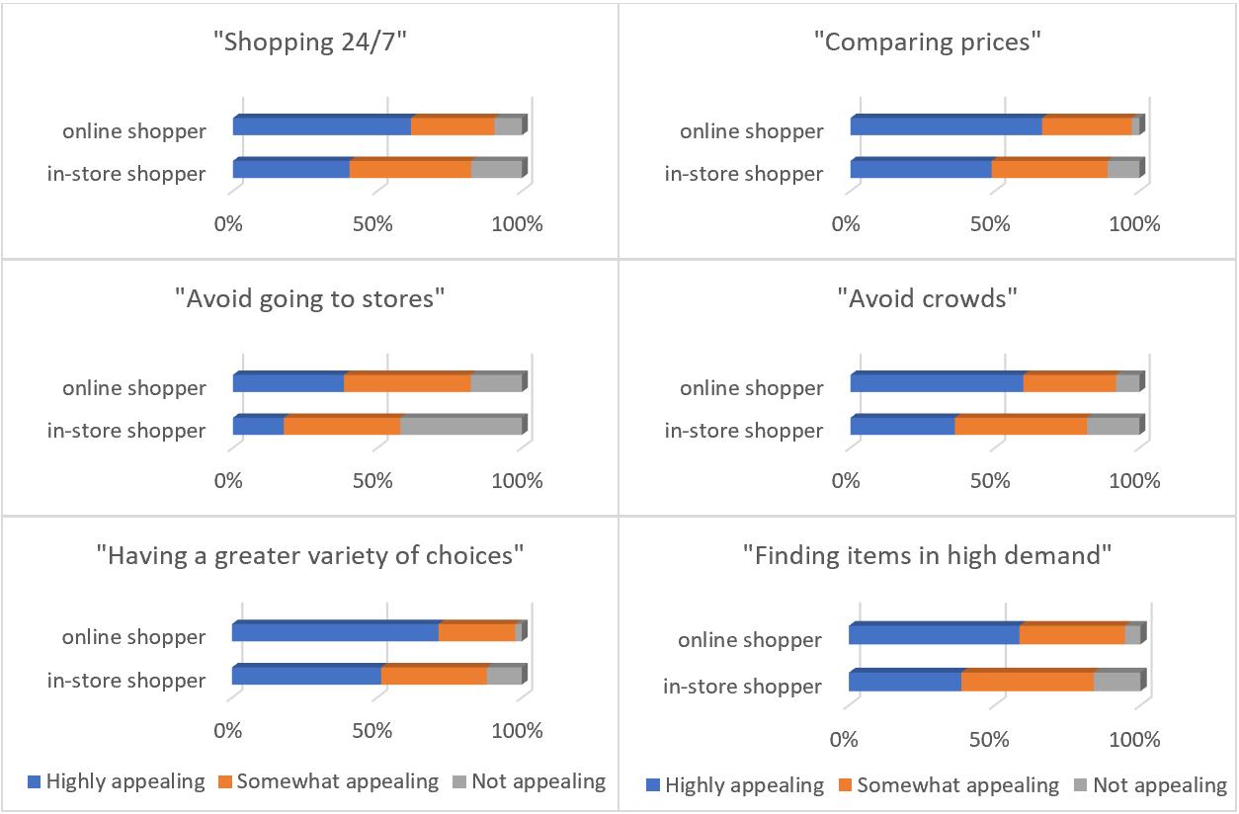
Factors Encouraging Online Shopping
Comparing products and their prices seem to be a big motivator of using online shopping

Slide 16
Conclusions
For the same product types, people tended to spend more money shopping online than in-store (except for grocery items), however they tended to shop more frequently in-store than online (except for BE)
People were more likely to shop more frequently online and were more willing to travel long distances for CSWJ
Although in-store shopping for grocery and prepared food were the dominant activities for most shoppers, they tended to be within relatively shorter distances
Generally, both online and in-store shoppers trusted online shopping, liked purchasing from local stores, and did not necessarily like social interaction in stores
However, online shoppers tended to use technology more and have positive attitudes toward technology, and were more influenced by time factor in choosing whether to shop online or in a store
In-store shoppers tended to be more concerned about putting in their personal information online, and were less likely to like unattended deliveries, curbside pickup or collecting items at a delivery point
Overall, comparing products and their prices seem to be a big motivator in using online shopping

