Slide 1
Florida’s Turnpike Modeling
State of the Practice
Southeast Florida FSUTMS User Group
06/24/2022
Notes:
Thank you for the invitation to be here. When Hongbo invited me I propose to showcase most of the modeling tools that we are using to perform our traffic forecasting for the projects that we have at FTE.
So, this is going to be a quick overview of all the things that we do and if the organizers want to go deeper in a particular topic that I'm going to be glancing over today we can schedule a subsequent meeting another day.

Slide 2
Overview
What are the Needs?
  Existing and Future Trends
  Model Lifecycle
What do we use?
  TSM NextGen
    Long-Distance, Short-Distance, Visitors and Residents, Trucks
    FLUAM
    Network tools
    Multi-Resolution
    ELToD
  Scenario Planning
    Mobilitics
    Risk Analysis
    DMDU: Decision Making Under Deep Uncertainty
  OD Data
  CAVs
  Emergency (Hurricane) Evacuation
  Traffic Trends Tool (3T): Profile optimization software
  SmartSheet: Project Management
Future Challenges
  Cloud computing
  Business Intelligence
  Knowledge Gap
2
Notes:
The agenda includes a brief description of the needs ….what are the modeling needs and what do we use to address those needs, to complete our work.
The first tool and most important one is the TSM NexGen that we started developing almost three years ago.
Then helping create inputs for this tool we have a Land Use Allocation Model, network tools (recently added a multi spatial resolution to it) and of course our ELToD model which is a macro DTA assignment model.
Other interesting apps included within scenario planning are listed here (Mobilitics, Risk Analysis, DMDU)
OD Data project is a tool that's going to be web based to track our distribution flows at our Turnpike facilities; CAV modeling is added within ELToD and the TSM; We also use TIME model for hurricane evacuation for project planning purposes; a traffic trends tool that’s basically our traffic profile optimization tool (Hongbo is very familiar with this since he developed the first version of it) and then some management tools like smartsheet that's pretty cool in my opinion and I am going to show you some applications of it.
I should also mention that most of our models/applications were developed for internal use, which means that we could share them but we do not provide support or even training to outside users. If there is interest in any of them, a special arrangement has to be made with FTE Management, on a project specific basis, so that our staff can spend time/resources to provide that support.
Finally, I'm just very quickly go over a few things that we are considering challenges for the future like cloud computing, the business intelligence that we need to apply to our analytics capability and that knowledge gap that we may experience moving forward.

Slide 3
What are the needs?
Notes:
The needs…

Slide 4
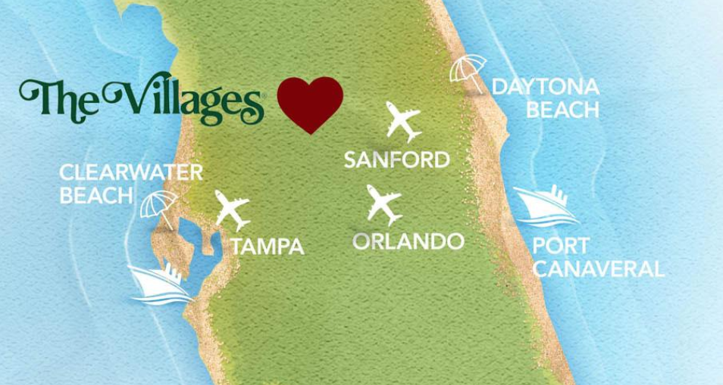
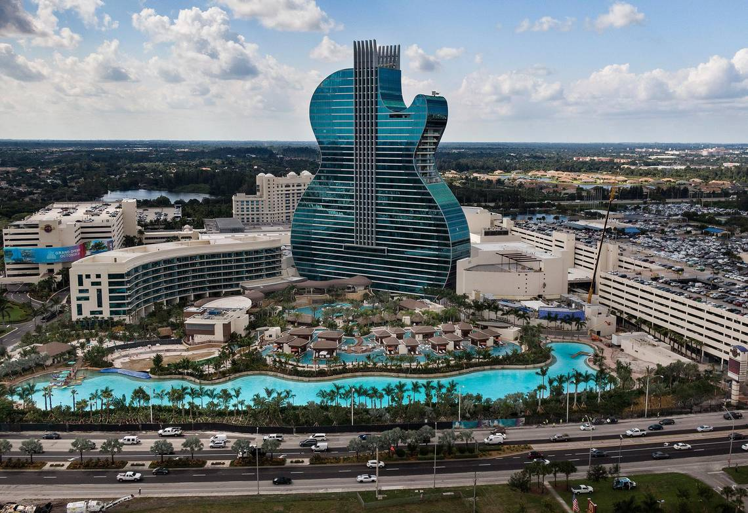
Understanding Florida Travelers
New & Large Communities:
  Expanding Airports
  Retirement Villages with Median Age of 74 and over
  Large shopping districts
https://www.thevillages.com/
Long Term Visitors:
  Winter Homes
  Vacation Homes
https://www.miamiherald.com/latest-news/x8oeyj/picture236566828/alternates/FREE_1140/103hardrock16NEWPPP
4
Notes:
Florida is very unique due to large retirement communities, large shopping and entertainment districts and the number of visitors and seasonal residents

Slide 5
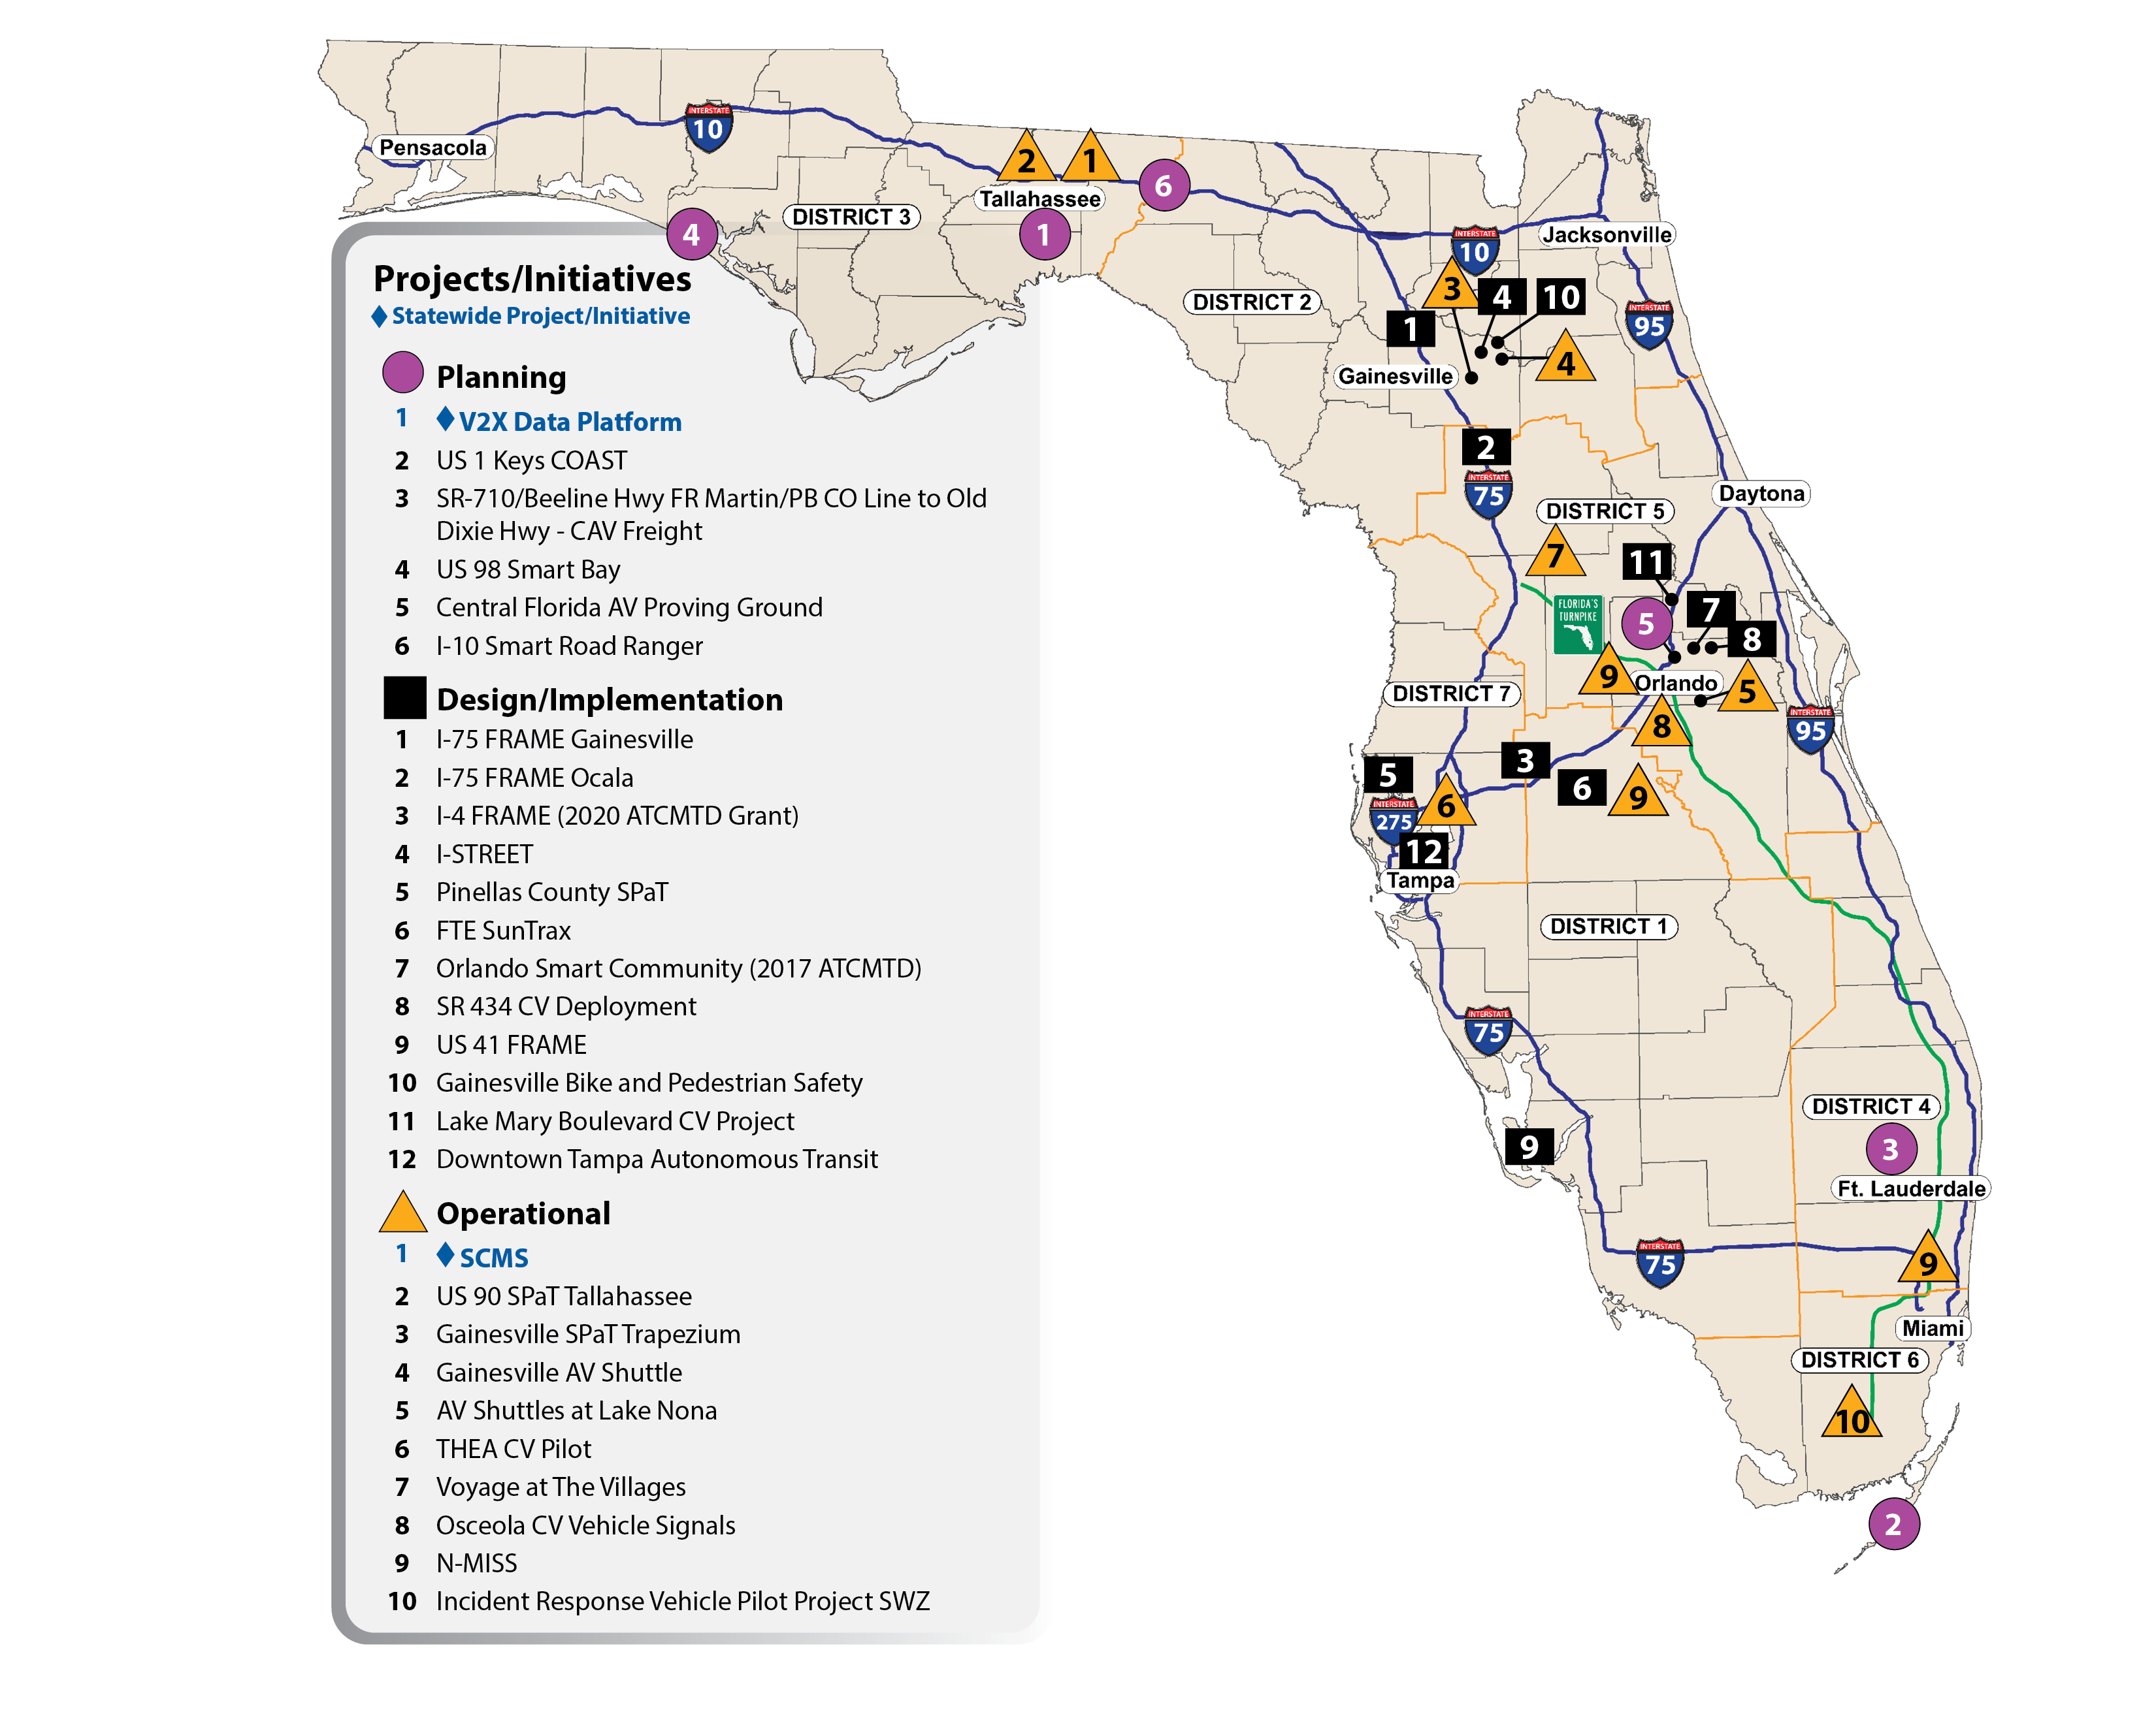

Emerging Technologies
The Florida Connected Vehicle Initiative
Florida Automated Vehicle Initiative
5
Notes:
We also have emerging technologies particularly CAVs that represent a transportation paradigm change

Slide 6
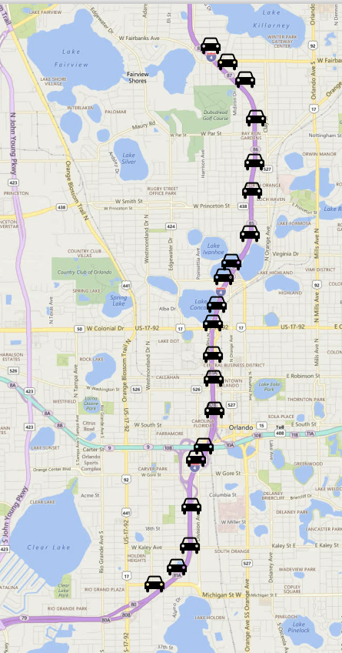
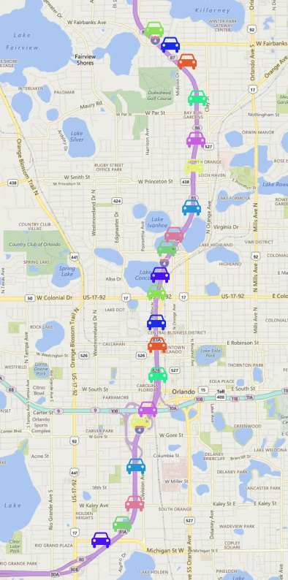


Understanding the Markets
Counts Based
Markets Driven
Market Type
Resident
Visitor
Household Info
Income
Type
Person Info
Age
Gender
Trip Info
Purpose
Mode
Depart Time
Aggregate Daily Trips
6
Notes:
Customer Centered ?
What do we know about our customers and how to serve them better?
In most of the FL trip-based models, we know nothing beyond the total cars on the facilities. We don’t know who they are, why they travel at what times do they travel and where they live and whether they are sensitive to changes in tolls or new technologies.. Who will be the early adopters of AV/ CV / ACES…
In the market driven model, we will not only have the market (as FL resident or out of state resident) but also household information, personal information and along with more detailed trip information at the facility level. This will allow us to know the customer to serve them better

Slide 7
Understanding Model Development Needs
Estimation
Calibration
Validation
Known Universe Control Totals
2013 - 2017
Observed data
2015 - 2018
Recent most year
2019
Every 5 Years
Very Frequent
One Time
Visitor Surveys (2019)
StreetLight OD data (2019)
Jacksonville Survey
(year 2017)
Treasure Coast Survey (year 2018)
SERPM Survey
(year 2017)
Tampa Bay Survey
(year 2019)
Year - 2015
Year -2020
7
Notes:
This should be very familiar for all modelers, but Management usually has a hard time understanding the differences and a travel demand lifecycle.
Working on projects throughout the State of Florida we have a hard time reviewing and updating Regional and Districtwide models mostly because of very outdated estimation or calibration, but even most validation years are currently based in 2015 data. We are in 2022 already. At FTE, we deal with T&R projects with constant audits of our processes by bond rating Agencies. We need to make sure we are up to date in terms of the most recent data that goes into the model.

Slide 8
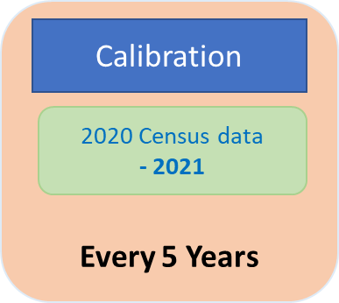
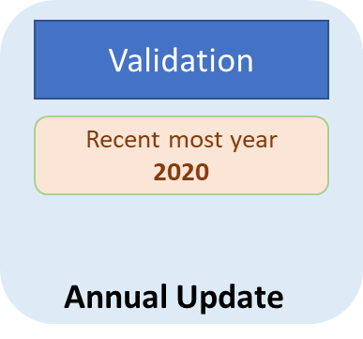
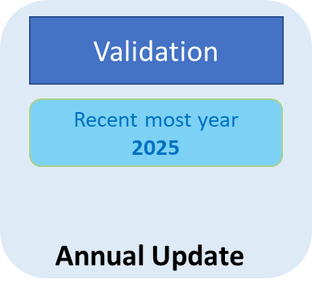
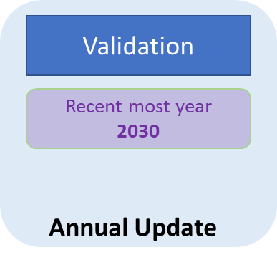


Model life cycle
Operational Model
Advanced model in FL
Updates & Maintenance
Completely In-House
Estimation
Known Universe Control Totals
2013 - 2017
Calibration
Example
Observed data
2015 - 2018
One Time
Validation
Example
Recent most year
2019
Every 5 Years
Known Universe
Very Frequent
Jacksonville Survey
(year 2017)
Treasure Coast Survey (year 2018)
Visitor Surveys (2019)
SERPM Survey
(year 2017)
Tampa Bay Survey
(year 2019)
StreetLight OD data (2019)
Year - 2019
Year -2020
Year -2025
Year -2030
8
Notes:
(skip this txt in the presentation to save time)
Model lifecycle can be described through maintenance of the core aspects:
Ideally in first year, all 3 could be the same year.
But over the time there could be different years
So, what is a base year – Year for which models are estimated. In this case 2015.
More data is available for recent years (HTS in 2017 – 2019, new toll information, new EL facilities, new OD data) then why 2015 ? Well, it is the year for which we know the entire population, households and their demographic distributions. The next phase of re-calibration would be in 2022 (?) when 2020 Decennial Census is available. No estimation just re-calibration (in-house).

Slide 9
What do we use?
Notes:
Ok. So how do we address those needs, what do we use?

Slide 10
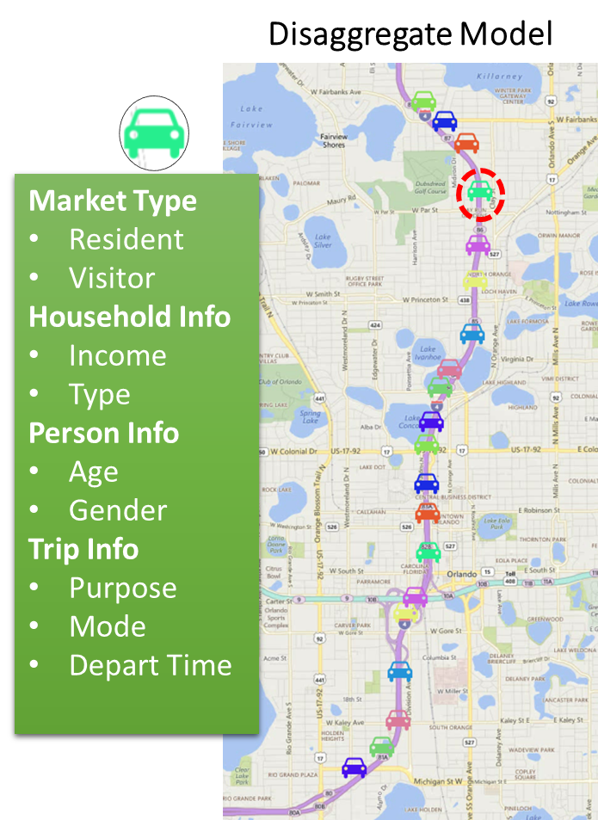
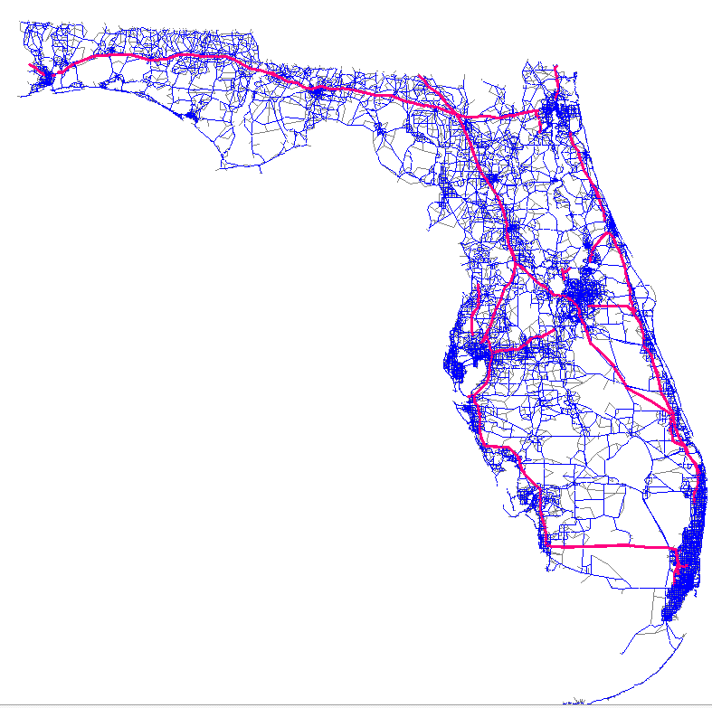
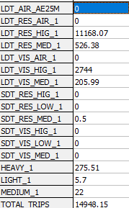
A New Statewide Model
Proposed / Scoped / Designed
Implemented / Achieved
Markets:
AIR - to/from Airport
LDT – Long Distance
SDT – Short Distance
RES – FL residents
VIS – Out of State
Heavy – Trucks
Medium – Trucks
Light – Commercial
VOT (RES / VIS):
HIG ($23.11 / 30.92)
MED ($11.01 / 12.21)
LOW ($5.76 / $5.76)
10
Notes:
We have a new Statewide model that accomplished all that market segmentation
(If running short on time, skip the text below)
TSM – Legacy is counts driven, and we need to go towards markets’ driven to measure policy impacts and also impacts from tourism and other emerging markets such as UBER (other TNC) and rise in online shopping impacts (including meal deliveries), impact of about to enter connected and automated vehicles, truck platooning and many others markets..
TSM – Legacy:
The legacy approach relies on developing an OD table from counts.
Then associate with parcel data to develop statistically sound correlations between OD trip table and parcels (via regression and probabilities)
Future year trip tables are developed based on landuse allocated to future year parcel (FLUAM) and base year correlations.
Travel Markets:
Primarily there are two kinds of travel users – In-state and out of state residents. Lets start with In-state residents..
Florida Resident: They travel within the city – like going to work, shopping, visiting friends, movies and Disney.
But they also travel to other cities (with in FL), such as Orlando resident going to Miami or Tampa residents going to Jacksonville.
Out-of-State Residents: Traveling to Florida or Florida residents traveling to other states. This travel is recorded at external counts stations near the borders, airports, seaports.
Out of state residents once, they arrive, they stay overnight in Hotels or other friends'’ places and then make more local trips (visit places that are close by that doesn’t prompt overnight stay). And then some travel to other cities just like FL residents doing intercity travel.
Modeling these markets allows us to accurately predict the impacts of each market on the system as well as the policy impacts on the travels in these markets. The generally notion is most visitors (outside state residents)are not in a hurry since they are on vacation, and they may not tend to spend on toll roads. But the counter argument is they are here only for short period and need to maximize their stay instead of stuck in traffic and tolls are fractional cost compared to the flight tickets they bought and thus these users may more likely take toll roads. Modeling markets allows us to test such theories where each maybe true but on different facilities.

Slide 11
FLUAM 3.0
MPO data compiler
Model Development / Update
New model features are being constantly added to improve model and expand its applications
The current version is v3, a fourth release (stable distributable copy) of TSM-NextGen.
The next upcoming version v4 shall include on going efforts of Multi-resolution modeling, sub-zone system loadings to improve run-time efficiencies.
Navteq Networks
10k TAZ System
Tour-based model
Long-distance model
Truck model
TSM - Legacy
Legacy Compatibility
TeleAtlas Network
Hourly Trip Table
Trips in Motion
Future year US state landuse
TSM - NextGen
Latest MPO Data
Streetlight O-D data
Select link analysis
ODME Application
TSM – NextGen (v1)
With Future Year
BEBR Scaled MPO Data
LDT Calibration
Long-distance trip O-D validation
Ticket System O-D data
Pre-ODME validation
Incremental LDT application (5 year)
Sub-sampling PopulationSIM
Navteq assignment
TSM – v2
Multi-spatial resolution
Sub-zone system
Refine ODME for Suncoast / Citrus additions
TSM – v3
TSM – v3 MSR
11
Notes:
…and we keep evolving it on a continuous basis.

Slide 12
TSM NextGen 3:
MODEL STRUCTURE
Database :
Scenario Manager
Scenario Manager
(R & C++)
Master Database to Scenario Specific Network
Free-Flow Model
Network -1: Network attributes to support Demand modeling (static time of day skimming)
Network -2: Attributes to support Macro DTA assignment
Demand Model:
Tour-Based Model
Long Distance Model
(PASCAL)
FL Residents: Out-of-State Tours (IE)
Out-of-State Residents: National long-distance Tours to FL (EI)
Short Distance Model (Feedback Iterations : 3)
(JAVA)
Level of Service Skims
Resident Tours
Visitor Tours
Auto Ownership Model
(JAVA)
Run model for Florida
Run model for rest of U.S.
FL Residents: In-State Tours (II)
Joint Destination Choice / Mode Choice Model
Value of Travel Time Model (JAVA)
Mixed Multinomial Logit Model (MMNL)
Distributed Curves as a function of Resident Status, Income, Purpose (Work & Non-work tours).
Level of Service Matrices (CUBE & OMX)
Free-flow (Loop 1)
Congested Skims (Loop 2 & 3
Land-use Model:
Synthetic Population
Network Model:
Hourly Route Choice Macro DTA
Florida synthesized household and person files
Outstate synthesized household and person file
Land Use Development (PostgresSQL, ArcGIS)
MPO Land use: Compiled from MPO Base year (2015) and Future year (2045)
Interim Years: Interpolated and scaled to match BEBR by County
FLUAM Land use: Compiled from FLUAM incremental 5 years for Counties with no MPO model data
Synthetic Population (Python)
Synthetic O-D trip tables.
Vehicle Class Frequency Distribution
Commercial Vehicles
(R & Python)
Macro DTA Assignment
(C++)
Aggregate Tour list to Trip list by O-D- HOUR-MODE
MODE: Value of Time Segmentation by Market
Aggregate Daily Volumes
Hourly Time of Day Model
12
Notes:
This is a flowchart of the TSM NextGen. I’m not going to go in details but basically it has that scenario manager that I’ll talk a bit more later, the LU model and a pop synthesizer for Florida and the rest of the continental US (for the long-distance component of the out of state travel); a tour-based model for FL residents and visitors, and the network model

Slide 13
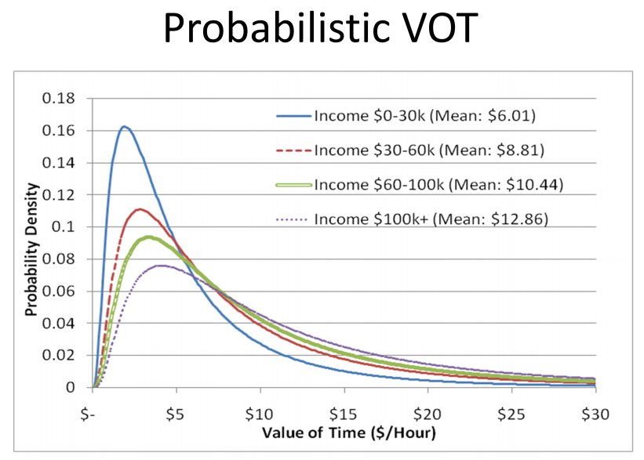
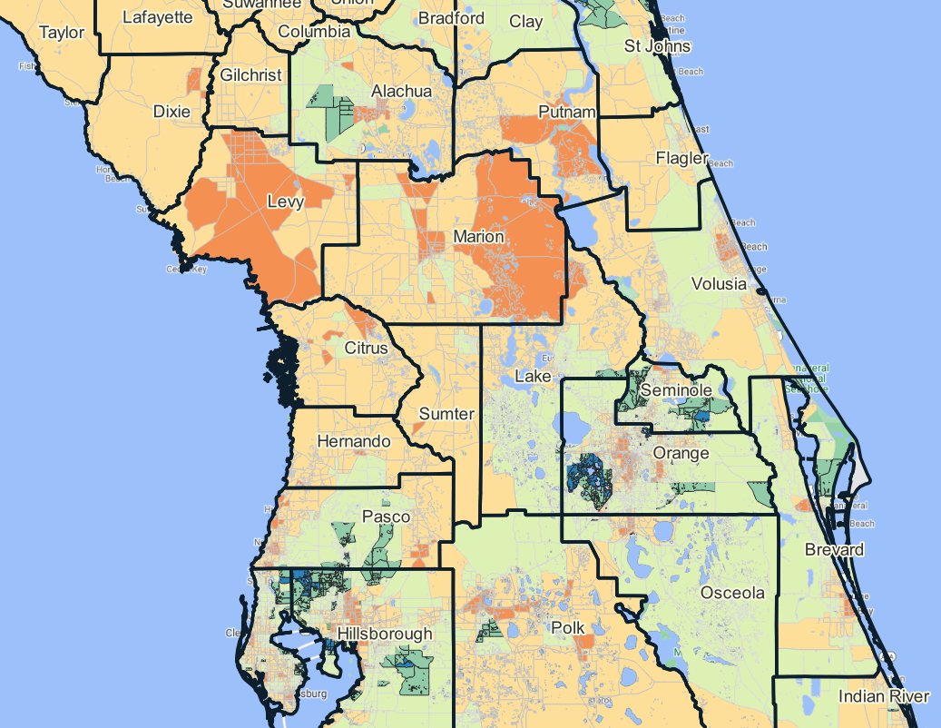
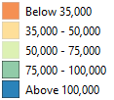
Understanding Value of Time
2019 SE Data with Median Household Income ($2015)
for each Household:
HH Incomes are assigned based on Geographic “med” Income (lognormal distribution)
Based on HH Inc, VOT based on “resident status” and “trip purpose” are assigned.
VOT for trips vary greatly across the state as the median household income varies.
13
Notes:
A key component of the model is the ability to use a distributed VOT based on the HH data and by considering the resident status and trip purpose we aggregate those person trips for assignment generally in low, med and high categories.

Slide 14
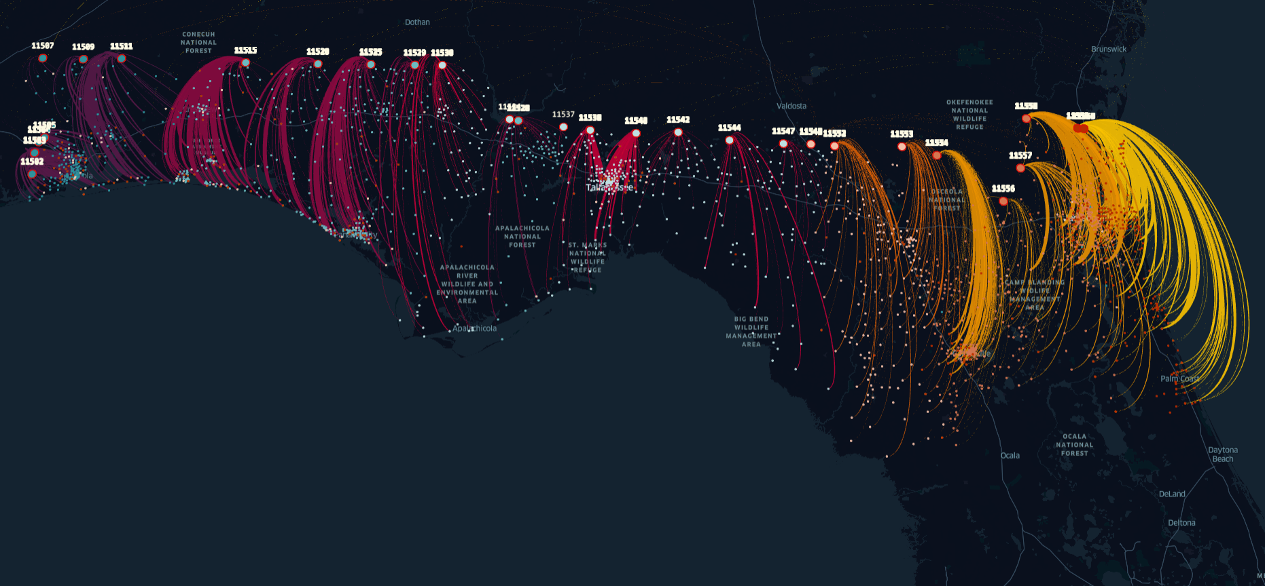
Cross-border Trips – now Part of rJourney
14
Notes:
A quick display of a couple of interesting trip types that we wanted to make sure we have them right: What we call the cross-border trips and the airport egress trips.

Slide 15
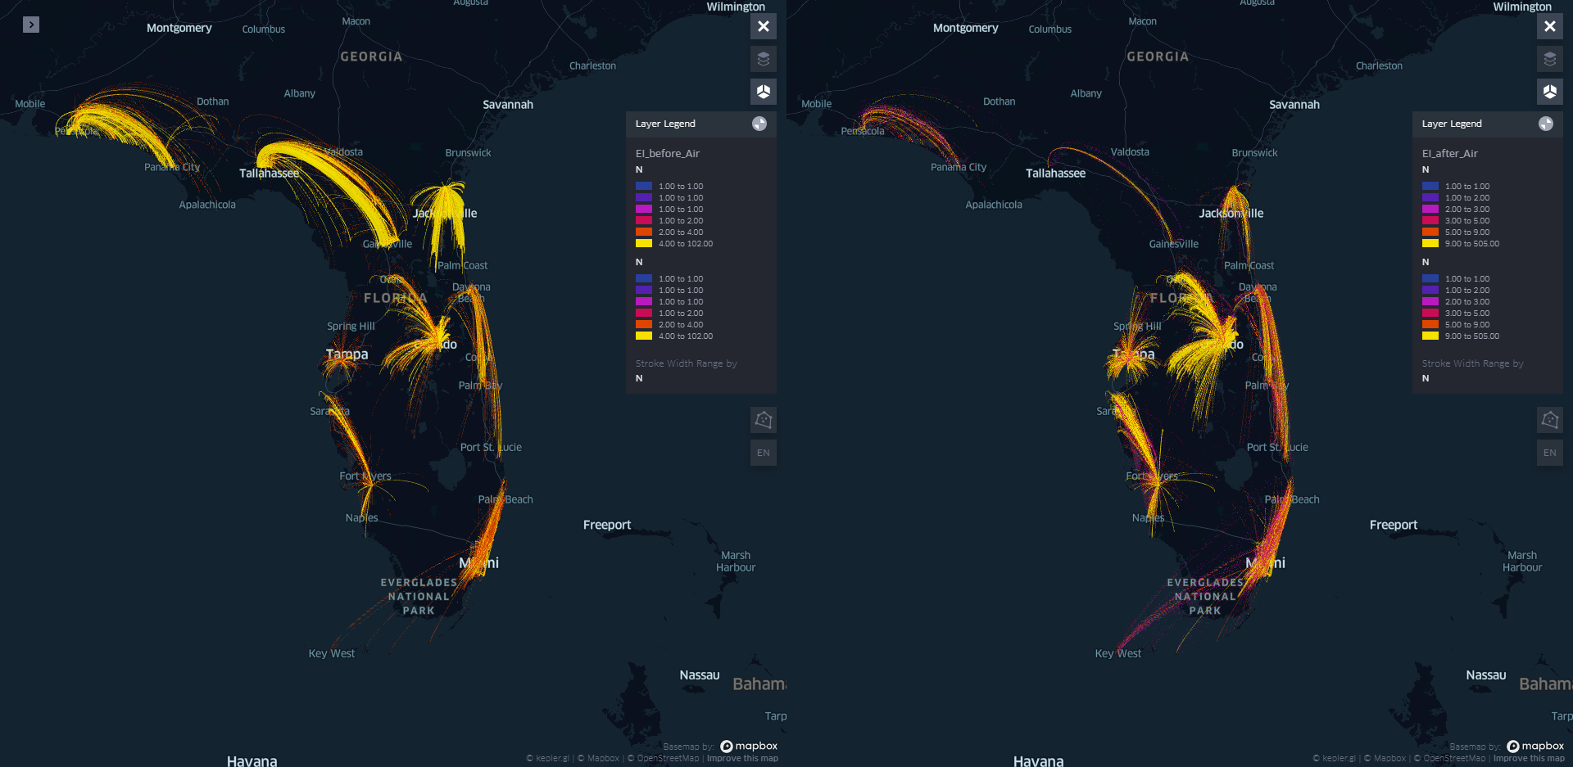

External (EI) to DMAs – Airport Egress Trips
Before Calibration
After Calibration
15
Notes:
DMA is a Designated Market Area as defined by Visit Florida.
See https://www.visitflorida.com/places-to-go/

Slide 16
Florida Land Use Allocation Model (FLUAM)
Notes:
Moving on to other tools that feed into the TSM, we have FLUAM

Slide 17
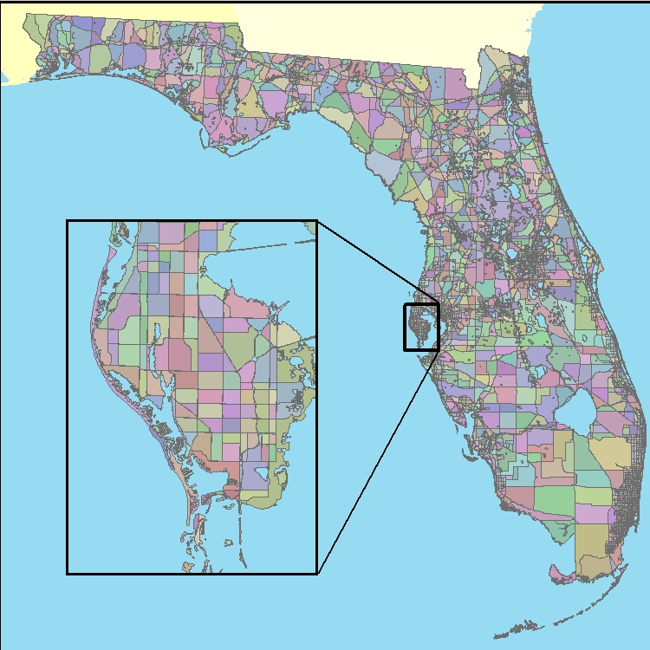
Basic FLUAM Process
Allocates housing and employment growth at TAZ-level using:
Growth control totals input at user-defined geography in 5-year increments
  County, MPO, other
Defined restrictive geography both Legal & Physical Constraints
Defined Land Availability
  By Land Use conversion
  By Re-developable acreage
TAZ Accessibility
17
Notes:
The flexibility of the FLUAM allows the user to define the geographic level whether it be at the state, county, city or other level where to establish control totals. The model is set up to allocate the given growth center information for household and employment to the TAZ level.
The model includes legal constraints: Zoning regulations, urban boundaries; Physical constraints like water bodies, parks etc. Agricultural land use conversion: age of the farm, rate of conversion. Redevelopment timeframe: Employment 35 years, residential 50 years

Slide 18
FLUAM Model Flow
Total Land Available
Legal & Physical Constraints
Base Year Zonal
Land Use
• Households
• Employment
Determine Remaining Developable Land
Generate
Travel Impedance
Matrix
Accessibility and
Overall Attractiveness
Florida - Calibrated Parameters
Allocate new Increment
of Land Use
Future Growth Increment
• Households
• Employment
Iterative Loop
Forecasting Analysis Procedures
TAZ Land Use
Forecasts
• Households
• Employment
5 Year
Dynamic Land Use Lag
18
Notes:
I’m not gonna go over this chart in detail, but basically FLUAM is a location choice model that uses accessibility from the travel demand model and other attributes to allocate the growth that is defined to occur in a pre-defined geography (usually the County level). The software is written in C++ and can be integrated into different types of travel demand models. The model has short run times typically less than five minutes.
(Skip from here down if no time available)
The FLUAM focuses on five general components:
First main component is accessibility and overall zonal attractiveness. Accessibility is obtained from the travel demand model and is defined as the vehicular travel time from each TAZ to all other TAZs along the road system. This travel time file is exported from the travel demand model to a comma separated ASCII file. This file is referred to as the “skim” file.
The second component is the transportation network. It consists of a link file and a node file. These files are used to calculate the straight line distance from each TAZ to the closest limited-access facility ramp and nearest arterial intersection as that information feeds into a couple of variables that help determine growth potential.
The third component is housing and employment. Housing and employment control totals specify the amount of housing and employment to be allocated to each “Growth Center.” Each TAZ is assigned to a Growth Center as part of the model structure. A FLUAM run could have anywhere from 1 Growth Center (where the FLUAM would perform a statewide allocation) to the sub-county level. The most common Growth Center designation is the county.
The fourth component is zonal attributes. Zonal detail includes several values which describe some characteristic of the TAZ, such as current usage of the land including available acres and built acres, the physical and legal land constraints (conservation lands and zoning), and political designations (DOT District, Urban Growth Boundary). All of these values are stored in the TAZ file.
The fifth component is model estimation parameters. These parameters are stored in the control file and are available for review but should not be altered because they are estimated for the current model calibration. They would only be updated with another FLUAM model calibration effort.

Slide 19
Network Tools
Notes:
Moving on to Network development tools

Slide 20
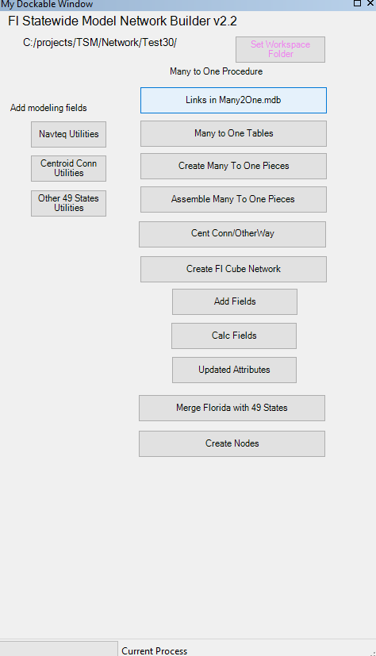
Network Development
Network Manager
2011 -Navteq
2019 -Navteq
Geo Master Network
Network Attributes
Manual Process
FLSWM Network
All District TIPS
Future Network
GeoMaster Network
Every 5 Years
(2020, 2025 ..2045)
Every 5 Years
(2020, 2025 ..2045)
Many-to-One Tool
Alt -1
Project - 1 Network
Future Prj -1
Alt -1
Alt -2
(2020)
Alt -3
Opens in 2020
Future Prj - 2 Alt-4b + Prj1 Alt-1
Alt -1
Project - 2 Network
Alt -3a
(2025)
Alt -4b
Opens in 2025
Complete
Run Many-to-One Tool for project linework merging and consolidating
Base Network
20
Notes:
The base network was developed from 2011 Navteq and porting 2015 linework from 2019 Navteq sources. Some of the modeling network attributes such as area type, facility types are ported from Statewide Model Network.
The first step is to convert Navteq into linear system and then consolidate network links based on Zone system. This is a manual process and reduces total links from 2 Million to 300K.
Then an automated process “Many-to-One” Tool is run to merge 300k links based on link information. In this process centroid connectors are also merged along with US networks outside FL state. The US network outside the state is required for long distance travel. It includes network by air, rail and road (check if CUBE US carries all modes?)
This produces a base network
However, we also need Network Manager:
The network manager tool allows users to add projects to the base network to create future year networks.
Ideally, if all district TIP and work program projects area available in geocoded format with all required network attributes (speed, lanes, type, capacity), we can simply add these by their respective years to develop future year networks.
In case we don’t have all the line work but if we have future year networks then we can diff it with base to create a list of projects by year.
For projects, each project can consists of several alternatives and so its best to carry each project as a file with alternatives as features (project as container and alternative as items)
Based on the year, user can simply add all the projects that should be included in the future year project lists.

Slide 21
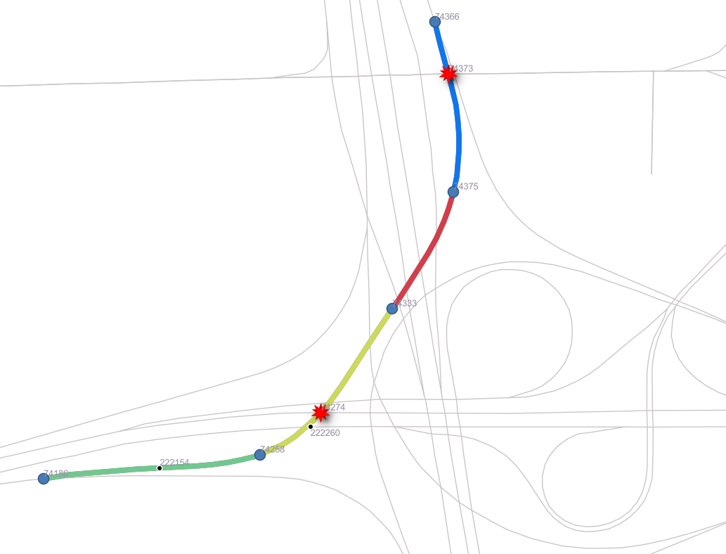
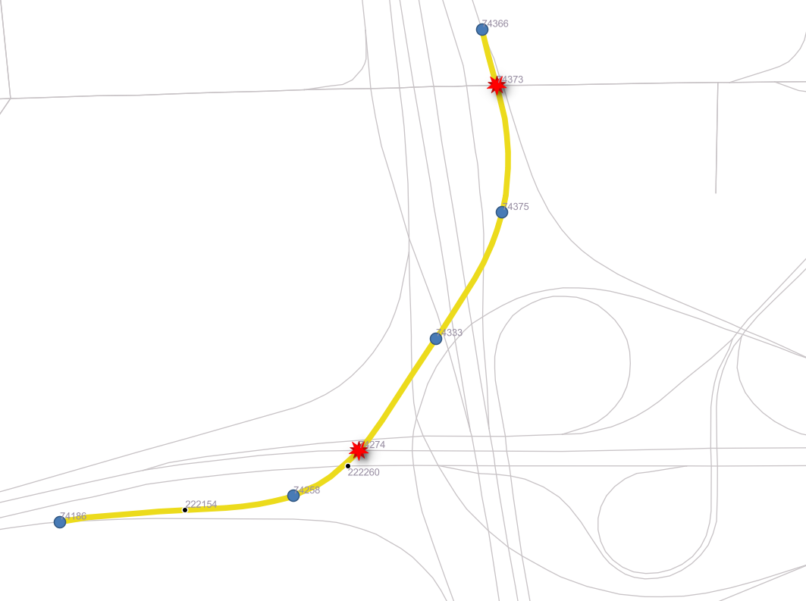
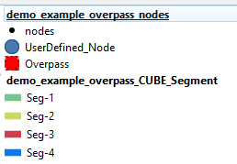

Program Insights:
Current Tool: Multiple Overpass Segments
New Tool: Single Overpass Segments
21
Notes:
At intersections and over (under) passes is where we need to add intelligence to the code to be able to merge segments, arcs, correctly. Trying basically to merge them if they share the same attributes such as number of lanes, speed, functional type, etc.

Slide 22
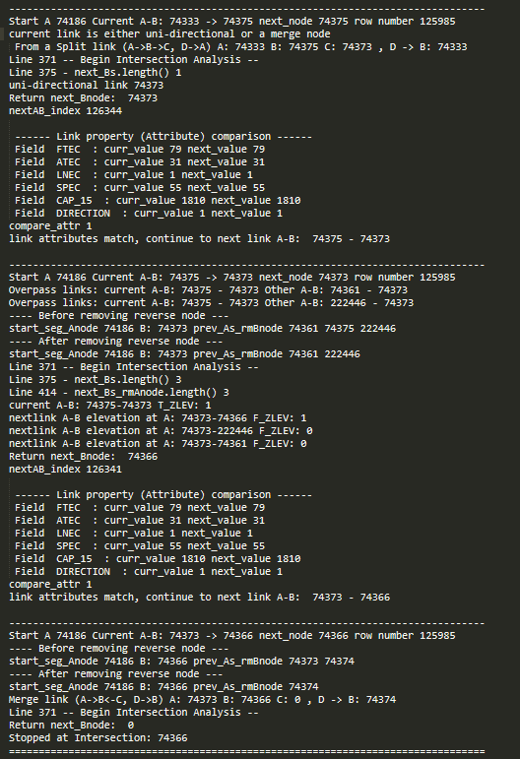
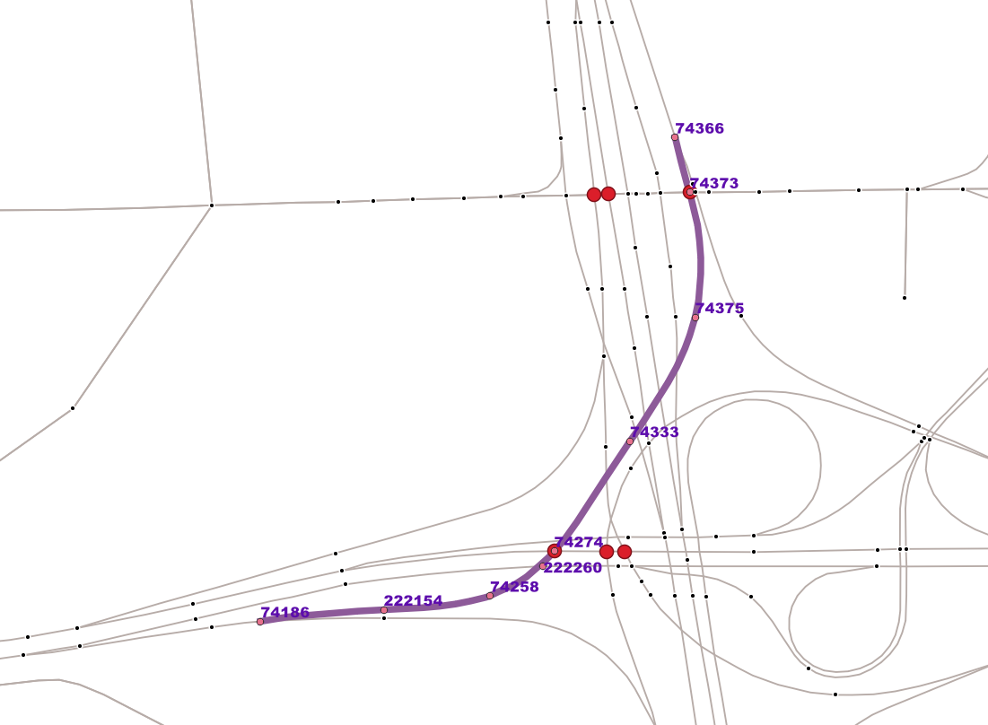
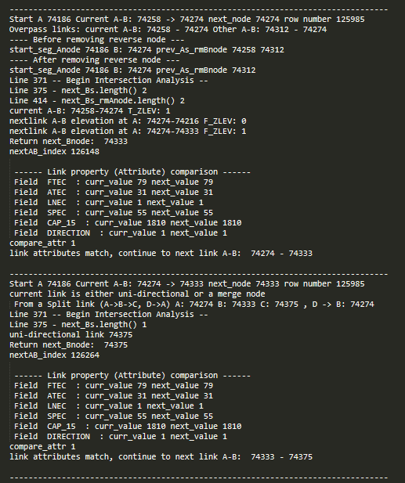
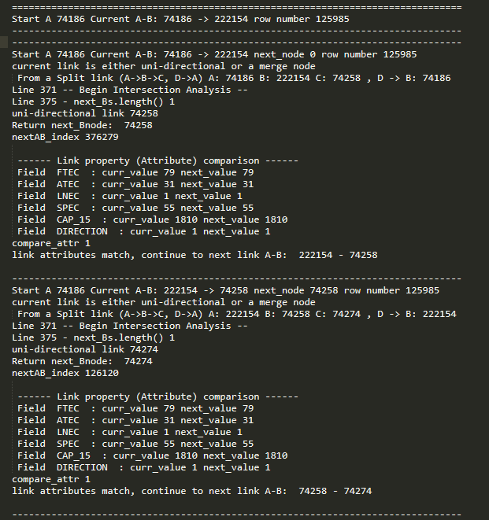
Program Insights:
Program log file: Identifies and classifies various types of intersections
Network: Overpass A -> (a1 … a6) -> B
B
a₁
a2
A
22

Slide 23
Multi-Spatial Resolution
Notes:
One application of the MTO tool is the MSR

Slide 24
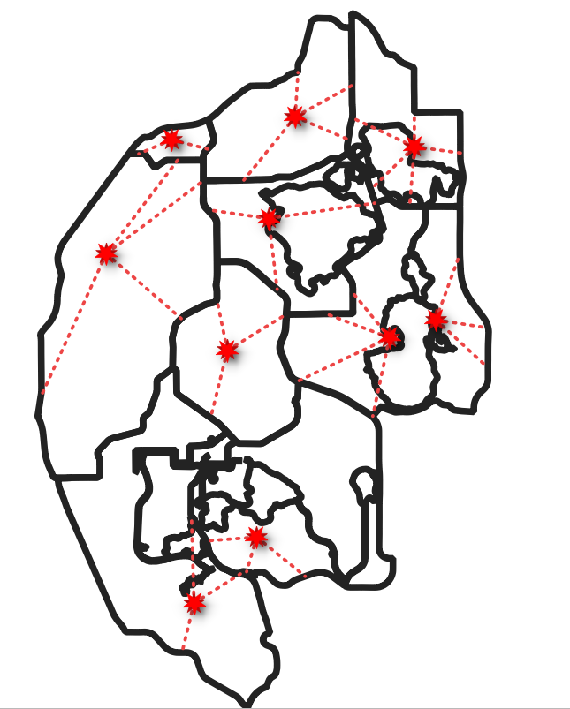
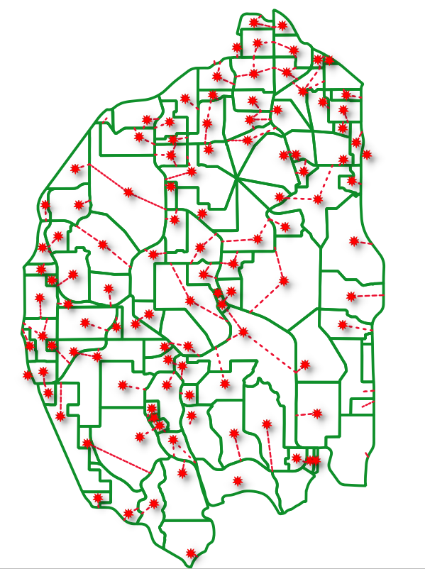
Multi-Resolution: Import Regional TAZ and Networks
10 TSM Zones
110 CFRPM zones
Process:
Discard 10 TSM
  Centroids
  Centroid connectors
Import 110 CFRPM
  Centroids
  Centroid connectors
3. Run Many-to-One tool
24
Notes:
For specific project study areas, we want to increase the TAZ and hwy network resolution: TSM in this example has 10 zones and the FDOT D5’s CFRPM has 110. Without losing the external trips around the project we add more and better loading points to provide better project assignments. We now have code to automate this regional model detail, into the TSM so that we can then generate a better loaded network.
(Skip the rest below if no available time)
Lets say we have a TSM subarea with 10 large zones consisting about 25k trips. This is a real zone systems (area between SR -429, Turnpike, I-4 and Disney) cover by only 10 TSM zones. Instead of traditional trip table of 10 x 10 OD with 25K trips, we now have a trip list with 25K rows with each row representing one trip.
Now say we need to split this into 100 zones (which are CFRPM zones for this area in new CFRPM v7 model). It’s pretty simple to do. Just change the O and D zones to Osub and Dsub zones
There are far more advanced methods than just recoding O and D zones. In one method, then entire model is re-run from popsyn to here when the socio-demographics are changed. Same thing on destination end, when we add more destinations the model needs to re-run at the subarea level and the resulting trips need to be scaled back to original large system trips to ensure consistency.

Slide 25
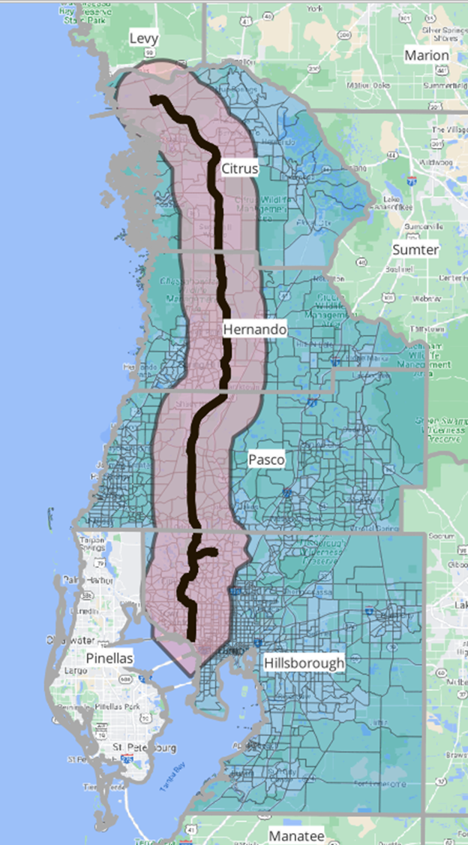
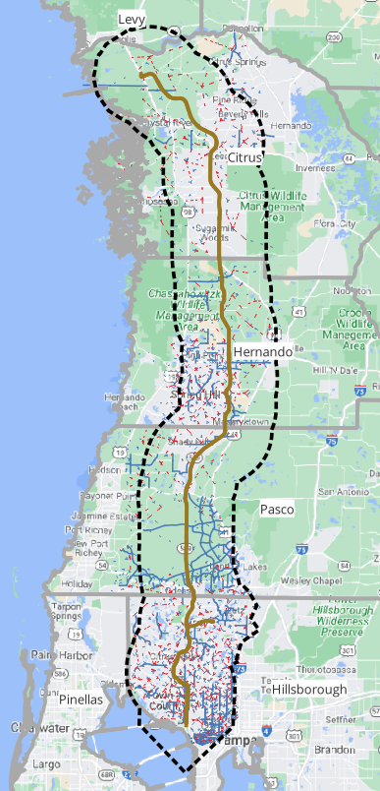


Zones with 5 Mile Buffer
Those 332 Zones will add 584 future roadways that are not in NextGen.
Roadway Network within 5 Mile Buffer
Notes:
This is an example within Tampa Bay where we needed a better resolution to handle future competing roadways that were not coded in the original larger TSM TAZs. By adding more resolution using the TBRPM model zones and highway network we were able to solve an overloading on the Suncoast Pkwy. In Pasco Co.

Slide 26
ELToD or Macro-DTA Assignment
Notes:
Our assignment application is ELToD

Slide 27
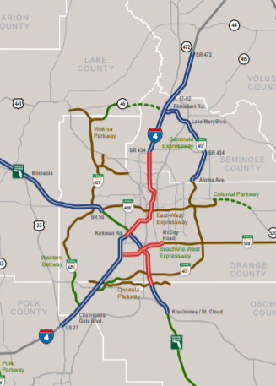
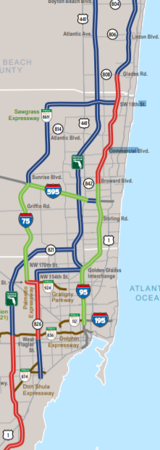
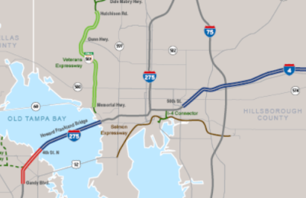
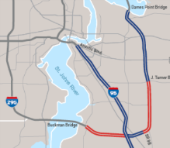
What is the ELToD Model?
Express Lanes Time of Day (ELToD) model is a traffic assignment model to forecast traffic and toll rates for Express Lanes in Florida
Four-Step Model
Activity-Based Model
Trip Generation
Activity Generation & Scheduling
Trip Distribution
Destination Choice
Mode Choice
Mode Choice
Traffic Assignment
Traffic Assignment
ELToD Model
ELToD Model
Notes:
It became a misnomer recently since FDOT wants to use managed lanes or thru lanes, but the tool still works turning on, or off, toll policy parameters or decision making nodes if using or not express lanes.

Slide 28
ELToDv4 Flow Chart
ELToDv4 Design and Features
Activity-Based Model
Read Trips Table
or
Four-Step Model
Read Network
Path Building
Time Dependent Shortest Path
Load Packets
Split Packets at Decision Nodes
Mixed Logit Toll Choice Model
Update Time
Toll Policy Curve
Update Toll
No
Technology Variables (e.g.CAVs)
CheckConvergence
Queue Spillback
Yes
Write Output
Current Design
New Design
28
Notes:
We could theoretically load the Statewide model every 15 minutes, but for fixed toll facilities hourly or daily level might be sufficient.

Slide 29
Scenario Planning
Notes:
Moving into scenario planning, we first want to mention Mobilitics

Slide 30
Mobilitics

Slide 31
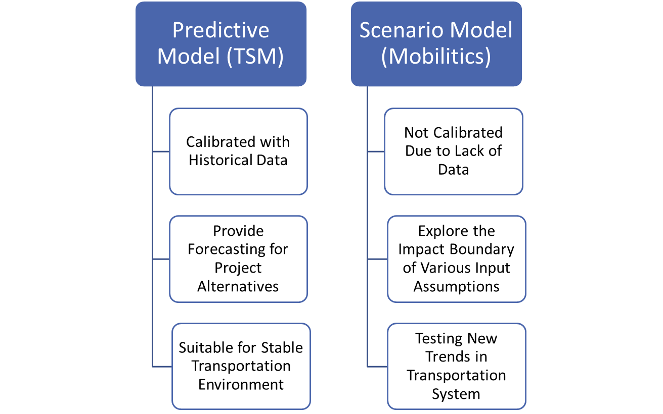

Mobilitics: Design
Stand-alone process
Use existing TSM model runs
Meta-model to simulate scenarios
Designed for high-level studies such as Traffic Trends
Source: AECOM at FTE
Notes:
It’s a strategic planning tool, based on the TSM model runs. A meta-model is developed from those runs and several submodels run in the background to quickly change parameters based on user input. The purpose is to explore the impact boundaries of various input assumptions.

Slide 32
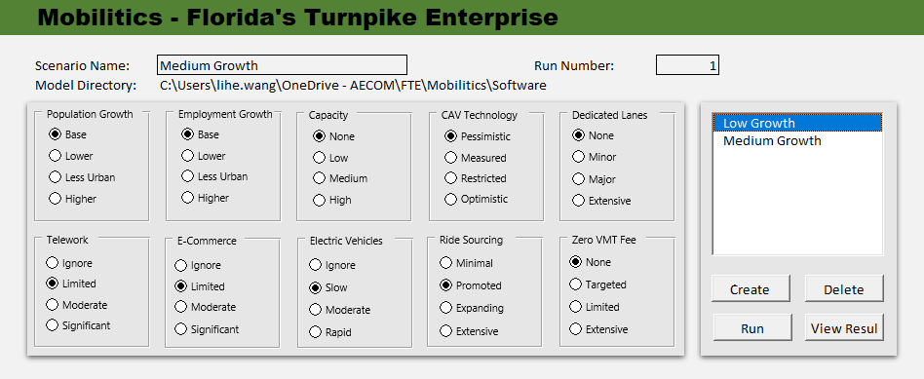
Mobilitics: Input Variables
CAV Adoption (Penetration) Rate
Road Capacity Factor
Socioeconomic data
Ride sharing (MaaS)
Value of Travel Time Savings (VTTS) Factor
Work-from-Home,
e-commerce
Other policy driven variables
Source: Data inputs interface developed for Mobilitics – FTE version
Notes:
For now we are mostly interested in CAV impacts on our facilities, but as you can see in the image on the right side, many variables could be selected at once, labeled as the user desires, and run up to 5-10 of those in minutes.

Slide 33
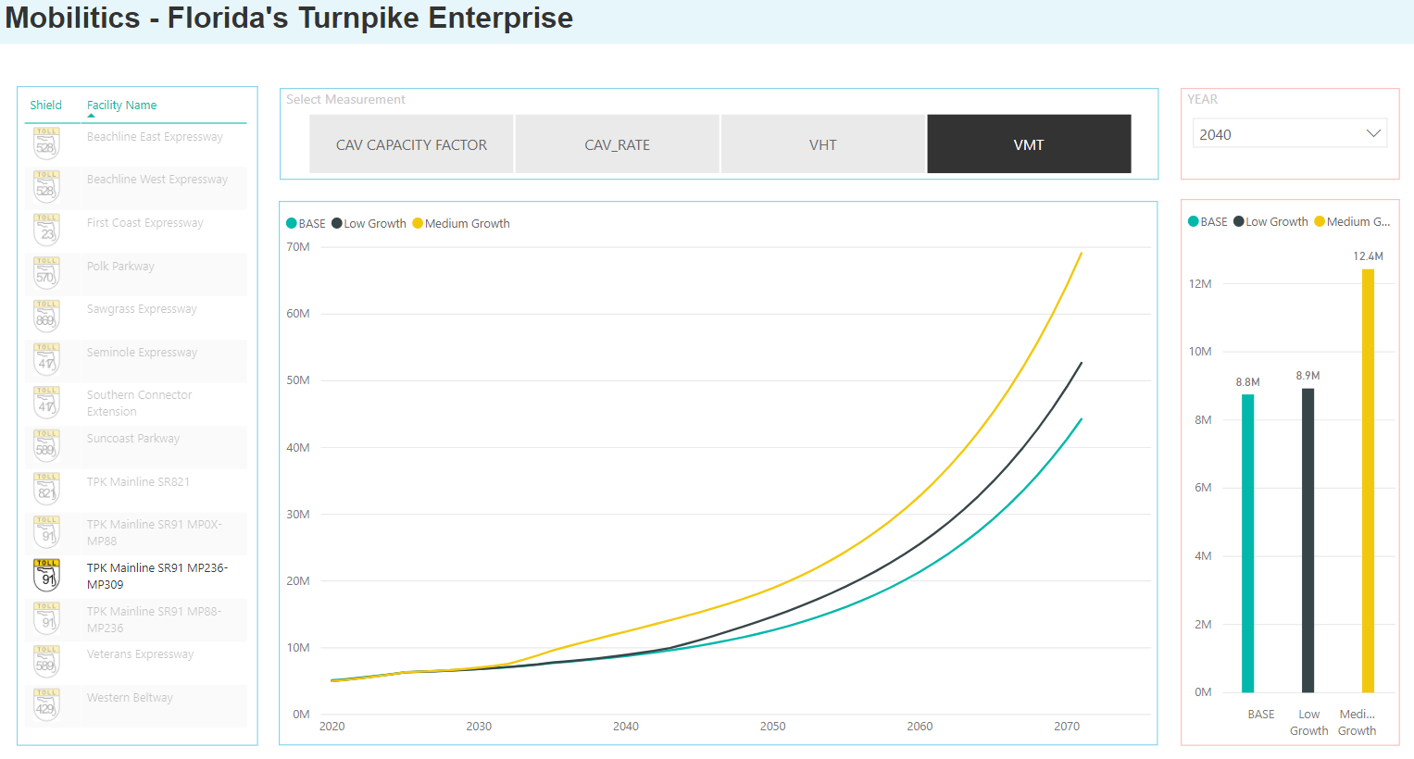
Mobilitics: Model Output
Measures of Effectiveness by System Component
  Vehicle Miles Traveled (Demand Changes)
  Vehicle Hours Traveled
  CAV Penetration Rates
  Capacity Factors
Source: Mobilitics for FTE, draft dashboard
Notes:
We can quickly share the results in this Power BI application. Any FTE facility could be selected, the parameter of interest, the year, and the graphics either curve format or bar charts display the results.

Slide 34
Risk Analysis
Notes:
All T&R forecasts either at the Planning Level or Investment Grade needs to go through a Risk Analysis

Slide 35
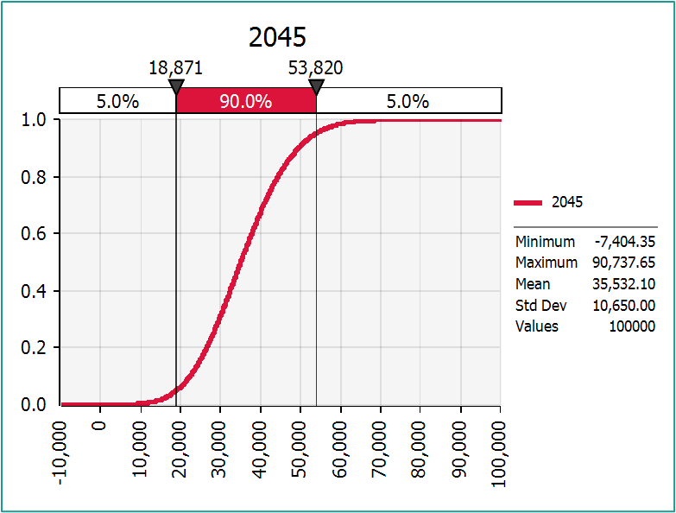
- Uncertainty in Land Use (around the project)
- Uncertainty in Committed Roadway Network
- Uncertainty in Economy (Jobs / Incomes / Willingness to Pay)
Risk & Uncertainty Analysis: How to Model
Uncertainty in Economy is toughest to model
Traditional methodology uses one mean VOT (CTOLL) for base model and uncertainty is modeled via VTTS by varying CTOLLS
NextGen base model uses distributed VTTS for better representation of willingness to pay. So, income uncertainty is modeled varying the “underlying assumption” that current 2019 Income distribution could vary
35
Notes:
The most common variables to include are shown in the slide. The idea is to run multiple combinations of these in the opening and design years of the projects to generate, via a montecarlo simulation, a frequency distribution. At the FTE we use what we call the P90 transactions, or the value that have a 90% chance of happening for that specific target year.

Slide 36
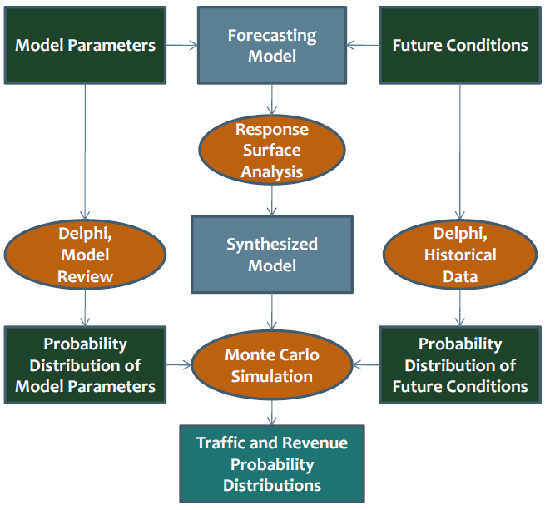
Risk & Uncertainty Analysis - How to Model
Methods for Quantitative Risk Analysis for Travel Demand Model Forecasts Adler, Doherty, Klodzinski and Tillman. TRB paper, August 2013
36
Notes:
Our design of the risk analysis. I’m not gonna go over this but I’m available for questions later on.

Slide 37
Decision Making under Deep Uncertainty (DMDU)

Slide 38
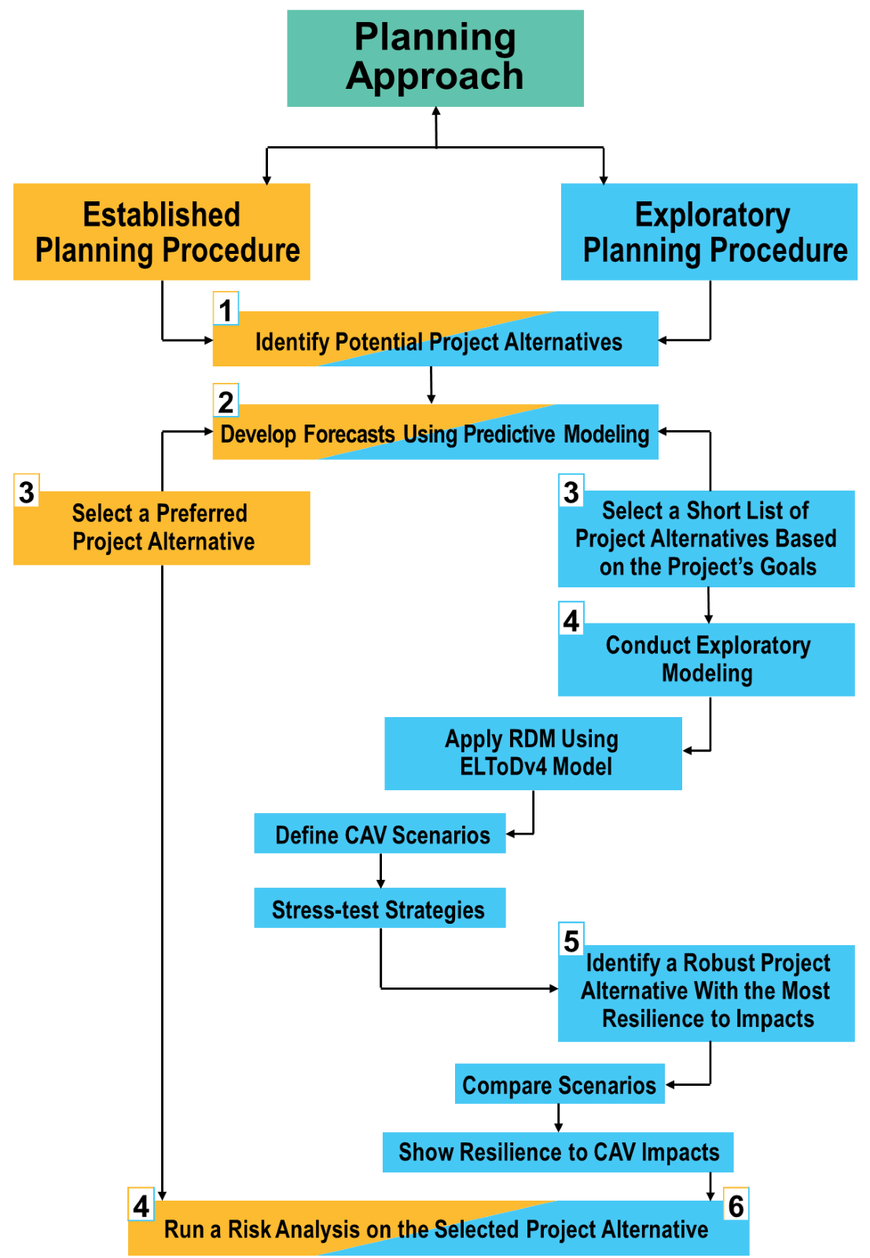
Addressing DMDU
Addressing Deep Uncertainty of CAV Impacts on Managed Lanes with an Enhanced Dynamic Traffic Assignment Model , Klodzinski, et al. TRB paper -2021, not published yet
38
Notes:
This is a new thing that we are doing some research on: Jack Klodzinski and LIhe Wang wrote a paper and presented at TRB a couple of years ago, but it became more attractive due to COVID and the CAV uncertainties. Jack presented on the MTF by the way a couple of year ago as well on this topic. You can look it up on FSUTMSOnline.

Slide 39
Other Topics

Slide 40
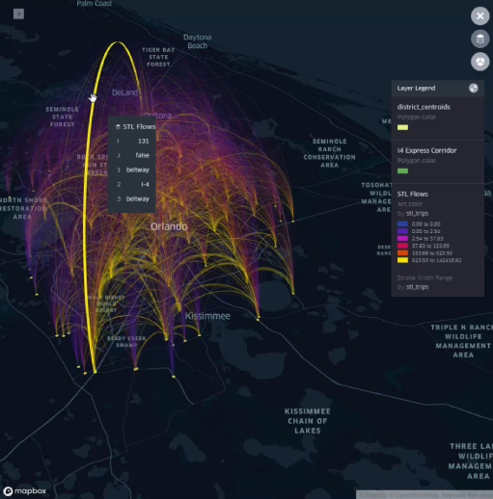
Proposed O-D Data Project
FTE/RSG/AECOM partnership project
Develop new cost-effective solution for O-D data analyses
Utilize existing RSG procedure for O-D data processing
Expand current O-D capabilities to refine process for FTE needs and automate procedure
Portal for standardized team access to automated procedure with no geographic or time restrictions
Data source: StreetLight Data
40
Notes:
OD-Data project: AT FTE we wanted to avoid the limitations imposed by private vendors, so we started with RSG a project to have our own OD data processing/access. This is just starting now, and initially will be limited to Turnpike facilities.

Slide 41
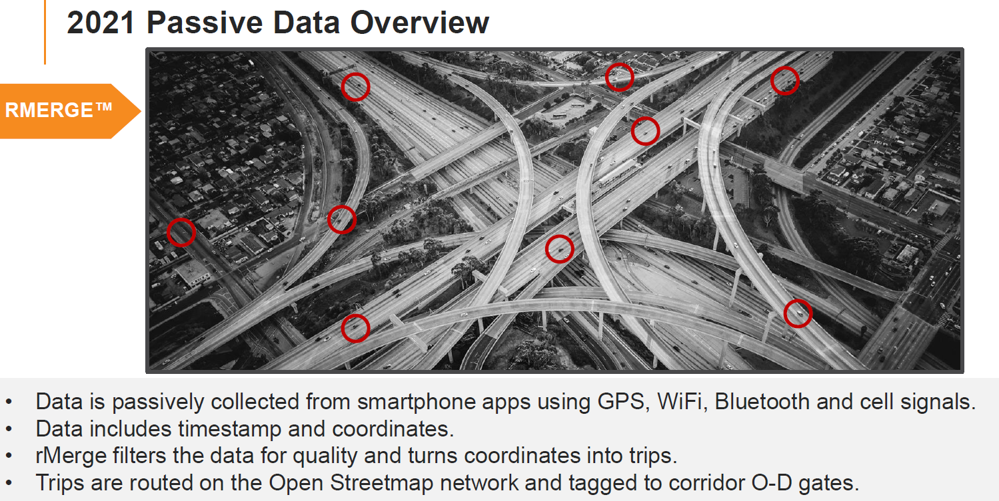
Proposed O-D Data Project
Data source: RSG, 2022
41

Slide 42
GAMS Tool for High Level Traffic Forecasting
Work
Program Development
High-level Screening Tool
Current Mobility Trends
Traffic Forecasts
Prioritized Needs
42
Notes:
GAMS is an optimization software that Hongbo is very familiar with that we use for our annual traffic trends projections exercise.

Slide 43
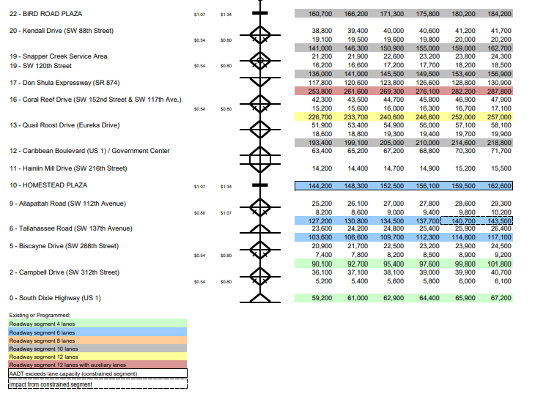
Traffic Trends Forecasting Process
Growth factors are updated annually for each facility and applied to obtain initial traffic forecasts for years 2020-2050, in 5-year increments
Traffic profiles are balanced / reconciled to satisfy various constraints:
    Comparison to TEAR and project forecasts
    (Model based)
    Impacts of new interchanges
    Minimum growth
    Decreasing growth trend
    Interaction between connected facilities
Forecasting effort identifies capacity
deficiencies by comparing future traffic
demand against available capacity to
identify unfunded needs
43
Notes:
For all FTE facitilies we develop unconstrained traffic to help identify needs and possible candidates for the annual work program. The smoothing and balancing of the traffic profiles as the one showing in the image, could be vey time consuming if doing it “by hand” The 3T application based on GAMS does solve this problem, very quickly for the entire FTE system.

Slide 44
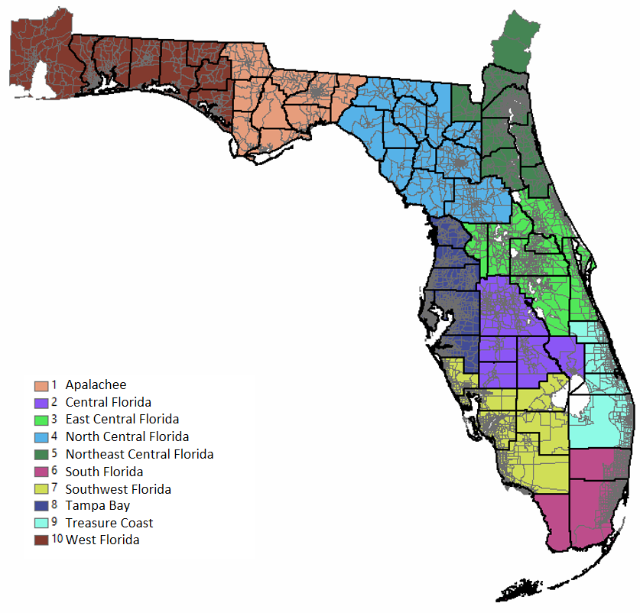
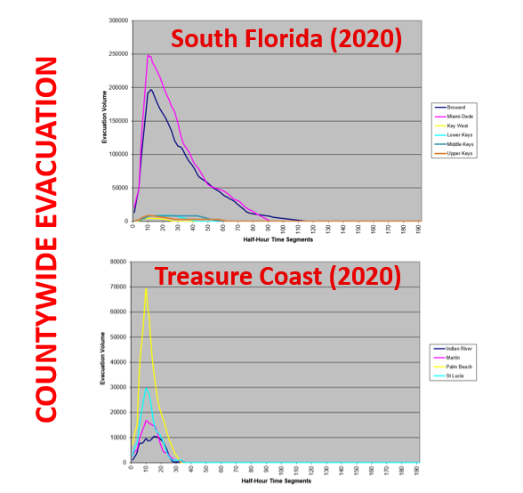
TIME Model: Hurricane Evacuation by Regional Planning Council
44
Notes:
10 Regions
TIME model is a software developed by the Florida Division of Emergency Management which we edited to be able to use it in project planning applications. Many PD&E’s purpose and need statements list hurricane evacuation as one of the projects objectives. We modified the inputs to match our population control totals and most recent hwy network from our TSM to run no-build/build scenarios for the project opening years to quantify any improvements in the evacuation clearance time within the study area or adjacent counties as needed.

Slide 45
Project Management

Slide 46
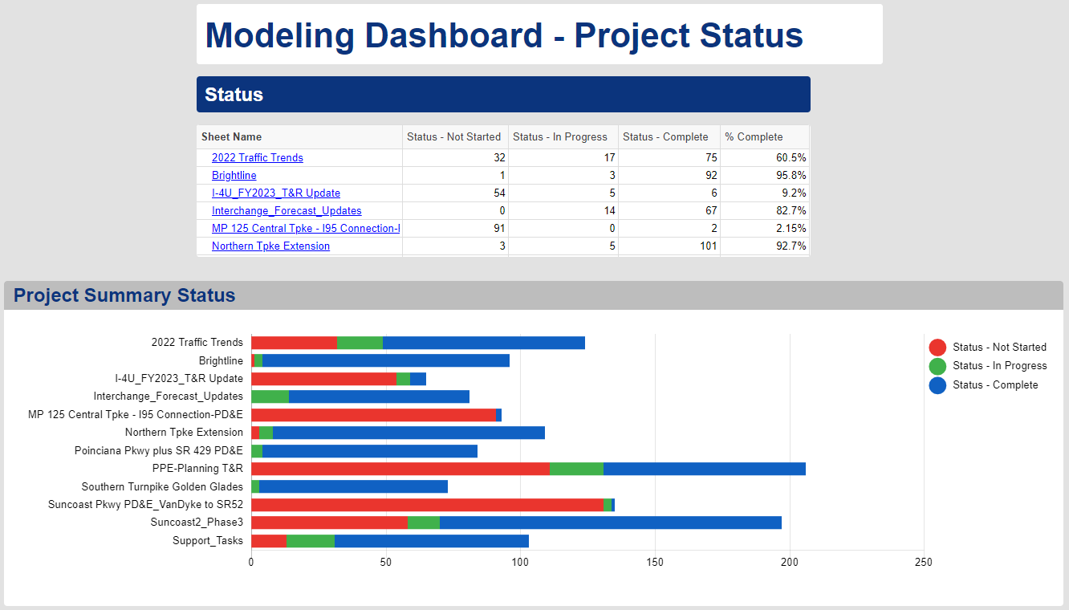
Current Project Status
https://app.smartsheet.com/b/publish?EQBCT=dded4290cf714581b9403e5f79a513fd
46
Notes:
An interesting application that we’ve been using for some time now is “smartsheet”: It allows us to keep track of the project schedules, (click on the link of project status, Poinciana PD&E for example). It also allow us to keep our Client and Program Managers up to date on the project status.
(Minimize the sheet, don’t close it to go back to the presentation)

Slide 47
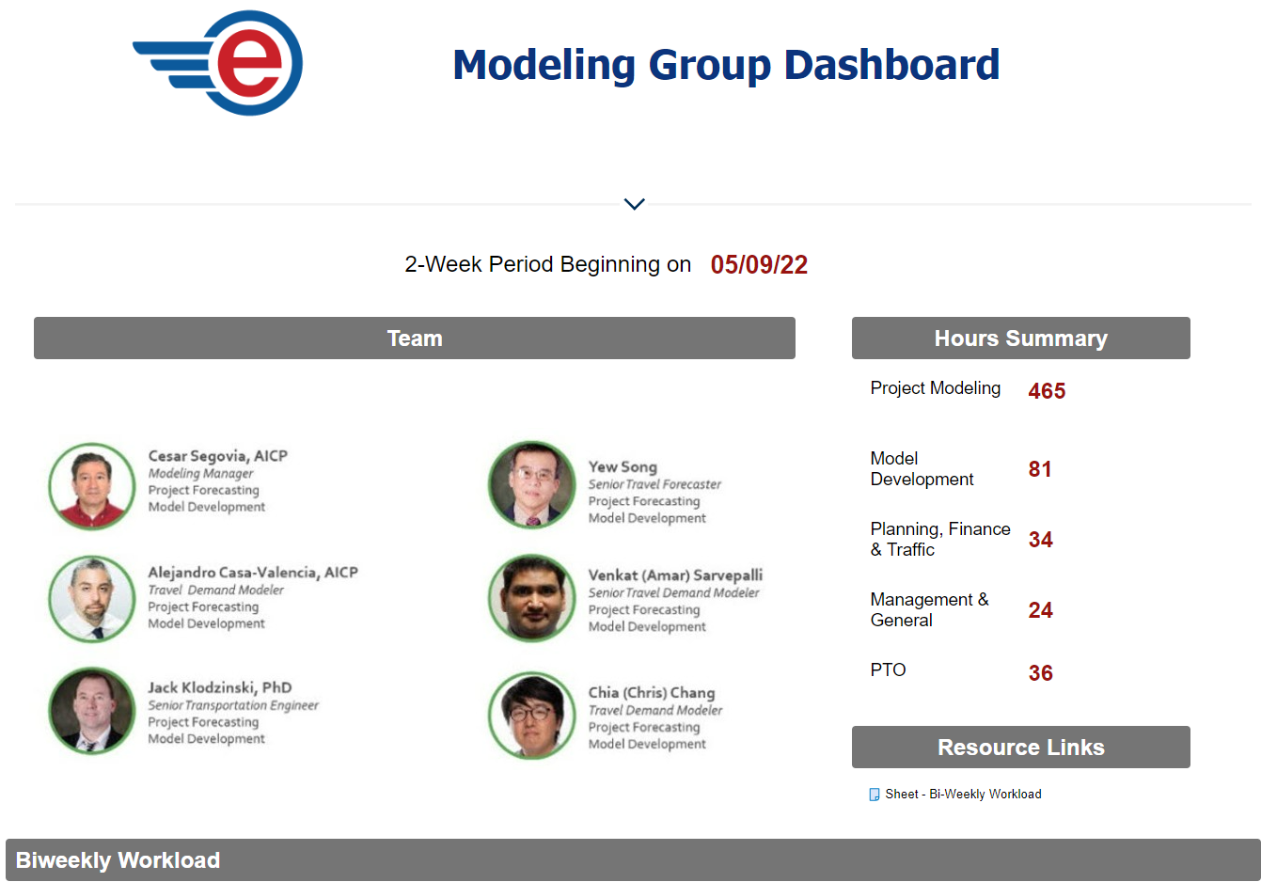
Team Members & Workload
https://app.smartsheet.com/b/publish?EQBCT=c3b624928f8947209ff03ad15f9270a1
47
Notes:
This other Smartsheet dashboard keeps track of what everyone is working on: (Click on the other smartsheet, present the modeling team members!! Minimize it to go back to the presentation

Slide 48
Challenges
Notes:
And these are the challenges….

Slide 49


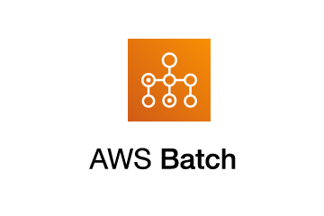


Cloud Computing: Flowchart
Input
Output
Program
Control
49
Notes:
Cloud computing: We have intense modeling applications and projects that requires expensive computers around $12k to acquire one desktop, six of us makes for a good budget already.
Using snowflake and amazon web services (aws) we tested one model configuration, which we run under several AWS packages and EC2 instance types which comprise of varying combinations of CPU, memory, storage, and networking capacity.
From Spot Instances - Amazon Elastic Compute Cloud

Slide 50
Test: TSM CAV Model Run Time and Cost
90 million unique OD trips (10 classes, 24 time intervals)
172 thousand links
TSM CAV Model 30 iterations
EC2 SPOT instance
m5zn family (4.5GHz)
EC2 Instance | Cost per hour (SPOT)
m5zn.3xlarge | $ 0.210
m5zn.6xlarge | $ 0.410
m5zn.12xlarge | $ 0.820
50
Notes:
A Spot Instance is an instance that uses spare EC2 capacity that is available for less than the On-Demand price. Because Spot Instances enable you to request unused EC2 instances at steep discounts, you can lower your Amazon EC2 costs significantly. From Spot Instances - Amazon Elastic Compute Cloud
The run time and cost are shown in the graph and those numbers are still a bit high for one model run or scenario, because we would normally run between 50-100 scenarios for any given project sometimes more depending on project alternatives and calibration/validation requirements.

Slide 51
Other Challenges
Knowledge Gap
Data science
Data mining
Computer Science
Big Data
AI algorithms
Agent-based type of modeling
51
Notes:
Other challenges include:
Big data for short term forecast using AI algorithms and the next generation of agent-based models.
Knowledge gap: data science combined with computer science and their application to transportation modeling in terms of human resources is a big one. Hard to find people with those types of individual or even combined expertise.

Slide 52
Questions?
Contact Information:
Cesar.Segovia@dot.state.fl.us
Notes:
And that’s the end of this presentation, If we don’t have time for questions, I’ll be happy to respond via email.
Thank you!!

