Slide 1
PopulationSim Introduction and Implementation
Jawad Hoque, Ph.D.
jawadmahmud.Hoque@wsp.com
WSP SAG

Slide 2
Presentation Outline
What is PopulationSim?
How to setup and configure PopulationSim?
SERPM8 Implementation Validation Statistics
Comparison with PopSynIII Results

Slide 3
What is PopulationSim? Overview
A new population synthesis tool
Software written in Python
Simple setup and usage
Robust algorithm
Very flexible geographic definition
Able to work with small sets of geographies without impacting the rest of the region.
Open-source
Well-documented and regularly maintained
Notes:
So what is populationsim? Very briefly, it is an open source software that creates synthetic population for any activity based model run. Like FHWA’s TRANSIM or PopSyn, this too creates a list of households and the persons in each household that represent the actual people that live (or are expected to live in the future) in a city, region, or state. Key advantages of PopulationSim over the previous iterations are that it is very easy to setup and use. It is faster and employs a robust algorithm. It is flexible in terms of the geography, e.g. PopSynII can only work with three geographic levels while this one can work with more. It is as I said open source, written in python and it is very well documented and maintained.

Slide 4
What is PopulationSim? Setting Up
Installation
Python Distribution and Conda Package Manager
Install PopulationSim Python Package using Conda
conda create -n popsim python=3.8
activate popsim
pip install populationsim
Test the setup using the github repository for PopulationSim as well.
Notes:
PopulationSim is available as a Python package, and like all python packages you install it using a conda package manager, like anaconda for example. There are a few different versions of prerequisite packages for PopulationSim and you need to make sure that they don’t mess up your usual build. So what we do first is to create a separate PopulationSim or ActivitySim environment. After that installation is as simple as typing pip install populationsim. No more do you have to wrestly with SQL setup.

Slide 5
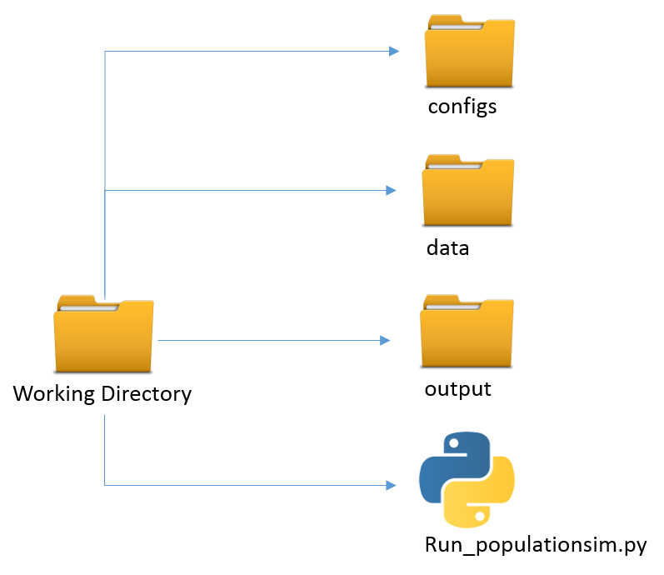
What is PopulationSim? Directory Structure
settings.yaml: yaml-based settings file to configure a PopulationSim run
controls.csv: CSV file to specify controls
Marginal control totals at each spatial resolution
Geographic crosswalk file or the hierarchical structure of geography
Seed sample of households and persons.
run_populationsim.py
Notes:
The folder structure follows a cookie cutter data science project structure. You have the configs directory where you store all the settings files that configures a PopulationSim run.

Slide 6
What is PopulationSim? Usage
No SQL database
Reads and writes comma-separated value text files
Easy to configure
Yaml based configuration
Trace functionality
Able to produce a lot of output files.
All tables are stored in an intermediate Hierarchical Data Format (HDF5) binary file that allows restarting from any point
Validation framework included

Slide 7
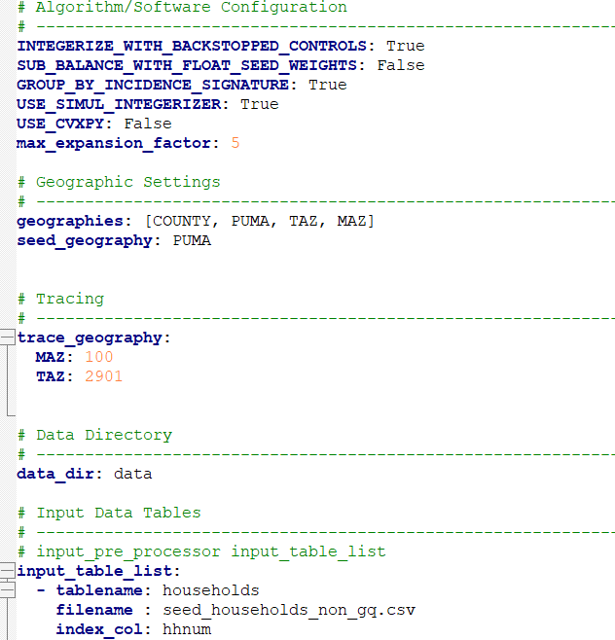
What is PopulationSim? Inputs Required
A config/settings file
Geography, input definitions
Trace capabilities
Model steps
Output fields

Slide 8
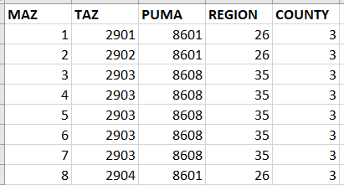
What is PopulationSim? Inputs Required
A geographic cross-walk file
Hierarchical structure of geography [Meta, Seed, Subseed]
Define Hierarchy in the config file
Point to the Geo Crosswalk file in the config
The Geo Crosswalk file

Slide 9
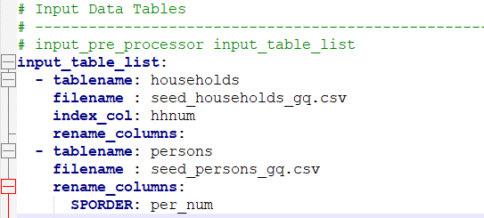
What is PopulationSim? Inputs Required
Input household and person ‘seed’ data
American Community Survey (ACS) Public Use Microdata Sample (PUMS)
There can be more than one seed sample
Define Seed Geography in the config file
Define Seed Files

Slide 10
What is PopulationSim? Inputs Required
Controls for each geography
Can be just one control file for TAZs
Can be separate controls for Districts, TAZs, MAZs, Blocks, etc.
Any control can be used (so long as it can be mapped back to seed data)
Define Control Files

Slide 11
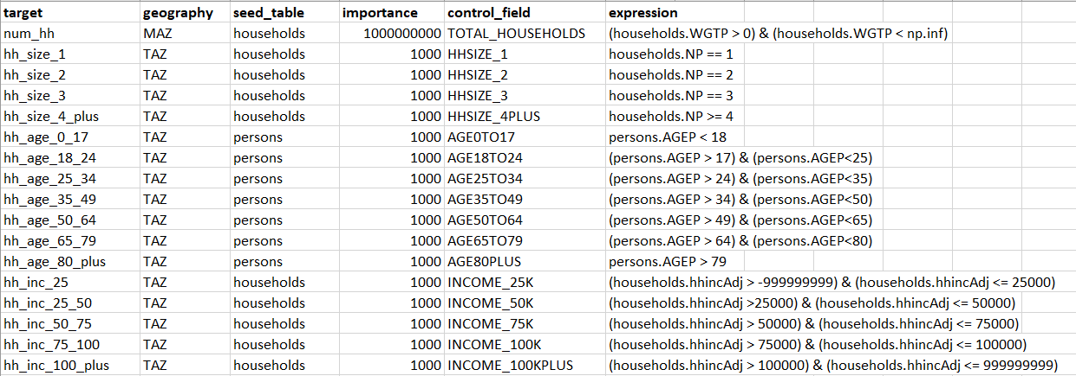
What is PopulationSim? Inputs Required
A file that describes how to map controls to seed data with valid python expressions
Define Control Specification File in the config

Slide 12
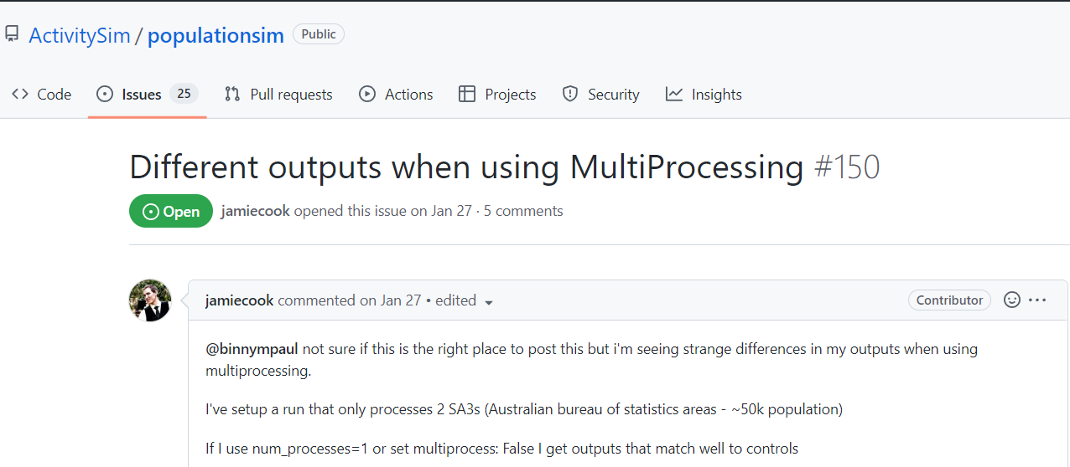
PopulationSim Added Features Multi Processing
Uses ActivitySim’s Multiprocessing feature to reduce runtime.
Configured using a different config file
Bugs exist!

Slide 13
PopulationSim Added Features Repop Mode
Create new population in a small part of the region
Don’t change the rest of the population
Different set of controls, like number of households by type of dwelling
The Repop feature does this
Two options
Add to existing population in selected geography
Replace existing population in selected geography

Slide 14
SERPM8 Implementation Overview

Slide 15
SERPM8 Implementation Overview
Uses the same controls, geography and seed as PopSynIII
Swapped the seed sample from ACS 2007-11 5 Year PUMS to ACS 2016-2020 5 Year PUMS.
Testing integration to CUBE
Able to create seed
Check control totals for validity
Automatically update config files for different Years/Scenarios
Postprocess synthetic population

Slide 16
PopulationSim Results Validation

Slide 17
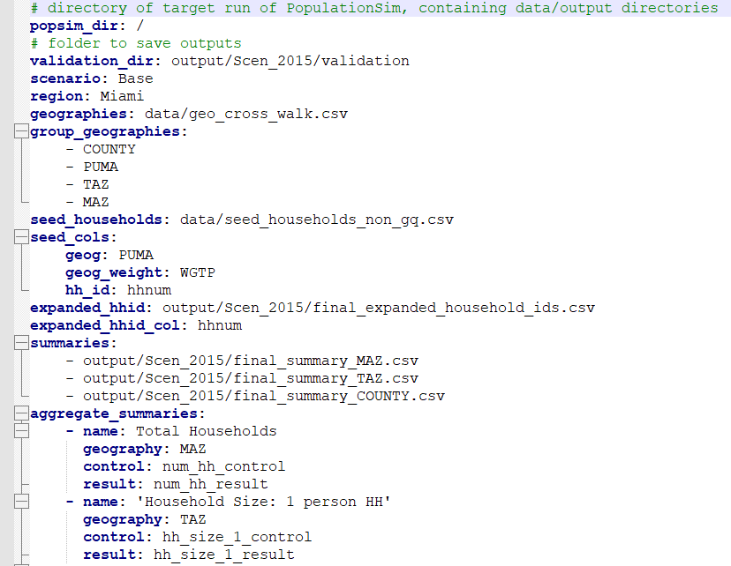
PopulationSim Result Validation Overview
PopulationSim reports the difference between the synthesized totals and the control totals for all the controls at each geographic level
Specified using another yaml file (validation.yaml)
Run using validation.py script
Creates summary statistics, comparison plots

Slide 18
PopulationSim Result Validation Summary Statistics for 2015 Scenario

Slide 19
PopulationSim Result Validation Summary Statistics for 2015 Scenario

Slide 20
PopulationSim Result Validation Summary Statistics for 2015 Scenario

Slide 21
PopulationSim Result Validation Summary Statistics for 2015 Scenario

Slide 22
PopulationSim Result Validation Summary Statistics for 2015 Scenario

Slide 23
PopulationSim Result Validation Summary Statistics for 2015 Scenario
Control | Control Totals | Difference Between PopSynIII and PopulationSim Results (Total) | Average Absolute Percent Deviation across the Geographic Unit, PopSynIII | Average Absolute Percent Deviation across the Geographic Unit, PopulationSim
Total Households | 2,207,563 | - | 0% | 0%
Household Size: 1 person HH | 613,784 | 542 | 1% | 1%
Household Size: 2 person HH | 697,081 | 110 | 1% | 1%
Household Size: 3 person HH | 365,718 | (176) | 2% | 2%
Household Size: 4+ person HH | 529,393 | (493) | 2% | 2%
Householder Age: 0_17 years | 1,209,094 | (725) | 2% | 2%
Householder Age: 18-24 years | 498,090 | (55) | 4% | 3%
Householder Age: 25-34 years | 780,253 | 83 | 3% | 2%
Householder Age: 35-49 years | 1,204,865 | 97 | 2% | 2%
Householder Age: 50-64 years | 1,129,544 | 256 | 2% | 2%
Householder Age: 65-79 years | 651,232 | 126 | 2% | 2%
Householder Age: >80 years | 283,033 | (115) | 2% | 2%

Slide 24
PopulationSim Result Validation Summary Statistics for 2015 Scenario
Control | Geography | Difference Between PopSynIII and PopulationSim Results | Average Absolute Percent Deviation across the Geographic Unit, PopSynIII | Average Absolute Percent Deviation across the Geographic Unit, PopulationSim
Household Income: (-Inf,25000) | 565,371 | 9 | 1% | 1%
Household Income: [25000,50000) | 552,601 | 76 | 1% | 1%
Household Income: [50000,75000) | 387,899 | (72) | 1% | 1%
Household Income: [75000,100000) | 239,404 | (134) | 1% | 1%
Household Income: [100000,+Inf) | 460,701 | 104 | 2% | 1%
Household Workers: 0 worker HH | 578,887 | 139 | 1% | 1%
Household Workers: 1 worker HH | 859,023 | 22 | 1% | 1%
Household Workers: 2 worker HH | 611,655 | 101 | 1% | 1%
Household Workers: 3+ worker HH | 156,411 | (279) | 3% | 2%
Household Type: Mobile Home | 49,523 | (204) | 6% | 3%
Household Type: Single Family Home | 1,187,612 | 159 | 4% | 2%
Household Type: Multi Unit | 968,841 | 28 | 1% | 1%

Slide 25
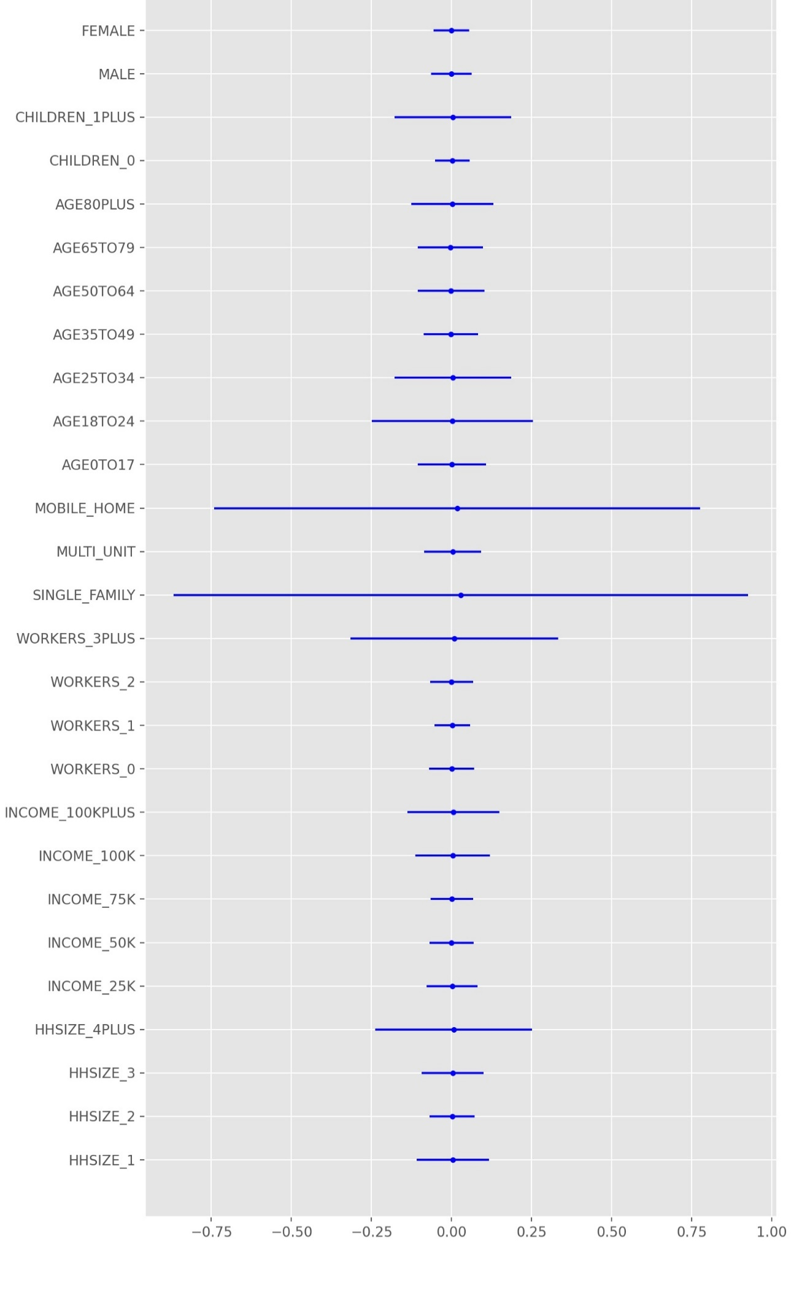
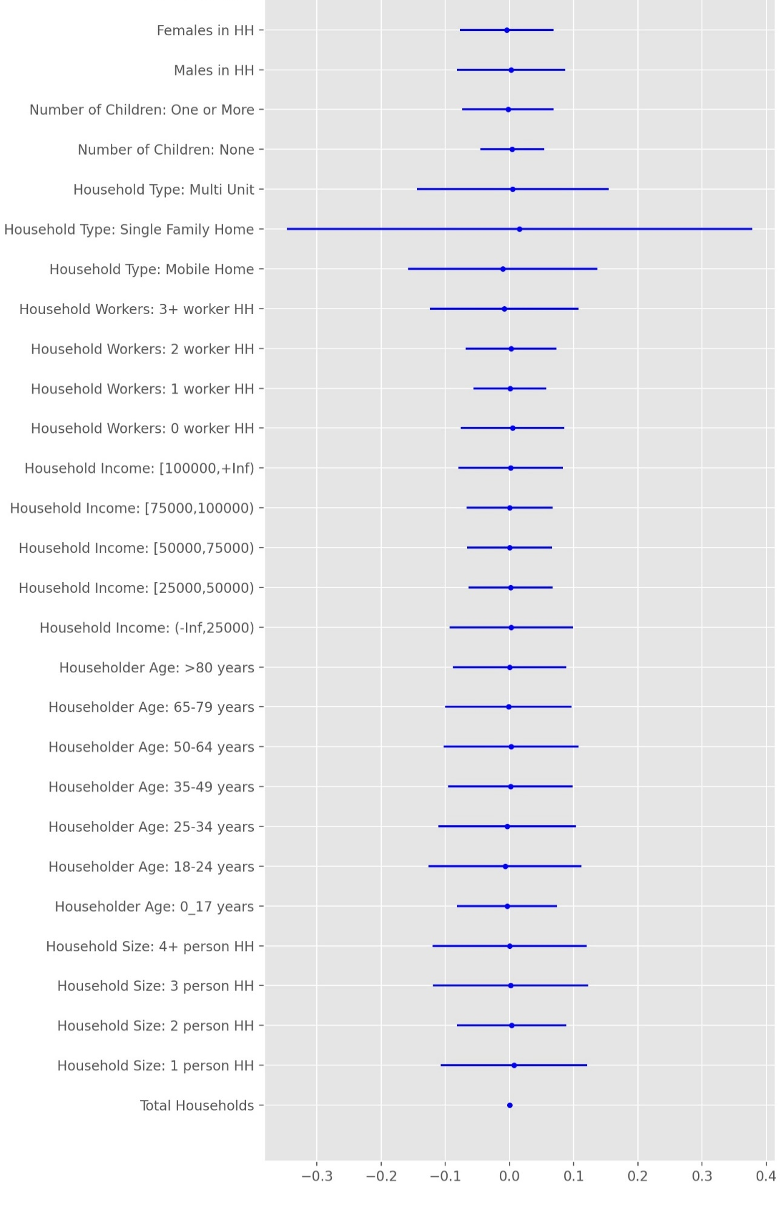
PopSynIII
PopulationSim

Slide 26
SERPM8 Implementation Comparison With PopSynIII Results: Control Totals

Slide 27
PopulationSim Result Validation Summary Statistics for 2045 Scenario

Slide 28
PopulationSim Result Validation Summary Statistics for 2045 Scenario

Slide 29
PopulationSim Result Validation Summary Statistics for 2045 Scenario

Slide 30
PopulationSim Result Validation Summary Statistics for 2045 Scenario

Slide 31
PopulationSim Result Validation Summary Statistics for 2045 Scenario

Slide 32
PopulationSim Result Validation Repop Mode
Needs the original synthesis
Tested Repopulating one single MAZ with updated Control Totals
Replaced the “existing” population in the zone with this new population.

Slide 33
PopulationSim Result Validation Repop Mode
 | Control | Repop additions | No Build Results | Repop Results | Difference in Repop additions from control totals
Geography | MAZ
Geography ID | 6470
Total Households | 2000 | 2000 | 219 | 2219 | 0
Household Size
1 person HH | 802 | 801 | 91 | 892 | -1
2 person HH | 673 | 674 | 74 | 748 | 1
3 person HH | 245 | 244 | 23 | 267 | -1
4+ person HH | 280 | 281 | 31 | 312 | 1

Slide 34
PopulationSim Result Validation Repop Mode Summary
Total runtime for repopulating a single MAZ: 3 minutes.
None of the other MAZs or TAZs had any changes to their original totals or population composition.

Slide 35
The Summary
PopulationSim and PopSynIII produce nearly identical results.
PopulationSim produce slightly better results as in lower absolute deviation in the smallest units of geography.
PopulationSim runtime around 70 minutes

Slide 36
The Summary
Repop Mode shaves time by a lot if the original synthesis is there.
Multiprocessing mode reduces runtime, but still unreliable based on experience.
Repop mode is still not compatible with multiprocessing.

Slide 37
Q&A
wsp.com

