Slide 1

A Simulation Platform for On-Demand Urban Air Mobility
Zhiqiang (Adam) Wu, PhD candidate
Yu Zhang, PhD

Slide 2


Simulation Platform Design – Introduction
Advanced Air Mobility (AAM) Mission is to help emerging aviation markets to safely develop an air transportation system that moves people and cargo between places previously not served or underserved by aviation – local, regional, intraregional, urban – using revolutionary new aircraft that are only just now becoming possible.
Urban Air Mobility (UAM) focuses on the transition from the traditional management of air traffic operations to the future passenger or cargo-carrying air transportation services within an urban environment.

Slide 3
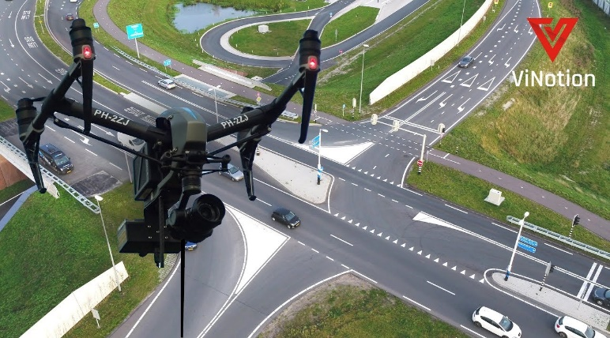


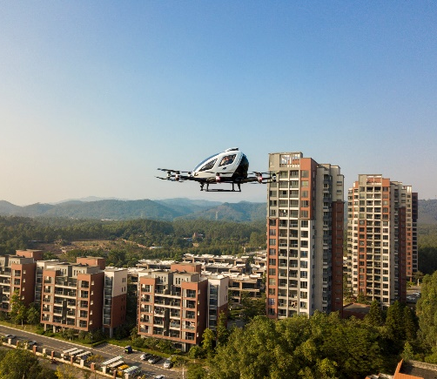
Introduction

Slide 4
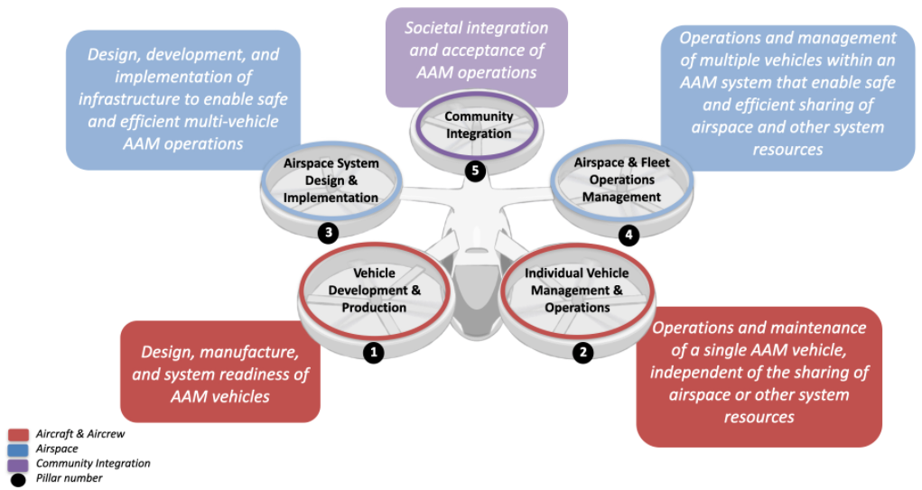
Simulation Platform Design – Introduction

Slide 5
Simulation Platform Design – Introduction
Figure 1. UAM Concept of Operation

Slide 6
Simulation Platform Design – Introduction
Figure 2. Hub-and-Spoke Network for UAM Service

Slide 7
Simulation Platform Design – Introduction
EVTOL Operation Features:
Station-based on- demand ridesharing service & scheduled service
  Origin & destination (OD) are fixed locations (i.e., vertiports)
  Vehicle operations are determined by real-time demand & route demand forecast
Electricity powered vehicle
Charging behaviors are conducted at OD
  Insufficient specific energy of the battery (the amount of energy per unit weight) requires frequent rapid charging to ensure continuous operations

Slide 8
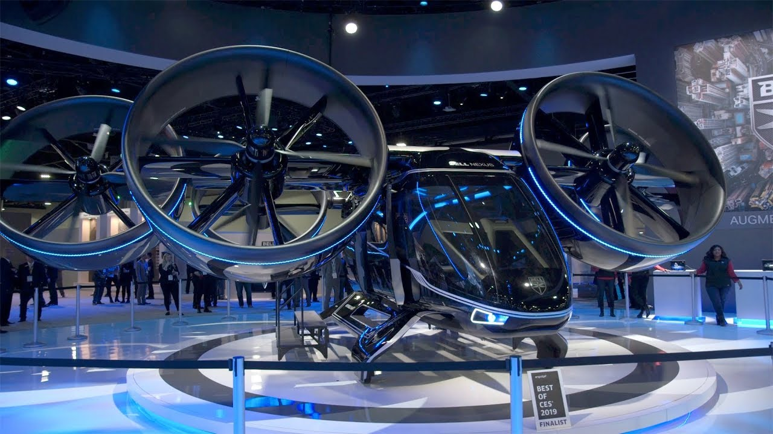
Introduction
UAM Aircraft Key Features:
Electric vertical takeoff and landing aircraft (eVTOL)
High degree of automation and distributed electric propulsion (DEP) technology
Capacity of 1-5 passenger
Cruise speed of 150 – 200 mph
Mission range 10 – 70 miles

Slide 9

Introduction
Elements for Future Vertiports:
Aircraft final approach and takeoff areas
Passenger boarding areas
Aircraft charging facilities
Space and facilities to accommodate various ground transportation modes
Integrate other business services

Slide 10
Simulation Platform Design – Introduction
UAM system for on-demand ride-sharing service performance concerns
Passengers: Level of service
Operators: eVTOL operational performance
Service providers: infrastructure and eVTOL fleet size supply

Slide 11

Simulation Platform Design – Problem Statement
Given the UAM network, eVTOL fleet size, vertiport infrastructure equipment, and passenger arrival distribution, the platform is designed to simulate the eVTOL operation and service process in the network over certain study horizon.
Vertiport
Vertiport
Vertiport
Vertiport

Slide 12
Simulation Platform Design - Objectives
Develop a platform to simulate the operation and service process of eVTOL over UAM network and enabled to evaluate the performance of the system.
The platform will be adopted as the foundation for finding the optimal infrastructure and eVTOL fleet size design.

Slide 13
Simulation Platform Design – Assumptions
There is no congestion in airspace and eVTOL cruise at a constant speed.
Time and energy consumption at each state is deterministic.
All the eVTOL in the network share the same property with respect to capacity, energy and time consumption at each state.
All vertiports have the same infrastructure structure design, including taxi-way, touchdown and liftoff pads and staging pads.
Within certain time horizon (e.g. 15 minutes), passenger arrivals can be known and generated in advance.
No trans-shipment of passengers at vertiports – that is, one trip goes through only two vertiports

Slide 14
Simulation Platform Design - Element Description
Vertiport Object
User Object
eVTOL Object

Slide 15
Simulation Platform Design - Element Description
Fixed input: Number of touchdown and liftoff pads, and staging pads, passenger arrival distribution
Vertiport Object
Status variables: facility occupation, passenger waiting queue, eVTOL status

Slide 16
Simulation Platform Design - Element Description
Fixed input : origin & destination (OD), arrival time
User Object
Status variables: vehicle assignment, out-of-vehicle waiting time, in-vehicle waiting time

Slide 17
Simulation Platform Design - Element Description
Fixed input: initial location, capacity, length of time and energy usage for each state
eVTOL Object
Status variables: State of Charge (SoC), seat occupation, destination, state information

Slide 18
Simulation Platform Design - Element Description
Table 1. Vehicle state definition and properties
State | Description | Hold Flag | Time (minutes) | Energy Consumption (SoC/min)
0 | Ready |  | Indefinite | 0
1 | Load | Yes | Indefinite | 0
2 | Taxi out |  | 2 | 0
3 | Take-off |  | 1 | 0.05
4 | Cruise | Yes | Dispatch Set | 0.01
5 | Land | Yes | 1 | 0.05
6 | Taxi in |  | 2 | 0
7 | Unload |  | 2 | 0
8 | Replenish |  | Indefinite | -0.04

Slide 19
Simulation Platform Design – Operation Rules
Passenger Service Rules
  First arrive, first serve.
  Passengers can take the same eVTOL as long as they share the same destination.
  Three Level of Service (LoS) parameters defined:
    LoS1 - The waiting time threshold of the first arrival passenger for a specific eVTOL
    LoS2 - The waiting time threshold of the last arrival passenger for a specific eVTOL
    LoS3 – The waiting time threshold for passenger to wait for an available eVTOL before switch to another transportation mode.
EVTOL Operation Rules
  EVTOL start to get charged once passengers are unloaded
  EVTOL finish charging once a passenger is assigned to it
  EVTOL can start service only when current State of Charge (SoC) satisfy the energy requirement (>= minimum reserve + energy required for the trip)

Slide 20
Simulation Platform Design – Input Data
UAM Network: distance matrix that defines the distance between any pair of vertiports.
Supply: Number of TOLFs and staging pads for each vertiport and number of eVTOLs at each vertiport before start of simulation.
Demand: Passenger demand distribution at each vertiport and predicted route demand for the study horizon.

Slide 21
Simulation Platform Design – Model Development
Define Time Units
  Study Horizon (H): Length of time for the whole simulation runs, e.g., 24 hours.
  Basic time unit (t): Length of time for each simulation iteration (step), e.g., 1 minute.
  Time slot (T): Length of time when exact passenger arrival time can be generated, e.g., 15 minutes.

Slide 22
Simulation Platform Design – Model Development

Slide 23
Simulation Platform Design – Model Development

Slide 24
Simulation Platform Design – Model Development

Slide 25
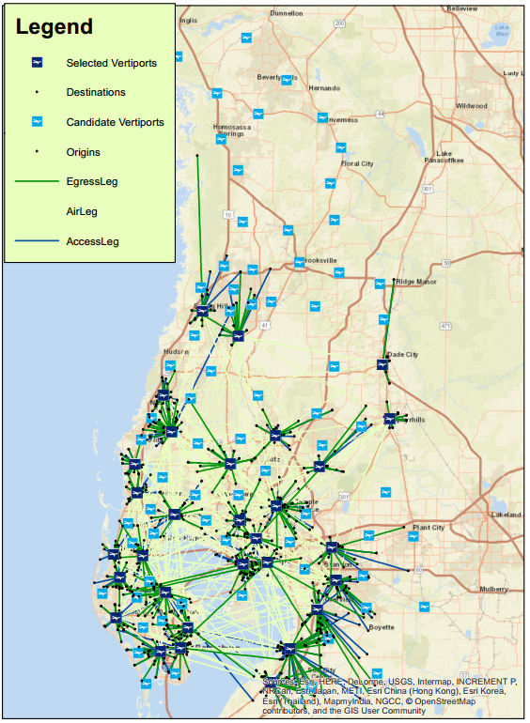
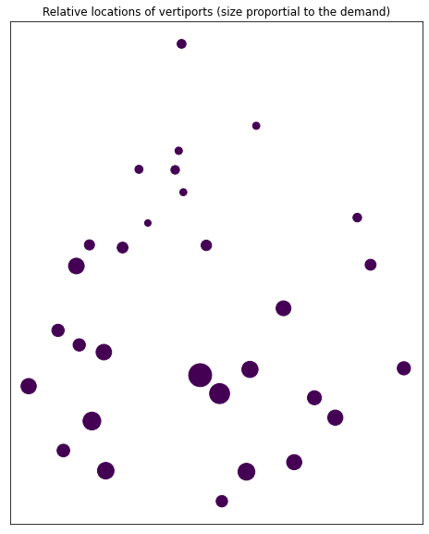
Simulation Platform Design – Numerical Study
TBRPM
Integrated Network Design
Vertiport Location, Passenger Demand
(a)
(b)

Slide 26
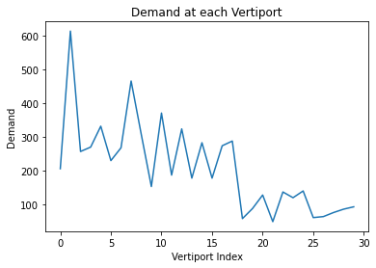
Simulation Platform Design – Numerical Study
Input Data (from the study Integrated Network Design and Demand Forecast for On-Demand Urban Air Mobility)
30 vertiports in Tampa Bay Area
There are 6287 trips generated for a typical weekday

Slide 27
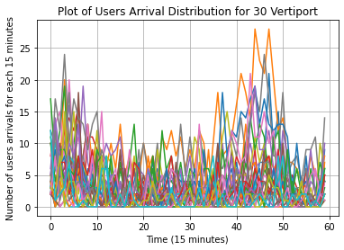
Simulation Platform Design – Numerical Study
Simulation Setting
Study Horizon: 6:00am – 9:00 pm
Time for each simulation step: 1 minute
Time for each time slot: 15 minutes
LoS1: 10 min
LoS2: 5 min
LoS3: 10 min

Slide 28
Simulation Platform Design – Numerical Study
Simulation Setting
A maximum and minimum value is set for infrastructures and eVTOLs at vertiport
  Staging pads(max = 10, min = 2); TOLF(max = 5, min = 2); eVTOL (max = 8; min = 2)
Number of infrastructures is proportional to the summation of the arrival demand (arrivals as origin as well as destination)
Number of eVTOLs is certain number (e.g. 2) less than the number of staging pads (satisfy the minimum requirement)
Example: Among all vertiports, maximum arrival demand is 100, the vertiport with maximum demand should have 10 staging pads, 5 TOLFs and 8 eVTOLs. Vertiport with 80 demand should have 8 staging pads, 4 TLOFs and 6 eVTOLs.

Slide 29
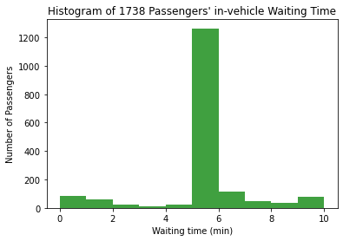
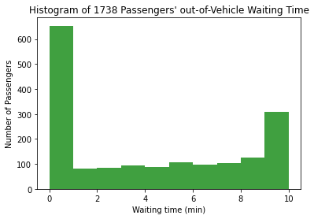
Simulation Platform Design – Numerical Study
Result Analysis – Service Quality
For 6287 arrival passengers, 1738 of them are served and 4328 of them switch to other transportation modes (LoS3). The rest of passengers are still waiting for assignment at the end of simulation.
Most of the served passengers have experienced 5 minutes’ in-vehicle waiting time (LoS1) and a significant number of them 10 minutes’ out-of-vehicle waiting time (LoS2)

Slide 30
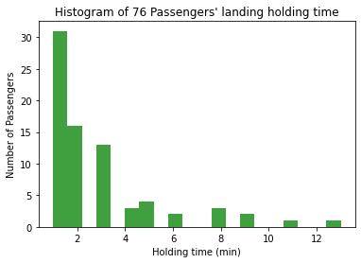
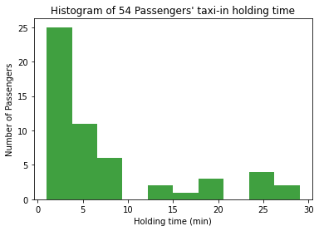
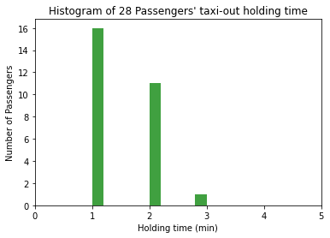
Simulation Platform Design – Numerical Study
Result Analysis – Service Quality
Overall, the number of passengers that experience holding at the state is small.
For a few passengers, they have experienced severe landing hold and taxi-in hold process, which indicates there may exists blocks at certain instants for some vertiports.

Slide 31
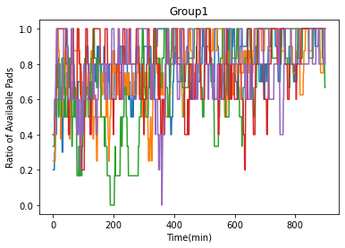
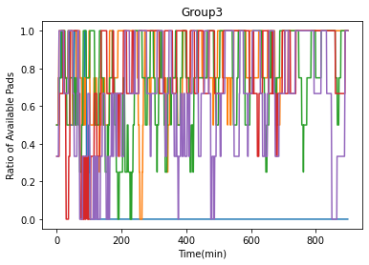
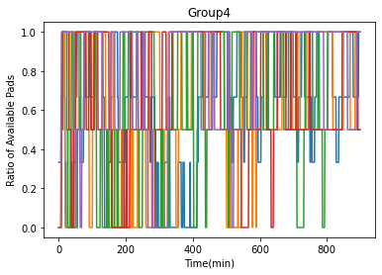
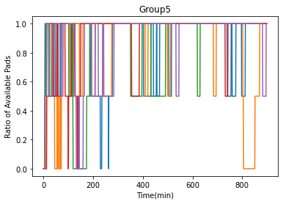
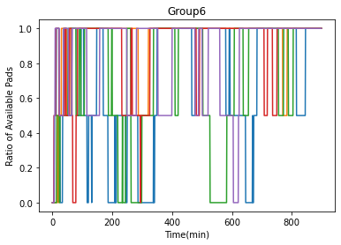
Simulation Platform Design – Numerical Study
Result Analysis – Staging Pads Occupation
Fully occupation last for almost the whole simulation process at certain vertiports.
Availability of parking pads is high across vertiports, indicating high usage rate of eVTOLs.

Slide 32
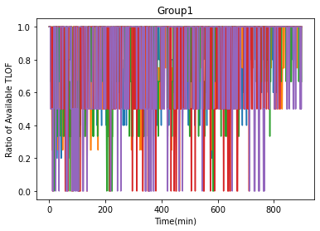
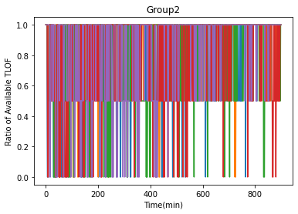
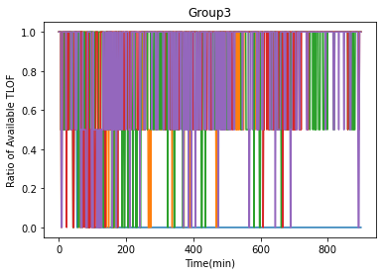
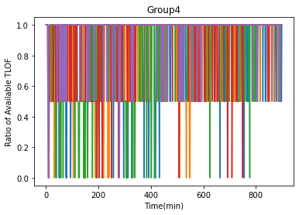
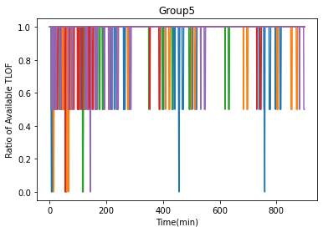
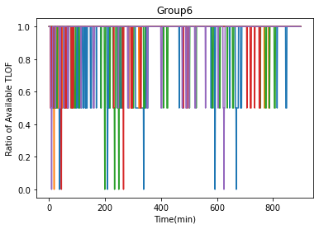
Simulation Platform Design – Numerical Study
Result Analysis – TOFL Occupation
Fully occupation last for almost the whole simulation process at certain vertiports.
Availability of parking pads is high across vertiports, indicating high usage rate of eVTOLs.

Slide 33
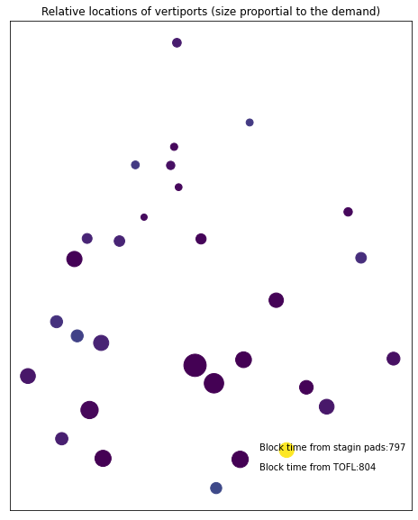
Simulation Platform Design – Numerical Study

Slide 34
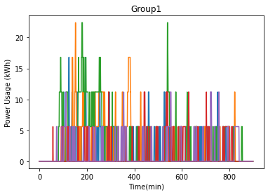
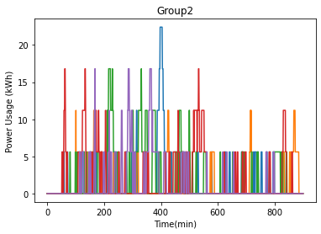
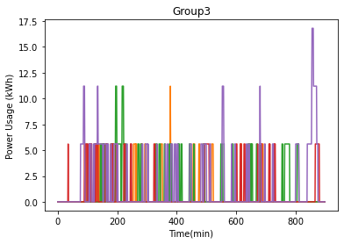
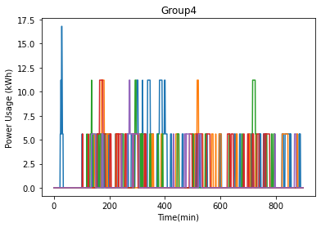
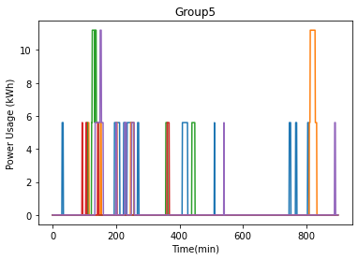
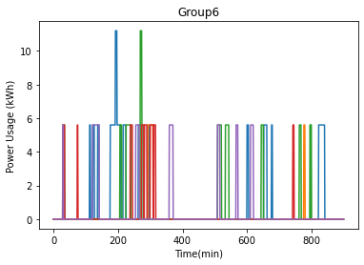
Simulation Platform Design – Numerical Study
Result Analysis – Power Requirement
Power requirement is evenly distributed across vertiport at most times
There are only certain time instants, which require high energy supply.

Slide 35
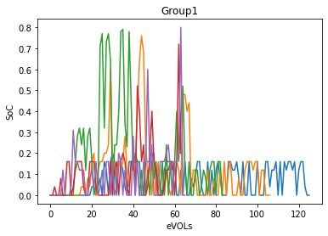
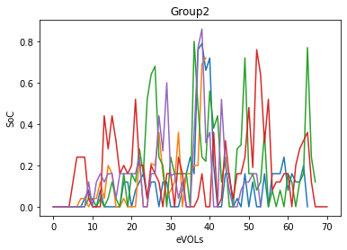
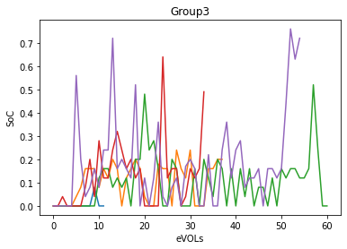
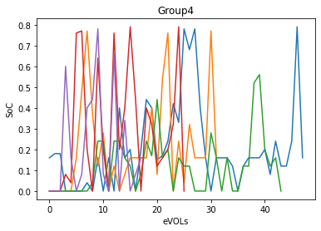
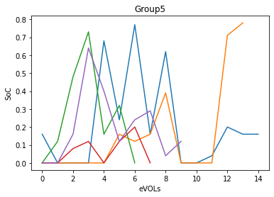
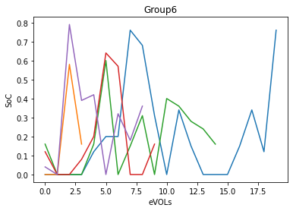
Simulation Platform Design – Numerical Study
Result Analysis – Charging Process
For vertiports with high demand, eVTOLs generally have low SoC charged before serving passengers.
For vertiports with low demand, SoC charged for eVTOLs varies.

Slide 36
Simulation Platform Design – Numerical Study
Brief Conclusion:
Severe block may exist for certain vertiports.
Supply cannot satisfy the demand.
  Increase eVTOL fleet size.
  Increase both eVTOL fleet size and vertiport capacity.

Slide 37
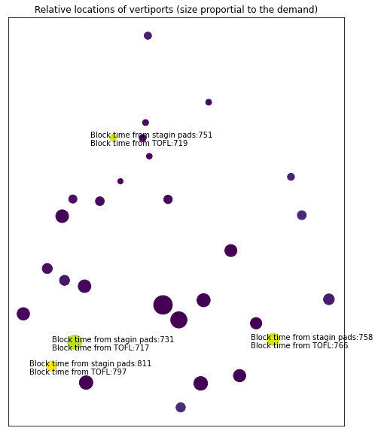
Simulation Platform Design – Numerical Study
Expand capacity of blocked vertiports
Total number of served passengers decreases from 1738 to 1029

Slide 38
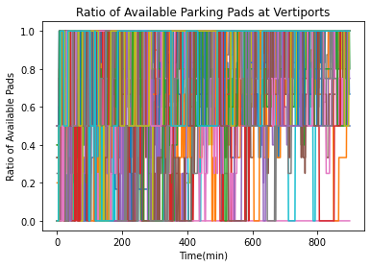
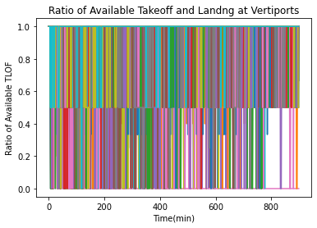
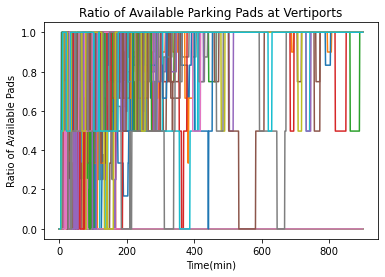
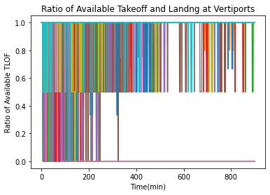
Simulation Platform Design – Numerical Study
Result Analysis – Supply Variation
Increase number of eVTOL to the number of staging pads at initial state.
Number of served passengers decreased from 1738 to 833.
Facility usage rate decreases, which indicates severe block exists, an increase of block can be expected.

Slide 39
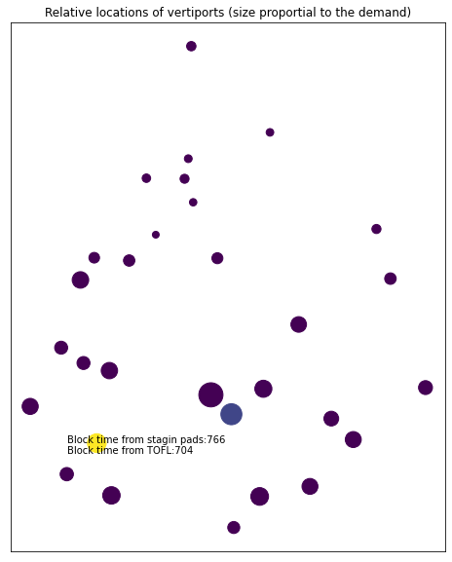
Simulation Platform Design – Numerical Study
Result Analysis – Supply Variation
Increase number of all parameters Staging pads (max = 40, min = 20); TLOF(max = 20, min = 10); eVTOL (max = 20; min = 5) (20 less than staging pads)
  3592 served + 2267 unserved
  Block only exists at one vertiports at certain time period

Slide 40
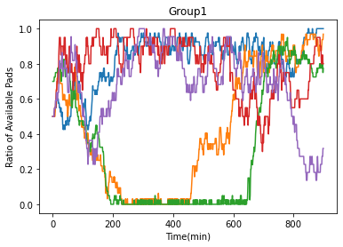
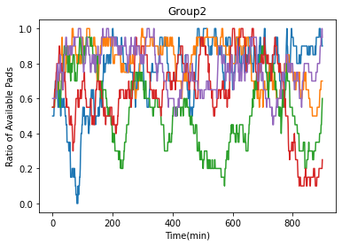
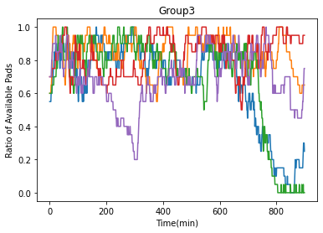
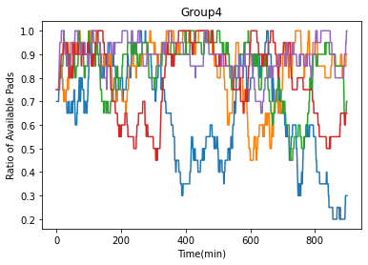
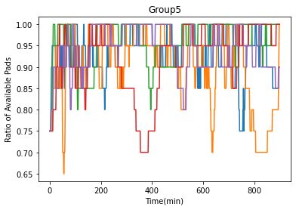
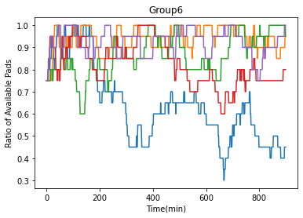
Simulation Platform Design – Numerical Study
Result Analysis – Supply Variation
Expand capacity of the blocked vertiport

Slide 41
Simulation Platform Design - Conclusion
A simulation platform is developed to simulate and monitor the eVTOL operation and service process for UAM network.
We have explored the performance of the system under different supply design.
The results can serve as foundation for finding the optimal network supply design.
Strategies like dispatching empty eVTOLs or design eVTOL depot can be explored and included in the platform design to mitigate potential blocks.

Slide 42
Thank You!
Q & A

