Slide 1
2021 Transit On-Board Survey
Southeast Florida FSUTMS Users Group - May 12th, 2023
metrocouncil.org

Slide 2
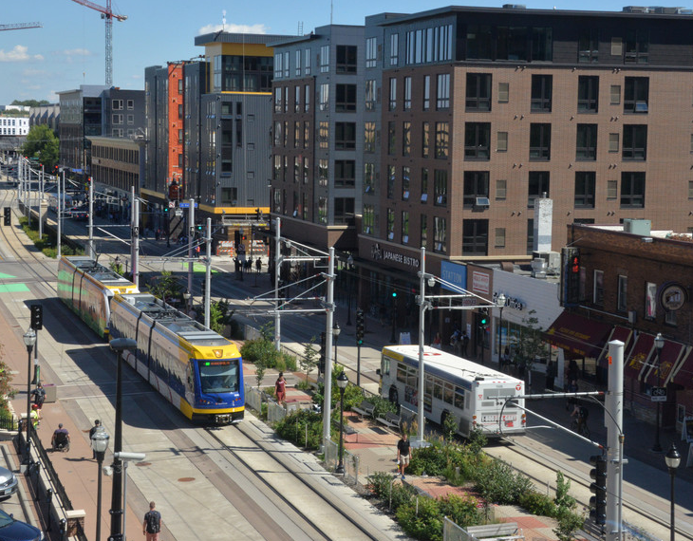
Outline
What is the on-board survey?
Pilot survey findings
Who is on board now?
What kind of trips are they making?
Plan for main survey

Slide 3
What is the On-Board Survey?
System-wide survey of who is on transit, and where they are going
An “intercept-interview” survey
Conducted every five years
Last survey 2016
Fall 2021 pilot sampled busy Metro Transit routes
Photo by David Joles, the Star Tribune 10/22/2021

Slide 4
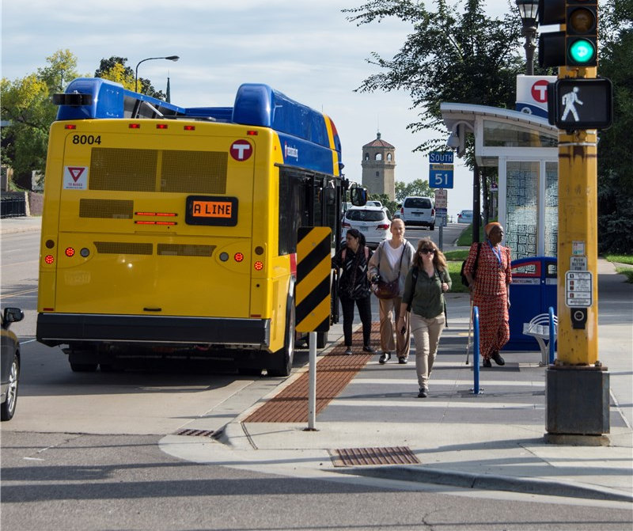
We do this survey to:
Better understand current transit riders and markets
Improve transit forecasts and planning
Support before-and-after studies
Federally required

Slide 5
How we understand these data: a subset of trips and riders
Riders and trips served by these
routes today are mostly a subset of the riders & trips served in 2016.
2021
These slides compare only the routes sampled in 2021.
2016
Full survey occurred in 2022 and is still being processed.

Slide 6
How we understand these data: trips lost, trips retained
Of the
157,000
trips per day in 2016
72,000
were retained
(46% retention rate)
85,000
were lost
(54% loss rate)
5,000 trips

Slide 7
Who is on board?

Slide 8
Retained a greater share of men’s trips than women’s trips
Of the
72,000
trips made by women and girls in 2016
Of the
90,000
trips made by men and boys in 2016
41%
were retained
(30,000 trips)
47%
were retained
(42,000 trips)
5,000 trips
Notes:
Number of people sampled on survey

Slide 9
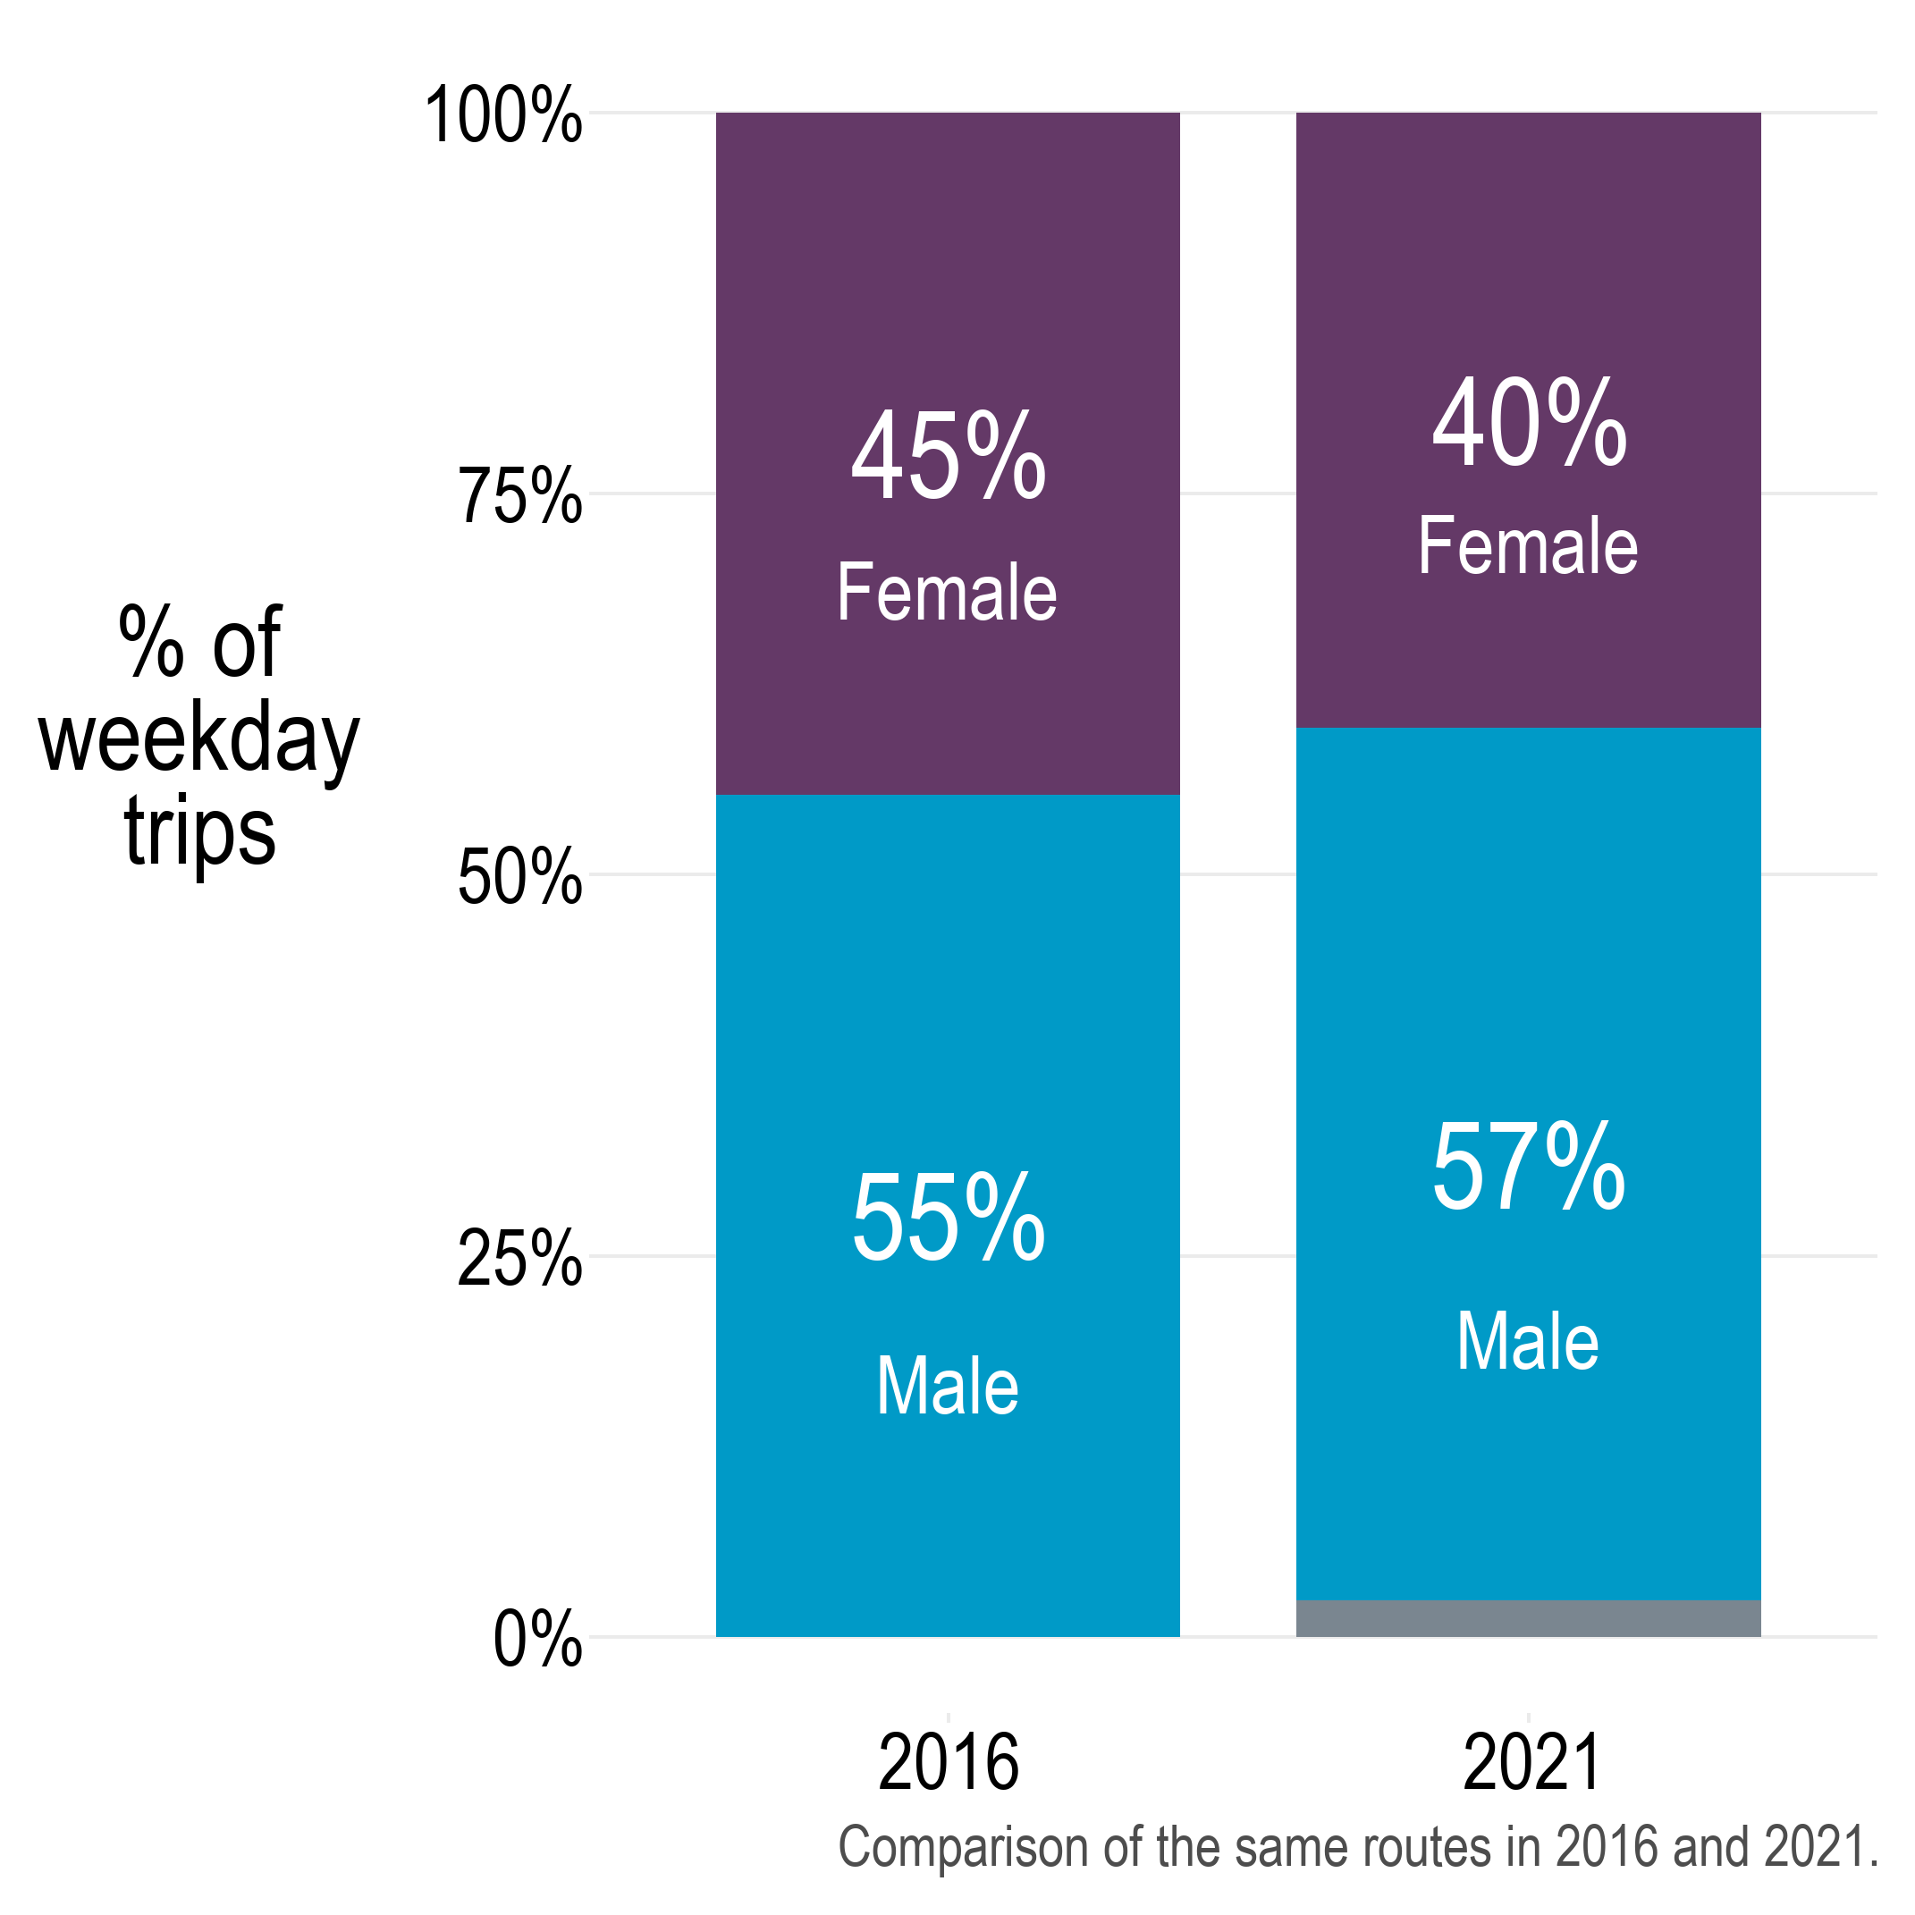
Share of men on-board has increased
Transgender, non-binary, and other identities (2%) – see “Appendix” slides
Notes:
Number of people sampled on survey

Slide 10
Similar gender splits in other transit systems Data courtesy of ETC Institute
Location | Date | Male | Female | Other
Volusia Co, FL | Spring 2021 | 65% | 35%
Lexington, KY | Spring 2021 | 57% | 43%
Tampa, FL | Fall 2021 | 57% | 43%
Rhode Island | Fall 2021 | 55% | 44% | 1%
Knoxville, TN | Fall 2021 | 56% | 42% | 2%
Boise, ID* | Fall 2021 | 58% | 39% | 3%
Tucson, AZ | Spring 2022 | 62% | 36% | 2%
Albuquerque, NM | Spring 2022 | 65% | 32% | 3%
Houston, TX* | Spring 2022 | 57% | 42% | 1%
* pre-expansion figures
Notes:
Number of people sampled on survey

Slide 11
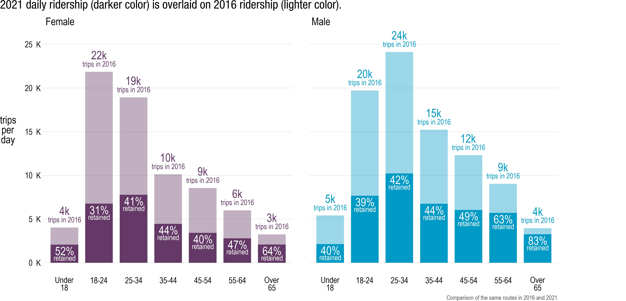
Retained greatest share of trips by older men, least by young women
2021
2021
2016
2016
Also note widening gender gaps for middle-aged & older adults, 45+
Notes:
Gender x Age

Slide 12
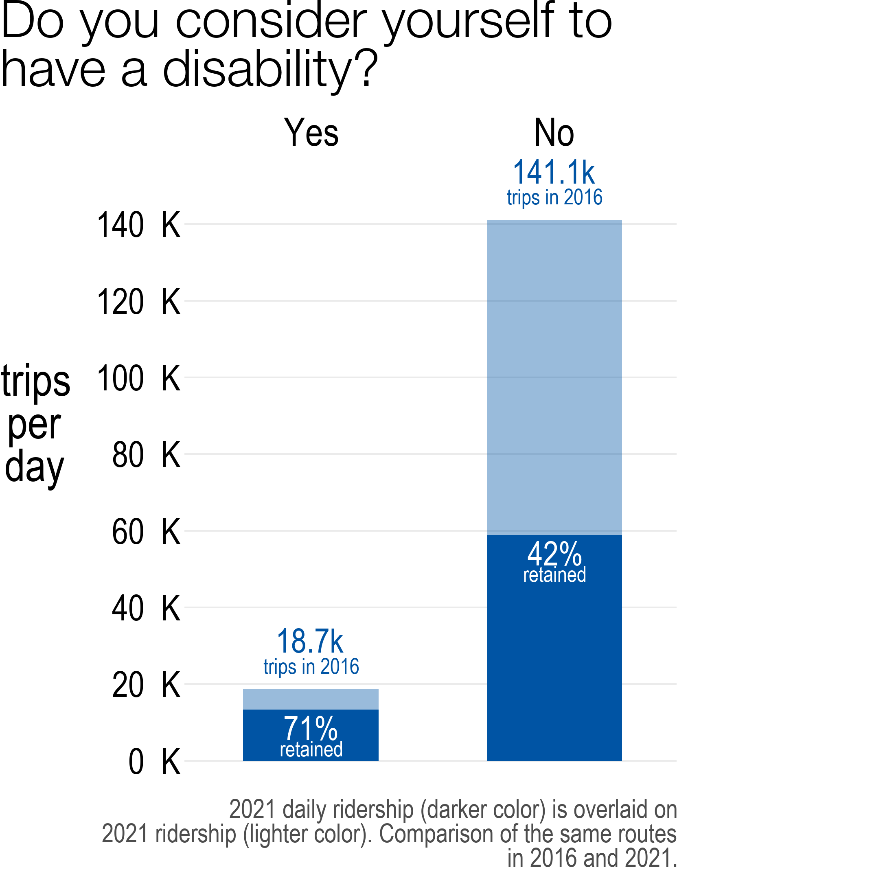
Retained a greater share of trips by riders with a disability
2021
2016
Additionally, the share of trips made by those with a disability has increased from 11% to 18%.
“Prefer not to answer” omitted.

Slide 13
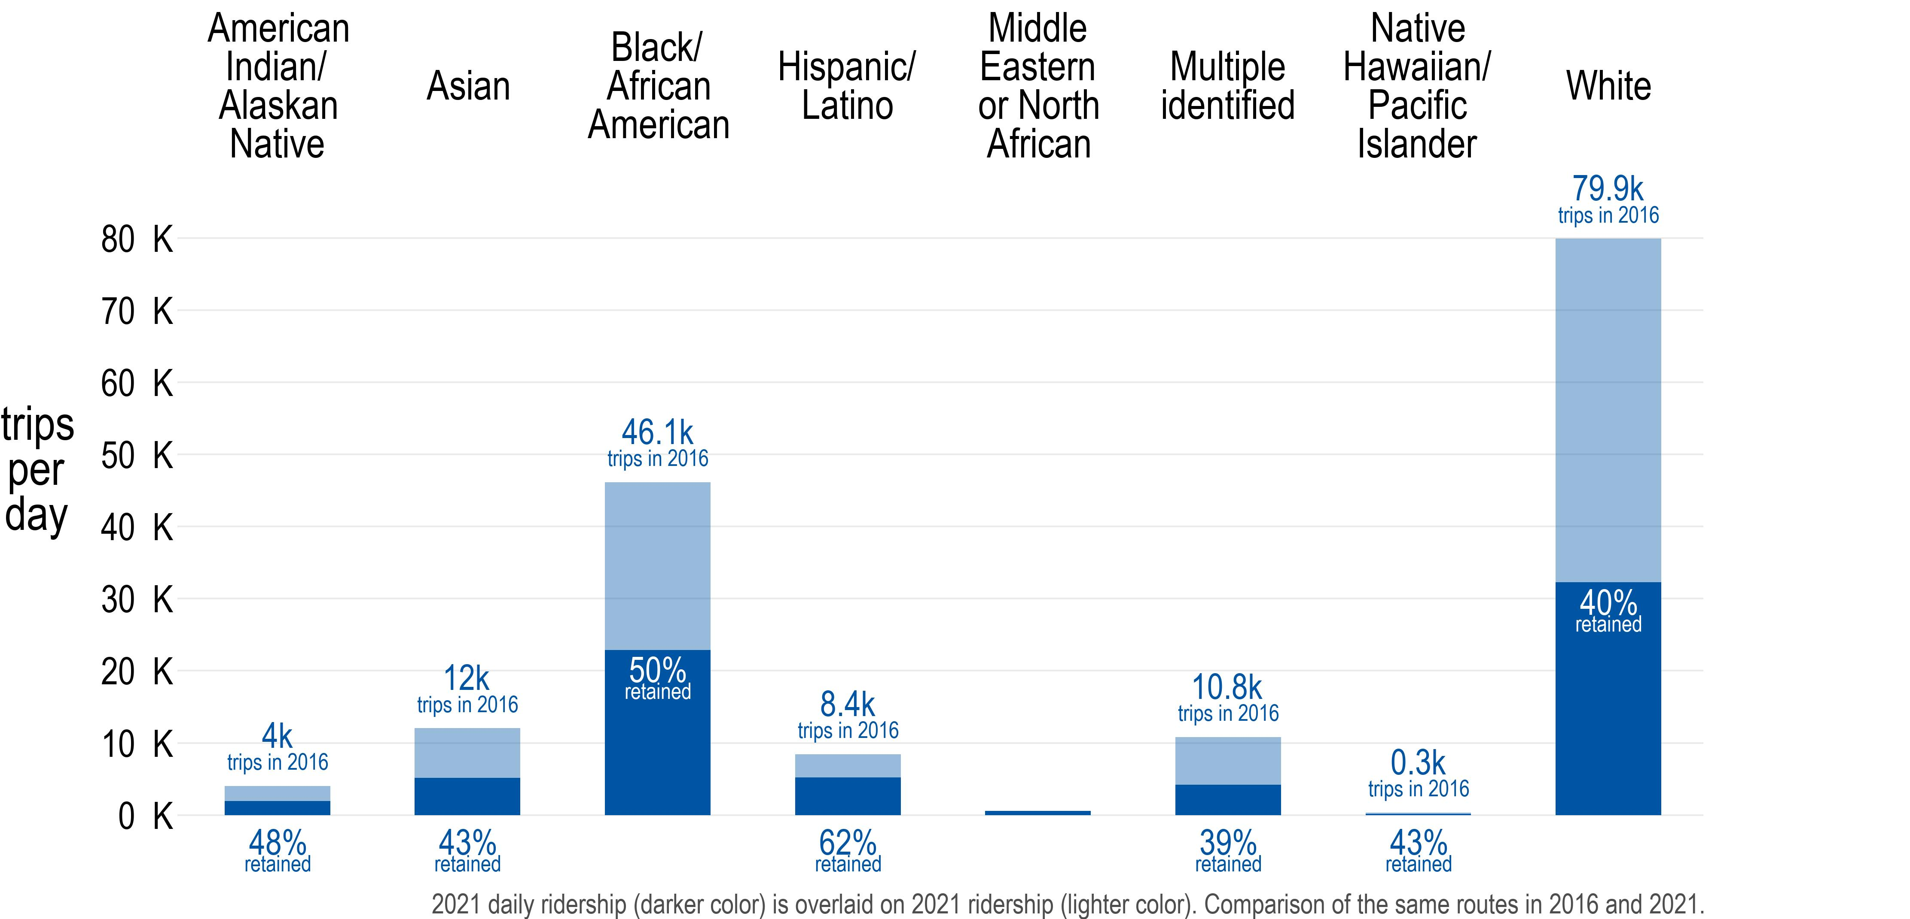
Retained greater share of trips made by riders of color
2021
* New option in 2021
2016
Retained the greatest share of trips made by Hispanic/Latino riders and Native American riders
<500 trips in 2021

Slide 14
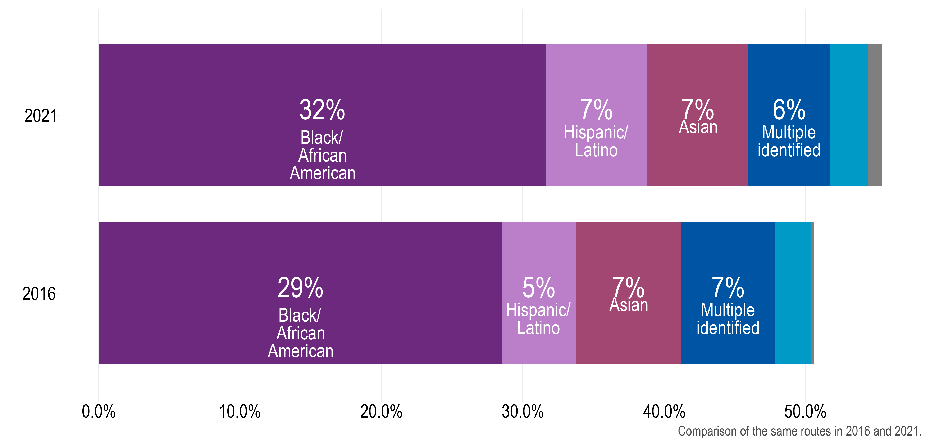
Share of riders who identify as Black or Latino has increased
This graph excludes the percent of trips made by white riders (45% of trips in 2021; 50% of trips in 2016).
Native American
<1% Middle Eastern, Pacific Islander
55%
Black, Indigenous and People of Color
2021
3%
Native American
<1% Pacific Islander
50%
Black, Indigenous and People of Color
2%
2016
% of trips
Notes:
Gender x Age

Slide 15
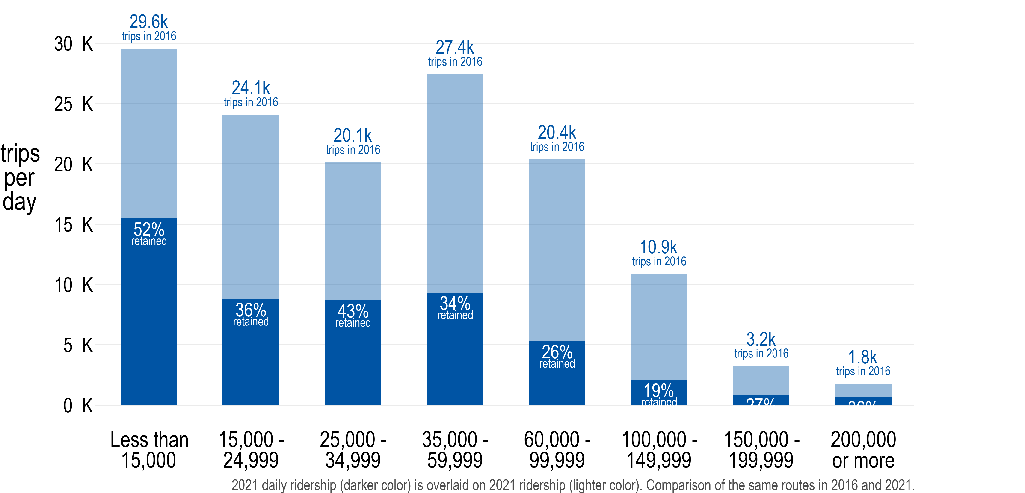
Retained greatest share of trips made by lowest-income riders
2021
2016
Retained 40% of trips from riders making less than $60,000/year, compared to 24% of trips from riders making more than $60,000/year.
27% retained
36% retained

Slide 16
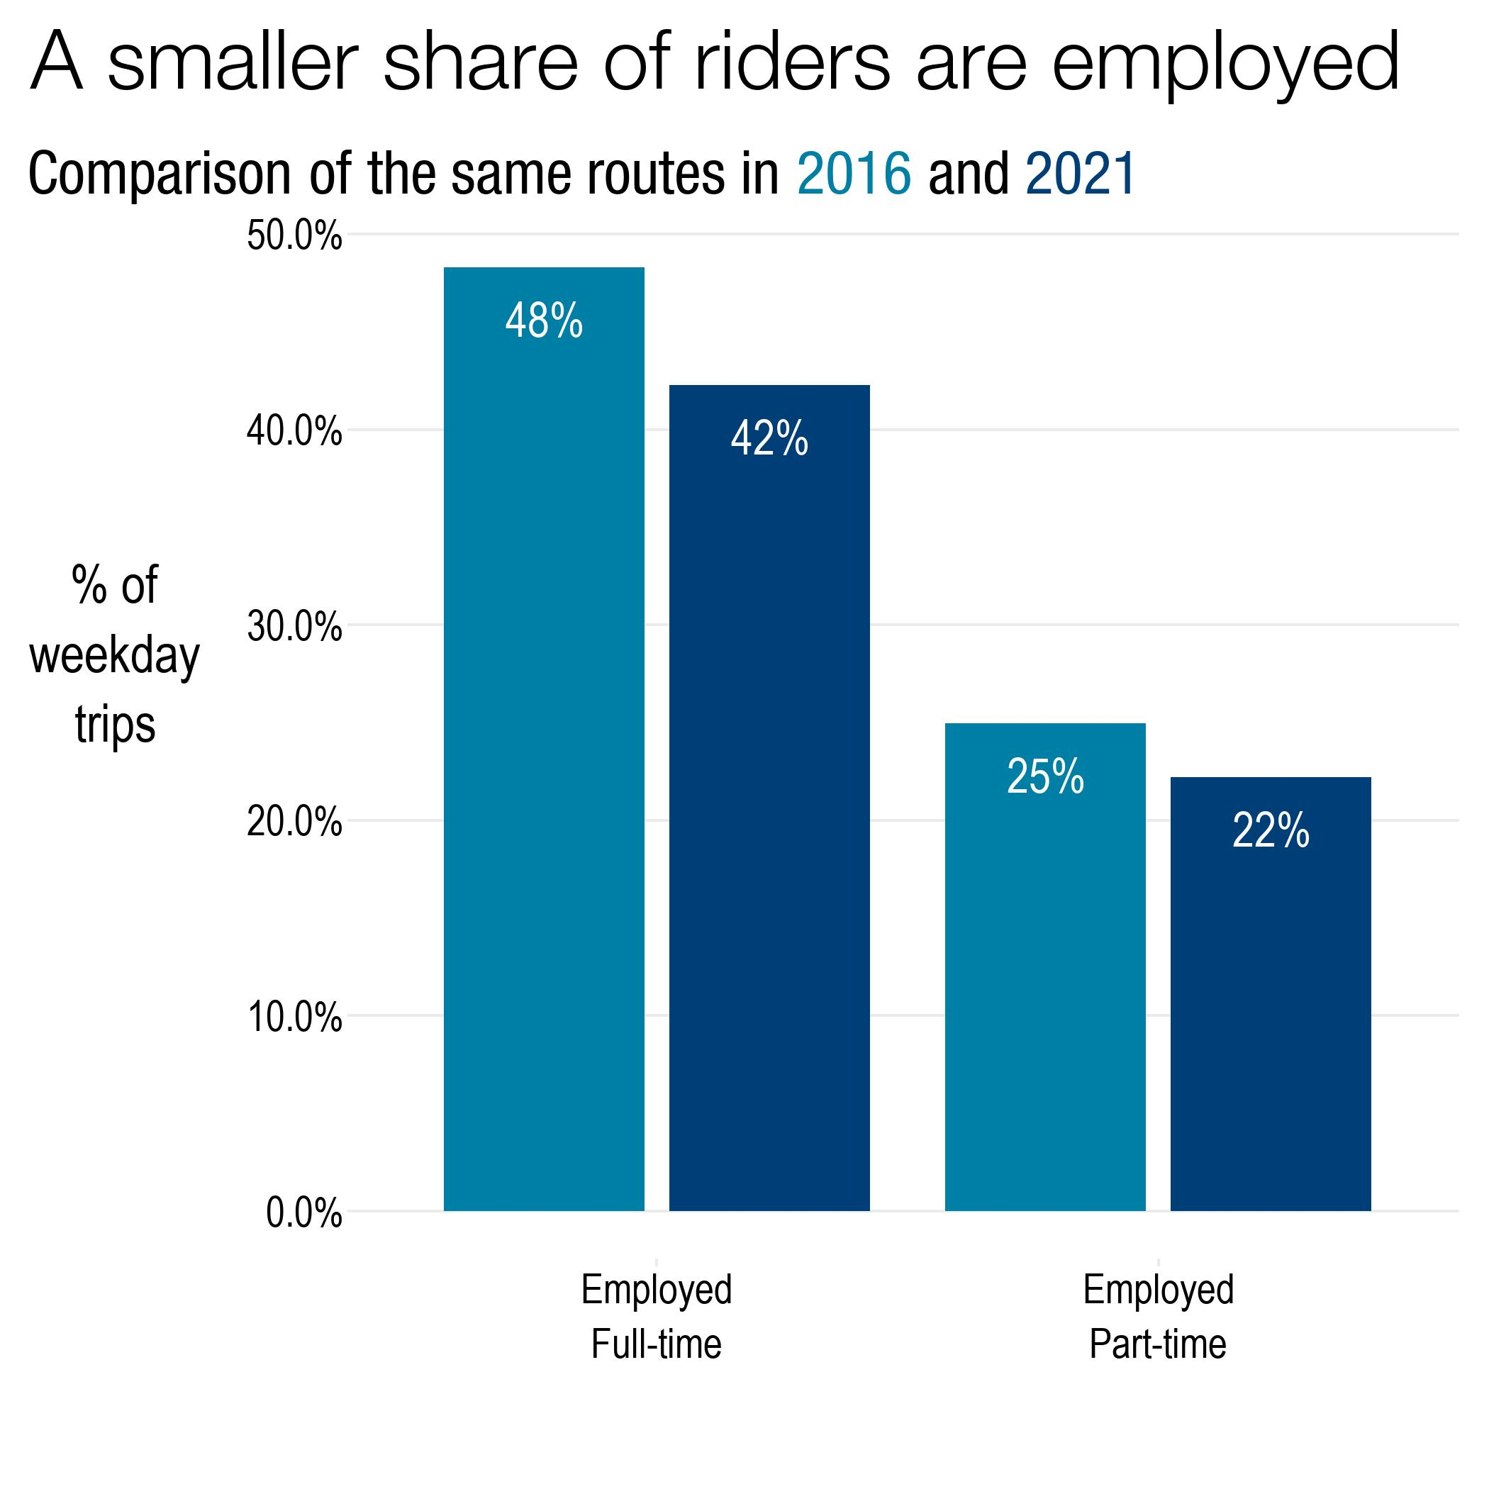
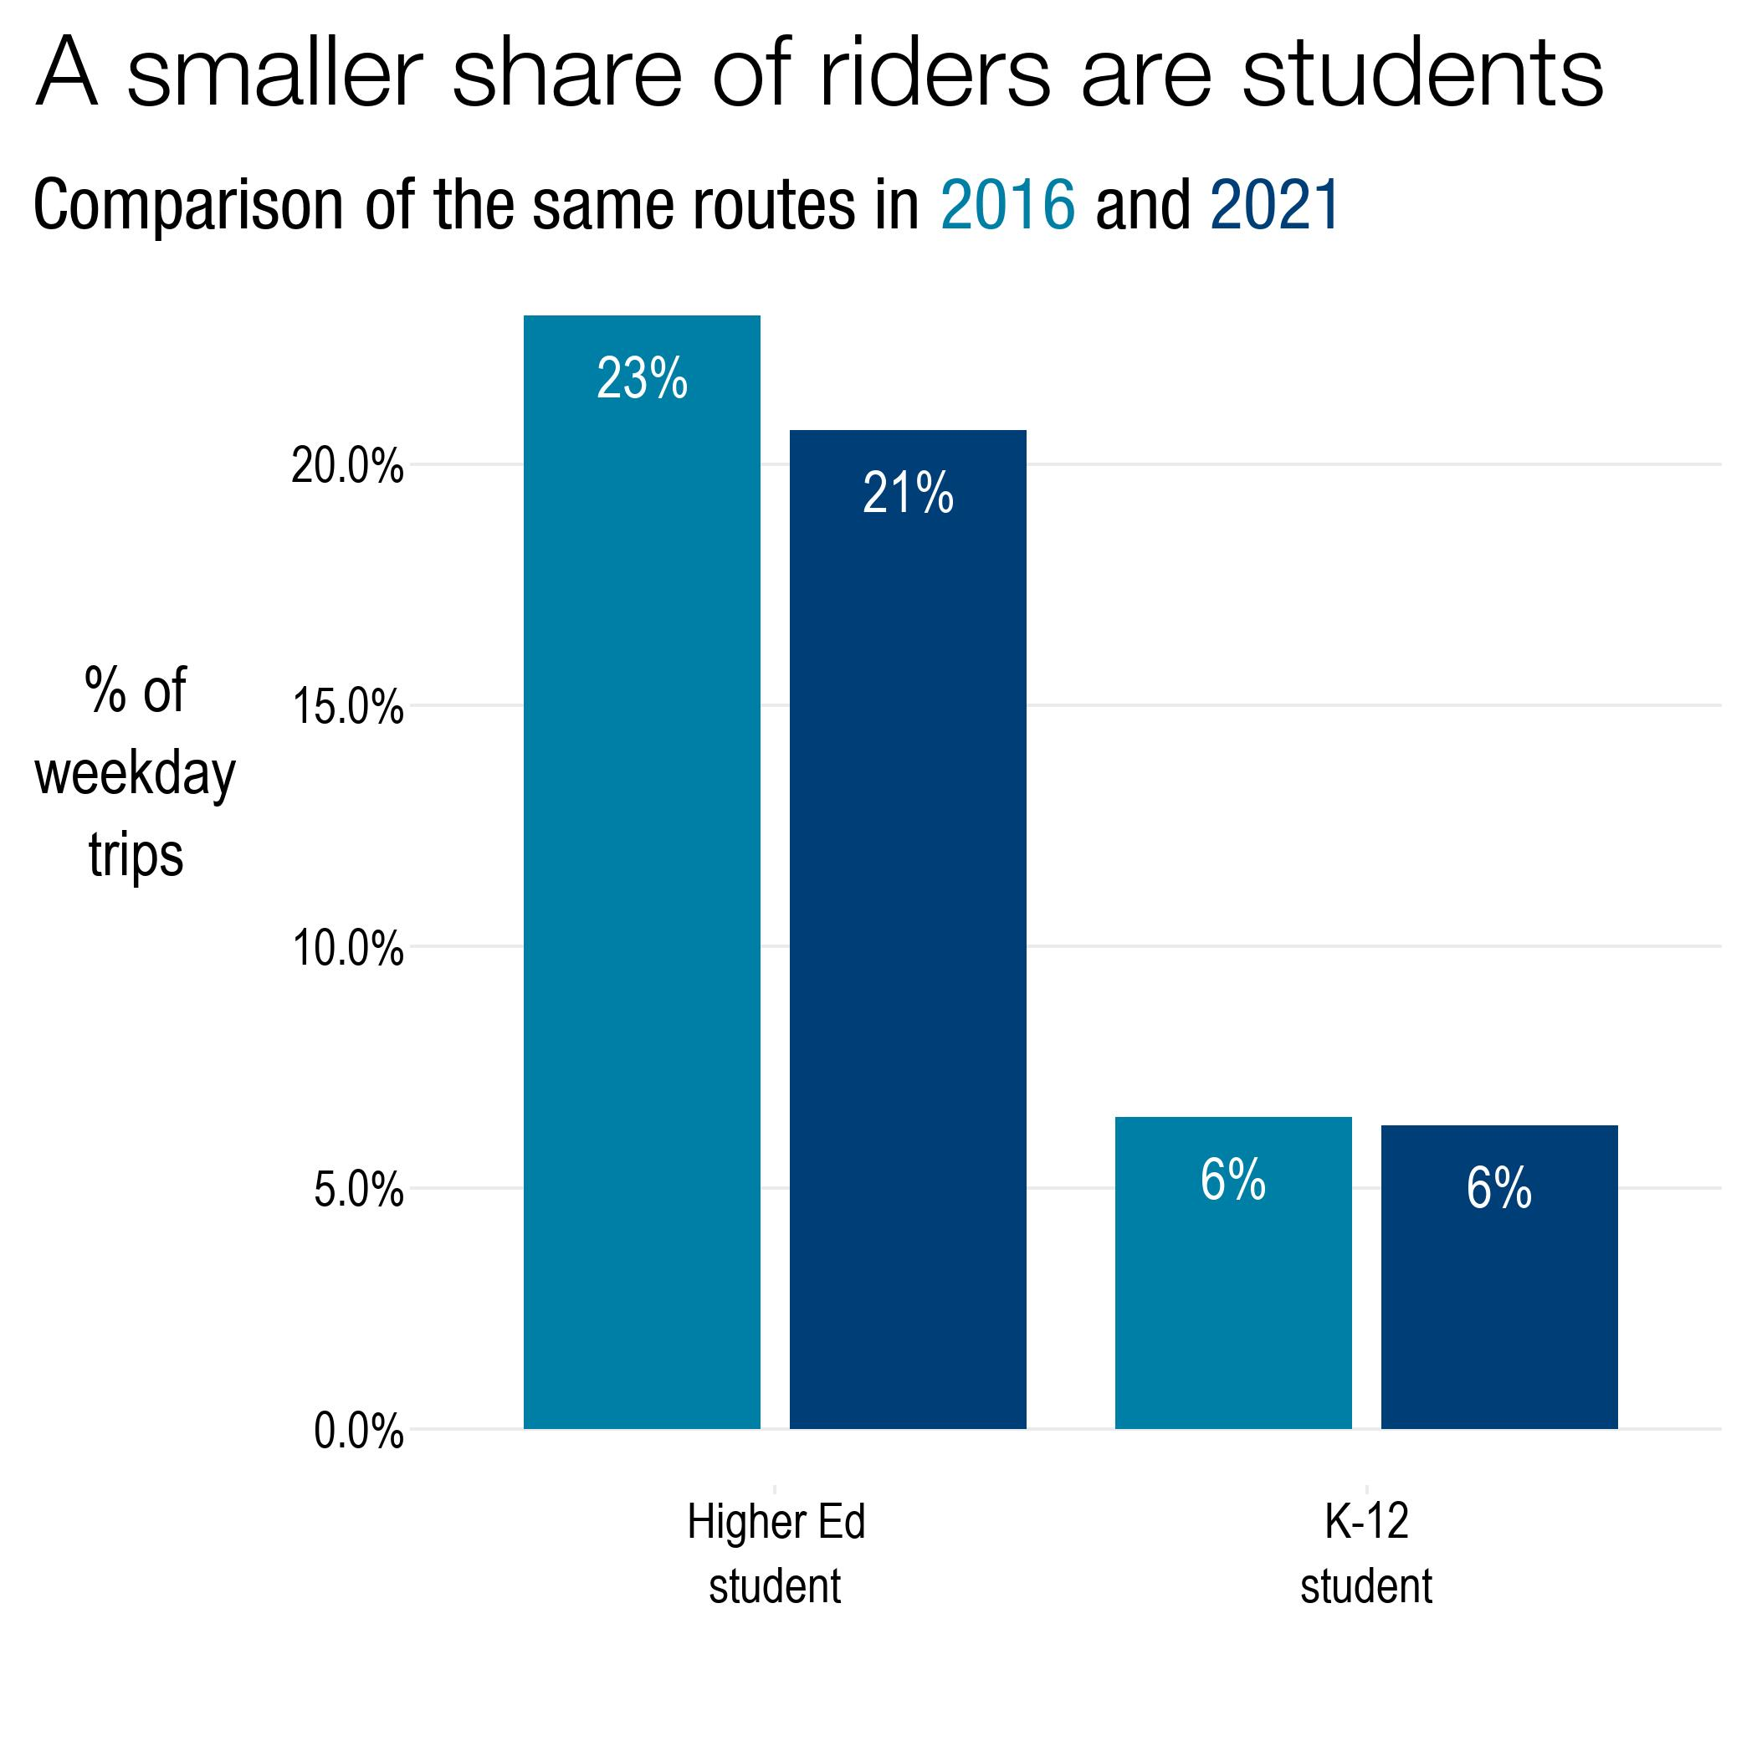
Share of trips made by riders who are employed or students decreased
Note: y-axes differ between plots
Notes:
Fewer people who are employed
About same or slightly more %HS students
Adding up higher ed students: about the same, more of them are now not employed (used to have more higher ed students who were employed PT)
Relates back to incomes <$15,000: students not working, retirees not working

Slide 17
What kinds of trips are people making?

Slide 18
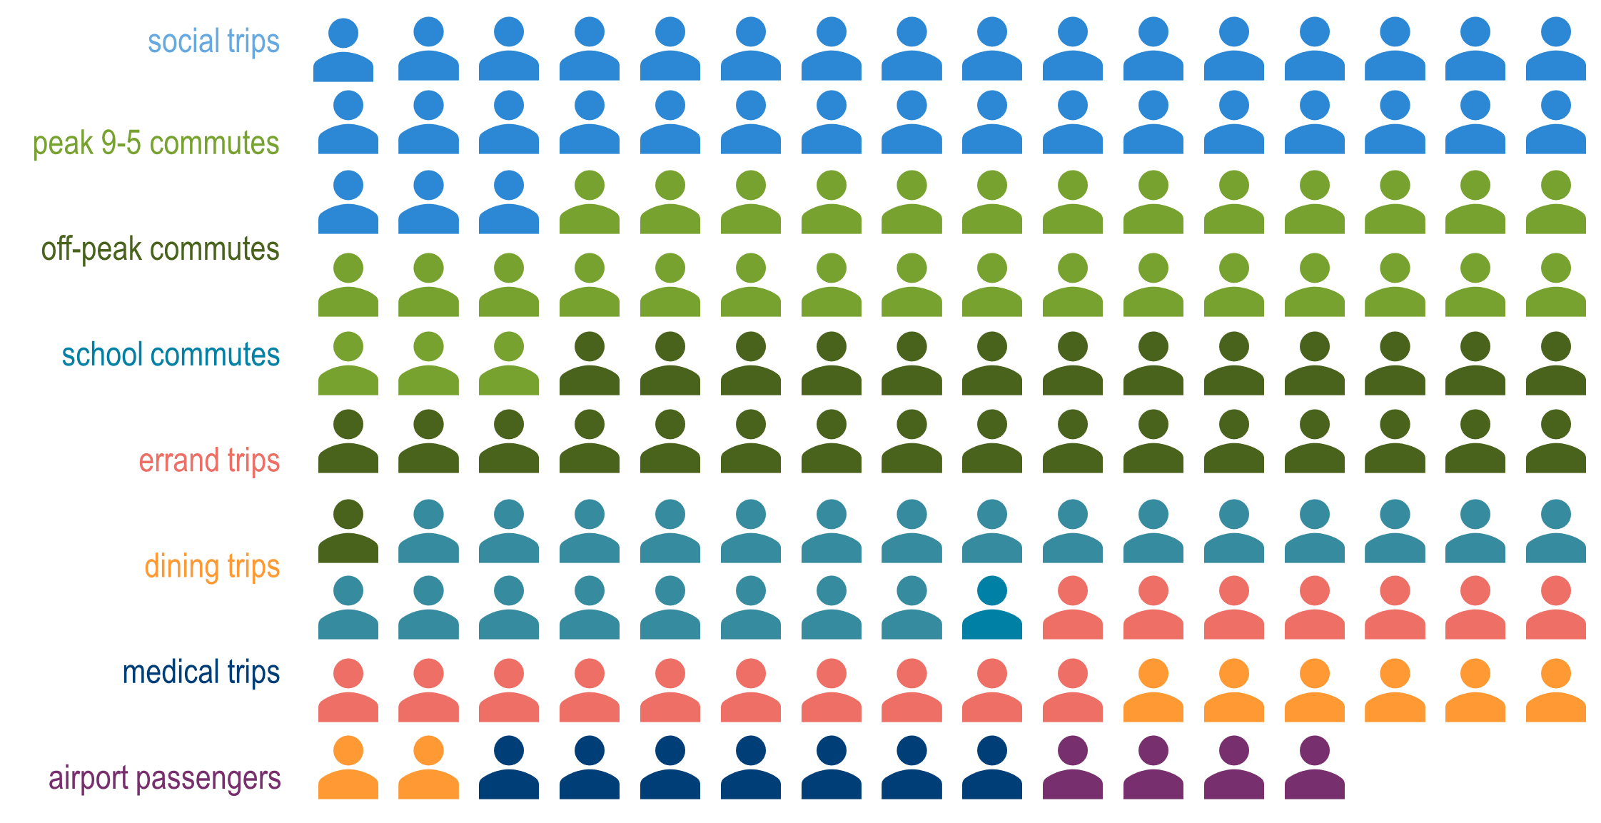
157,000 trips in 2016
= 1,000 trips

Slide 19
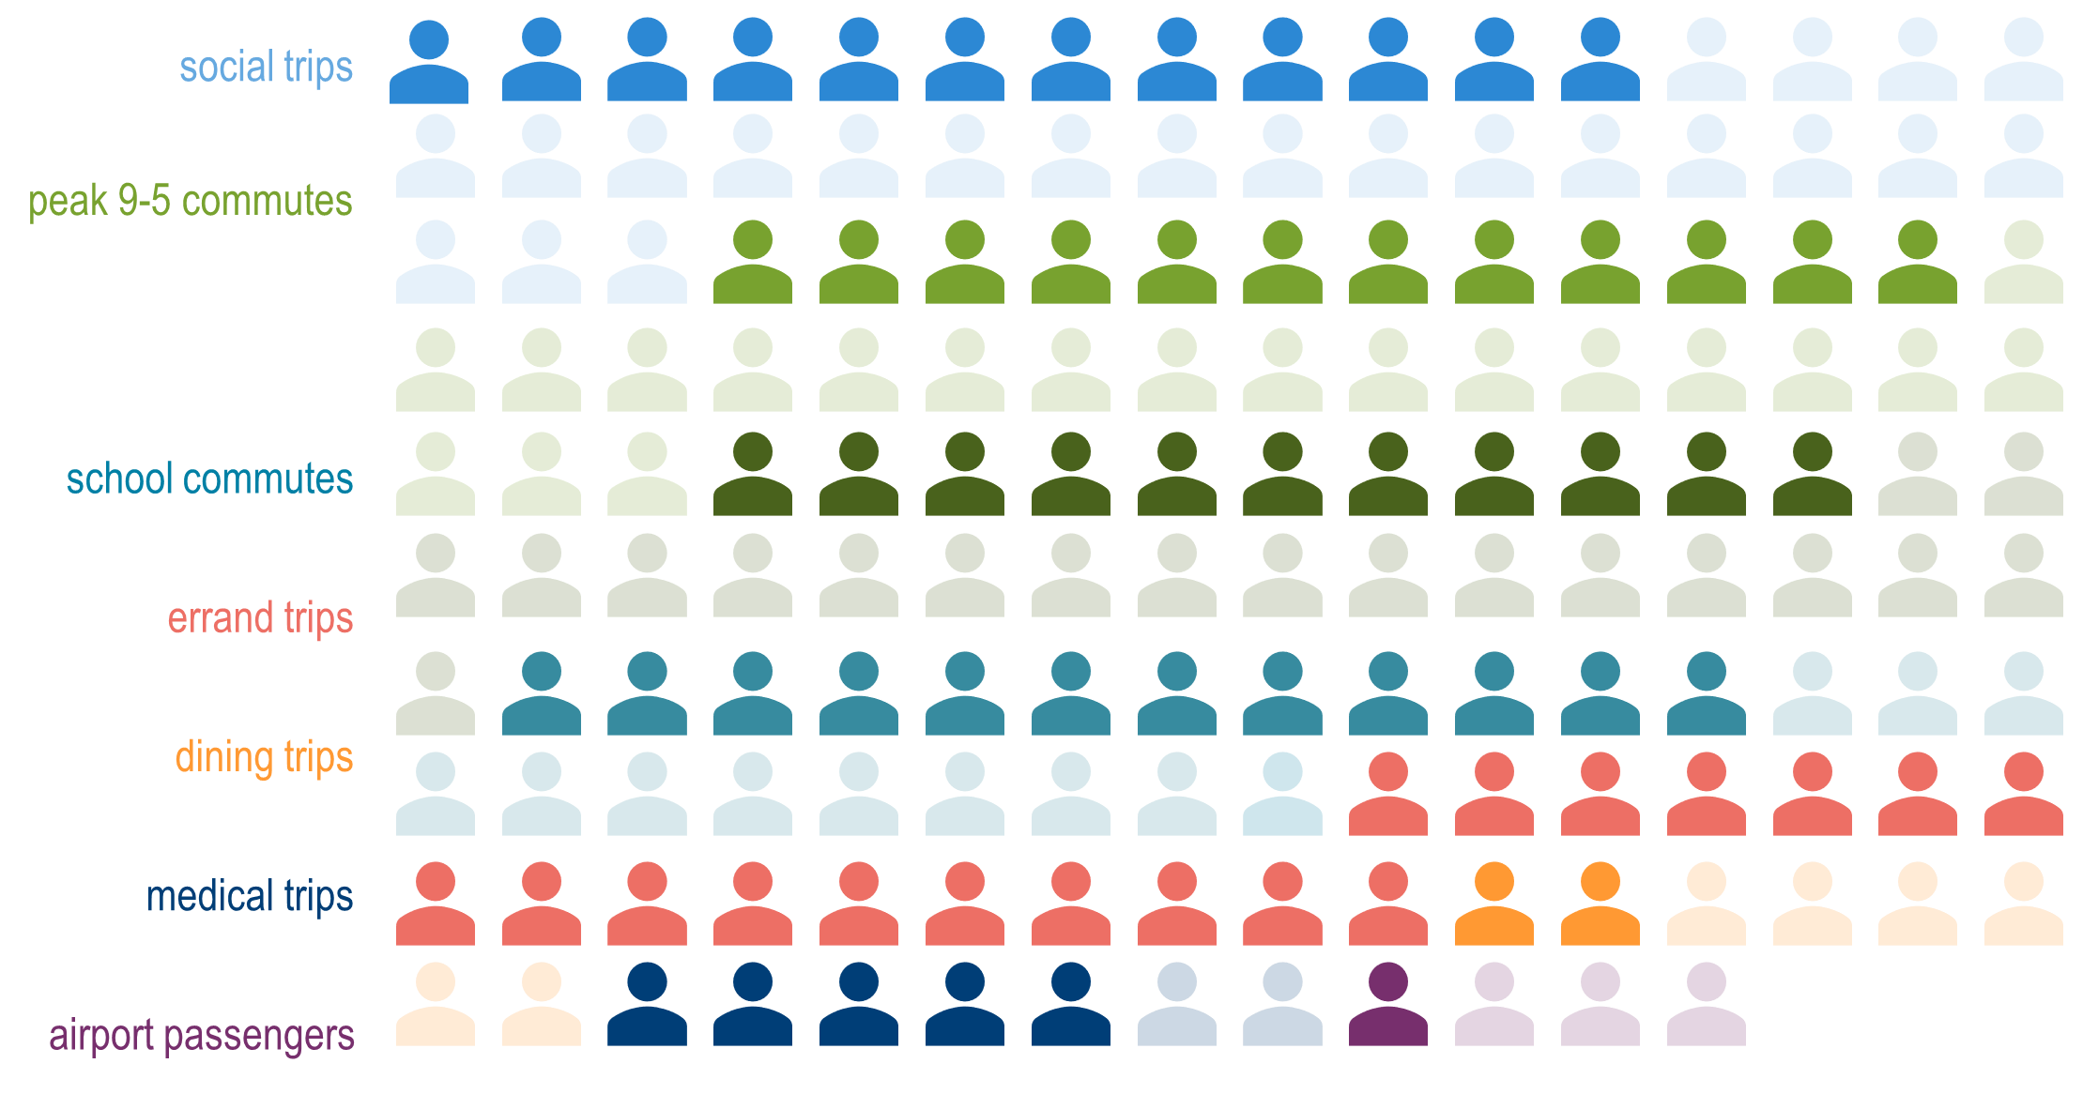
72,000 trips retained in 2021
= 1,000 trips

Slide 20
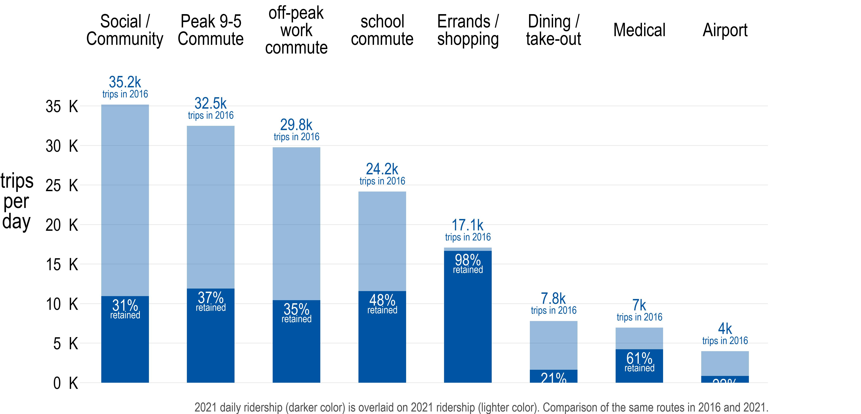
Retained greatest share of trips made for errands, least for airport passengers
2021
2016
Retained 39% of all school and work commutes
21% retained
21% retained

Slide 21
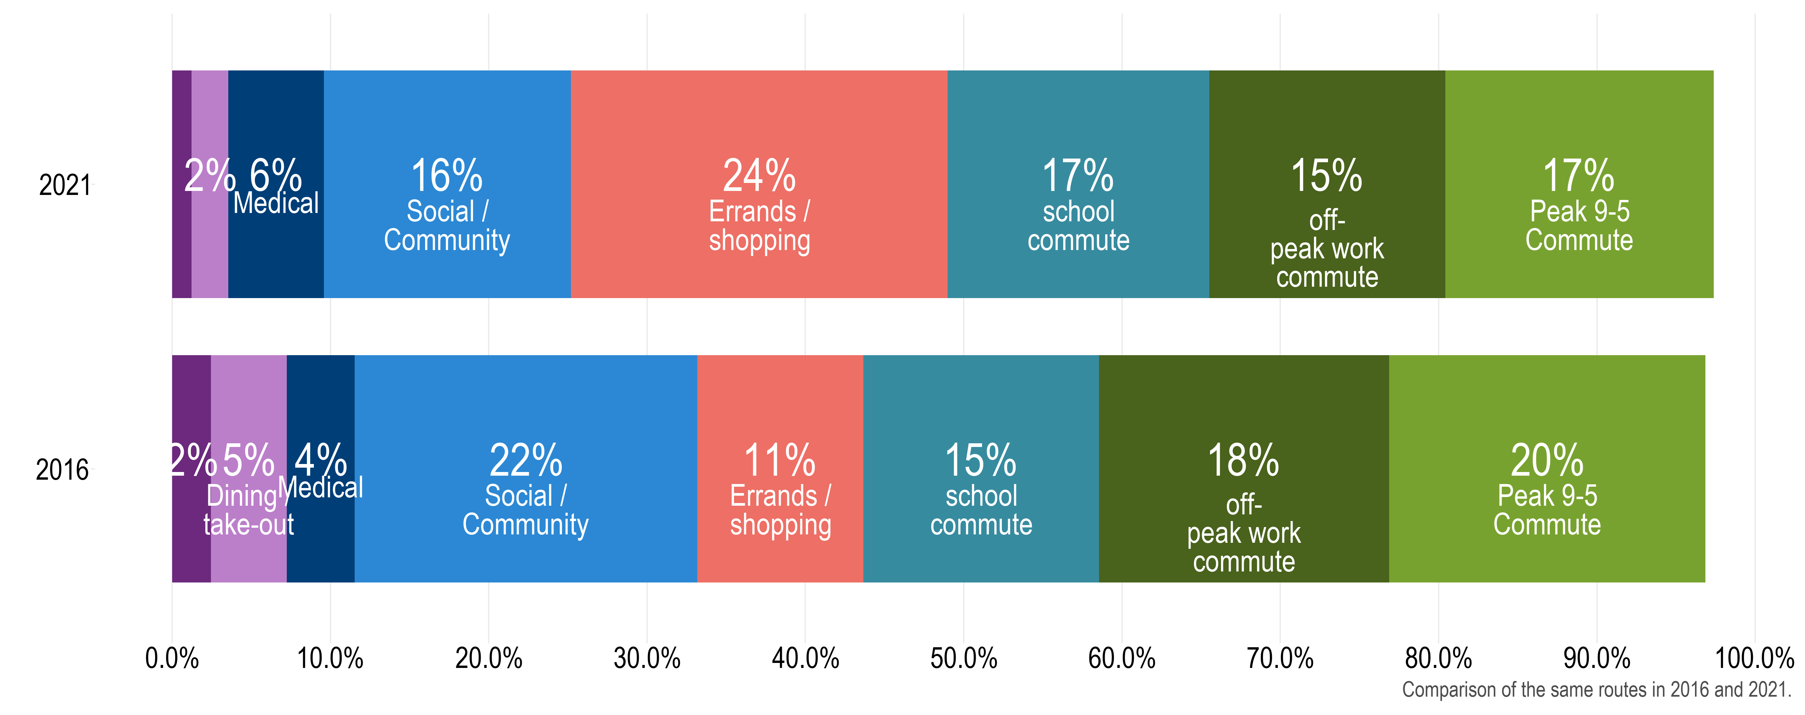
The share of people traveling for errands has grown
1% of trips are airport passengers
2021
2% of trips are airport passengers
2016
% of trips
Notes:
Trip Purpose: Home-based other, school etc//vs. categories ~ trip purpose category Grocery shopping, other maintenance errands.
Peak 9-5 commute didn’t drop AS MUCH, probably because of the lines we were sampling – mostly not commuter express lines, except perhaps Blue Line
All day travel patterns

Slide 22
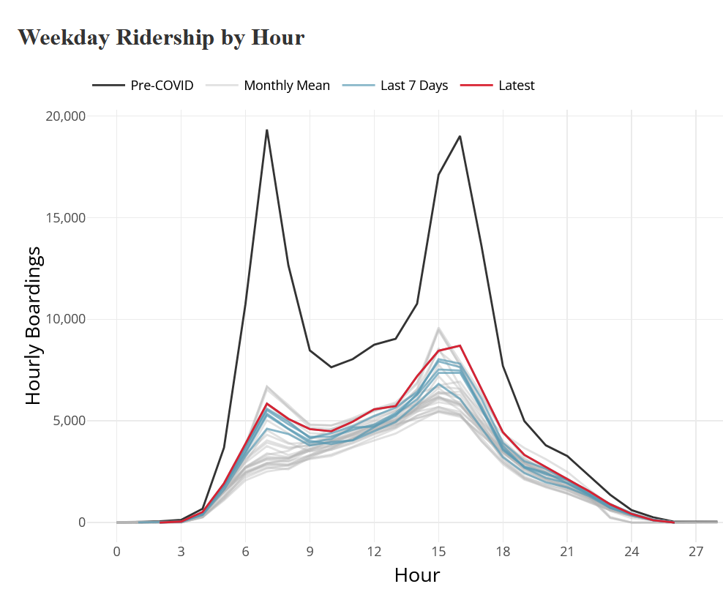
Previously observed trends: ridership by hour

Slide 23
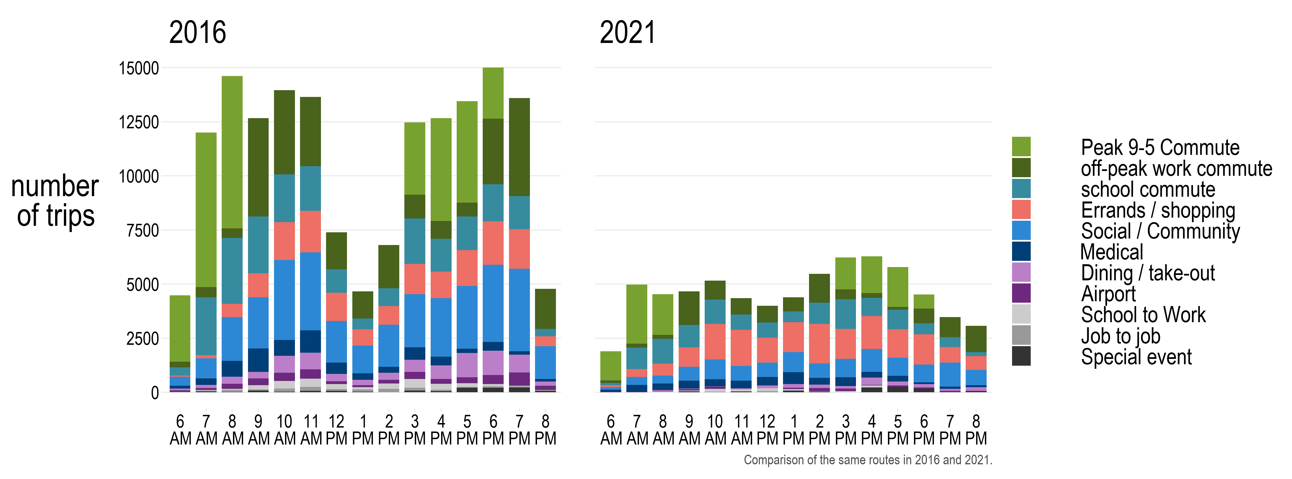
Trip purpose by time of day, then and now
A rebound in 9-5 commutes alone will not restore ridership to pre-pandemic levels.

Slide 24
Key Findings: Trips and Riders Retained
What is the “core ridership” in the Pandemic era?
BIPOC riders
older riders, especially men
lower income riders and those who are unemployed
riders who identify as having a disability
What are the “core trip types” transit continues to serve?
Basic life maintenance (shopping, errands, medical appointments) retained more than other trip types
Transit continues to serve a wide variety of trips: all-day, all-purpose
Notes:
Trip Purpose: Home-based other, school etc//vs. categories ~ trip purpose category

Slide 25
Main survey starts Summer 2022
Currently in planning phase
Planning for uncertainty
All routes, directions, time of day
Includes weekends
Will be reaching out to providers to ensure operators are aware of our presence
Final data back Q1 2023
Will make data available to all providers, stakeholders in online dashboard

Slide 26
Your questions are welcome!
Jonathan Ehrlich, MTS Planning:
jonathan.ehrlich@metc.state.mn.us
Eric Lind, Metro Transit Strategic Initiatives:
eric.lind@metrotransit.org

Slide 27
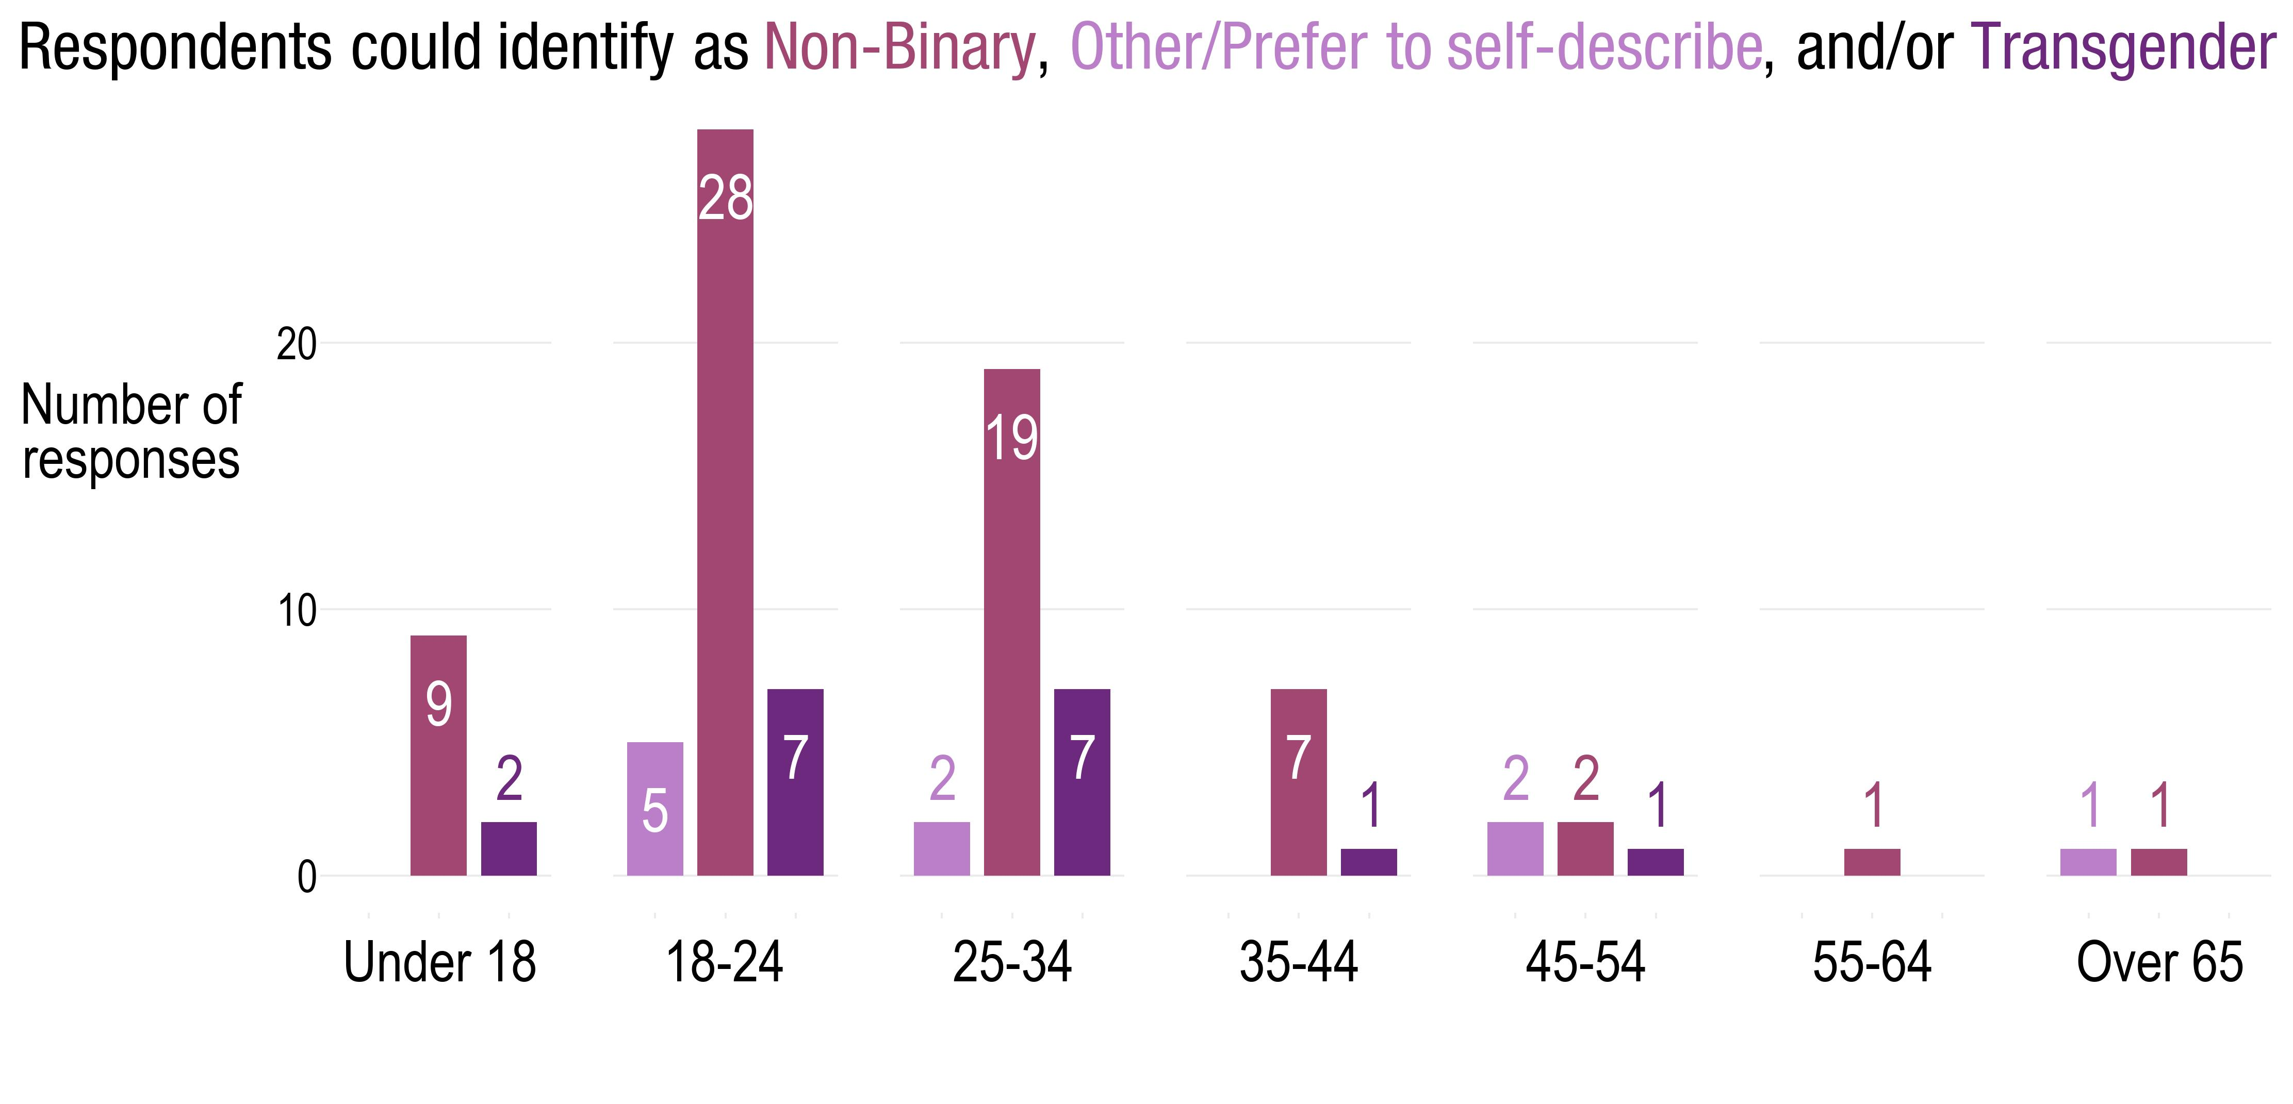
Appendix: More complete gender identity options available in 2021
The question was “select-all-that-apply”, with Male/Female presented in the same checklist as these gender identities.
Notes:
new info: Gender identities in 2021
example of adapting survey practice to capture respondent identity and ensure representation

Slide 28
Appendix: Routes sampled in pilot survey
Routes
Light rail (Green and Blue), BRT (A and C line) and 8 Core Local Routes: 2, 3, 5, 6, 10, 18, 19* partial, 21
Chosen by ridership
Ridership on these ten routes totaled to:
59% of Metro Transit boardings in Fall 2019, and
64% of Metro Transit ridership in Fall 2021
Survey sample
Surveyed September 13 – November 15
Completed 4,000 questionnaires
Weighted to Fall 2021 ridership (route, time of day, and direction)
In 2016, same routes: 15,580 questionnaires completed (51% of all questionnaires completed 2016)

Slide 29
Survey incentives work!
Free ride coupons increased participation from 47% to 76% and doubled participation by Black riders

